Slide 1
NWC Project Update October 2014
Flow estimation in ungaged catchments

Slide 2
Completed comparisons
Southeast region model comparison
  Report with SPN
  Results posted to WaterCensus portal
  Refinements being finalized
    matching flows at gages
    Improved behavior at extremes
Iowa model comparison
  Report in prep (very basic write-up)

Slide 3
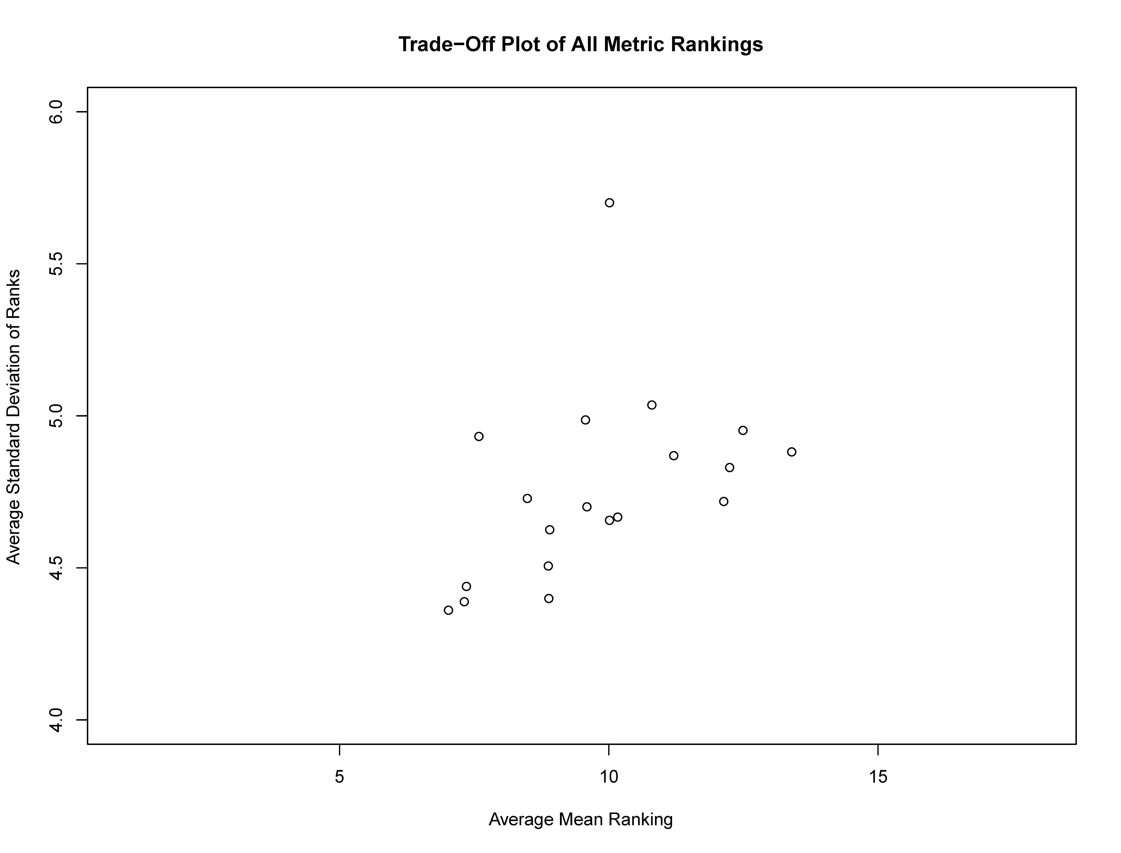
PRMS
AFINCH
NN-DAR
NN-SMS12L
NN-SM12
NN-QPPQ
NN-SMS12R
PRELIMINARY RESULTS

Slide 4
SEMC: Conclusions
Non-linear spatial interpolation with the use of flow duration curves and the nearest-neighboring index gage (NN-QPPQ) performs best, on average.
  A widely-used technique: Fennessey (1994), Hughes and Smakhtin (1996), Archfield and others (2009), Shu and Ouarda (2012), Farmer and Vogel (2013), …
Depending on your application, some other technique might be more useful.
Notes:
General conclusions. NNQPPQ is the best method for this region, in general. This aligns nicely with its widespread usage.
For specific purposes, you would want to target your metrics towards your specific application. Adaptability!

Slide 5
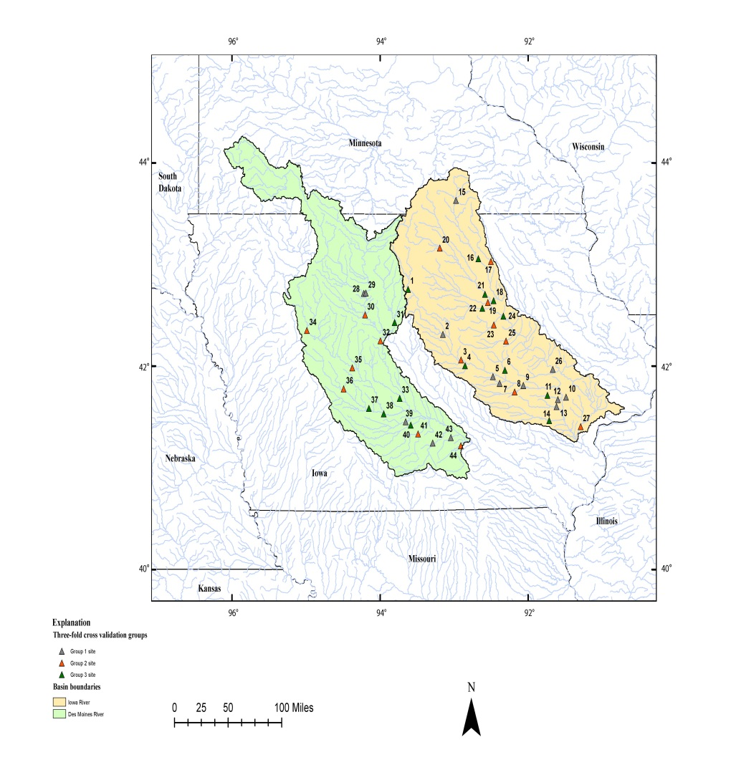
SEMC Extensions: Iowa Model Comparison
44 near-natural sites in Iowa River and Des Moines River
Compared PRMS, QPPQ and DAR (NN and MC)
Found generally the same result
For general application, NN-QPPQ was best.
(see Farmer and others, in prep.)
Notes:
One of the major limitations of this work is location.
With that in mind, we have begun to explore other regions.
Using fewer PUB techniques, we replicated our work in Iowa.
The conclusions were not dissimilar.

Slide 6
Completed
Southeast region model comparison
  Report with SPN
  Results posted to WaterCensus portal
  Refinements being finalized
    matching flows at gages
    Improved behavior at extremes
Iowa model comparison
  Report in prep (very basic write-up)
National PRMS model setup
  Papers in prep
TN River basin – preliminary testing of hybrid methods
EFlows R package
Presented work at AGU, EGU, JASM, USGS Nat’l WQ Mtg and CUAHSI-UCOWR-NIWR (included internal project meeting)

Slide 7
Ongoing
National PRMS model refinements
  Improve base parameters
  Establish methods for interpolating from PRMS geospatial modeling fabric to HUC-12s
Gulf Coast region PRMS model
  More complete testing hybrid approach: calibration with stats model input with uncertainty bounds
Uncertainty in statistical estimates
  Testing bootstrap techniques to derive confidence intervals
Compare regional model statistics to daily flow estimated statistics
Sparse vs. dense network – differences in model performance
Getting set up to look at performance of models in West, particularly where gap analysis indicates a sparser network with greater interannual variability in flow.

Slide 8
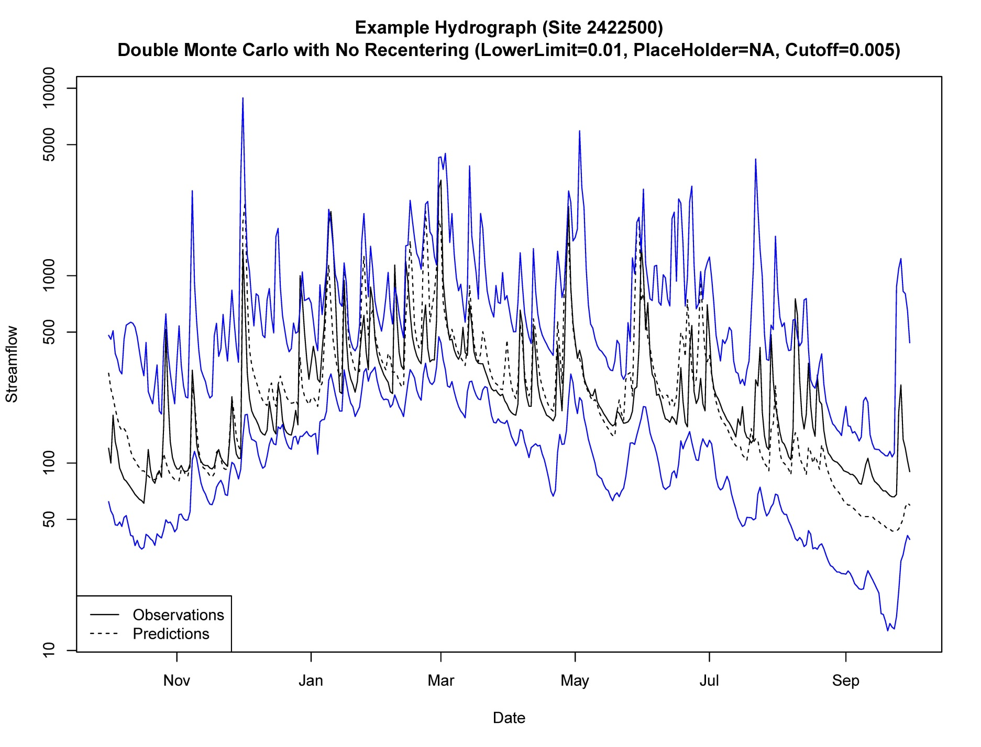
PRELIMINARY RESULTS

