Slide 1


The National Water Census Leadership Team Meeting WELCOME TO NEW JERSEY !! * Part of the Initiative
U.S. Department of the Interior
U.S. Geological Survey

Slide 2
To place technical information and tools in the hands of our stakeholders, allowing them to answer questions they face about water availability.
Our objective for the Water Census

Slide 3
The Agenda
Tuesday, October 28, 2014
8:30am Welcome and Meeting Overview
9:00am NWC Implementation Plan
10:00am Break
10:15am Budget Discussion – FY15 and FY16
11:30am Lunch – ordered in
12:30pm Annual Project Updates
12:30 – 1:00 Water Use Activities – Molly Maupin
1:00 – 1:20 Streamflow – Julie Kiang
1:20 – 1:40 Groundwater – Howard Reeves
1:40 – 2:00 Ecoflows – Jonathan Kennen
2:00 – 2:20 Evapotranspiration – James Verdin
2:20pm Break
2:45 – 3:30 ACF –Brian Hughes
3:30 – 4:15 CRB – Bret Bruce
4:15 – 5:00 DRB – Jeff Fischer
5:00pm Adjourn

Slide 4
The Agenda
Wednesday, October 29, 2014
8:30am New Projects – New project chiefs will introduce new NWC projects
8:30 – 9:30 Estimating Uncertainty – Dr. Kenneth Potter
9:30 – 9:50 South Atlantic Drainages – Chad Wagner
9:50 – 10:10 Red River – William Andrews
10:10am Break
10:20 – 10:40 Rio Grande – Matt Ely
10:40 – 11:00 Unconventional Oil and Gas – Kathy Rowland
11:00am Working Lunch - Collaboration possibilities between Topical and New Studies
12:30pm Management Requirements for NWC Projects (and how it helps!)
2:30pm Break
3:00pm NWC Data Portal
5:00pm Adjourn

Slide 5
The Agenda
Thursday, October 30, 2014
8:30am Current and Future Collaboration Opportunities
Water Use Grants Program (20 minutes)
ICWP Proposal (20 minutes)
Internal NWC Collaborations – Continued discussion from previous FASs and Topical Studies collaboration possibilities (1 hour)
10:15am Break
10:30am Synergy with other USGS Programs
12:00pm Adjourn

Slide 6
Questions or Comments?

Slide 7
Some Notable Accomplishments

Slide 8
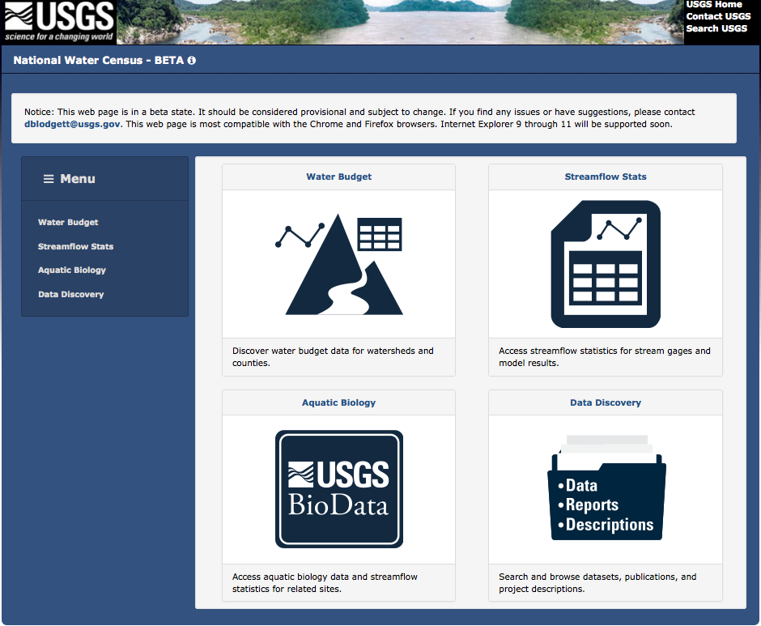
Notes:
Home page, each of the tiles represents a set of functionality.

Slide 9
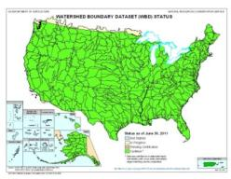
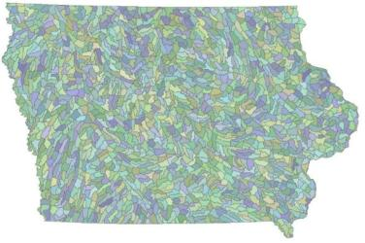
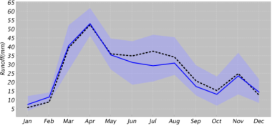
Surface Water Models
Estimating Flows at Ungaged Locations
Models provide us a means of estimating streamflow for time periods where we don’t have record or places where we don’t have monitoring capabilities.
Notes:
We are testing various models throughout the Nation to see which models provide the best means of estimating daily flows at ungaged locations. The estimated flows which you just saw in the SE US are a direct result of this work. Additional testing is going on in the midwest, around Iowa, and will be conducted in the mountains and deserts of the west and southwest. We plant to have this model testing complete and implemented by the conclusion of calendar year 2015.

Slide 10
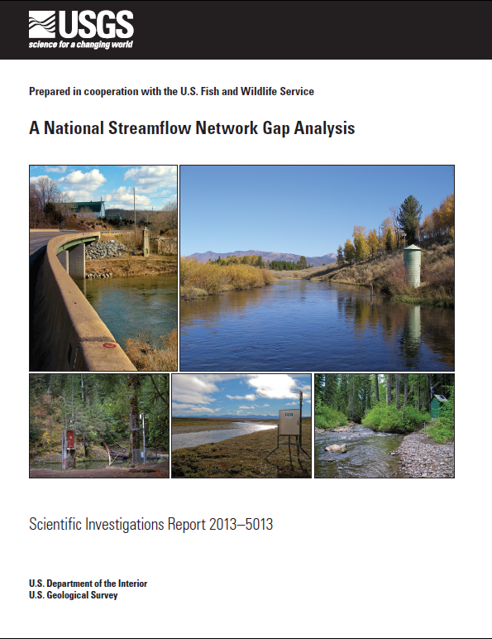
Notes:
Our surface water team has also completed a streamflow network gap analysis, specifically looking at the ability of our streamgaging network to support the applications of these models for estimating flows at ungaged locations. Not surprisingly, there were gaps noted in the Western US.

Slide 11
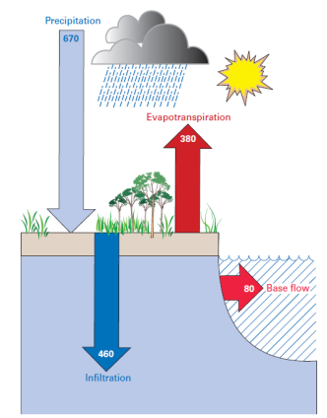
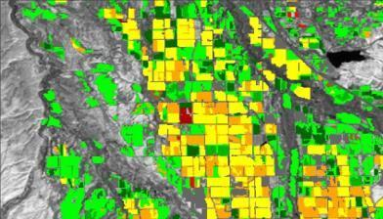

ET
Water Use Effort:
For irrigation water use to estimate consumptive use.
Water Budget Effort:
Total ET as a component of the water budget.
Small Watershed Scale
Notes:
We are estimating ET, both as a feature for the landscape (depicted on the right side of this slide) and as ET is enhanced by irrigation of agriculture crops (depicted on the left side of this slide)

Slide 12
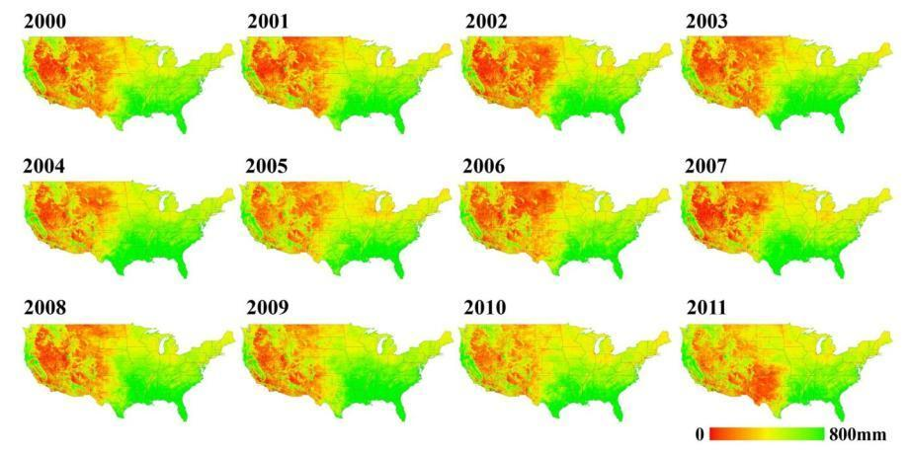
Annual and Monthly ET Totals from MODIS
Senay, Gabriel B., Stefanie Bohms, Ramesh K. Singh, Prasanna H. Gowda, Naga M. Velpuri, Henok Alemu, James P. Verdin. 2013. Operational Evapotranspiration Mapping Using Remote Sensing and Weather Datasets: A New Parameterization for the SSEB Approach. Journal of the American Water Resources Association (JAWRA). 49(3):577-591
Notes:
We have now constructed a time series of monthly ET for the coterminus 48 states going back to 2000 and we are looking for opportunities to go back further in time, by using older LANDSAT images, and to go to a sub-monthly timestep. All of this is part of our commitment to providing long-term data streams of ET data for water availability analysis.

Slide 13
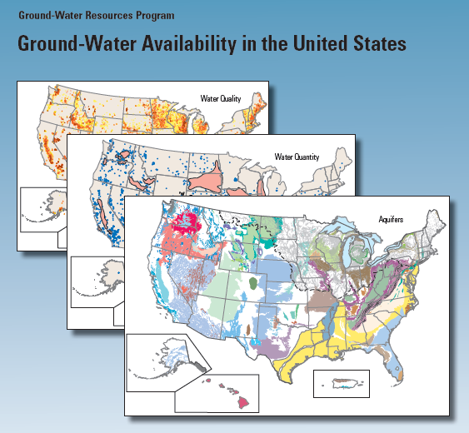
Assess Groundwater’s role in Water Availability
Use the strength of and
enhance the resources
within this program to provide
the information on:
Recharge
GW yields
Changes in storage.
Trends in GW Indices
GW/SW Interactions
Notes:
We will invest resources in expanding our work through the Survey’s Groundwater Resources Program. This program assesses groundwater availability through studies of principal aquifer systems. We will concentrate on those systems that account for the greatest groundwater use. The new resources planned in the initiative will give us the ability to double the number of studies starting in 2011. From these studies, we will obtain the information we need about recharge, yields, changes in storage, etc. for the Water Census.

Slide 14
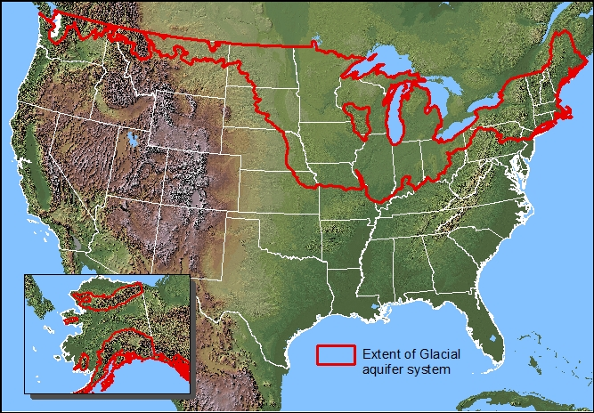

Assess Groundwater’s role in Water Availability
Study of the Glacial System
Notes:
We will invest resources in expanding our work through the Survey’s Groundwater Resources Program. This program assesses groundwater availability through studies of principal aquifer systems. We will concentrate on those systems that account for the greatest groundwater use. The new resources planned in the initiative will give us the ability to double the number of studies starting in 2011. From these studies, we will obtain the information we need about recharge, yields, changes in storage, etc. for the Water Census.

Slide 15
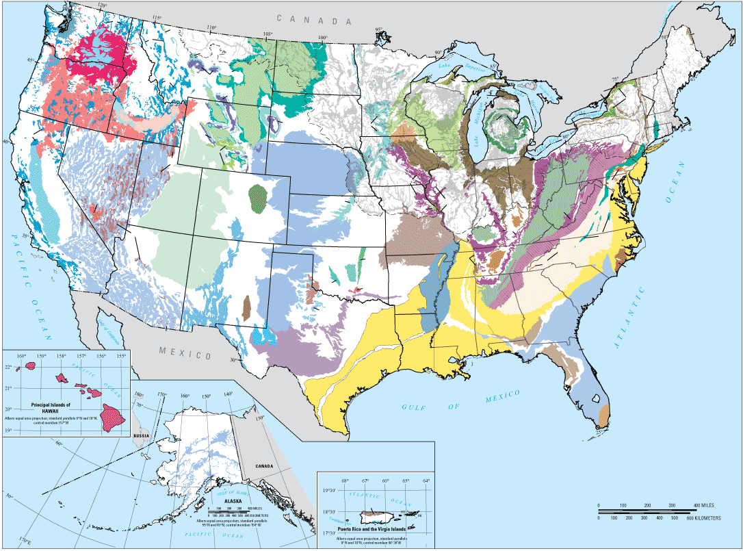
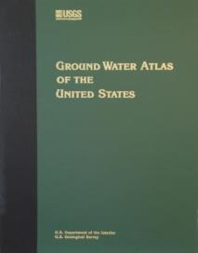
Network Design →Principal and Major Aquifers
Notes:
This also is an opportunity to explain that the SOGW had extensive discussions on this concept. We determined that given the objective of the network, we needed to focus on Principal and Major aquifers. So the Network is based on Principal Aquifer, and the Major Aquifers identified in the Ground-Water Atlas (right).
We also acknowledge that in some cases, the data provider may justify other aquifers, so there is a process identified in the framework for including other important aquifers as well.

Slide 16
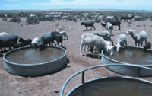
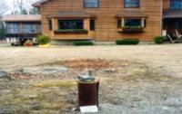
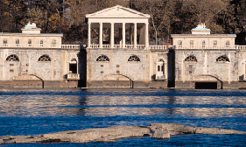
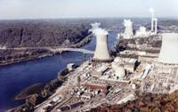
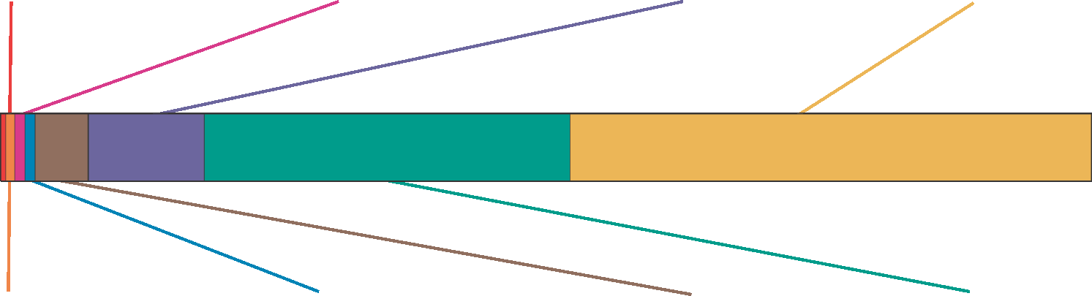
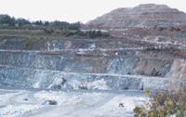
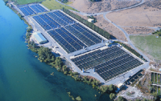

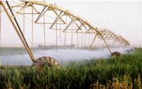
Water Use
Livestock
Self-Supplied Domestic
Public Supply
Thermoelectric Power
Less than 1 percent
1 percent
11 percent
49 percent
1 percent
2 percent
4 percent
31 percent
Mining
Aquaculture
Self-Supplied Industrial
Irrigation
Notes:
USGS has been conducting work on water use for a long time. This image depicts the eight principal sectors of “out-of-channel” water use. Thermoelectric, irrigation, and public supply account for over 90% of the water use.

Slide 17
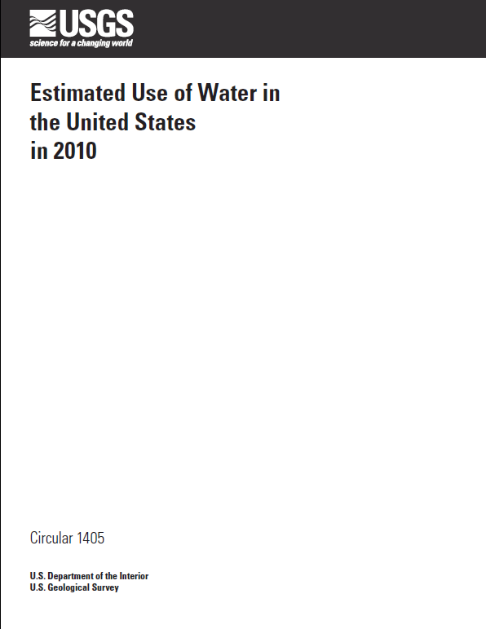

Slide 18
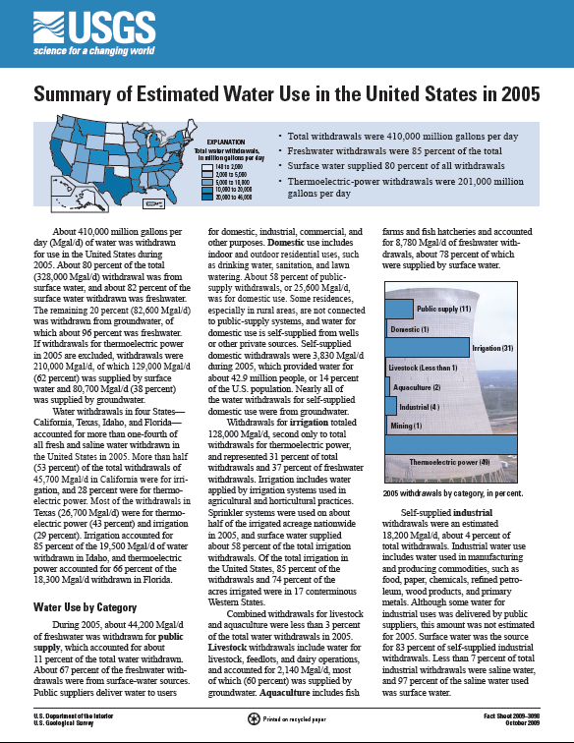
in 2010

Slide 19
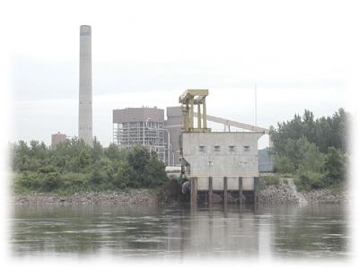
Thermoelectric Withdrawals
Notes:
19

Slide 20
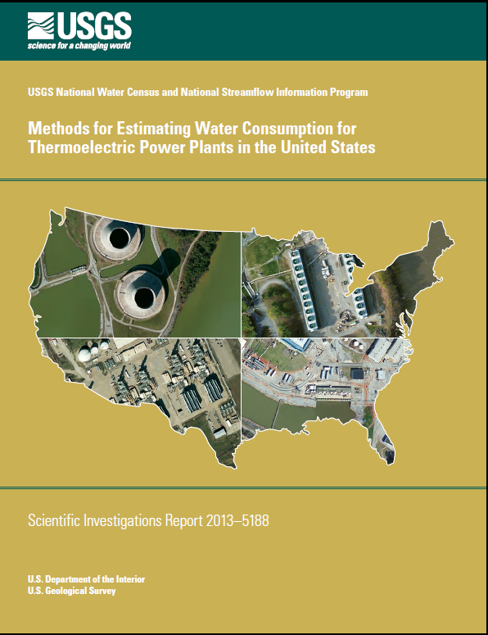

Slide 21
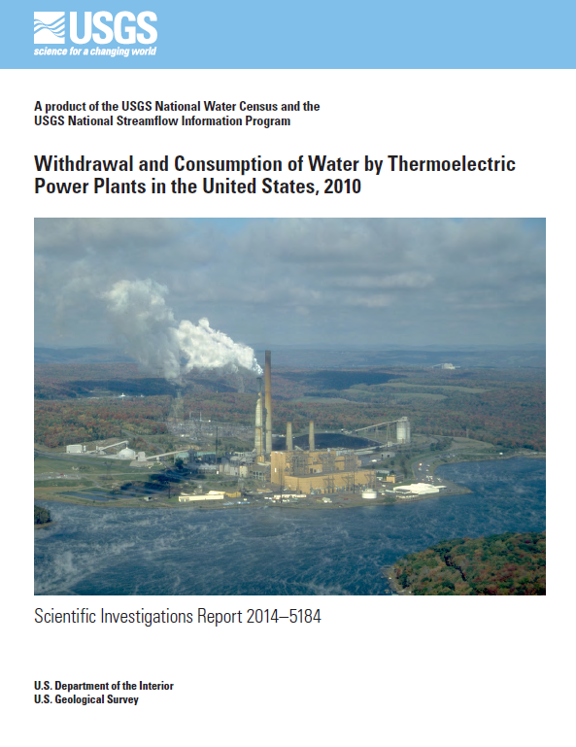

Slide 22
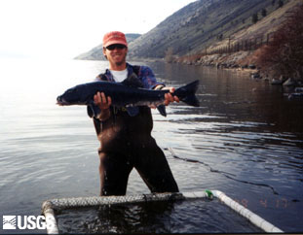
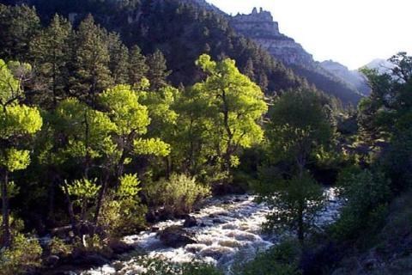
Flows Needs for Wildlife and Habitat
Classify streams - hydro-ecological type
Tools to systematically assess ecological affects of hydrologic alteration
Develop flow alteration – ecological response relationships by “h-e” type
Notes:
We are investing in the science of ecological flows to classify our streams for analysis, systematically examine the ecological effects of flow alteration, and from this, develop a relationship between flow alteration and ecological response for each class of stream. From this information, state water managers can establish ecological flow goals in their respective states.

Slide 23
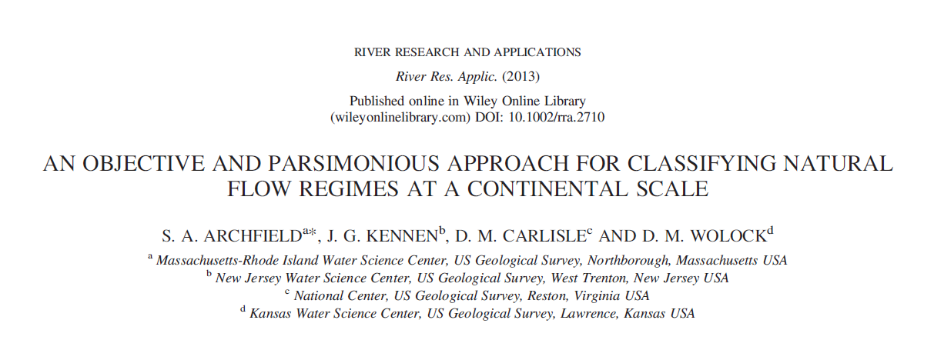
Article first published online: 30 Sept. 2013 | DOI: 10.1002/rra.2710
Notes:
Our principal product here is the journal article, published last year, laying out a logical approach to classification of natural flow regimes at the continental scale.

Slide 24
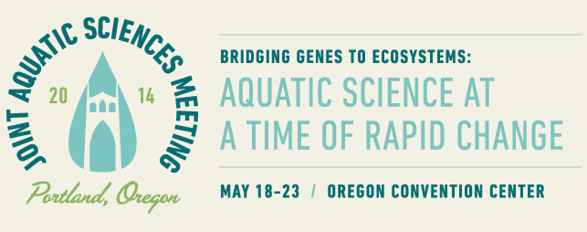
Notes:
Our principal product here is the journal article, published last year, laying out a logical approach to classification of natural flow regimes at the continental scale.

Slide 25
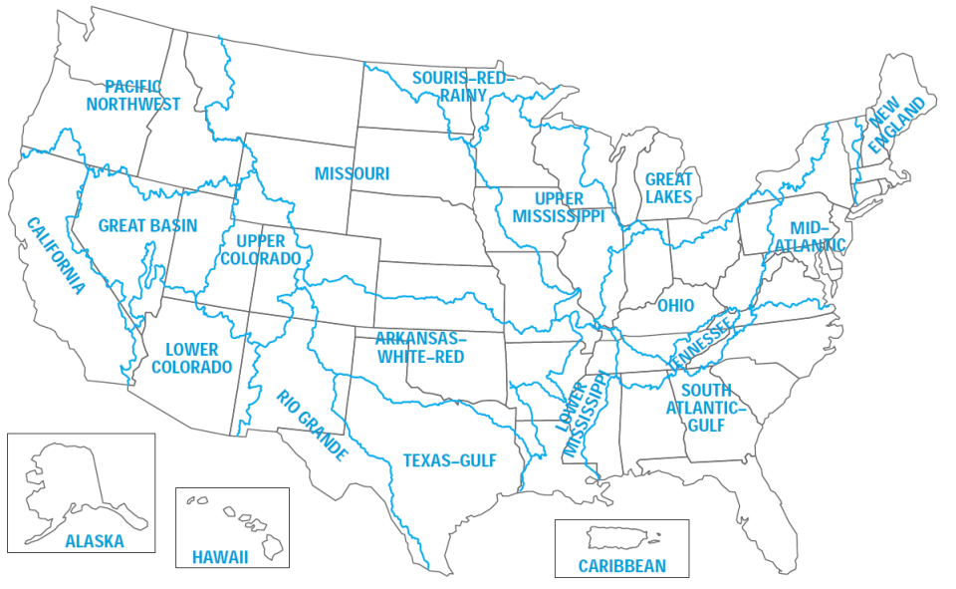
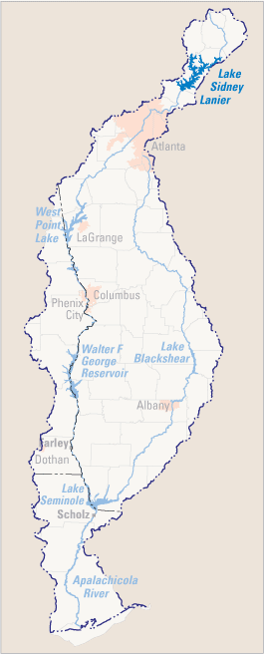
Focus Area Studies within Water Resource Regions
Apalachicola-Chattahoochee-Flint
Water Use
GW/SW Model
Ecological Flows

Slide 26
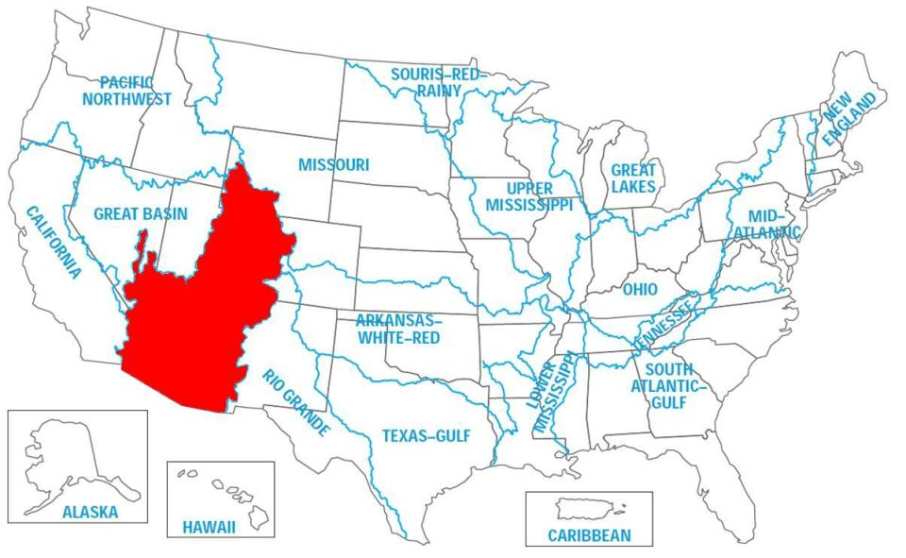
Focus Area Studies within Water Resource Regions
Water Use
ET and Snowpack Dynamics
GW Contrib to Baseflow
Colorado
Apalachicola-Chattahoochee-Flint

Slide 27

Focus Area Studies within Water Resource Regions
Water Use
Watershed Model
Ecological Flows
Delaware
Colorado
Apalachicola-Chattahoochee-Flint

Slide 28
Data Management Planning
ScienceBase

