Slide 1
NWC National Meeting
October 28-30, 2014
USGS New Jersey WSC

Slide 2
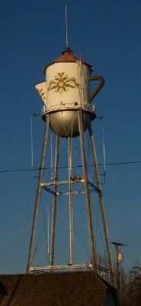
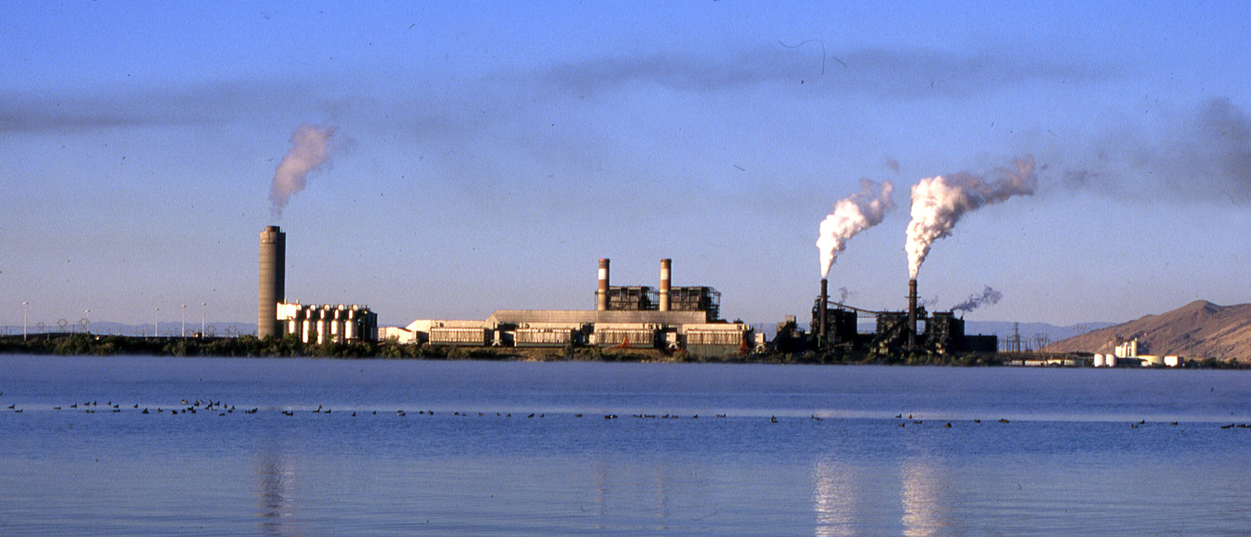
Water Use Activities
Thermoelectric
Public Supply SWUDS (PS SWUDS)
Data Exchange—EPA ODW
PS SWUDS--Status
Report
FY15 Plans

Slide 3
PS SWUDS
All datasets distributed (5/2011 to 8/2014)
Templates to create new sites in NWIS, build connections btw sites and systems, pop served, owners, permits.
New sites for wells/intakes/systems.
Previously matched wells integrated into templates using NWIS site-ids.
De-dupe—list of systems that deliver water across State lines.
Large datasets…steep learning curve.

Slide 4
Data Exchange—EPA ODW
Contact with EPA ODW.
Data exchange – data updates (new CA wells and NC facil+systems).
EPA interested in USGS locations (TX/OH).
Planning for next full SDWIS refresh (end of 2015/or as needed-NC)
NC—SDWIS not current with State. Inconsistent ‘active’ vs ‘inactive’ codes. Many system-to-system configurations.

Slide 5
Ps swuds—STATUS of data entry (AUG, 2014)
*NWISMA incl ME, NH, VT, MA, RI

Slide 6
PS SWUDS STATUS
*NWISMA incl ME, NH, VT, MA, RI

Slide 7
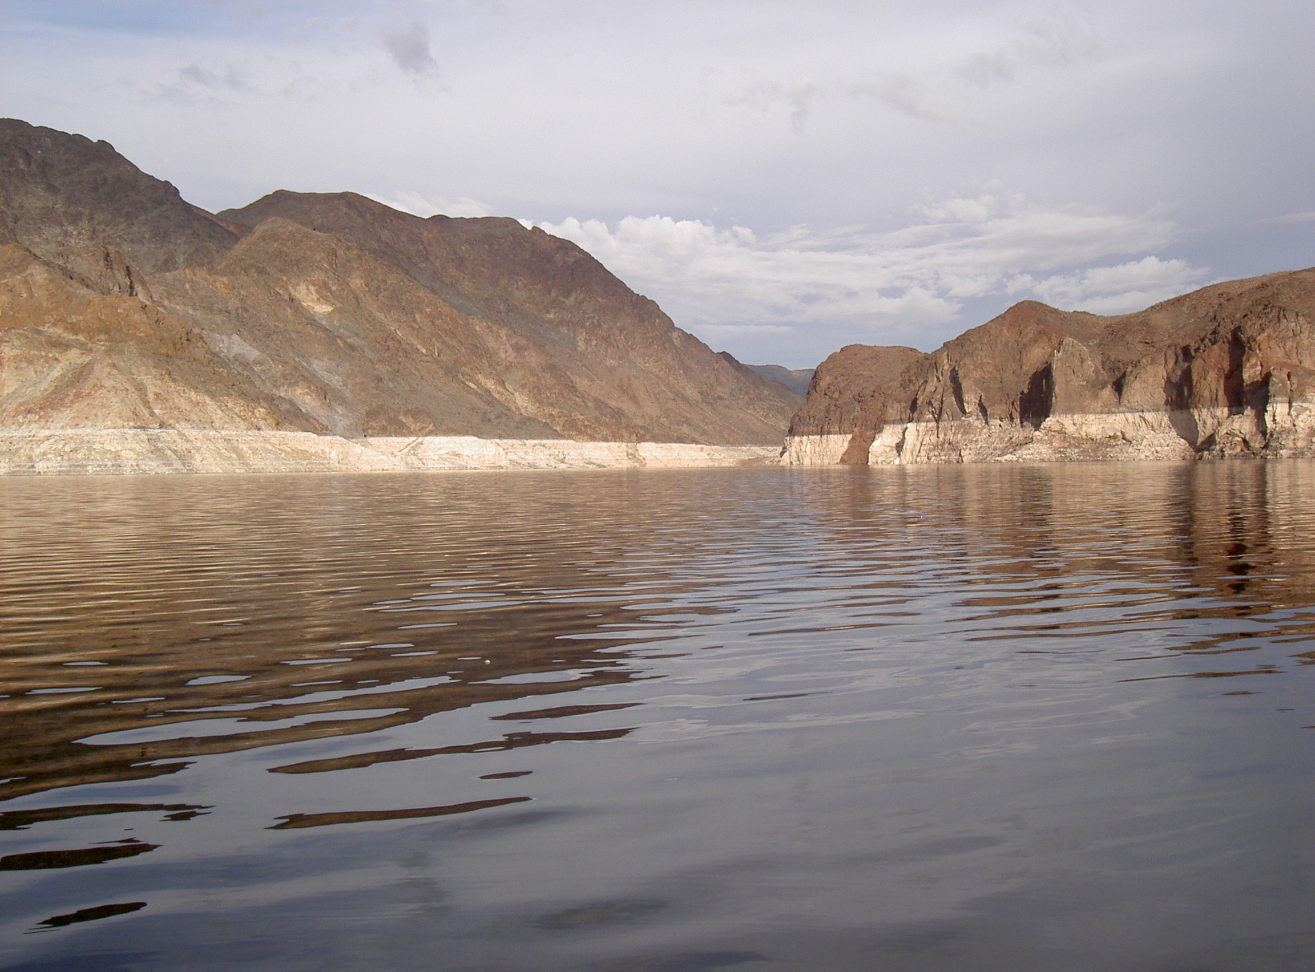
Report
PSDB OFR approved -- in SPN
Documentation and data dictionary for the Public Supply Data Base (PSDB).
PSDB is national database of public-supply intakes, wells, distribution systems, and system to system information, PLUS--USGS info.
Source for SWUDS data templates.

Slide 8
fy15
Pull quarterly reports (looking for wdls/diversion—OK).
Help people over SWUDS hurdles.
Project Network.

Slide 9
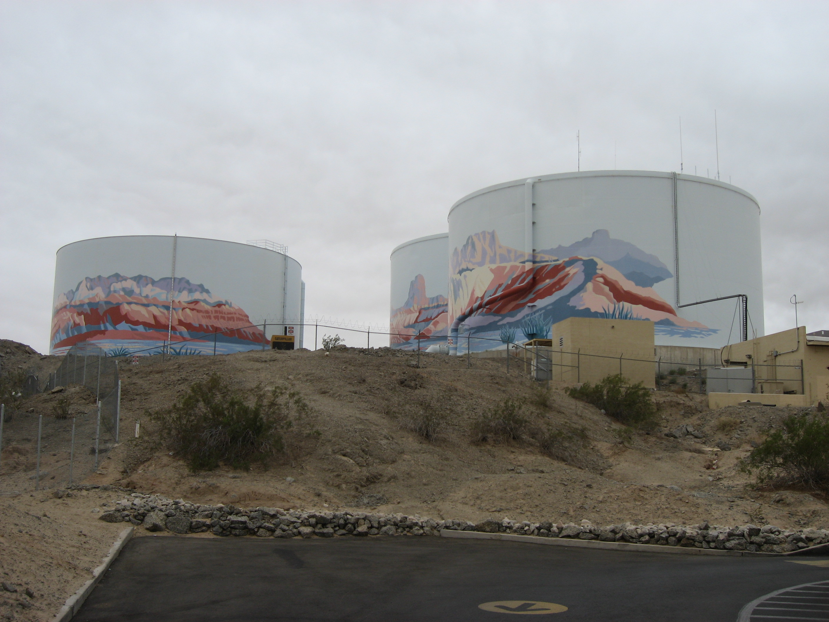
QUESTIONS

