Slide 1
Upper Rio Grande Focus Area Study
NWC National Meeting
USGS New Jersey WSC
October 28-30, 2014
Matt Ely
USGS New Mexico Water Science Center
U.S. Department of the Interior
U.S. Geological Survey

Slide 2
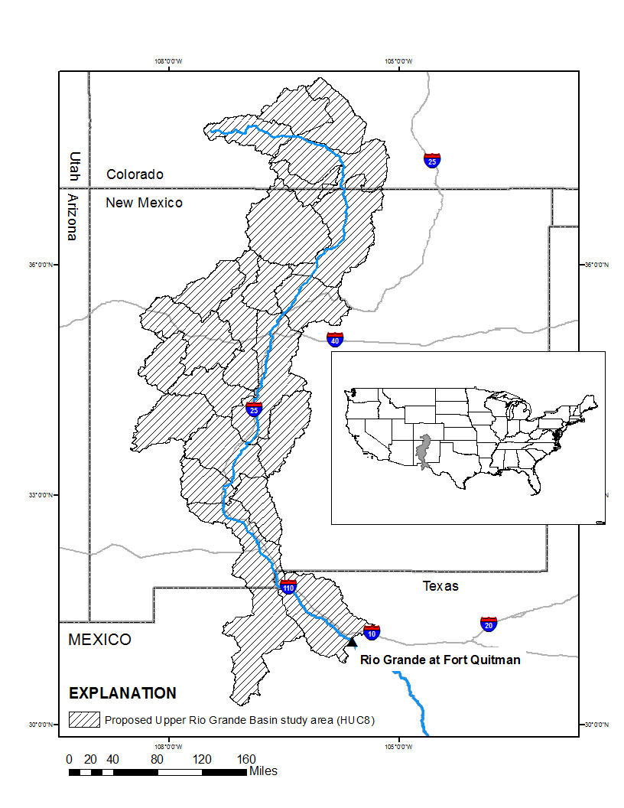
URG Study Area
Colorado, New Mexico, and Texas (and Mexico)
670 miles draining about 46,000 sq mi
Located in the Southern Rocky Mountains and Basin and Range physiographic provinces

Slide 3
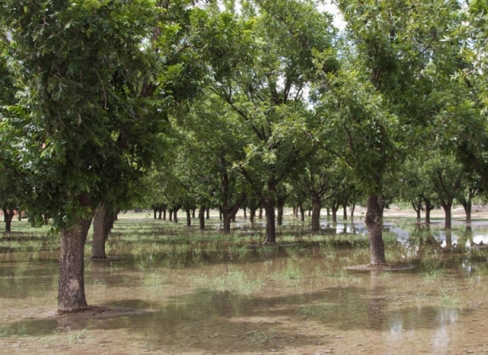
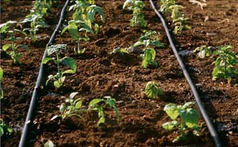
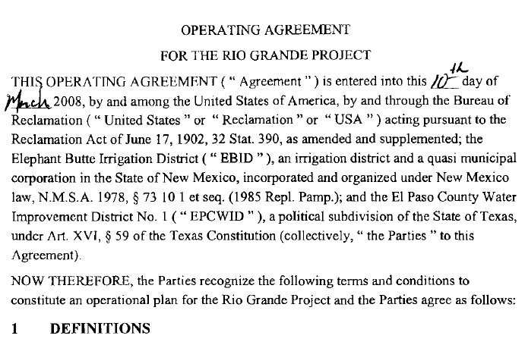
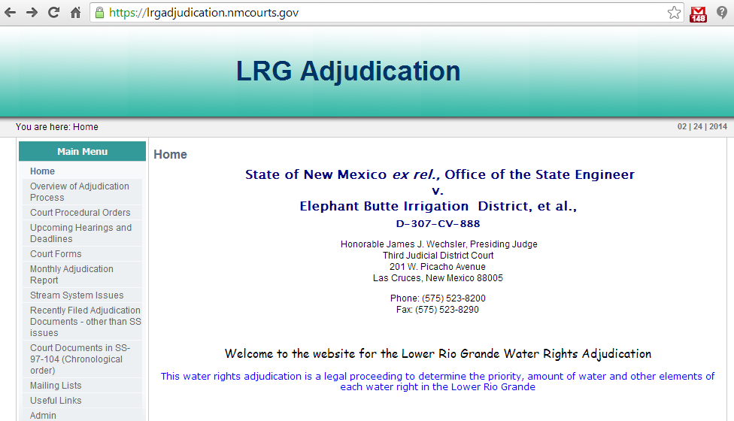
Motivation
Recent changes in climate, water demand, and water management are placing increased pressure on the Basins’ limited water resources

Slide 4
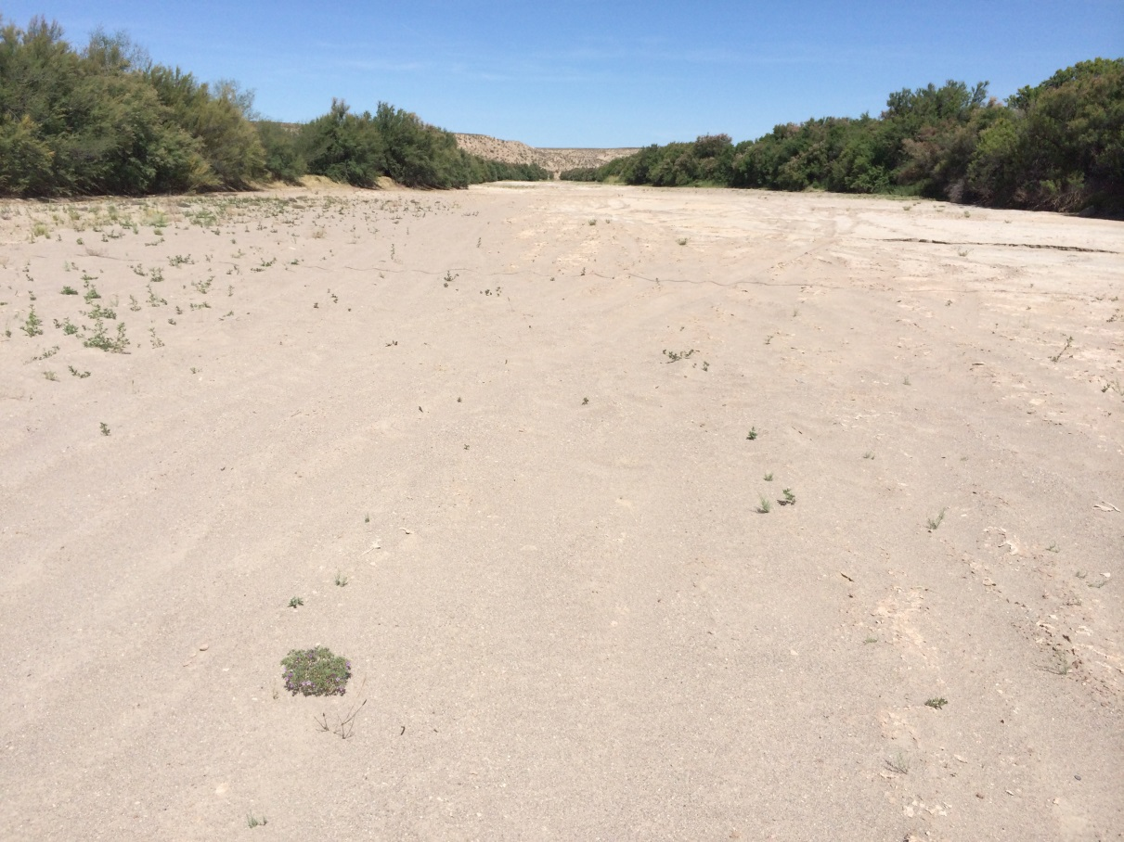
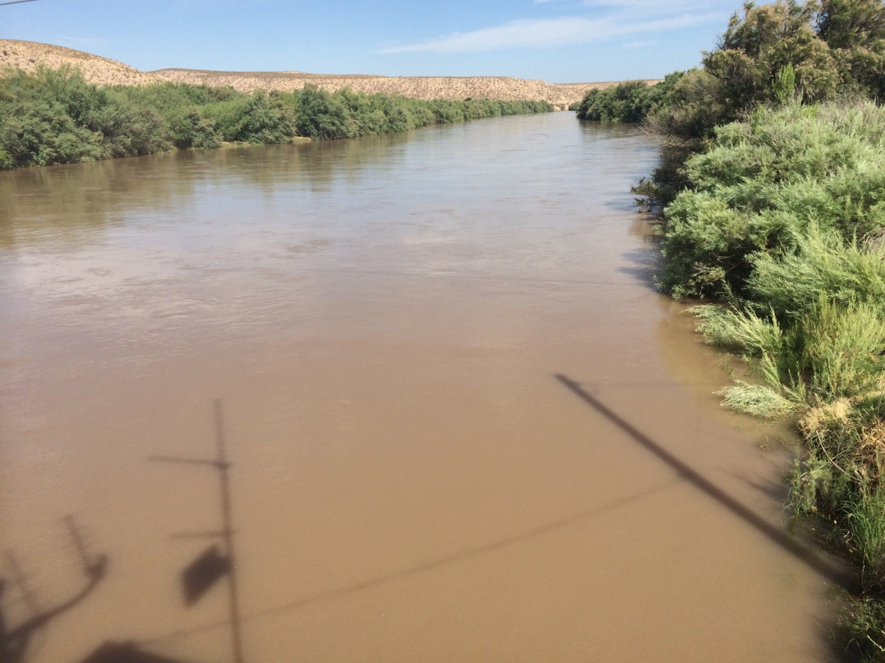
Rio Sand, May 2014
Rio Grande, June 2014

Slide 5
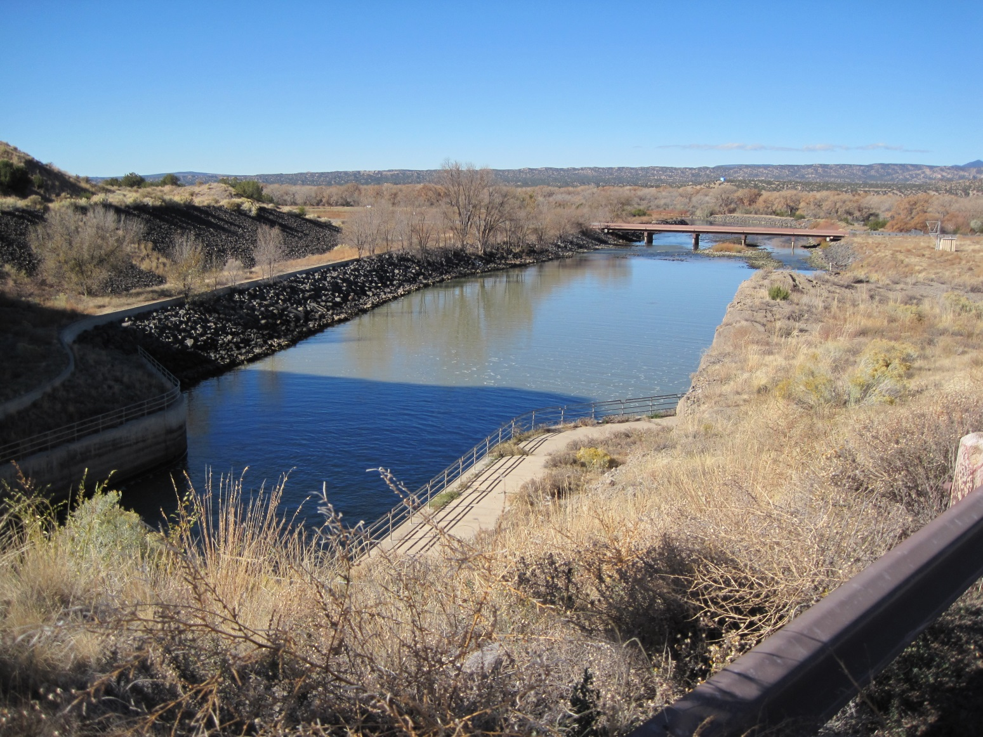
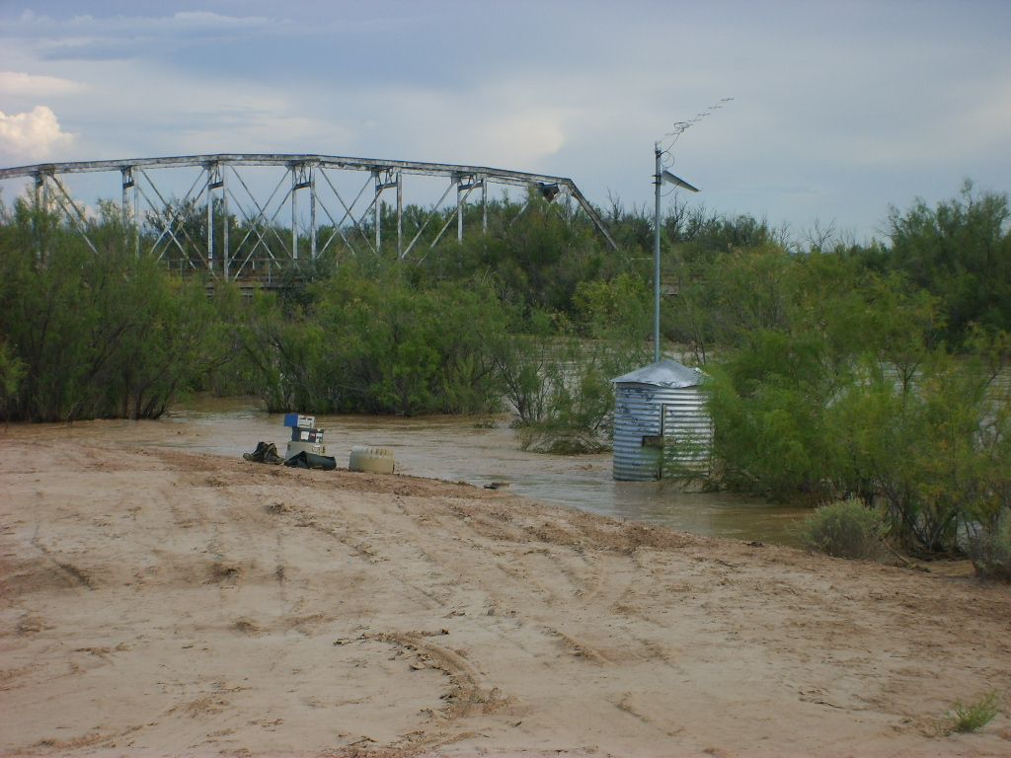
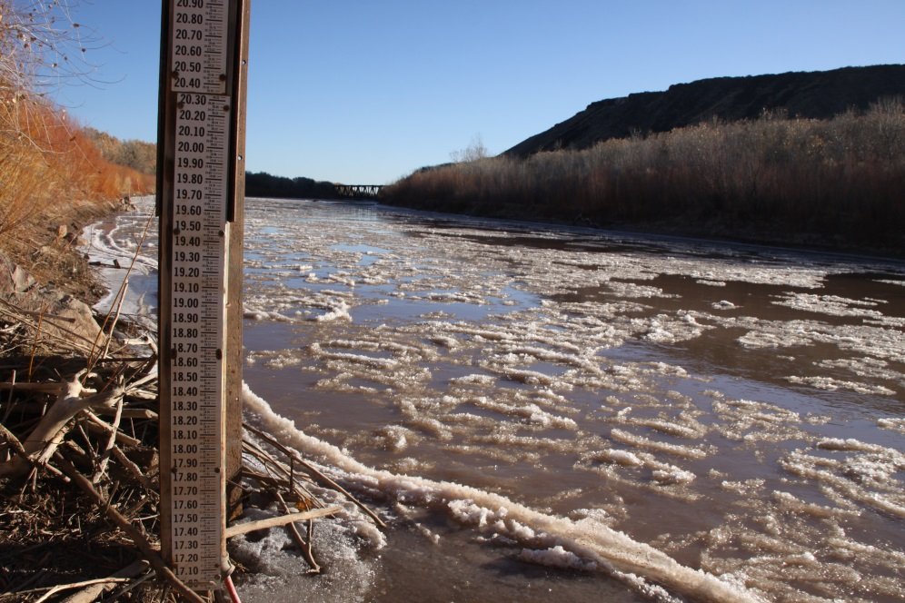

Slide 6
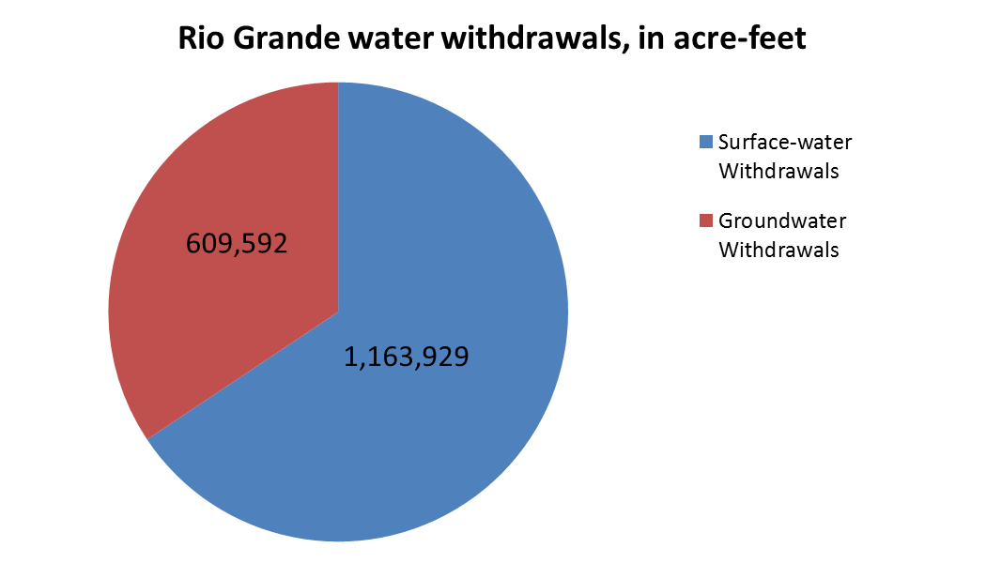
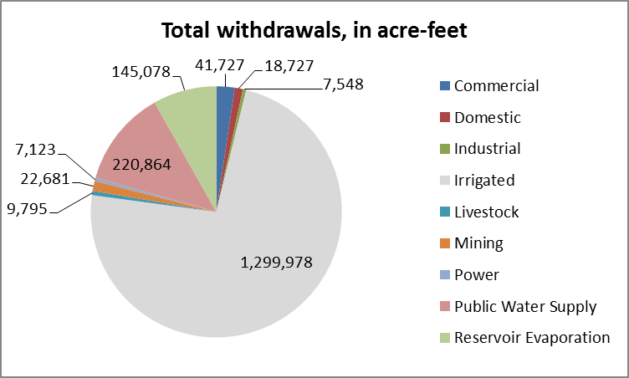
Rio Grande Water Use in New Mexico

Slide 7
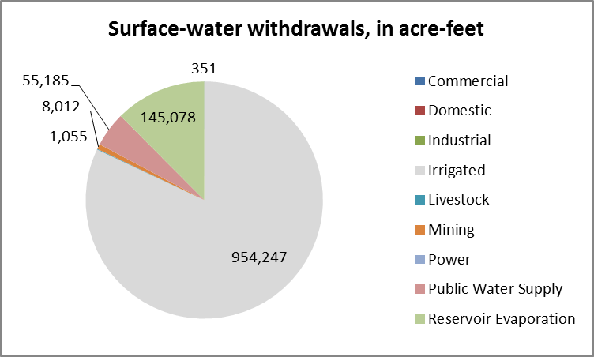
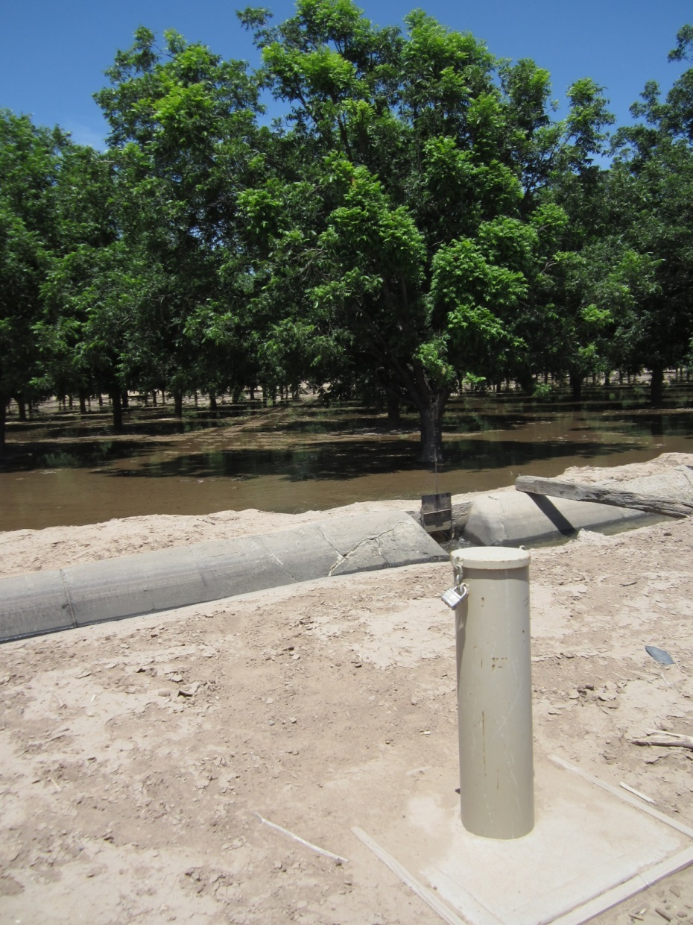
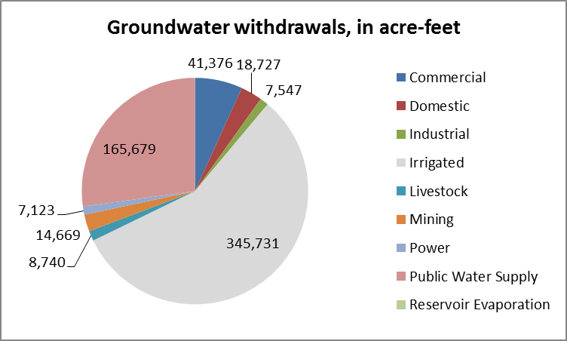

Rio Grande Water Use in New Mexico

Slide 8
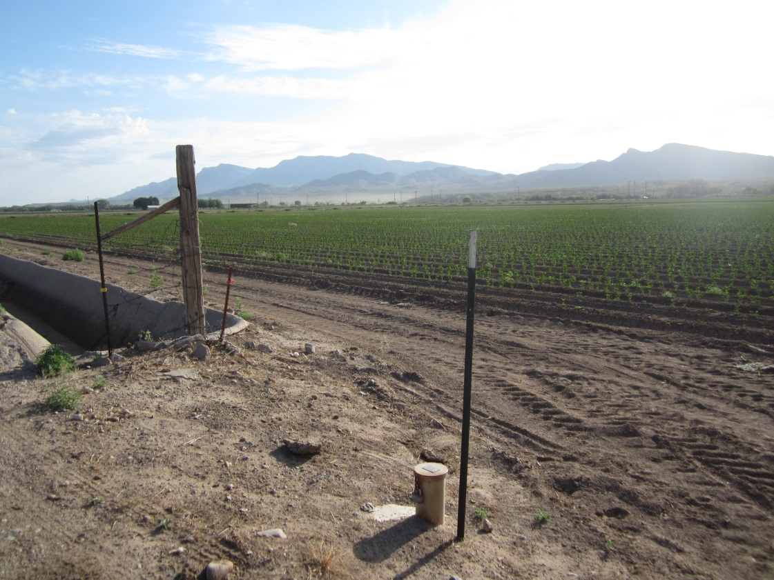
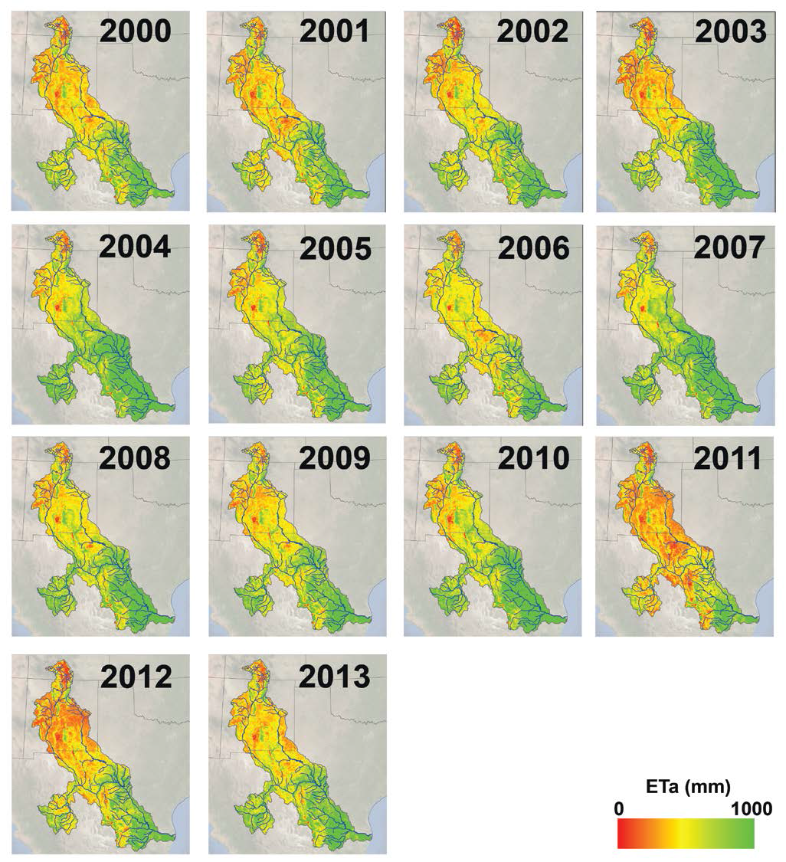
Landsat Scale ET
Field Verification
Senay and Verdin, 2014
NGWA Conference on Hydrology and Water Scarcity in the Rio Grande

Slide 9
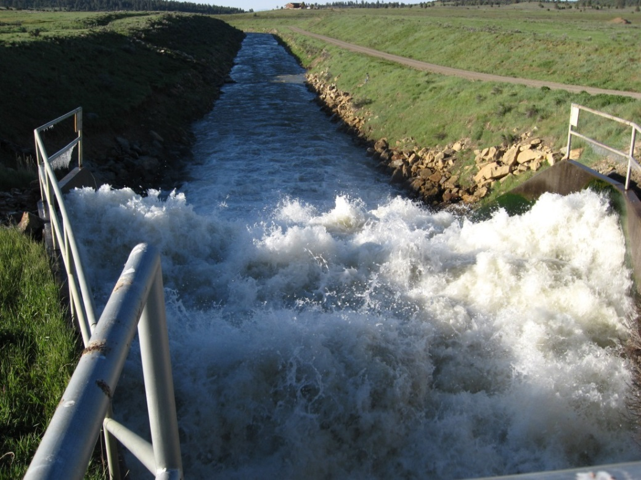
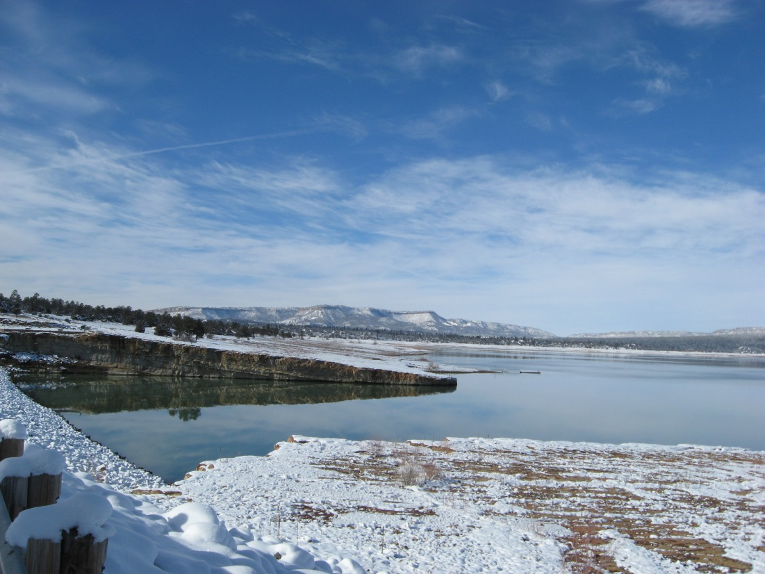
Interbasin Transfer San Juan-Chama

Slide 10
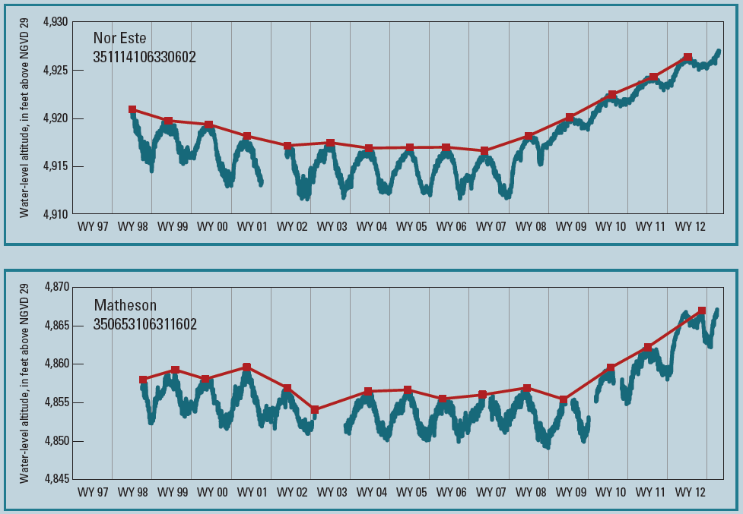
SIM 3301

Slide 11
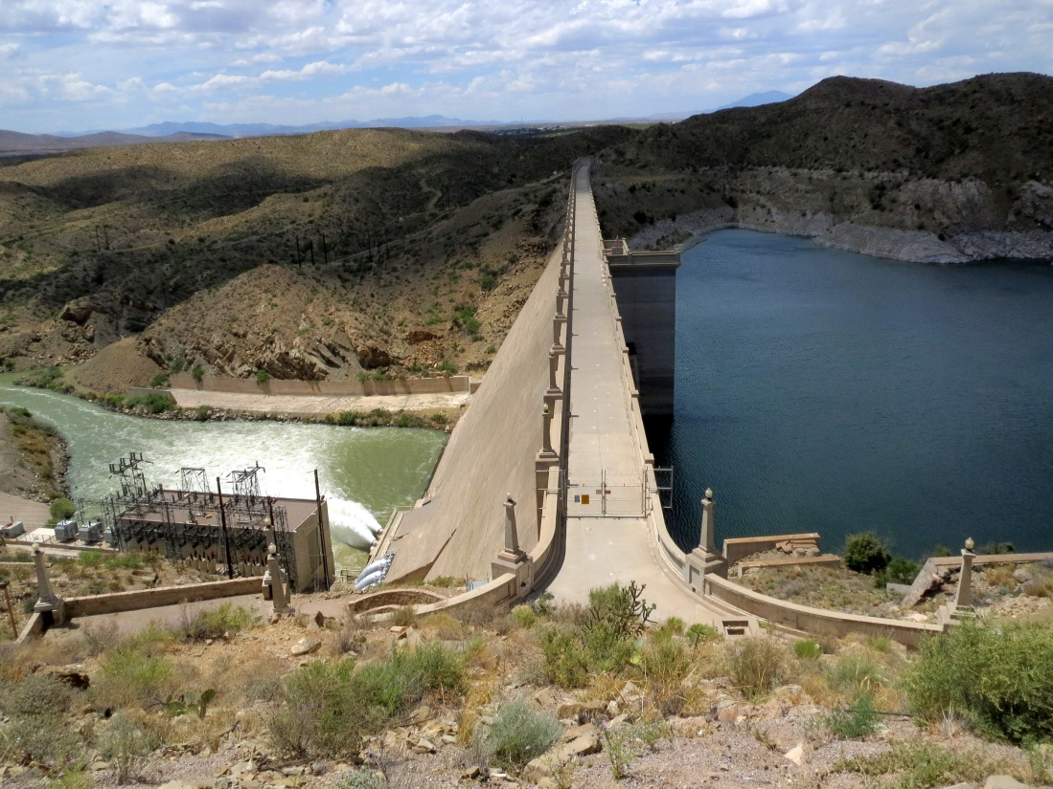
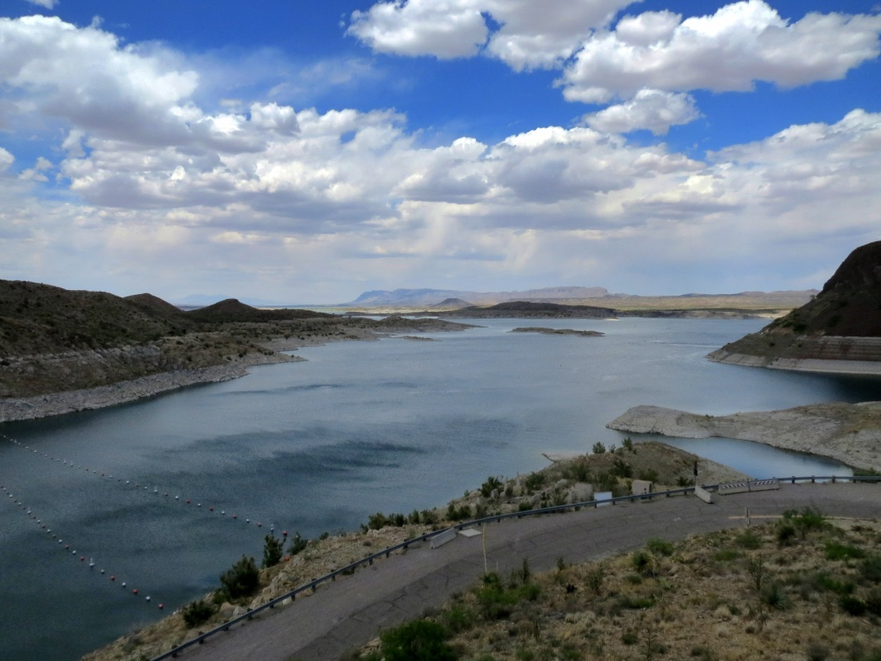

Slide 12
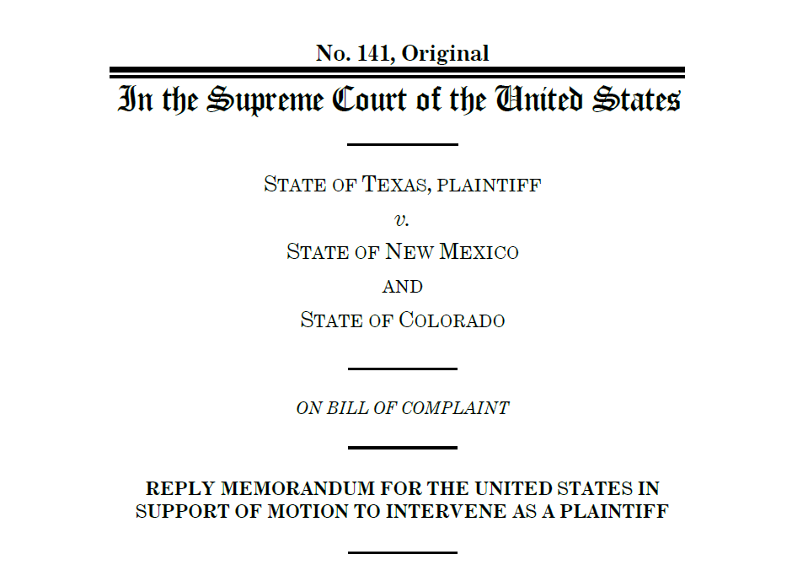

Slide 13
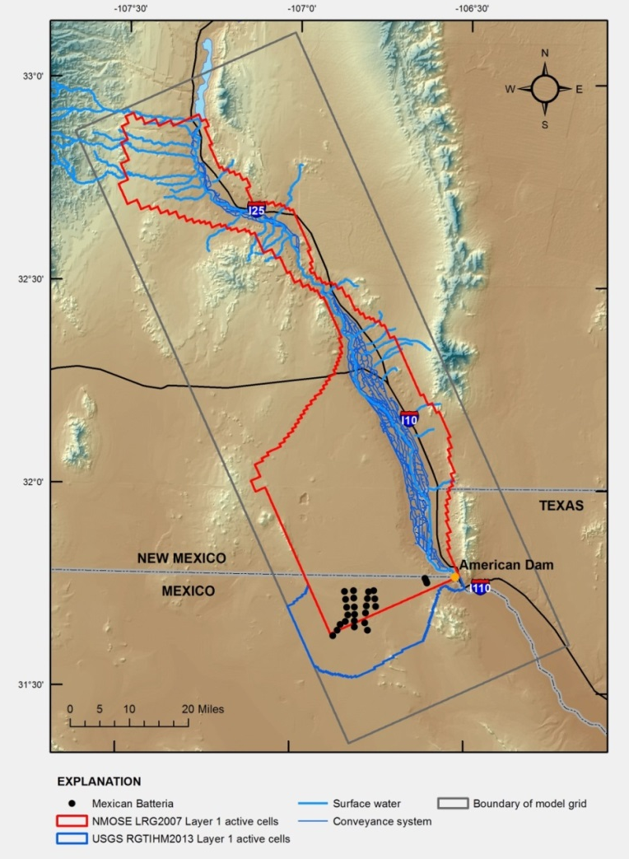
RGTIHM
Develop an improved integrated hydrologic model to better understand the many factors affecting the conjunctive use of groundwater and surface-water resources in the Basins

Slide 14
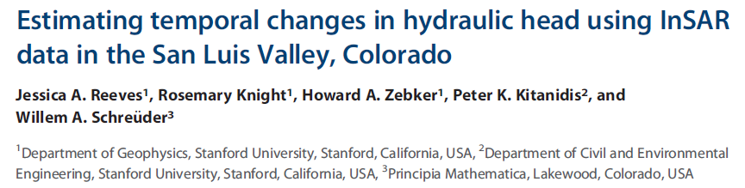
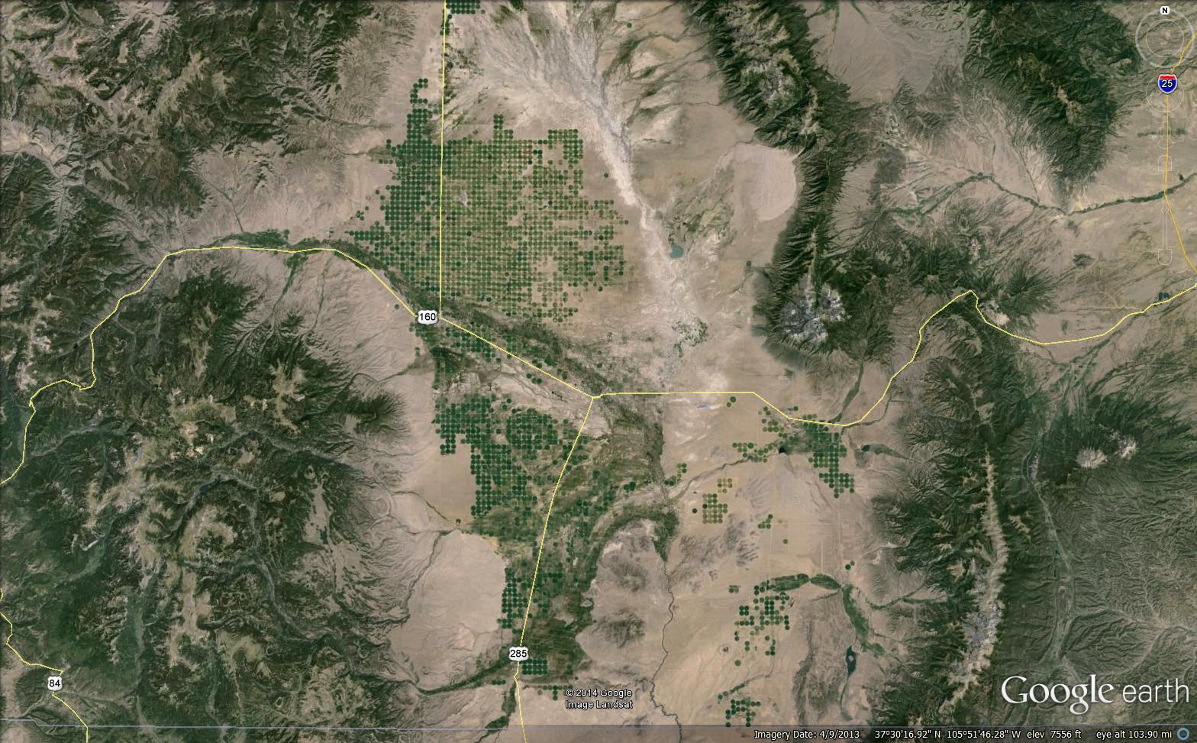
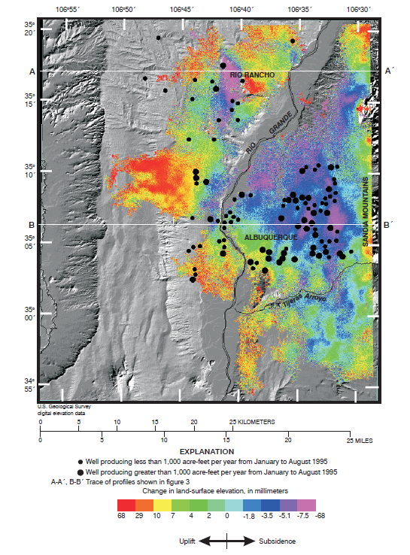
WRIR 02-4235

Slide 15
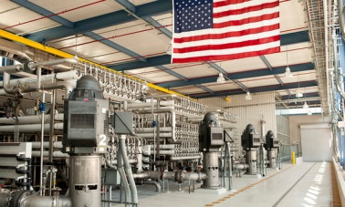
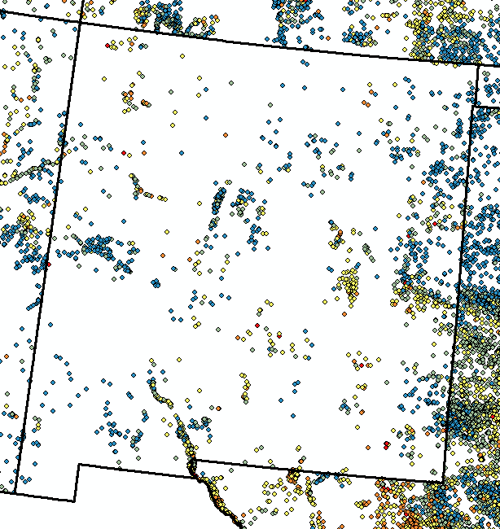
Brackish Groundwater
The New York Times
Sites with TDC or SC

Slide 16
Potential Cooperators
Federal
U.S. Army Corps of Engineers
U.S. Bureau of Reclamation
U.S. Fish and Wildlife Service
U.S. Geological Survey
International Boundary and
Water Commission – U.S. Section
Local
Irrigation Districts
Water Utilities
Rio Grande Water Users Association
Lower Rio Grande Water Users Organization
Mexico
Comision Internacional de Limites y Aquas - Seccion Mexicana
Tribal
State
Rio Grande Compact Commission – CO, NM, TX
Colorado Division of Water Resources
New Mexico Office of the State Engineer
New Mexico Interstate Stream Commission
Texas Commission on Environmental Quality
Texas Water Development Board
Water Resource Research Institutes

Slide 17
Study Team Personnel
Colorado Water Science Center
Tammy Ivahnenko
New Mexico Water Science Center
Jeff Cordova
Jesse Driscoll
Matt Ely
Texas Water Science Center
Tom Burley
Natalie Houston
Daniel Pearson

Slide 18
