Slide 1
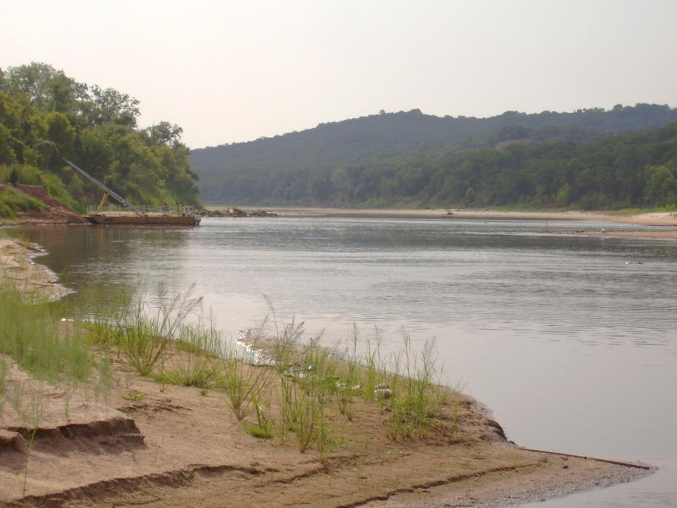

Activities Planned for and Related to the Red River Basin Focus Area Study
By W.J. Andrews, PhD
for the National Water Census National Meeting,
Lawrenceville, NJ,
October 28, 2014

Slide 2
WaterSMART Focus Area Study Background
The Oklahoma Water Science Center, in collaboration with USGS Centers in TX, AR, and LA, was awarded the opportunity to conduct a 3-year focus area study funded by the WaterSMART Program.
Water resources in this basin are being stressed by increasing water demand from rapidly growing metropolitan areas in Oklahoma, Texas, and Arkansas and increasingly severe droughts.
A water utility in Texas recently lost a suit in the U.S. Supreme Court regarding whether they could purchase water from southeastern Oklahoma under terms of the Red River Compact.
Tribes and other parties in southeastern Oklahoma are concerned about reductions in water resources and disruptions of aquatic ecosystems.
Many parties in the basin are concerned about potential increases in salinity of water in the river and its tributaries and lakes.
More than $4 M is being spent annually by the USGS and its cooperators for ongoing streamflow gaging and studies in this basin.

Slide 3
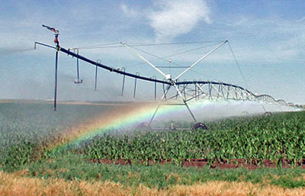
Planned activities
Tasks conducted for this project will include:
1) Refining 2010 USGS water-use estimates for the Red River basin by:
a) Producing water-use estimates by basin and aquifer,
b) Using GIS-based crop-cover estimates to refine irrigation water-use
estimates,
c) Obtaining additional information about interbasin transfers,
d) Refining estimates of consumptive water use for public-supply, industrial,
mining, and thermoelectric categories, and
e) Estimating water use from categories that were optional for the National
compilation.

Slide 4
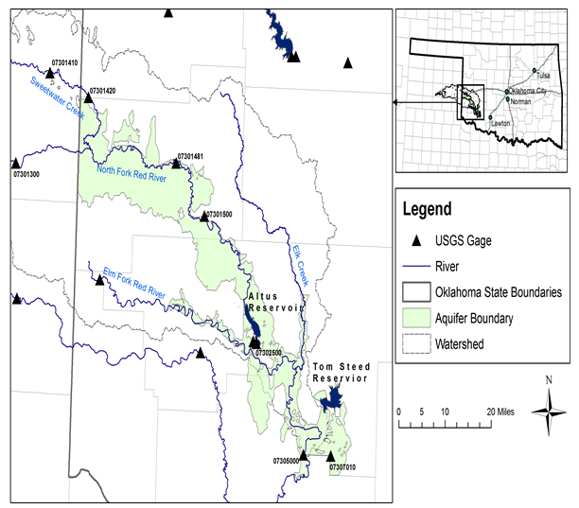
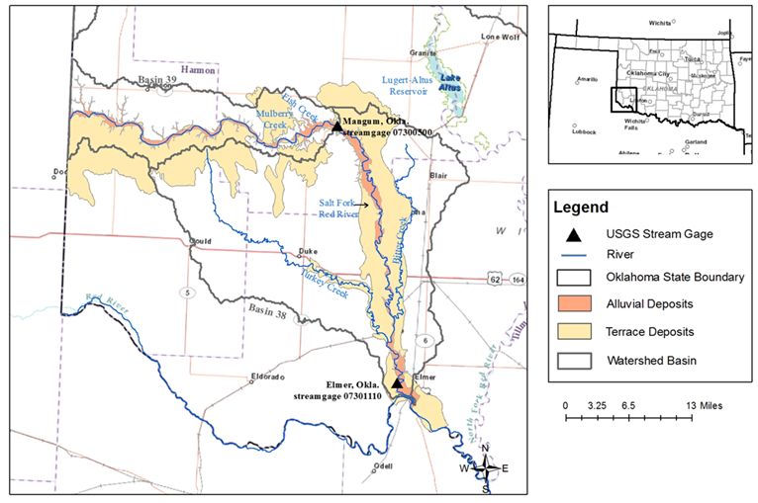
Planned activities
2) Constructing a MODFLOW model for the area upstream of the Denison Dam on Lake Texoma to quantify groundwater/surface-water interactions and likely effects of climate change and increased groundwater withdrawals. This work will augment modeling work of alluvial aquifers in the Salt Fork and North Fork Tributaries of the Red River being done in cooperation with the Oklahoma Water Resources Board.

Slide 5
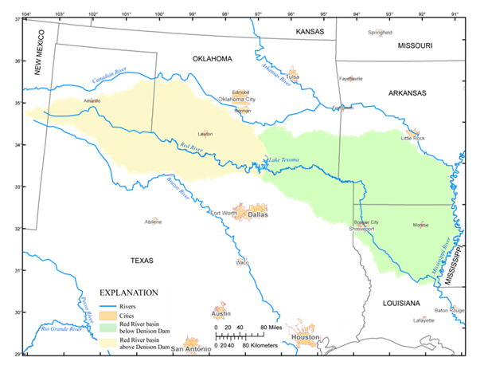
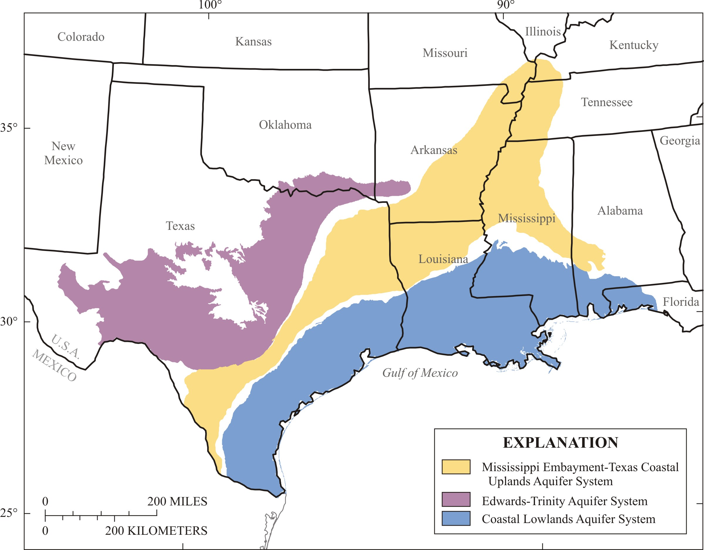
Planned activities
3) Estimating streamflows at a daily time step for stations along the entire course of the Red River using a PRMS rainfall-runoff model expanding on work that has been done for the Mississippi Embayment Regional Aquifer Study.

Slide 6
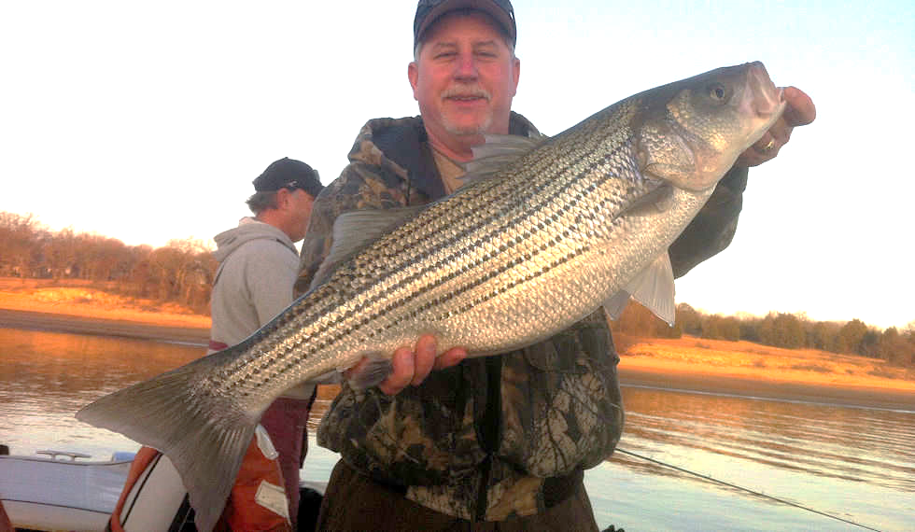

Planned activities
Existing aquatic ecological data will be summarized and compared to land-use changes. Ecological flows would be analyzed in the mainstem of the Red River and selected tributaries. A similar study is being conducted in the adjoining Canadian River Basin with funding from the South Central Climate Science Center. That team, from the USGS Okla. Coop Unit and the NJ WSC will conduct similar analysis with funding from the Ecological Mission area and USFWS State Wildlife Grants.

Slide 7
Selected stakeholders
The Chickasaw and Choctaw Nations
Federal agencies such as the Red River Compact, the Bureau of Reclamation, the US Fish and Wildlife Service, the Corps of Engineers, the Agricultural Research Service, and the Natural Resources Conservation Service
State agencies such as the Okla. Water Resource Board, the Texas Water Development Board, the Arkansas Natural Resource Comm., the Lousiana Dept. of Transportation and Development, and State wildlife, parks, and tourism departments
Local agencies such cities and other public water suppliers
Local residents including agricultural producers, lake and river associations, and chambers of commerce

Slide 8
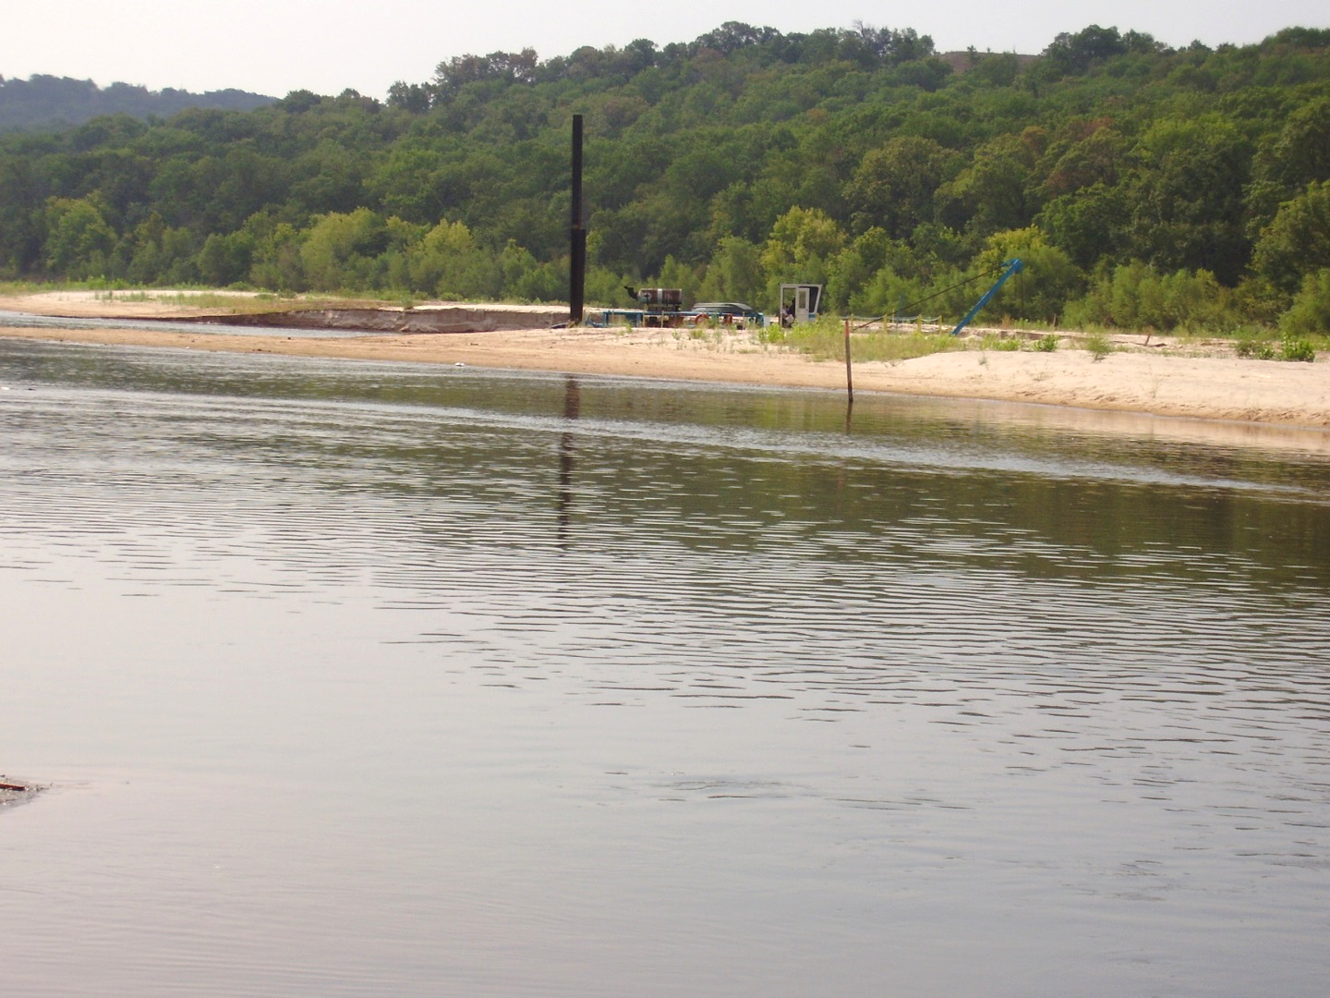

Questions?

