Slide 1
Glacial Aquifer Project National Water Census National Meeting
Howard W. Reeves, USGS Michigan Water Science Center
Kevin F. Dennehy, Groundwater Resources Program
October 28, 2014

Slide 2
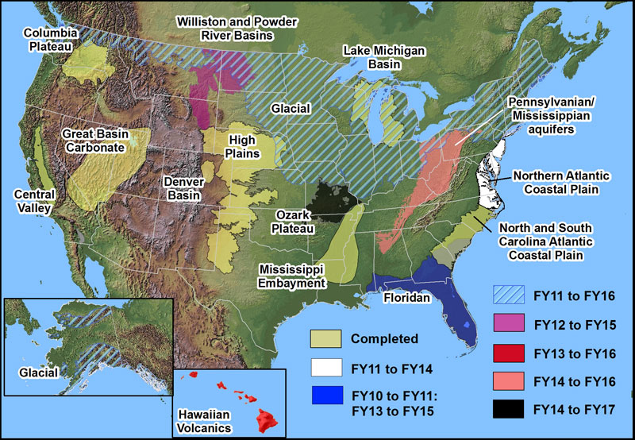

Slide 3
Regional Groundwater Availability Studies
Status of groundwater resources
Trends and response to development
Likely response to future changes
Climate
Development
Groundwater/surface-water interaction
Size of study area and ‘disconnectedness’
Study will not be centered around a single numerical model of part of the principal aquifer

Slide 4
2014 Project Highlights
Status of groundwater resources
Groundwater budgets and hydrogeologic framework
Trends and response to development
Trends and correlation task
Likely response to future changes
Trends and correlation task
Methods development
Groundwater/surface-water interaction within regional models
Statistical extension of model results
Enhancements to SWB

Slide 5
Status of groundwater resources: budget - recharge
Previous work, baseflow separation
GAGES II dataset: reference gages
PART, HYSEP1, HYSEP2, HYSEP3 for reference gages
Adjust Wolock, 2003 national grid for recharge
Apply Soil Water Balance (SWB)
Spatial patterns
Varies with time: monthly, seasonal, annual, period of record estimates

Slide 6
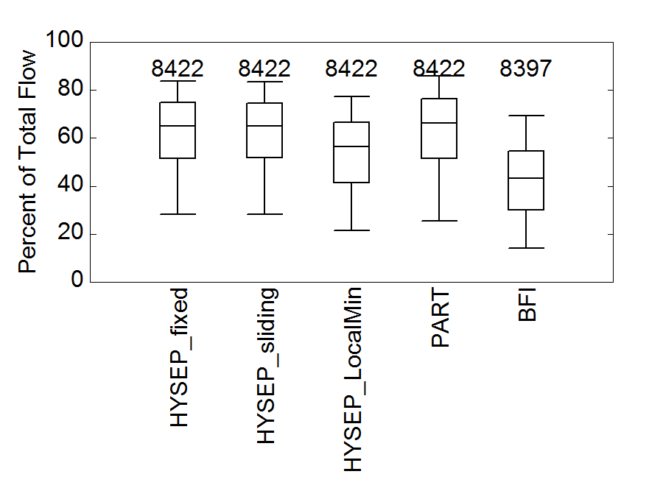
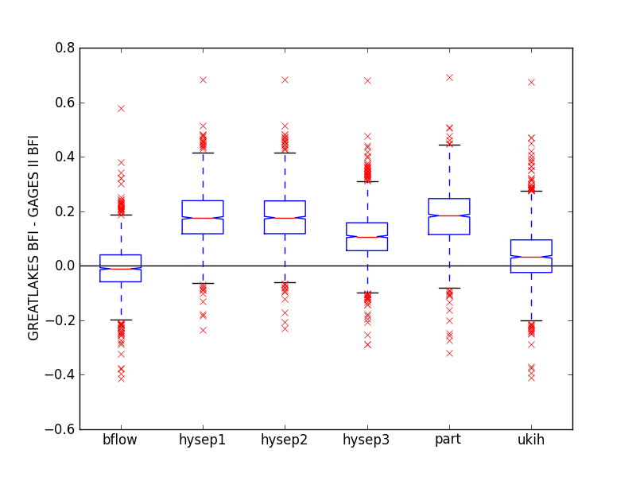
Compare GAGES II to other methods

Slide 7
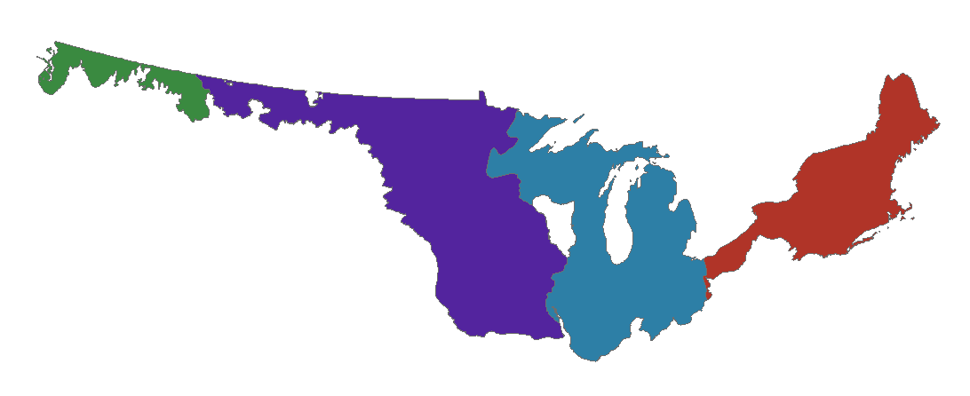
Adjusted recharge from Wolock, 2003
20.9 inch/year; 1.8 x 10¹² ft³/year
51 km³/year
1.6 inch/year;
1.1 x 10¹² ft³/year
32 km³/year
13.4 inch/year;
4.2 x 10¹² ft³/year
120 km³/year
6.4 inch/year;
3.3 x 10¹² ft³/year
94 km³/year
Sum of area*rate from Wolock raster
increased by 18 percent
Total = 1 x 10¹³ ft³/year
Water withdrawals (2000) = 3,560 Mgal/day
1.7 x 10¹¹ ft³/year 1.6 percent

Slide 8
Initial SWB model run
First run completed, 1988-2000, showing average over this time period
STATSGO (Schwarz and Alexander, 1995) used for soil parameters
2006 Land cover
10 km grid
Lookup table from calibrated MN SWB model (Smith, in prep).

Slide 9
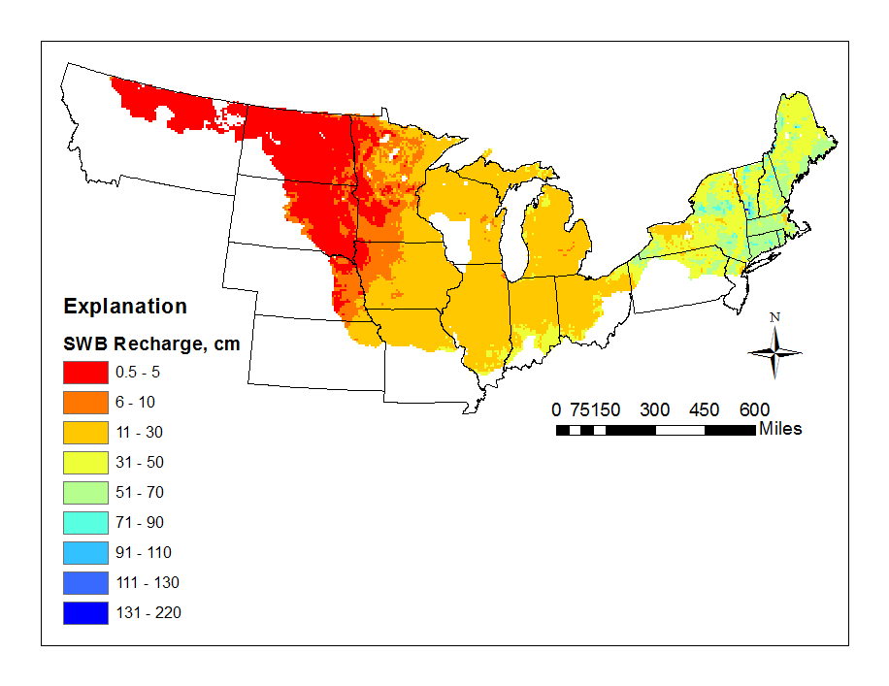
SWB model run
Broad pattern agrees, but there are some anomalies to be investigated
Notes:
Mention SWB support and enhancements to facilitate this…

Slide 10
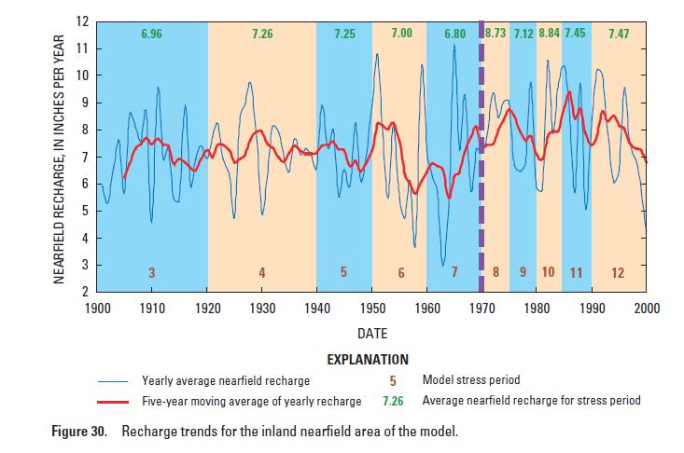
Example SWB time series

Slide 11
Status of groundwater resources: Storage and Storage Change
Emphasize change in storage
Total storage value is quite large compared to use, baseflow
Change is more important than absolute value
Approach:
Thickness map * representative specific storage = water in storage
Point analysis of well data
Analyze data from GRACE satellite and examine GRACE results from literature

Slide 12
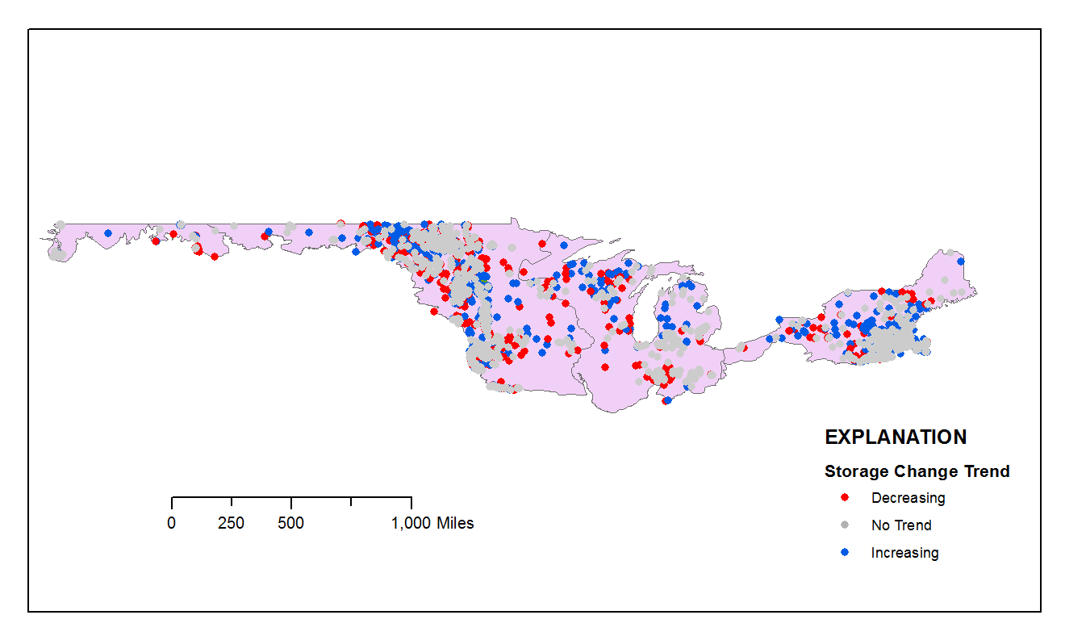
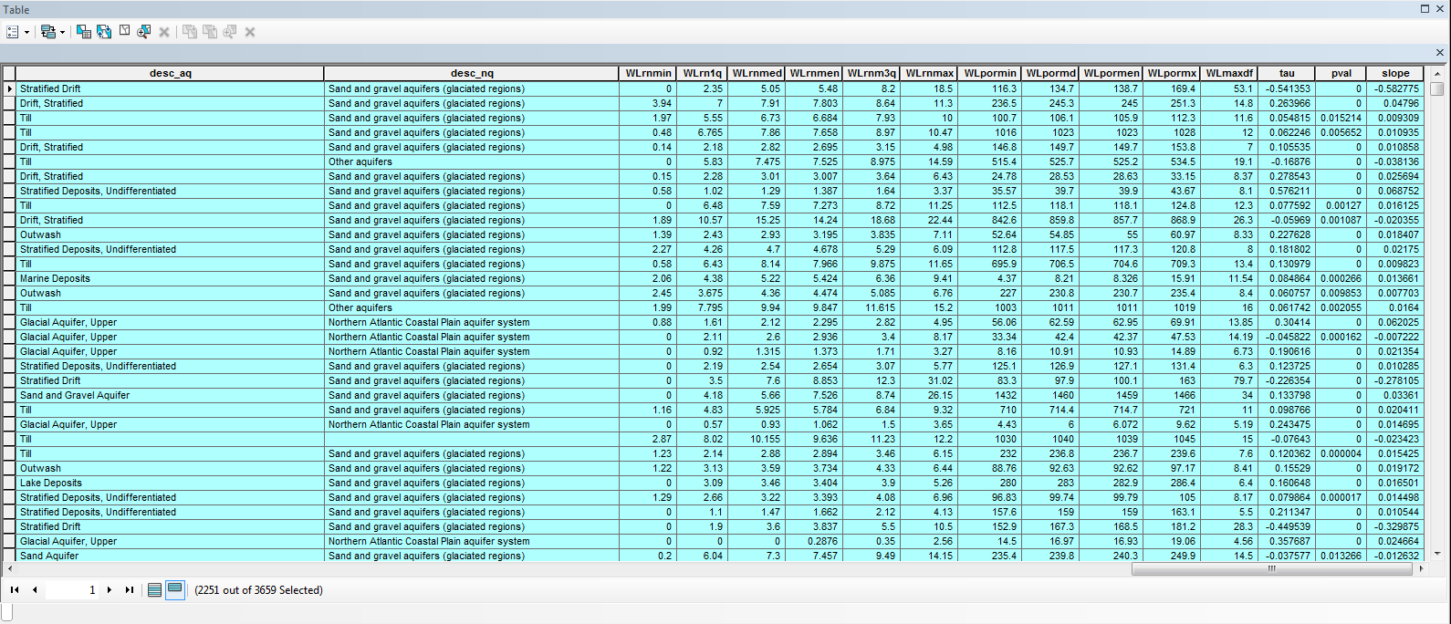

Slide 13
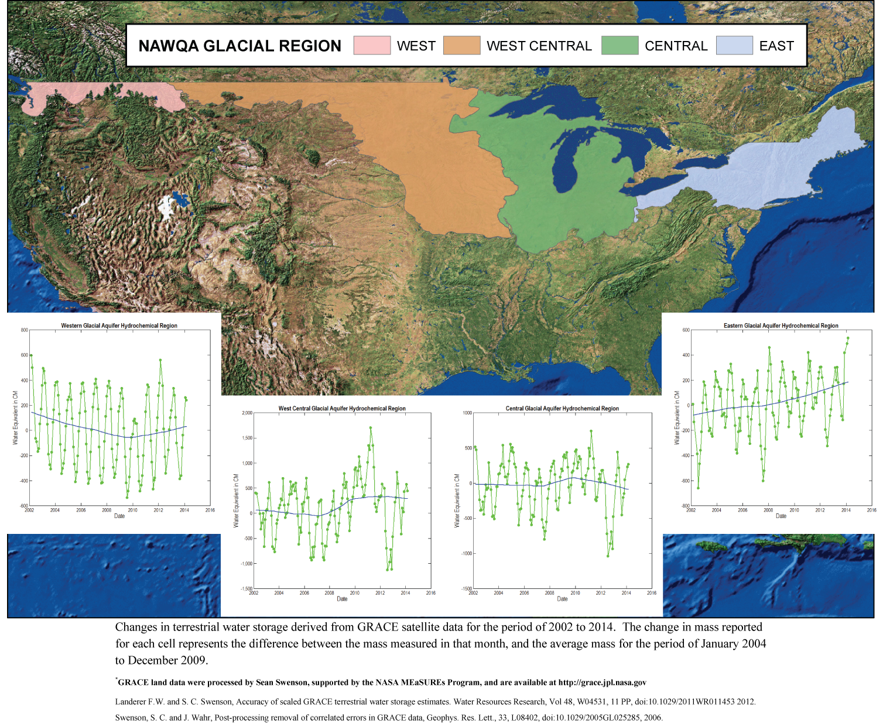
GRACE results

Slide 14
Storage conclusions
Well analysis: positive, negative, and no change sites next to each other
Systematic changes in glacial water levels are small in area and magnitude compared with bedrock principal aquifers
Unconfined or leaky conditions
Surface water capture stabilizes water levels
Change in storage from agricultural tiling can be large over the study area; 54 km³ (Konikow) – hard to pick up from wells
Groundwater trends from GRACE in study area are difficult to identify

Slide 15
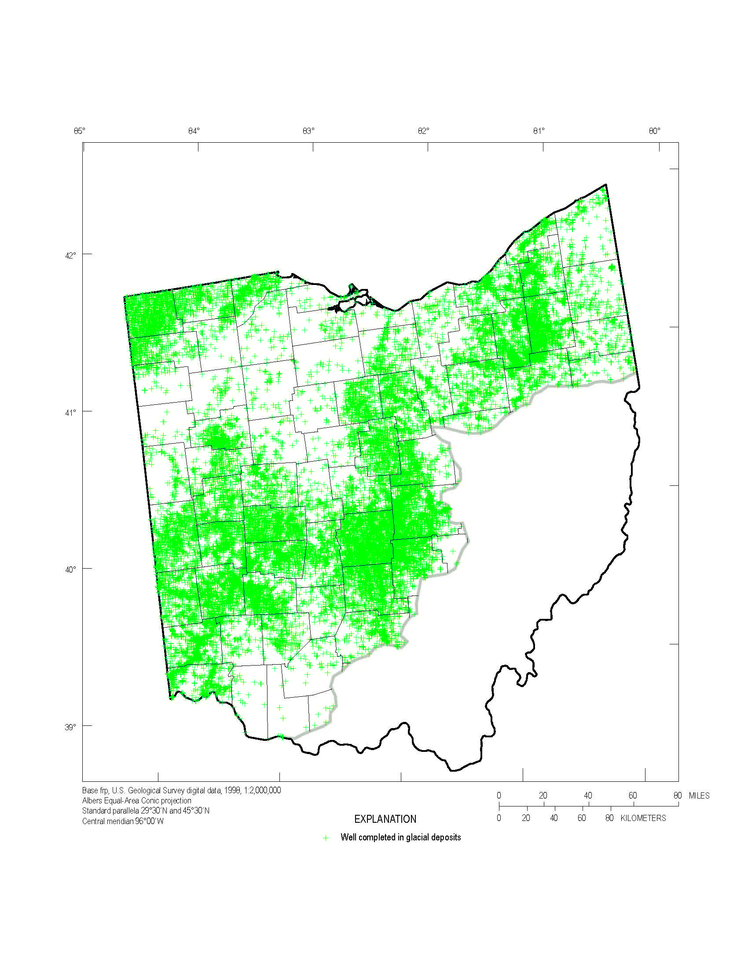
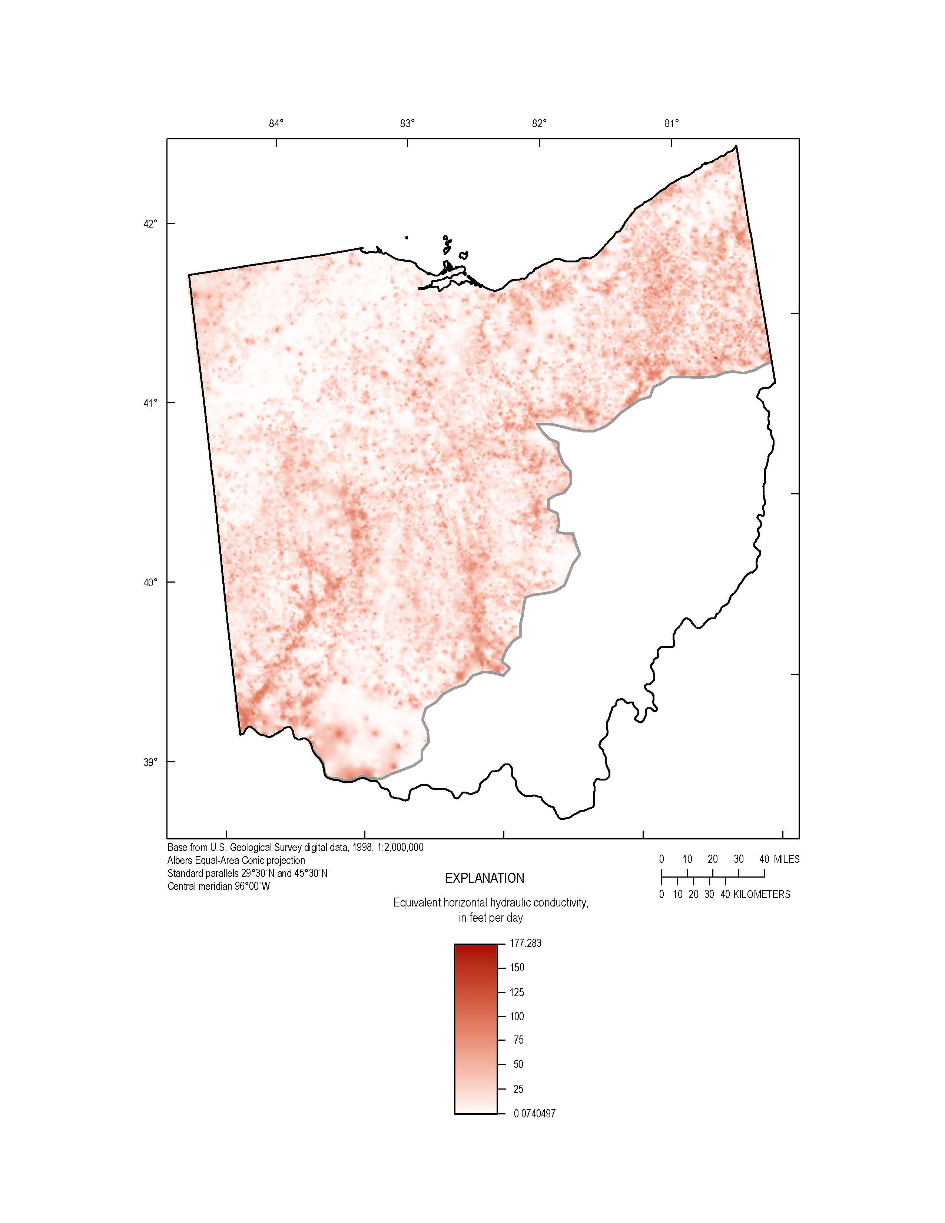
Status: hydrogeologic framework water well records analysis
Collect digital well-record databases – approximately 15 million collected.
Standardize a Nationwide well-record database.
Information with depth.

Slide 16
Status
Processing Complete | Processing In Progress | Database Created | Database In Progress
Connecticut | Alaska | Idaho | Kansas
Illinois | Maine | New York | New Hampshire
Indiana | Missouri | Washington | Rhode Island
Iowa | Nebraska |  | South Dakota
Massachusetts | Vermont
Michigan
Minnesota
Montana
New Jersey
North Dakota
Ohio
Pennsylvania
Wisconsin

Slide 17
Trends and Correlations
Analyze historical changes in groundwater levels
Documenting response of the Glacial Aquifer System to changes in climate and development
Based on many USGS and some state wells
Document trends at different types of wells
Correlations between groundwater levels and other observed hydrologic data
Streamflow
Precipitation
Pacific decadal oscillation
Extend historical groundwater records back in time, based on strong correlations
Other nearby GW wells
Nearby streamflow or meteorological variables

Slide 18
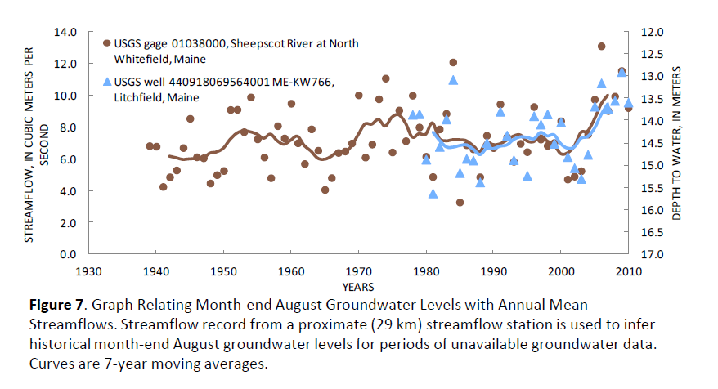
Example correlation between streamflow and month-end August groundwater level
From: Dudley, R.W. and Hodgkins,G.A., 2013. Historical groundwater trends in northern New England and relations with streamflow and climatic variables: Journal of the American Water Resources Association (JAWRA), v. 49, no. 5, pgs. 1198–1212, DOI: 10.1111/jawr.12080.

Slide 19
Likely response to future changes Modeling and Methods Development
Provide simulation results to quantify and illustrate aspects of the glacial system
Refined simulation of groundwater/surface-water interaction within regional groundwater flow models
Challenge to represent local surface-water capture and effects of individual wells in regional model
Application of a statistical method to extend model results to non-modeled areas

Slide 20
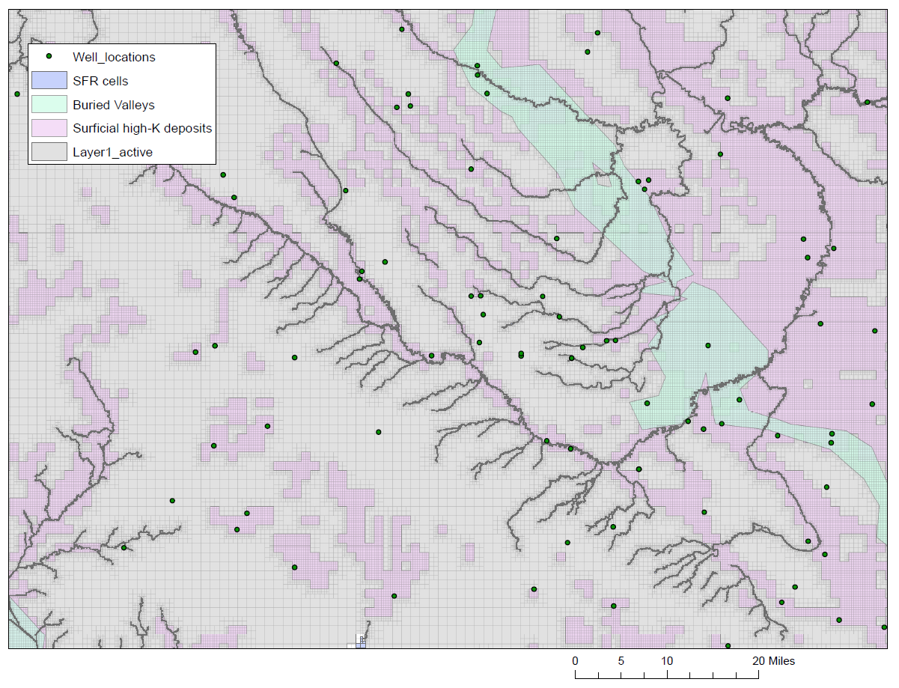
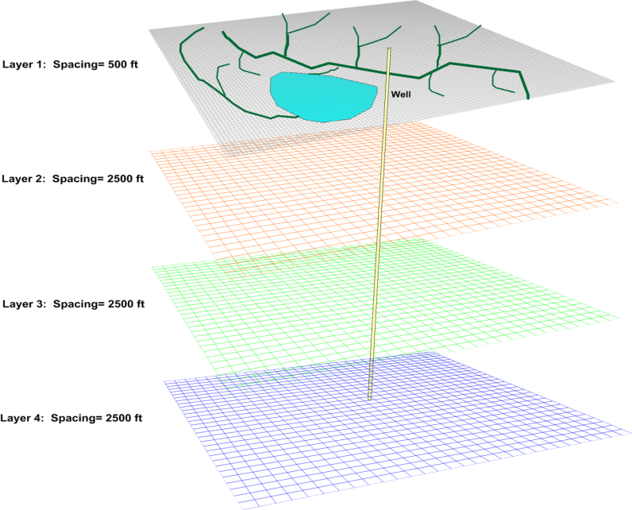
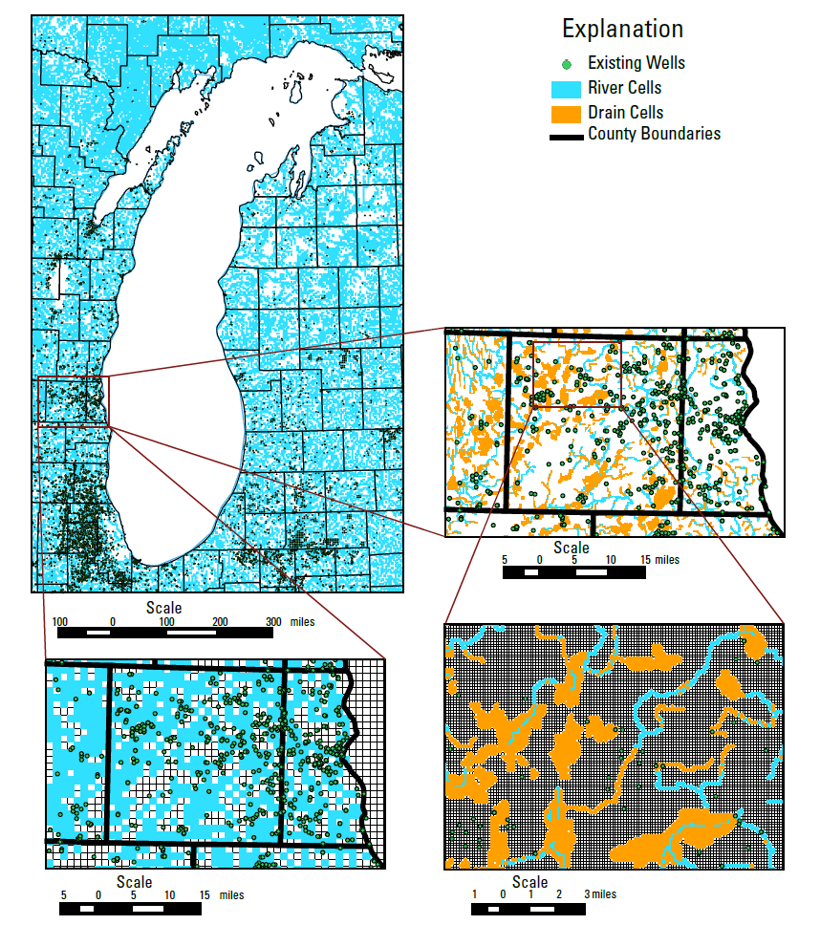
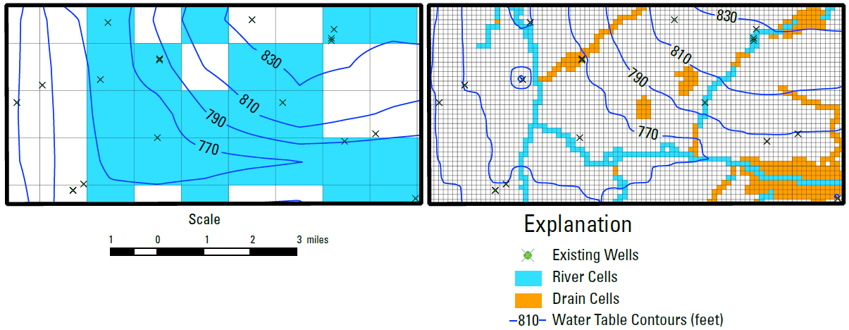
Unstructured grids and streamflow routing (SFR)

Slide 21
Extension of Model Results
How transferrable are results from a calibrated regional groundwater-flow model to similar areas?
Can we improve upon analytical solutions or coarse water budget analysis to assess regional groundwater availability in the absence of a calibrated model?

Slide 22
Bayesian Network
Bayesian Network selected as statistical technique
Use calibrated model to build the Bayesian network
Sampling the model by looking at many places within a single simulation or running the model many times:
Quantify input parameters for wells added to the model
Input parameters should be able to be defined in non-modeled area through GIS
Simulate streamflow depletion or source of water to each introduced well
Apply Bayesian network to link input parameters to output behavior

Slide 23
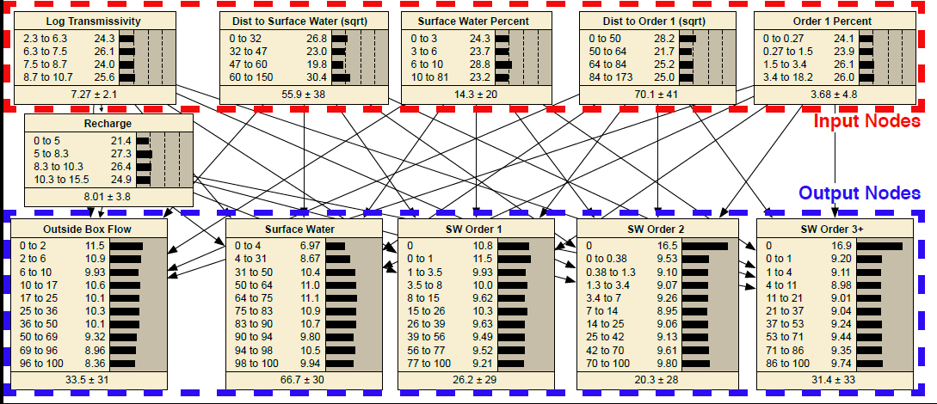

Slide 24
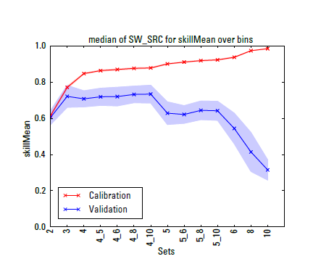
Lake Michigan Basin Bayesian Network – Uncertainty
Blue line shows loss of skill as number of bins describing the input and output parameters of the BN are increased. A large number of bins leads to improved calibration skill, but loss of predictive skill.
overfitting
Shading indicates approximation of the 95 percent credible interval around the median value in the validation trials
Input bins_output bins

Slide 25
Products: Status of groundwater resources
Regional water budgets and hydrogeologic framework report, FY14-15
Report describing methods for water-well records analysis (draft complete)
Maps and grids of wells, thickness, sand and gravel thickness, coarse fraction, inferred hydrogeologic parameters
Report on SWB application to study area: FY15-16
Callegary, J.B., Kikuchi, C.P., Koch, J.C., Lilly, M.R., Leake, S.L., 2012, Review—Groundwater in Alaska (USA): Hydrogeology Journal, v. 21, no. 1, pgs. 25-39, doi 10.1007/s10040-012-0940-5
Kahle, S.C., and Futornick, Z.O., 2012, Bibliography of groundwater resources of the glacial aquifer systems in Washington, Idaho, and northwestern Montana, 1905–2011: U.S. Geological Survey Open-File Report 2012-1053, 32 p. (also available at http://pubs.usgs.gov/of/2012/1053/)

Slide 26
Products
Trends and correlations
Trends report/Journal articles, FY16
Response to development
Unstructured grid for Lake Michigan Basin model journal article – colleague review
Bayesian network application to Lake Michigan Basin – in preparation
Fienen, M.F., and Plant, Nathaniel, 2015, A cross-validation package driving Netica with Python: Environmental Modelling & Software, v. 63, no. 1, pgs. 14-23, doi: 10.1016/j.envsoft.2014.09.007 (on-line early view posted October 3, 2014).
Final: will summarize status, trends, forecasting
Professional Paper, FY16

Slide 27
People
Water well records
Les Arihood, Indiana-Kentucky Water Science Commonwealth, Randy Bayless, Indiana-Kentucky Water Science Commonwealth,
Trends and correlations
Rob Dudley, Maine Water Science Center, Glenn Hodgkins, Maine Water Science Center,
Unstructured Grids, Bayesian Analysis, SWB code
Daniel Feinstein, Wisconsin Water Science Center, Steve Westenbroek, Wisconsin Water Science Center, Mike Fienen, Wisconsin Water Science Center,
Don Walter, New England Water Science Center,
Budgets, framework, GRACE, GIS support
Howard Reeves, Michigan Water Science Center Chris Hoard, Michigan Water Science Center,
Sharon Qi, Colorado Water Science Center,
SWB Application
Jay Roth, Minnesota Water Science Center, Jared Trost, Minnesota Water Science Center,

