Slide 1
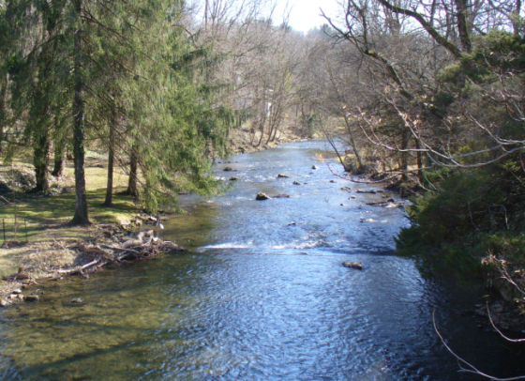

National Water Census
EWater Science
October 28, 2014
Jonathan Kennen
Ecological Water Lead,
National Water Census

Slide 2

Presentation Overview
Classifying natural flow regimes at the continental scale
Combining ecological data from multiple agencies – the effects of data preparation
Hydrological modeling for flow-ecology science in the Southeastern US
EflowStats: an R package to compute ecologically-relevant streamflow statistics
USGS-BOR Eflows Symposium, JASM 2014, Portland Oregon

Slide 3
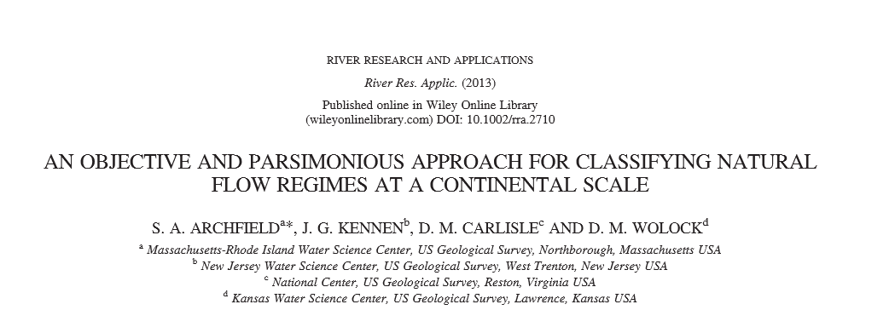

An approach for classifying natural flow regimes at a continental scale and predicting stream classes at ungaged locations
S. A. Archfield¹, J.G. Kennen², D. Carlisle³ and D. Wolock⁴
¹National Research Program, USGS, Reston, VA
²New Jersey Water Science Center, USGS, West Trenton, New Jersey
³ National Center, USGS, Reston, Virginia
⁴ Kansas Water Science Center, USGS, Lawrence, Kansas

Slide 4
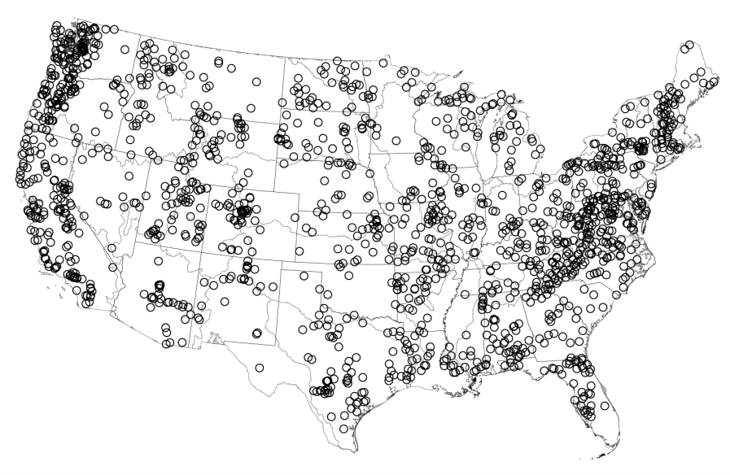
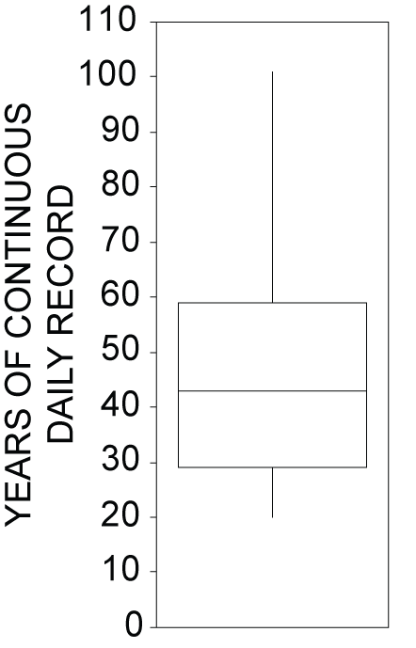
Study Sites
N = 1,543
GAGESII Reference Sites
[Falcone et al., 2010]
Notes:
(

Slide 5
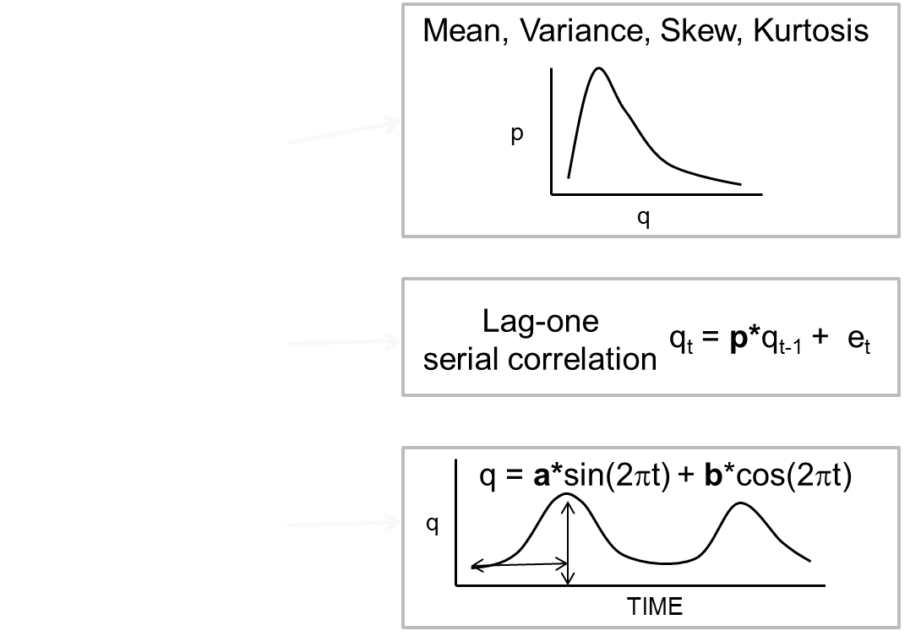

Fundamental stochastic properties of daily streamflow

Slide 6
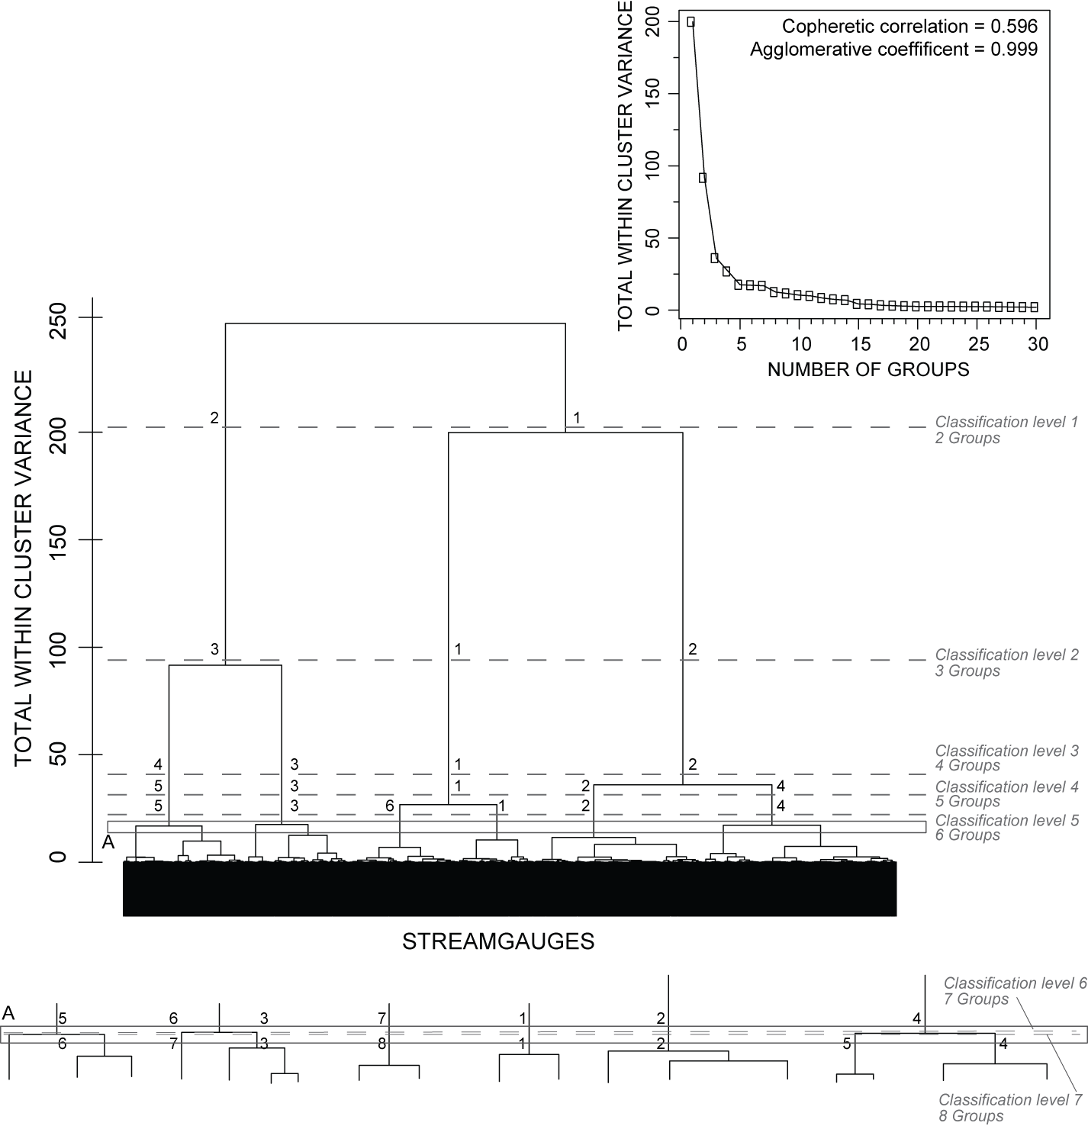
Classification of streamgauges
Classification followed recommended procedures in Olden et al., [2011].
The dendrogram was cut at 7 levels, which divided the streamgauges into 2, 3, 4, 5, 6, 7, and 8 groups, respectively.

Slide 7
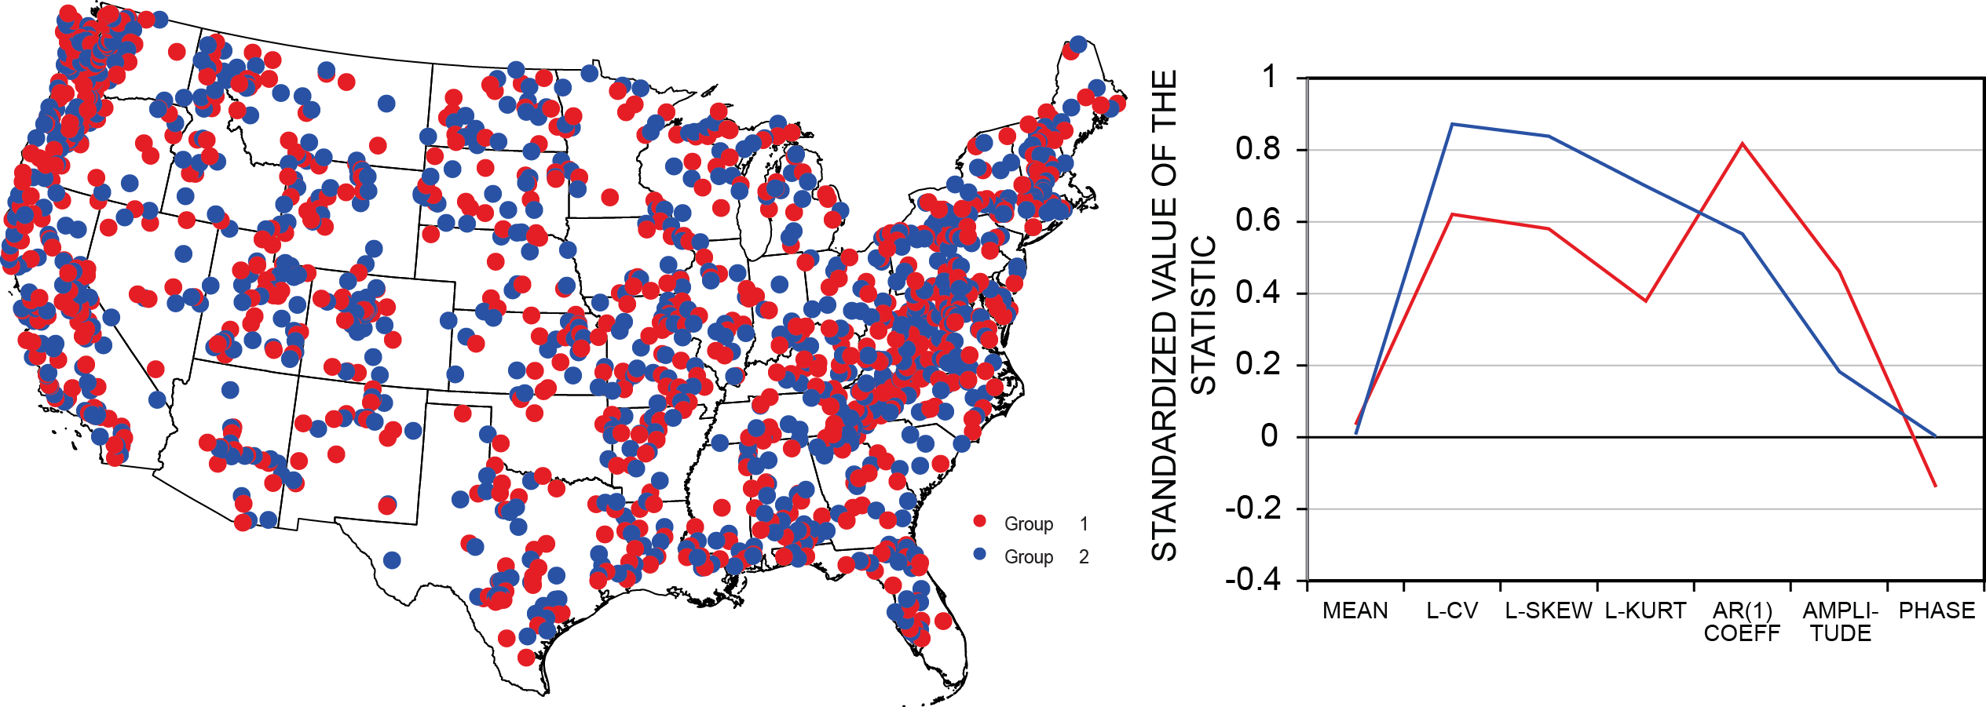
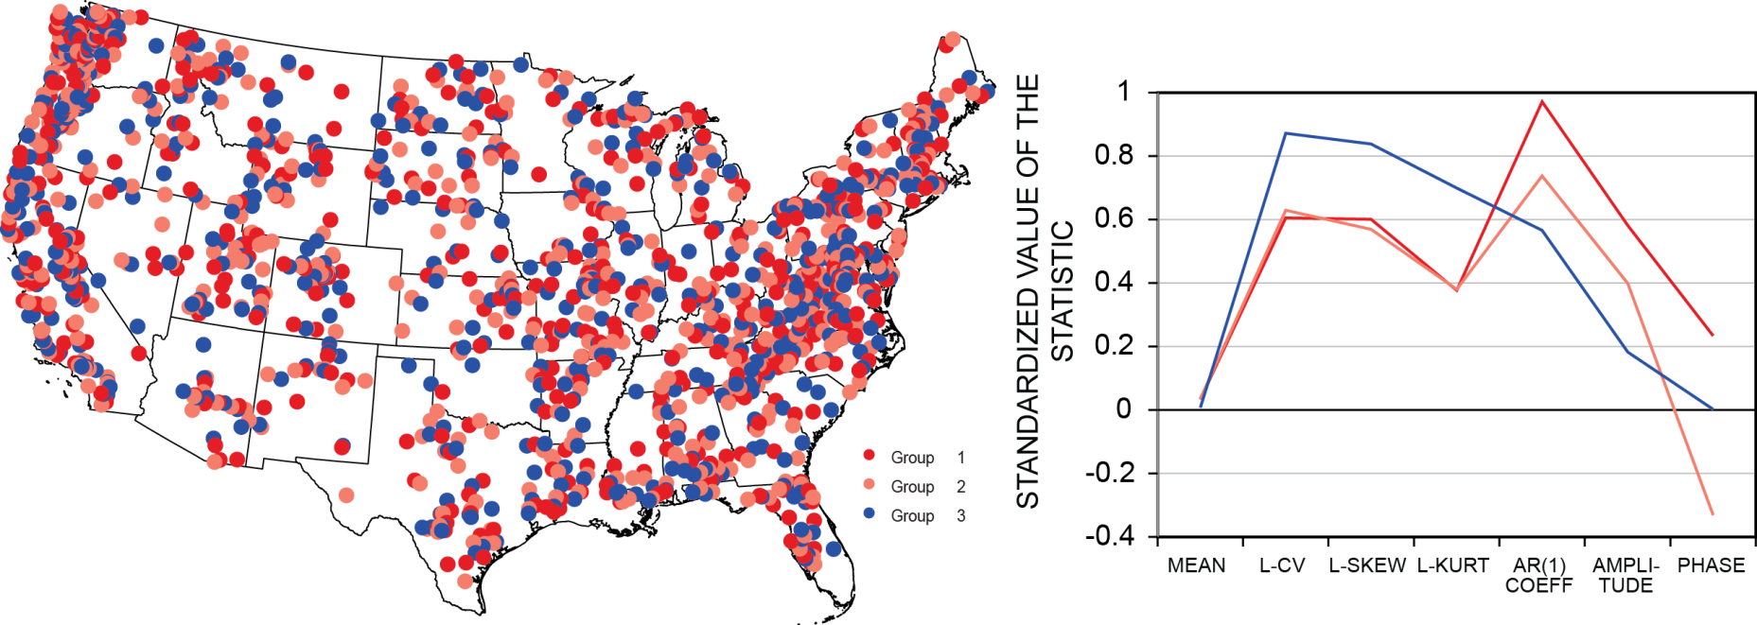
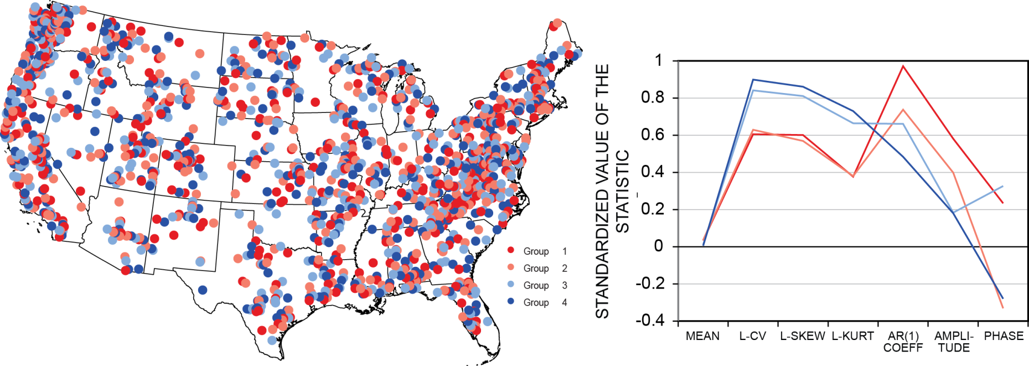
Classification of streamgauges – example
Statistics are standardized by their range [Milligan and Cooper, 1998]
Colors indicate similarity to one another.
Notes:
FIX

Slide 8
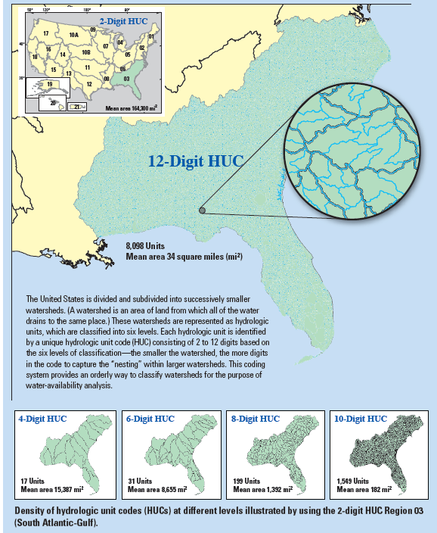
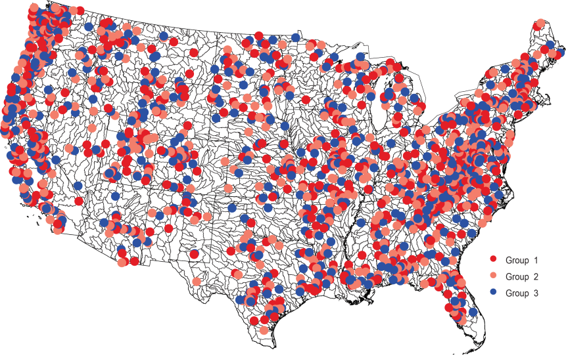
Assignment of ungauged rivers to classes
Water Census will be providing information about water availability at the HUC-12 basin scale (mean area of 34 mi²)
Discriminant analysis & Random Forest is being used to establish relations between basin characteristics and classification groups
Properties of catchment
f(x)
Classification groups
Location of classified gages with ungaged HUC-12 areas

Slide 9
Products / Publications
Hydroecological classification of ungaged rivers in the United States, by S.A. Archfield and J.G. Kennen.
The thrust of this USGS National Water Census study is to use the recently published National hydroecological classification of gaged rivers in the US by Archfield and others (2013) to assign all ungaged rivers in the US to one of the published stream classes. A draft manuscript is planned by the end of 2014.
Work with CIDA to Build a Classification Tool into WC Data Portal
Notes:
(

Slide 10
Combining Ecological Data from Multiple Agencies: Effects of
Data Preparation
Jonathan G. Kennen
USGS, New Jersey Water
Science Center
&
Tom Cuffney
USGS, North Carolina Water
Science Center

Slide 11
Regional & National studies require aggregating data from a large number of sites dispersed over a large areas and often over a long time period.
Consequently, most regional studies will require combining data from multiple sources:
  States
  Federal agencies
  Non-governmental agencies
  Other
Notes:
As more and more data become available and these data span broad geographic regions which encapsulate numerous state, federal and Non-government organization, there is a growing need to better understand the complexities associated with the aggregation of these data and it is essential that we understand how best to place them on a more common footing for bioassessment and flow-ecology modeling.

Slide 12
The Ideal
Data collected by one agency.
Data collected using consistent methods and crews.
Data processed using consistent methods…
  Consistent subsampling method
  Consistent set of major groups identified
  Common level of taxonomic resolution within major groups
Notes:
Ideally, data are collected by a single agency that uses consistent collection methodologies and the samples are identified to a common taxonomic resolution.

Slide 13
The Reality
Data collected by multiple agencies.
Samples collected using multiple methods.
Samples processed using multiple methods.
Major taxonomic groups collected differ among agencies.
Level of taxonomic resolution varies by agency.
Data from multiple agencies must be combined for analysis.
Notes:
The reality is that these data are collected by multiple agencies using differing SOP’s, they are processed by taxonomists with different levels of expertise and interests, and ultimately, the taxonomic resolution will differ. Therefore, these data need to be combined in an appropriate and consistent way for analysis.

Slide 14
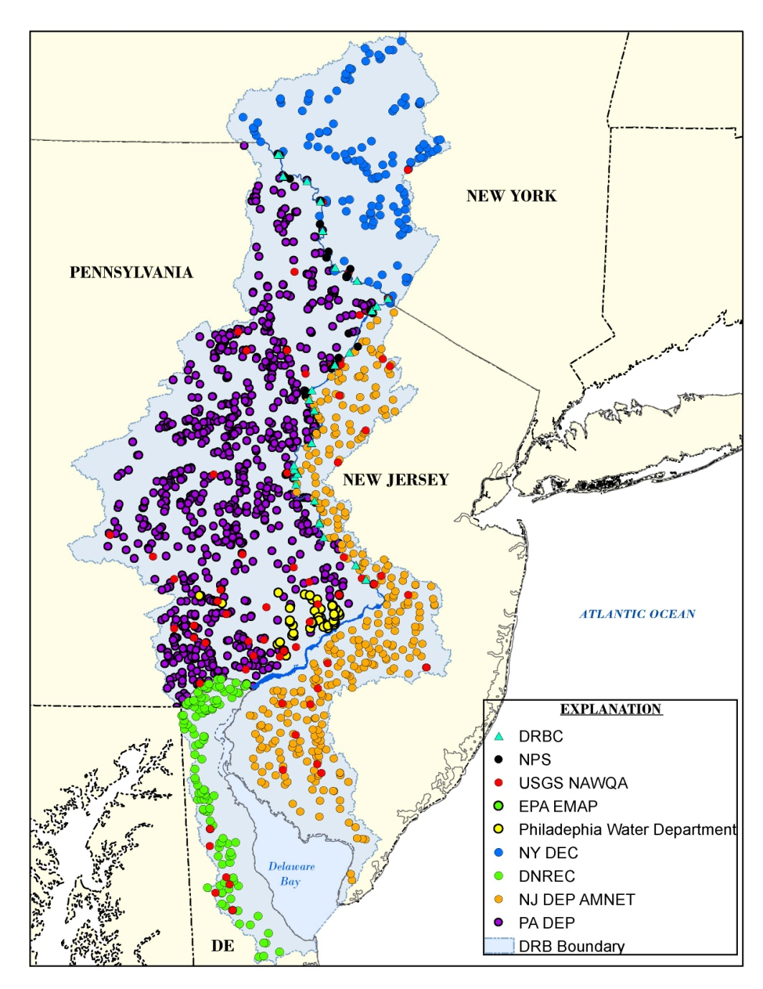
Leveraging Delaware River Focus Area Study Data
1,575 sampling sites
9 separate data sources: USGS, USEPA, NPS, PADEP, DE-NREC, NJDEP, NYDEC, Delaware River Basin Commission, City of Philadelphia Water Department
Notes:
We will use the National Water Census Delaware River Focus Area Study as an example:
1,575 unique sampling sites that span ~15 years (1996-2012), and include 9 separate data sources:
USGS, USEPA, NPS, NJDEP, PADEP, DRBC, NYDEC,
DENREC – Delaware Department of Natural Resources and Environmental Control
PhilWD –Philadelphia Water Department

Slide 15
Fixed counts
Fixed count |  | Source
100 |  | D, F
200 |  | A, B,G, H
300 |  | C, I
>300 |  | E
Notes:
Additionally, it should be noted that fixed counts differed among agencies and ranged from 100 to >300. These differences also need to rectified to place samples on a more comparable footing.

Slide 16

Larger fixed-count increases richness
Taxa recovered
Increasing subsampling effort
Notes:
Why not just throw all the fixed count data into the mix and let the taxonomic chips fall where they may? Well, because the higher fixed counts ultimately result in greater taxonomic richness, therefore, analysts that fail to recognize this relationship and move forward with post-hoc assessment prior to putting all samples on an even taxonomic footing, may be increasing the potential for bias in their results. This may be especially true for any aquatic invertebrate metric based on taxonomic richness…..of which there are many….

Slide 17
IDAS was used to harmonization data across sources
Taxonomic harmonization….
  Liberal (DHL): retains differences in taxonomic resolution within major taxonomic groups
  Conservative (DHC): maximizes comparability of taxonomic resolution within major taxonomic groups
Fixed count subsampling….
  Reduce data to common 100-count subsample
  25, 100-count subsamples
Notes:
So, we need to be able to examine the effects of these data harmonization approaches across sources and understand the effects of fixed count subsampling.
Note – not sure if this slide is needed?

Slide 18
Taxonomic Harmonization Example:
Liberal vs. Conservative
 | Raw | Liberal | Conservative
NON-INSECTS
 | NEMATA | DROP | DROP
 | COPEPODA | DROP | DROP
MAYFLIES
 | EPHEMERELLIDAE | EPHEMERELLIDAE | EPHEMERELLIDAE
 | ATTENELLA | ATTENELLA | EPHEMERELLIDAE
 | DANNELLA | DANNELLA | EPHEMERELLIDAE
 | DRUNELLA | DRUNELLA | EPHEMERELLIDAE
 | EPHEMERELLA | EPHEMERELLA | EPHEMERELLIDAE
 | EURYLOPHELLA | EURYLOPHELLA | EPHEMERELLIDAE
 | SERRATELLA | SERRATELLA | EPHEMERELLIDAE
 | TELOGANOPSIS | TELOGANOPSIS | EPHEMERELLIDAE
 | TIMPANOGA | TIMPANOGA | EPHEMERELLIDAE
TOTAL TAXA | 11 | 9 | 1
Notes:
This table illustrates an example of the taxonomic differences among the Raw data and data harmonized using the Liberal and Conservative methods. Lets look at the Non-insects and the Order Ephemeroptera across the Raw, Liberal, and Conservative approaches. All non-insect taxa would be retained in a Raw data set, however, taxonomic harmonization using the liberal and conservative approach would result in the removal of these taxa. You can see differences even more clearly for the Ephemeroptera – for example, all family and genus level taxa are maintained in the Raw and Liberal harmonization approach, however, under the more conservative approach, all genus level data would be rolled up to the family level. Which in most cases would be the lowest common taxonomic level among data sources….
Why would the “Liberal” approach remove the Non-insects?

Slide 19
Summary
Data from different sources require modification before they can be combined:
      Harmonization of taxonomy
      Comparability of subsample sizes
Failure to modify data from different sources can lead to incomparable assemblages and misleading results, especially for metrics based on Richness.
Next step is to see how differences in metrics affect response to environmental factors –factors such as flow, LU, physio, & climate that affect the distribution of organisms.

Slide 20
Products
Journal Article describing how data from multiple States (e.g., PA, NY, NJ, DE) and Federal (US EPA, USGS, NPS) agencies are combined to produce comparable data for ecological flow studies.
This paper, focuses on DRB invertebrate data, will address issues related to harmonization of taxonomy and simulation of fixed count sub-sampling and their effects on data content and comparability. (Authors – Jonathan Kennen & Tom Cuffney). Draft complete – pub expected spring 2015.

Slide 21
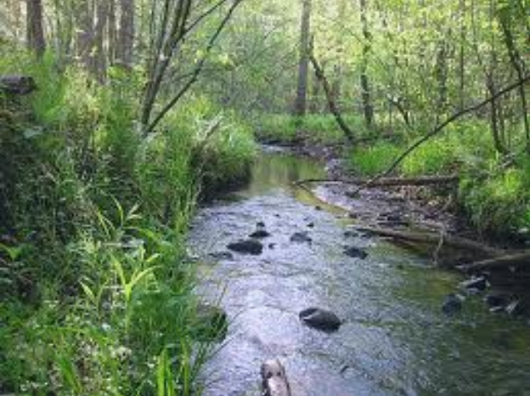
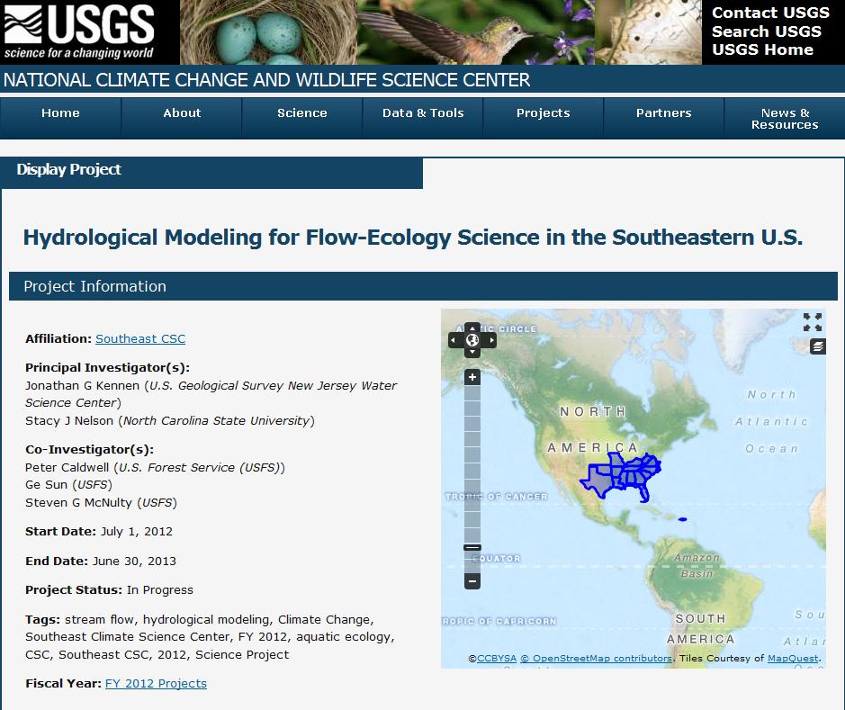

Hydrological Modeling for Flow-Ecology Science in the Southeastern U.S.
Evaluate and compare models across the Southeast
Pilot study in NC for regional flow-ecology modeling and global change impacts
http://home.doi.gov/csc/southeast/science.cfm

Slide 22
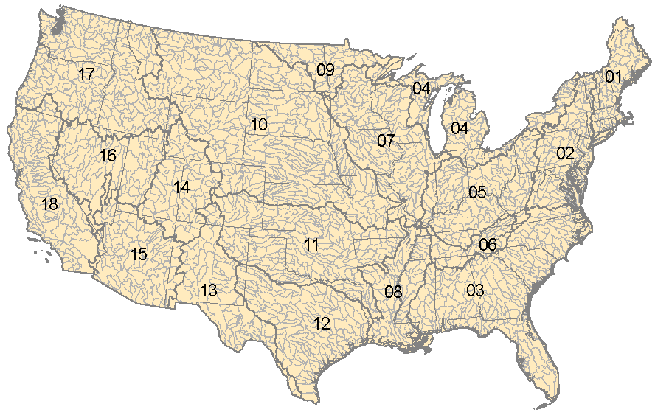
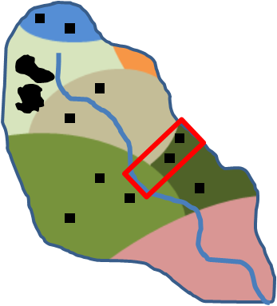
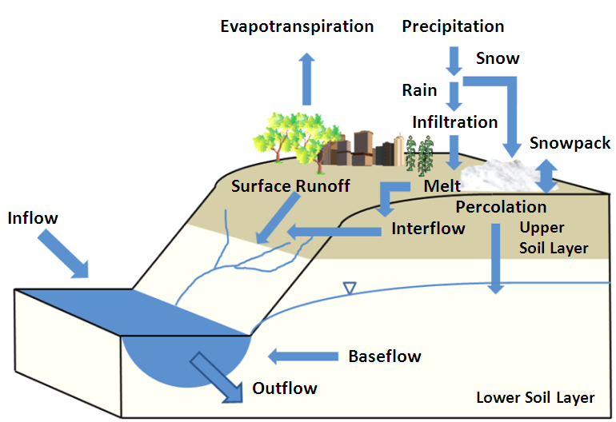
The WaSSI (Water Supply Stress Index) Model
WaSSI was developed by the Forest Service to evaluate the impact of climate change on water supply and demand and ecosystem productivity
Water Accounting Model (monthly)
Evapotranspiration
ET=f(PET, PPT, LAI)
Soil moisture and runoff
NOAA, National Weather Service
Water withdrawal and return
Estimated water use in the U.S. by sector, adjusted for population
Streamflow
Qout = Qin + Qgen – WU
Caldwell et al., HESS, 2012
HUC8 /
HUC12
Notes:
To do this we used the Water Supply Stress Index (WaSSI) ecosystem services model. WaSSI was developed by the Forest Service Southern Research Station to evaluate the impact of global change on water supply and demand, ecosystem productivity or carbon sequestration dynamics, and to evaluate tradeoffs between management strategies for water and carbon.
WaSSI is a monthly time step water balance model that operates at the HUC8 or HUC12 watershed scale for the conterminous US. The average HUC8 is a little bit bigger than Rhode Island while the average HUC12 is about the size of a county.
WaSSI is sensitive to land cover type in that ecosystem water use, or evapotranspiration is computed using an empirical equation developed using eddy flux measurements from several land cover types all over the globe.
Each of the 2100 HUC8s or 160,000 HUC12s in the US are divided into 10 land cover classes, and the full water balance accounting for precipitation, snow accumulation and melt, evapotranspiration, surface runoff and baseflow processes is computed independently for each land cover class.
Runoff and baseflow are accumulated and routed from one HUC watershed to the next, and the total monthly discharge at the outlet of each HUC is computed.

Slide 23
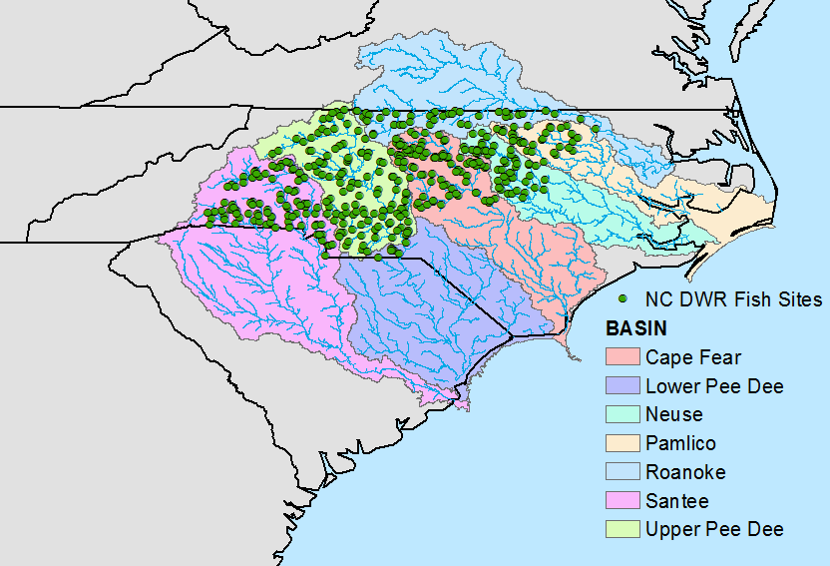
Climate and land cover change impacts on fish species richness in NC
N=428
Notes:
N=428

Slide 24
Scenarios
Historical (1991-2010)
  Train flow-ecology models for 428 NC DWR fish sampling sites
  Baseline streamflow for region
Future Climate (2041-2060)
  NOAA GFDL CM2.0 for the A2 (high) emission scenario
Future Impervious Cover (2060)
  U.S. EPA Integrated Climate and Land Use Scenarios (ICLUS) for A2
Hypothetical Withdrawals
  Subtract fixed percentages from the discharge at the outlet of each HUC12

Slide 25
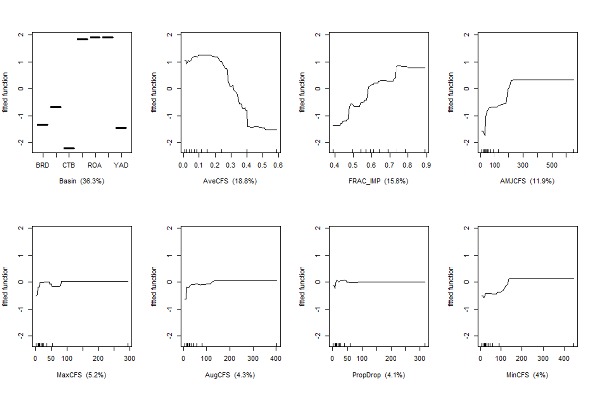
Developed boosted regression tree models predicting change in fish species richness in NC streams
These BRT Partial dependency plots provide a way to visualize the effect of a specific explanatory variable on the response variable
Notes:
N=428

Slide 26
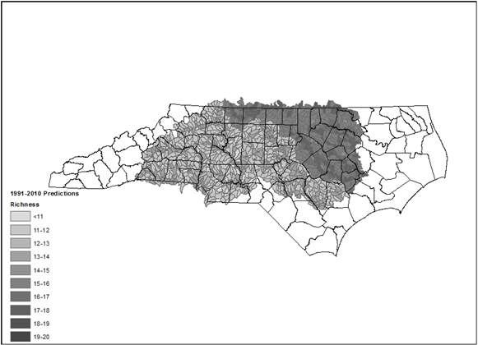
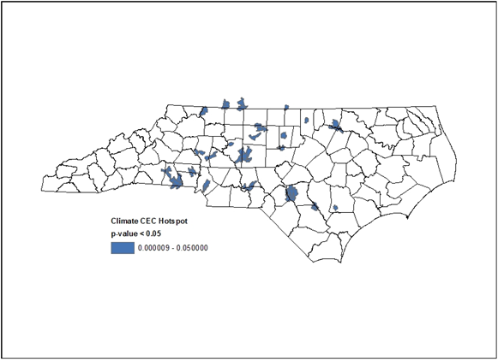
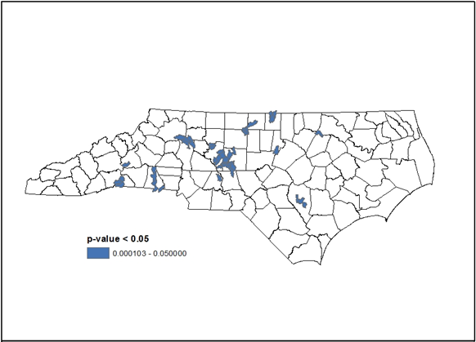
Identifying areas of greatest change (“hotspots”) in fish species richness.
Predicted Data (Current Conditions)
Projected Climate (2041-2060)
20% Withdrawal
Notes:
N=428

Slide 27
Summary
The WaSSI streamflow model provides reasonable estimates of monthly streamflow relative to other flow models and is useful for estimating streamflow under global change.
Predicted streamflows can be used for regional assessments of global change impacts on aquatic ecosystems
BRT models were useful in identifying hotspots of fish richness changes associated with changes in water availability and climate change.
Notes:
(

Slide 28
Products / Publications
A Comparison of Hydrologic Models for Ecological Flows and Water Supply. by P. V. Caldwell, J. G. Kennen, G. Sun, J. E. Kiang, J. B. Butcher, M. C. Eddy, L. E. Hay, J. H. LaFontaine, E. F. Hain, S. A. C. Nelson, S. G. McNulty. Submitted for review to the journal Ecohydrology July 2014.
Hydrological modeling for flow-ecology science in the Southeastern U.S: An inventory and evaluation of current efforts and knowledge gaps for global change impact studies addressing the SECSC FY2012 Annual Science Work Plan Ecohydrology Priority Science Need. By J.G. Kennen, P.V. Caldwell, E.F. Hain, S.A.C. Nelson, G. Sun, S.G. McNulty, and T. Shortley. Draft Report submitted to SECSC Sept 5, 2014. OFR or FS Series
Flow-Ecology Response Models for Fish Species Richness in Piedmont Streams. By Ernie F. Hain, Jonathan G. Kennen, Peter Caldwell, and Stacy A.C. Nelson. Draft of JA by Mid-Nov. 2014.
Notes:
(

Slide 29
EflowStats: an R package to compute ecologically-relevant streamflow statistics
Jessica Thompson¹, Jonathan Kennen², Stacey Archfield³ and Julie Kiang⁴
¹Center for Integrated Data Analytics, USGS, Middleton, WI, USA
²New Jersey Water Science Center, USGS, West Trenton, NJ, USA
³National Research Program, USGS, Reston, VA, USA
⁴Office of Surface Water, USGS, Reston, VA, USA

Slide 30
Project Overview
The Water Census is tasked with quantifying water availability for watersheds across the United States.
Calculating ecologically-relevant streamflow statistics is an important step in understanding water availability to meet both human and ecological needs.
The EflowStats package was developed using the open-source R software environment.
Notes:
(

Slide 31
EflowStats Benefits Include
Calculates ecologically-relevant streamflow statistics (Kennen et al., 2007)
Calculates the fundamental properties of daily streamflow (Archfield et al., 2013)
Batch USGS station processing capability
Handles daily flow data from multiple sources
R software is part of an open source environment that is heavily used by scientists, researchers, and academics across the globe.

Slide 32
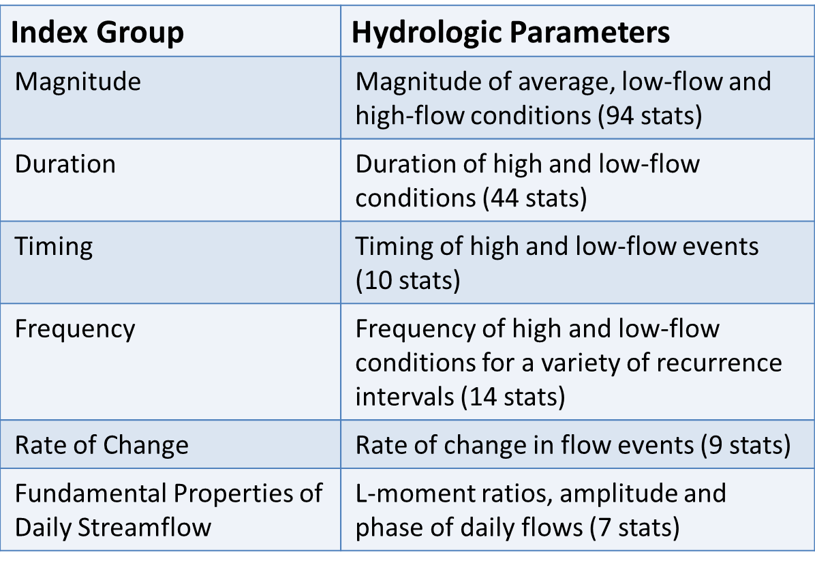
Statistical Groups
Notes:
(

Slide 33
Summary
Ecological streamflow statistics are an important component in understanding water availability requirements for human and ecological needs
Existing HIP software is aging and does not include the more recently published fundamental properties of daily streamflow statistics (i.e., the magnificent 7!) and is not 64 bit compatible
This package provides users with a streamlined method to calculate the existing statistics quickly and consistently
The open-source R environment makes it easy for others to use and expand the utility of this package
Notes:
(

Slide 34
EFlowStats Publication
EflowStats Package is available on GitHub at: http://github.com/USGS-R/
EflowStats Package, by authors J. Thompson and S. Archfield, is currently making it’s way through IPDS so it can be published on CRAN and is currently awaiting Bureau Approval.
Expected publication data is ??
Note – There is already a Growing USGS and non-USGS user community

Slide 35


Environmental Flow Science in the WaterSMART Program -- Joint Aquatic Sciences Meeting, May 22, 2014 Portland Oregon
Jonathan G. Kennen¹, Carly Jerla² and Anne Brasher³
¹USGS New Jersey Water Science Center, Lawrenceville, NJ
²Bureau of Reclamation, Boulder City, NV
³USGS Utah Water Science Center, Moab, UT

Slide 36
Summary
Special Session at the joint Aquatic Sciences Meeting in Portland, Oregon on Environmental Flow Science in the WaterSMART Program.
Collaboration between U.S. Geological Survey and Bureau of Reclamation to provide a broad overview of National and river basin investigations in the “WaterSMART” Program.
Goal – to bring together scientists who are engaged in efforts that support and broaden WaterSMART environmental flow science and to emphasize emerging and ongoing research on assessing water availability, developing baseline hydrographs at ungaged locations, evaluating trends in streamflow, developing ecological flow criteria, flow-ecology response models and decision support systems, and the integration of this information through a common spatial framework.
Notes:
Physiological, ecomorphological, and life-history characteristics inherent to a species; advantages to using traits

Slide 37
Summary (cont.)
Twenty three talks accounting for four distinct sub-sessions
  Environmental Flow Building Blocks
  Flow-Ecology modeling and assessment
  Ecological vulnerability to climate change
  Data Integration
Introductions provided by Eric Evenson (USGS) and Seshu Vaddey (BOR)
Notes:
Physiological, ecomorphological, and life-history characteristics inherent to a species; advantages to using traits

Slide 38
Presentations
1) Eric Evenson – USGS National Water Census
2) Seshu Vaddey – BOR RB Supply and Demand Studies
3) Nancy Barber – Water Use and Accounting
4) Julie Kiang – Daily Flow Estimation
5) Pete Caldwell – WaSSI Flow Model and Eflows
6) Howard Reeves – Groundwater for support of Eflows
7) Williamson – Simulating Minimally Impacted Flow
8) Jessica Thompson – Intro to the EflowStats Package
9) Stacey Archfield – Classifying Flow Regimes
10) Mary Freeman – Flow Ecology Relations in ACF
11) Ernie Hain – Flow Ecology Response Models in NC
Notes:
Physiological, ecomorphological, and life-history characteristics inherent to a species; advantages to using traits

Slide 39
Presentations (cont.)
12) Anne Brasher – Impacts of Flow Changes in the Verde
14) Tom Cuffney – Flow to Maintain Ecological Integrity
15) Jennifer Phelan – Flow Alteration Relations for Fish
16) Kelly Maloney – Effects of Flow Scenarios in DRB
17) Carly Jerla – Eco Resources & WSD Studies in CRB
18) Lindsey Reynolds – Effects of Stream Drying in CRB
19) Tori Turner – Climate Change Impacts in the Hood
20) Dagmar Llewellyn – Climate Effects in the Rio Grande
21) Jonathan Kennen – Effects of Data Preparation: DRB
22) Pete Ruhl – USGS BioData for Extant Eco Information
23) Dave Blodgett – Data and Processing tools for EFlow.
Notes:
Physiological, ecomorphological, and life-history characteristics inherent to a species; advantages to using traits

Slide 40
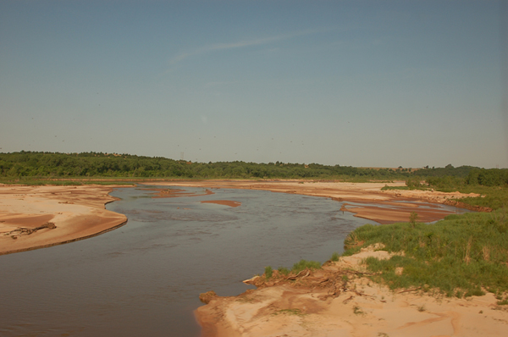
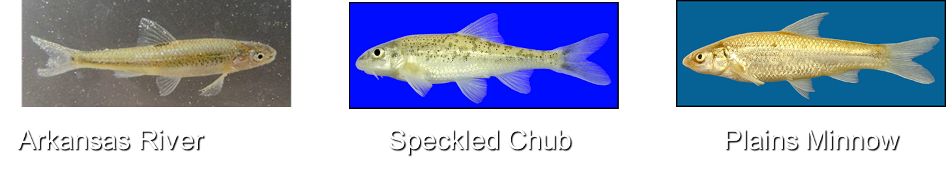
Assessing the Effects of Flow Stress & Climate Change on Fish Traits in the Arkansas - Red River Basin
S.K. Brewer¹, T. A. Worthington², J. G, Kennen³,
²B. Vieux, and W. Andrews⁴
¹USGS Oklahoma Cooperative Fish and Wildlife Research Unit, OSU
²Oklahoma State University
³USGS New Jersey Water Science Center
⁴USGS Oklahoma Water Science Center, Oklahoma City
Canadian River Fishes of conservation concern

Slide 41
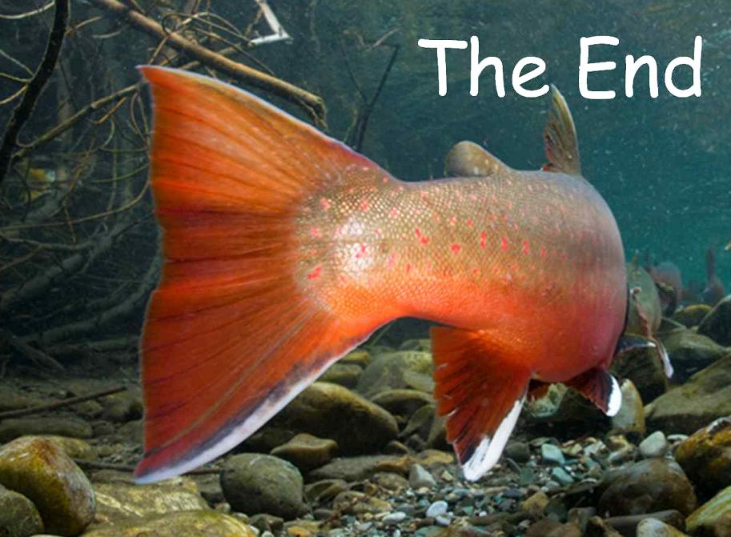
Jonathan Kennen
Water Census, Ecological Flow Lead
U.S. Geological Survey
3450 Princeton Pike, Suite 110
Lawrenceville, New Jersey 08648
609-771-3948 jgkennen@usgs.gov

