Slide 1
Remote Sensing Evapotranspiration Modeling for USGS Water Census
Gabriel Senay and James Verdin
USGS EROS
National Water Census Meeting
October 28 – 30, 2014
USGS New Jersey WSC

Slide 2
Team and Contributors
USGS EROS:
Jim Rowland
InuTeq/SGT EROS:
Ramesh Singh
Manohar Velpuri
Stefanie Bohms
MacKenize Friedrichs

Slide 3

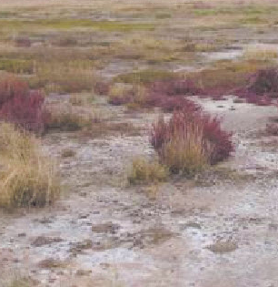

Why ET?
It is a RESPONSE variable as opposed to precipitation (driver)
It reflects the integrated effects of Energy/Aerodynamics, Soil Moisture, Vegetation and Environmental Stress
Energy
Wind/RH
Moisture
Vegetation
Env. Stress

Slide 4
Remote Sensing ET Research and Application Funded by: USGS Groundwater Program -Columbia Plateau/Central Valley/High Plains WaterSMART/USGS Water Census - CONUS water use USAID FEWS NET -for international applications
Notes:
Emphasize this objective and the questions to be answered

Slide 5
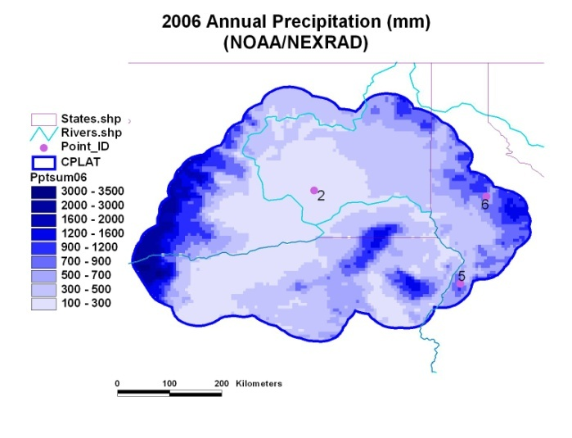
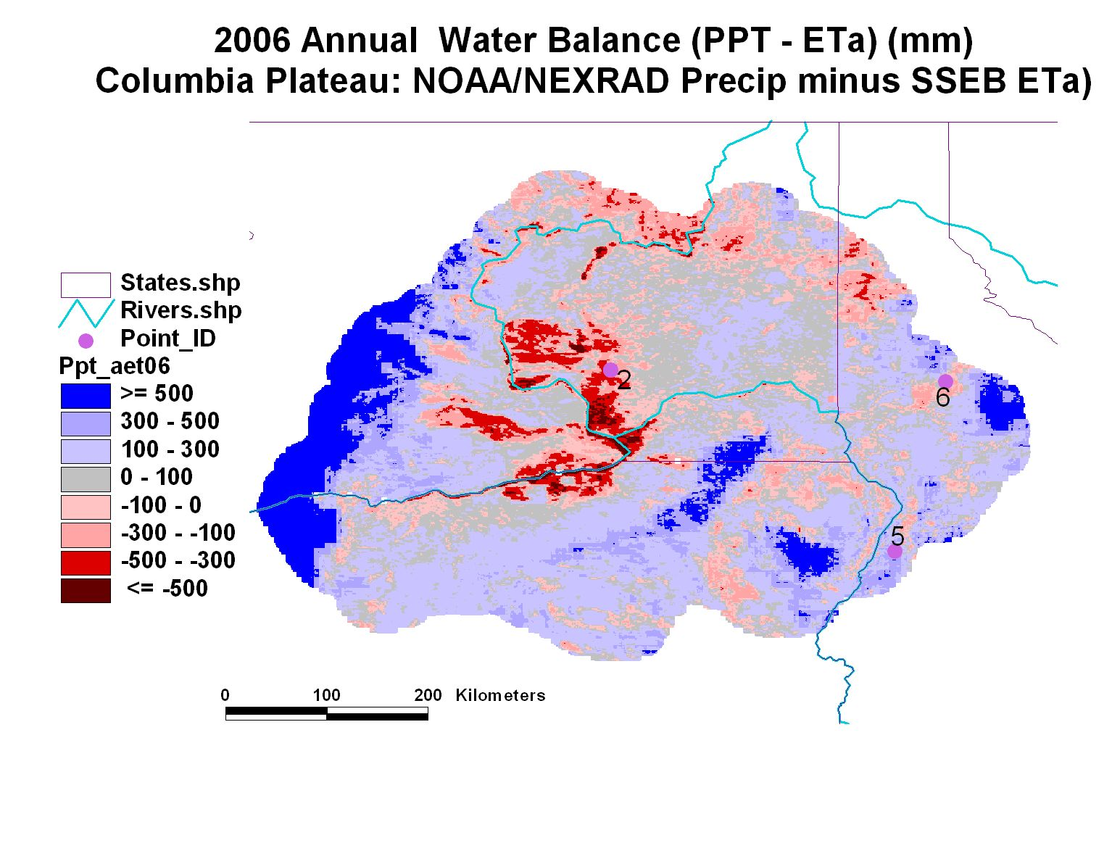
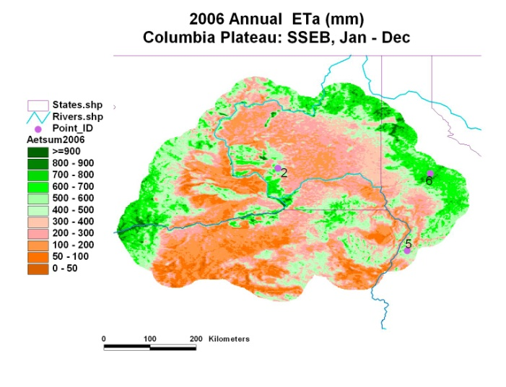
Annual Water Balance
Withdrawal
Recharge

Slide 6
FY 14 Update
1. MODIS-based 2013 CONUS ET completed and updated at the USGS Geo Portal
-Global ET implemented, leveraging Water Census effort
2. CRB 2013 ET completed using Landsat 8
528 Landsat Images processed
3. Delaware River Basin ET completed for 2005 in addition to 2010 (last year) ~ 50 images

Slide 7
FY 14 Update, Cont’d
4. Progress made in ET source partitioning: rainfall vs non-rainfall (Irrigation, GW sources)
5. Palo Verdi Irrigation ET and Walnut Gulch ET participation, part of the USGS/USU guideline and specifications study
6. Two papers published with Remote Sensing:
i) CRB 2010 ET; first ever CRB-wide ET
ii) Merging of MODIS and Landsat to create monthly ET at Landsat Scale

Slide 8
2013 ET Data on USGS Geo Portal http://cida.usgs.gov/climate/gdp/ (Center for Integrated Data Analytics) Monthly and yearly grids: 2000-2013

Slide 9
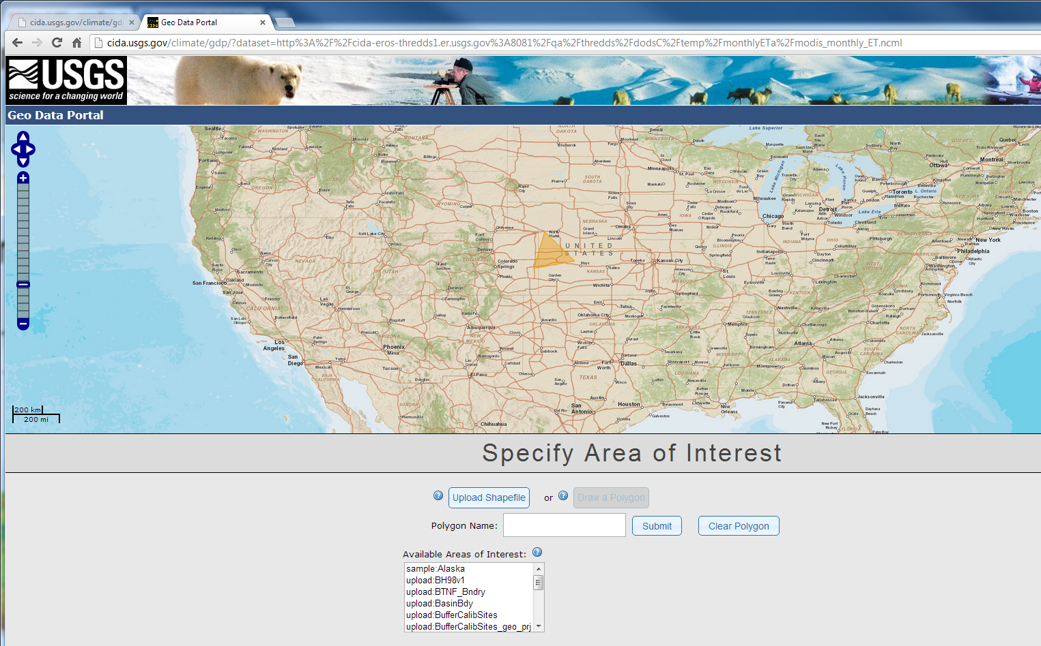

Slide 10
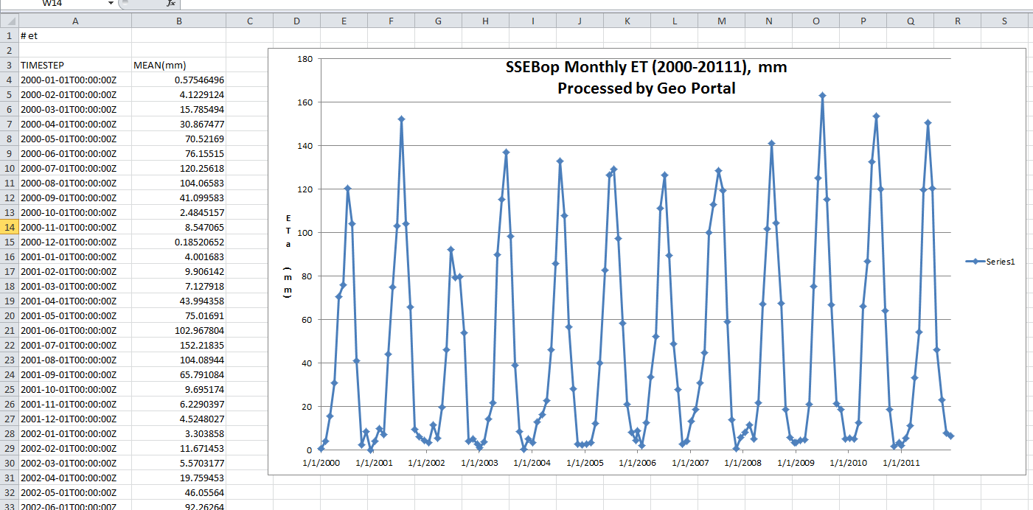
Data summaries are available for analysis

Slide 11
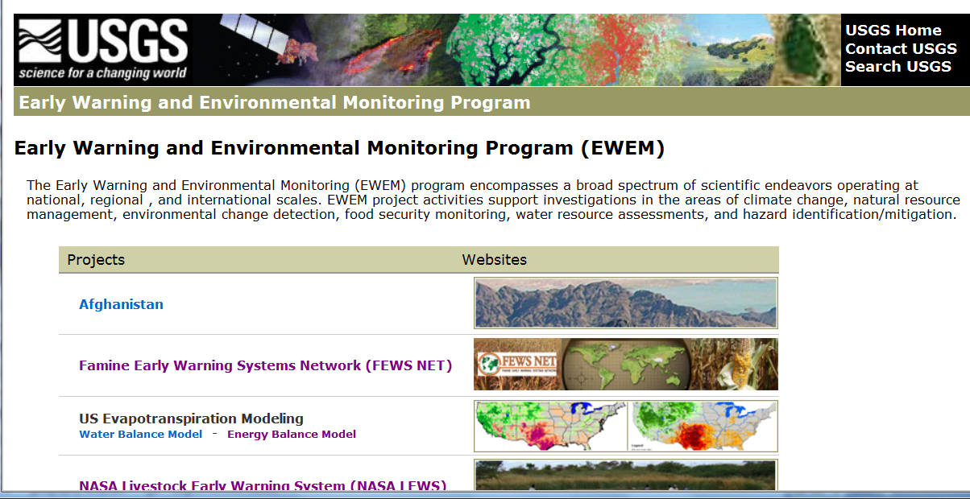
Global and Regional Operational Products
ET anomalies are created as percent deviation (ratio) from the median over (2003-2013) ET datasets.

Slide 12
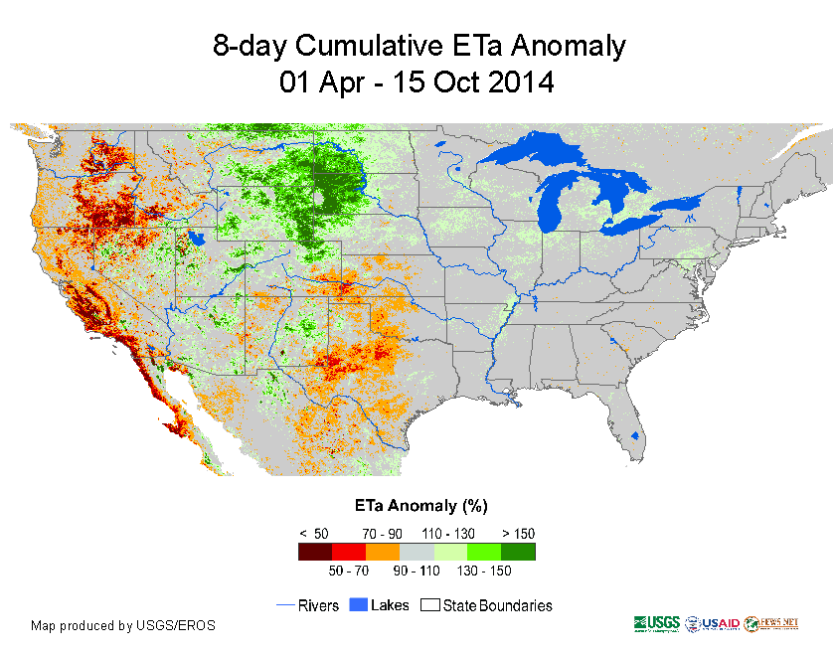
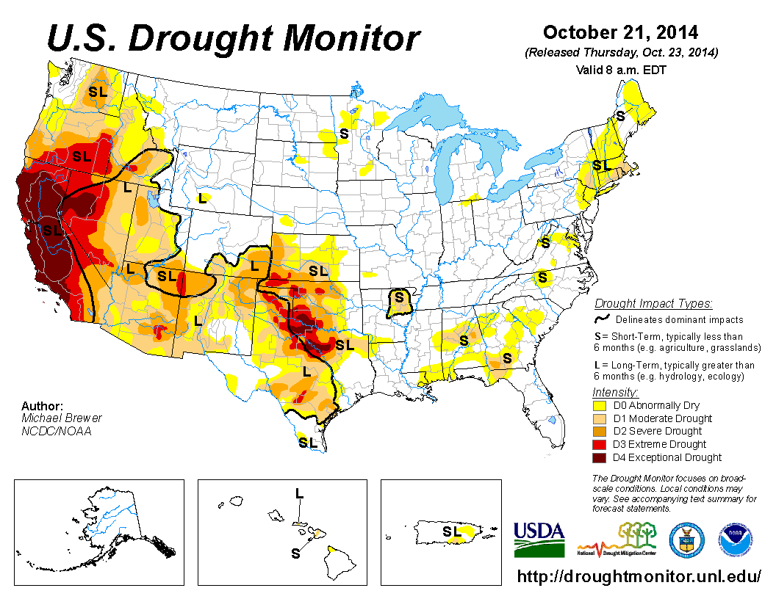

Slide 13
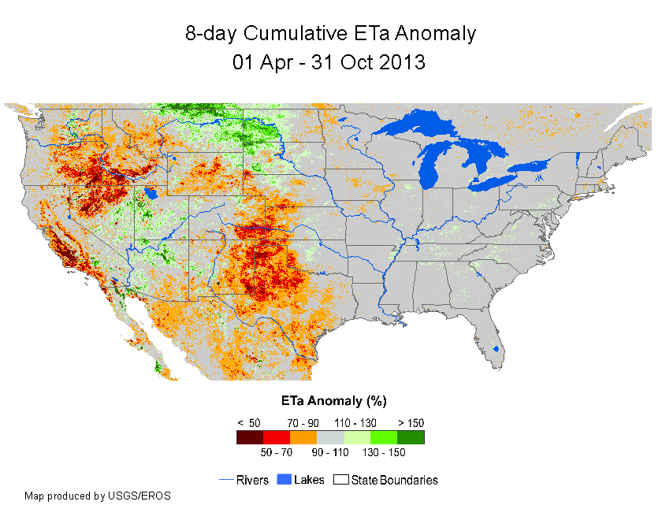
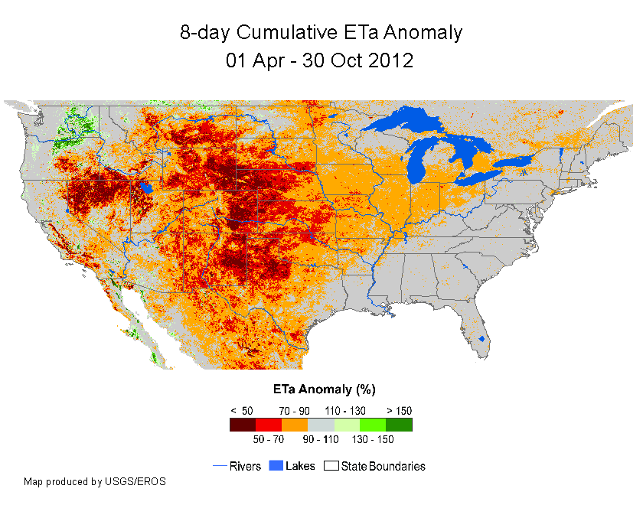
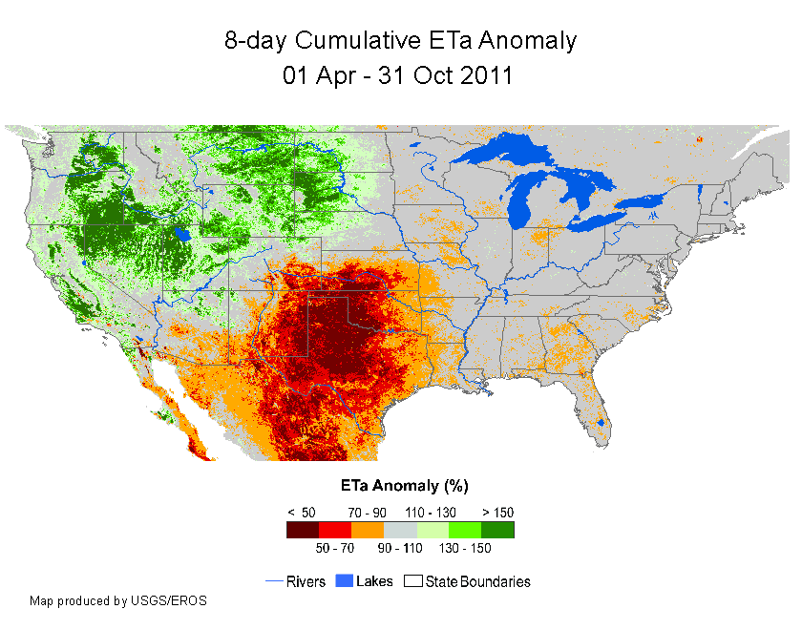

Slide 14
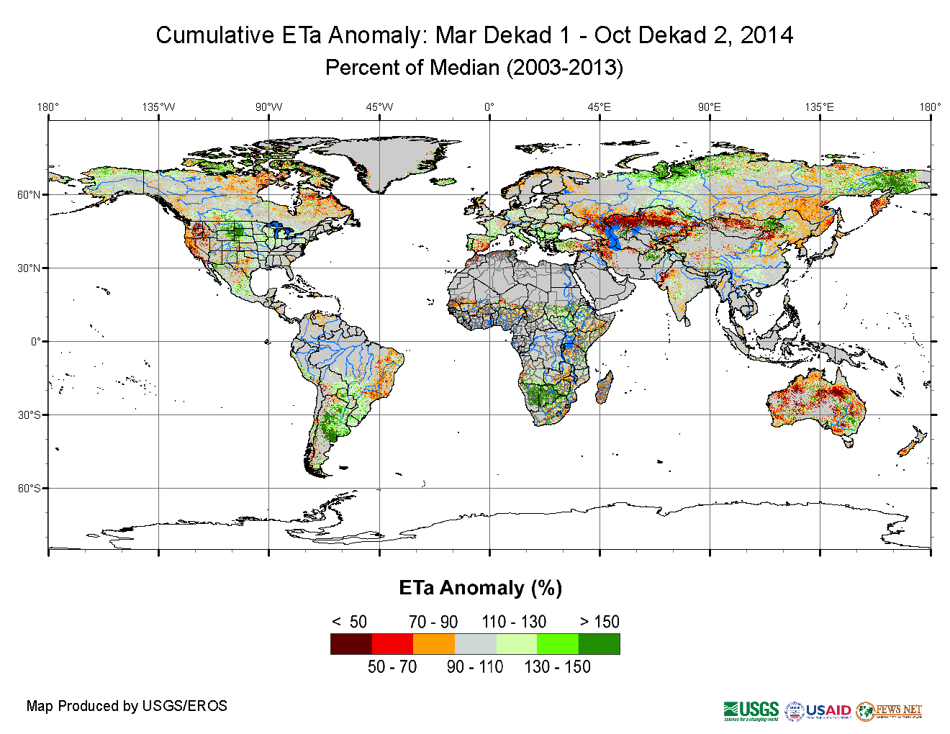
http://earlywarning.usgs.gov/fews/global/index.php

Slide 15
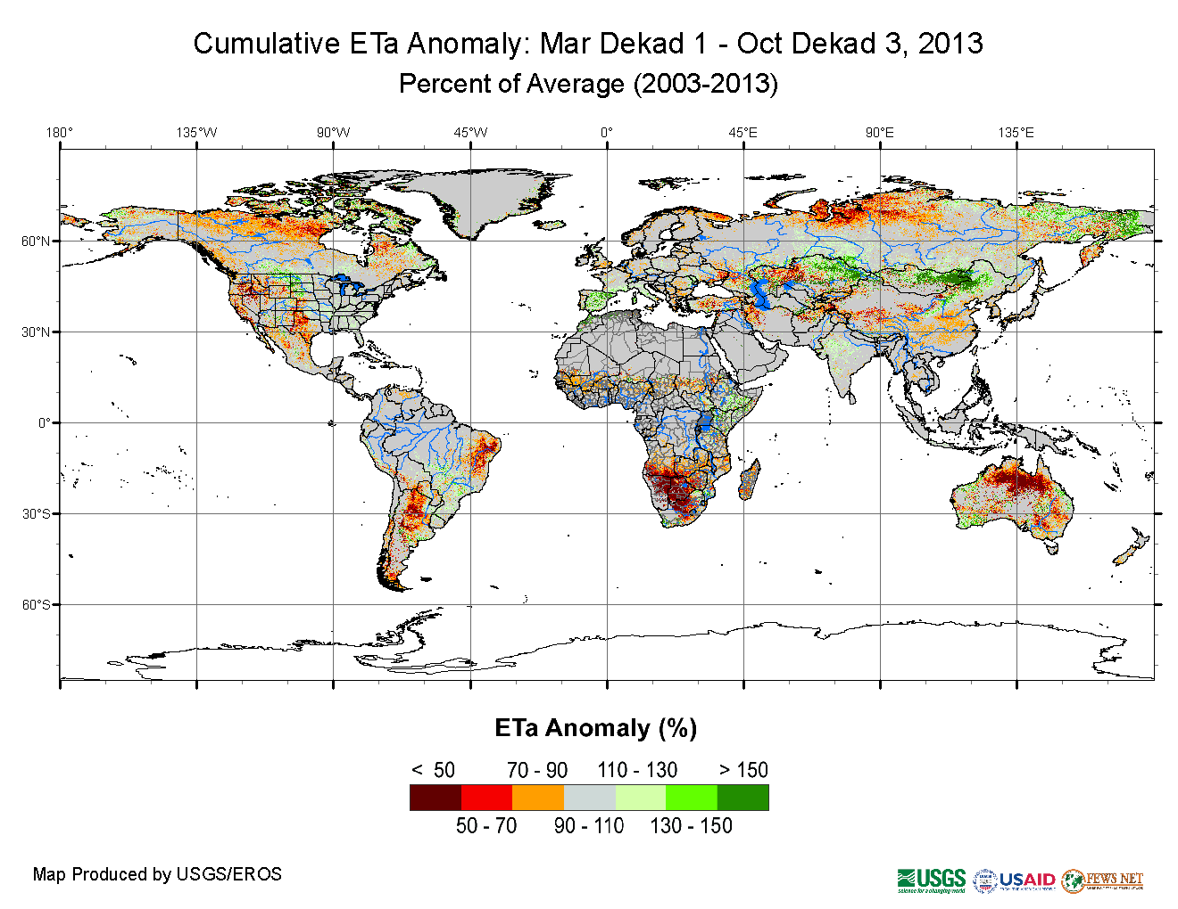
http://earlywarning.usgs.gov/fews/global/index.php

Slide 16
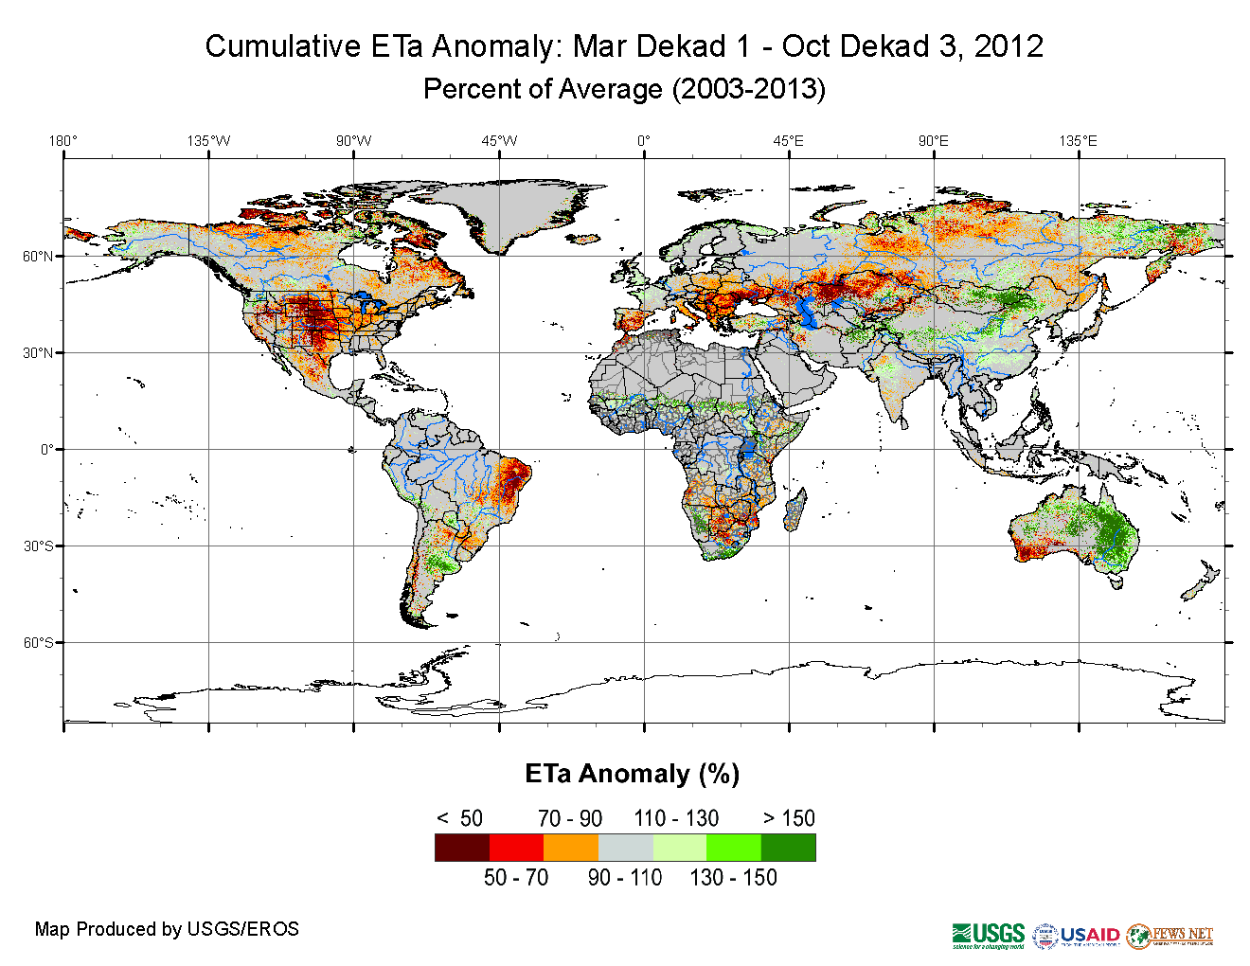
http://earlywarning.usgs.gov/fews/global/index.php

Slide 17
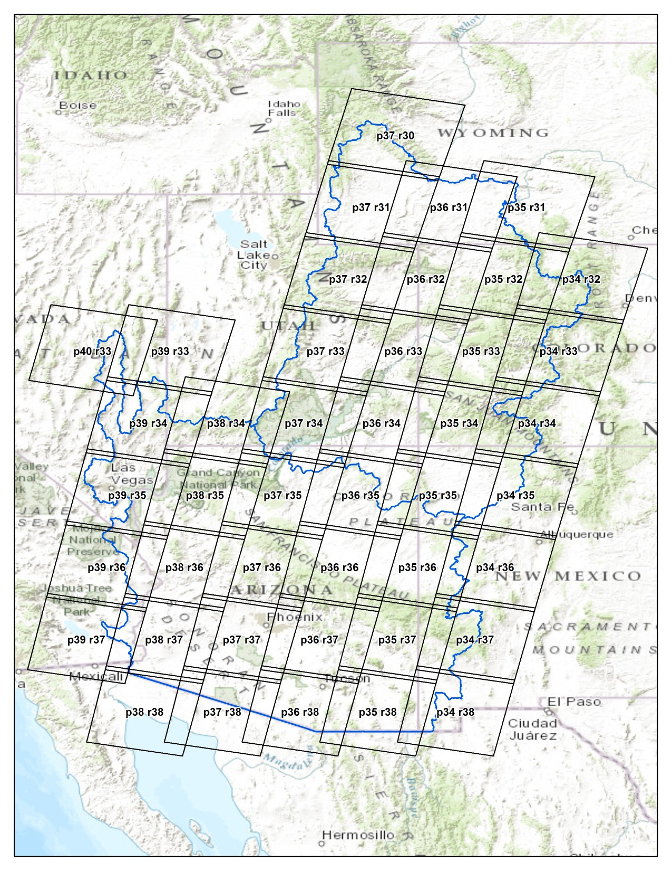
Landsat 8 ET, 2013
43 Landsat path/row
Scenes to cover
CRB
Clouds Issues:
9 to 15 images
for each are used
Total = 528 for 2013

Slide 18
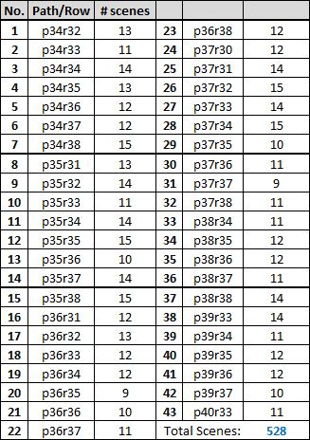
Scene Inventory, Landsat 8

Slide 19
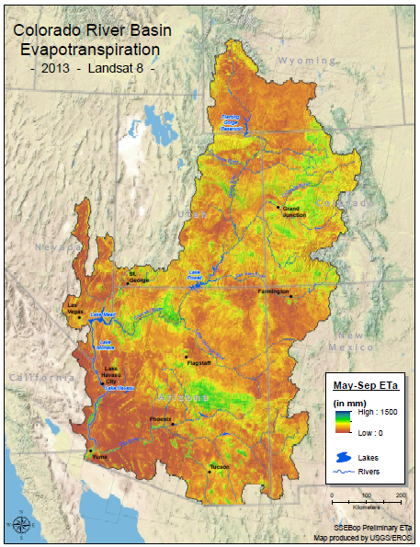

Slide 20
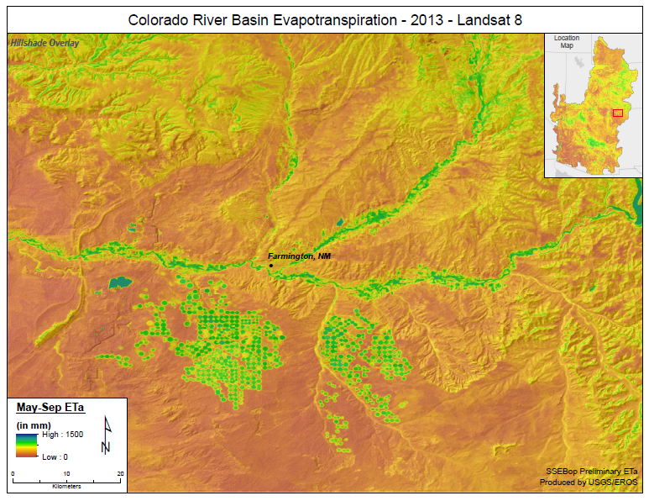

Slide 21
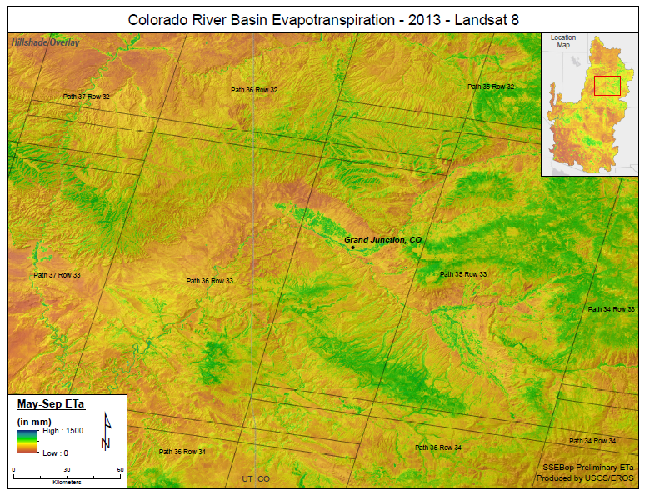

Slide 22
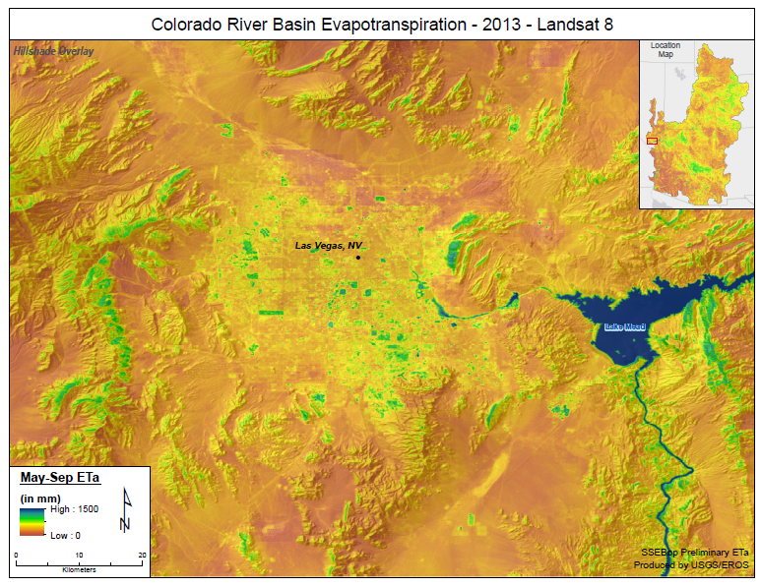

Slide 23
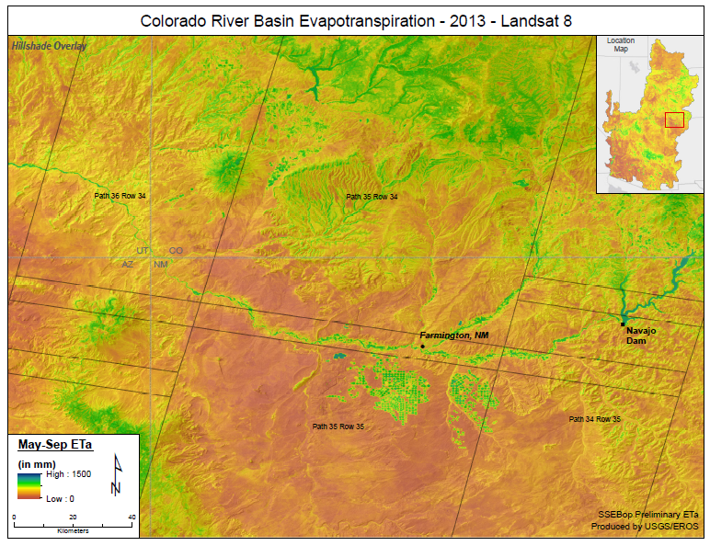

Slide 24
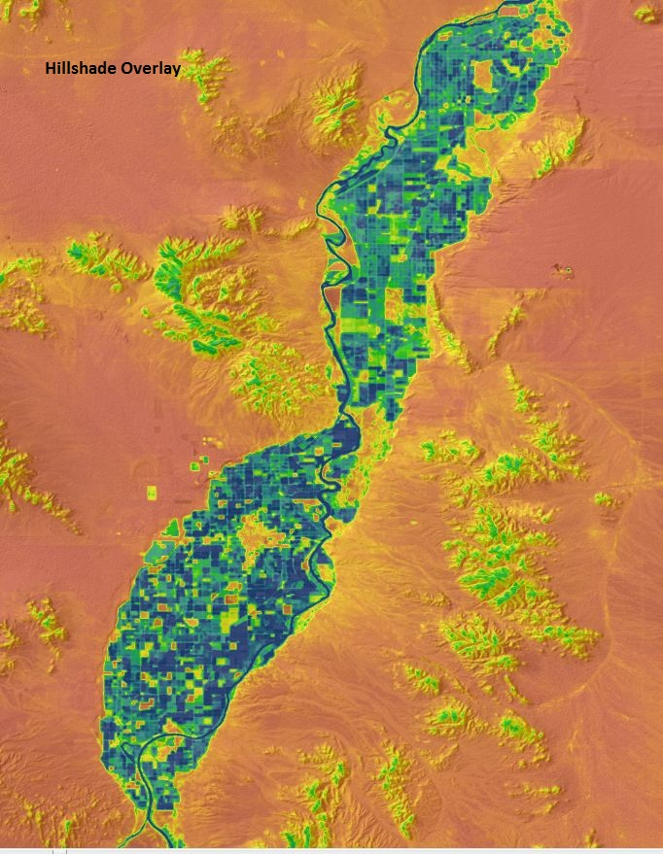
Palo Verdi
2013
Landsat 8

Slide 25
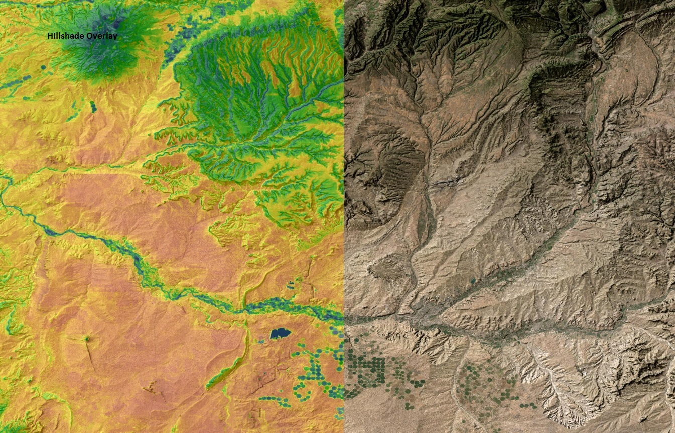

Slide 27
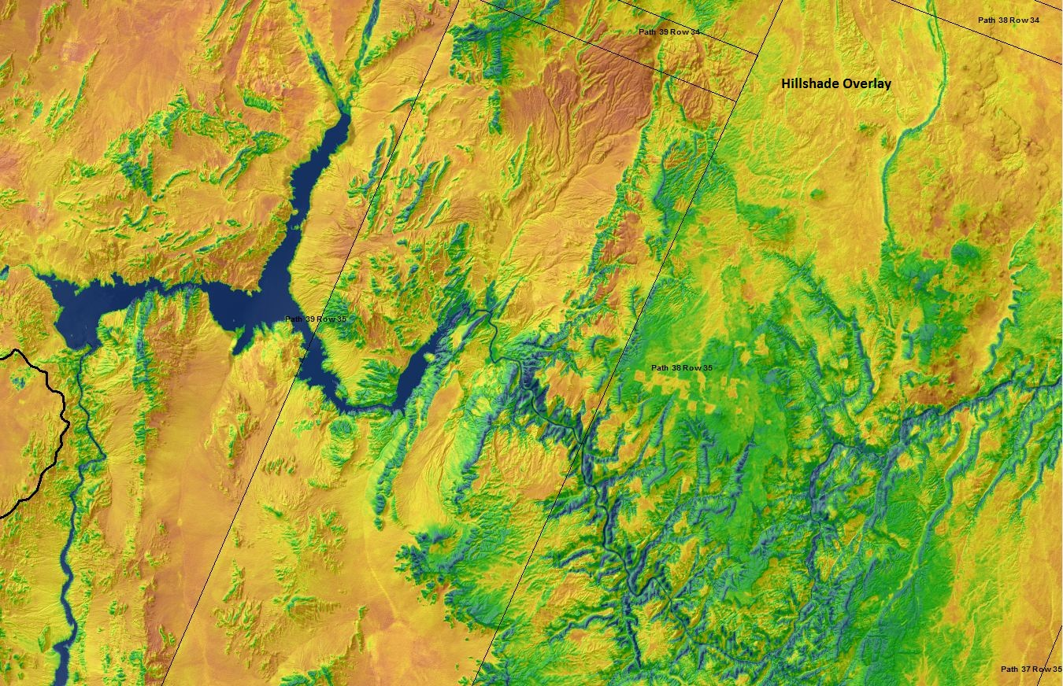

Slide 28
Delaware River Basin Completed for 2005
Evaluation of 2005 and 2010 is being conducted; 2010 was completed last year
Seasonal graphics for 2005 not created yet.

Slide 29
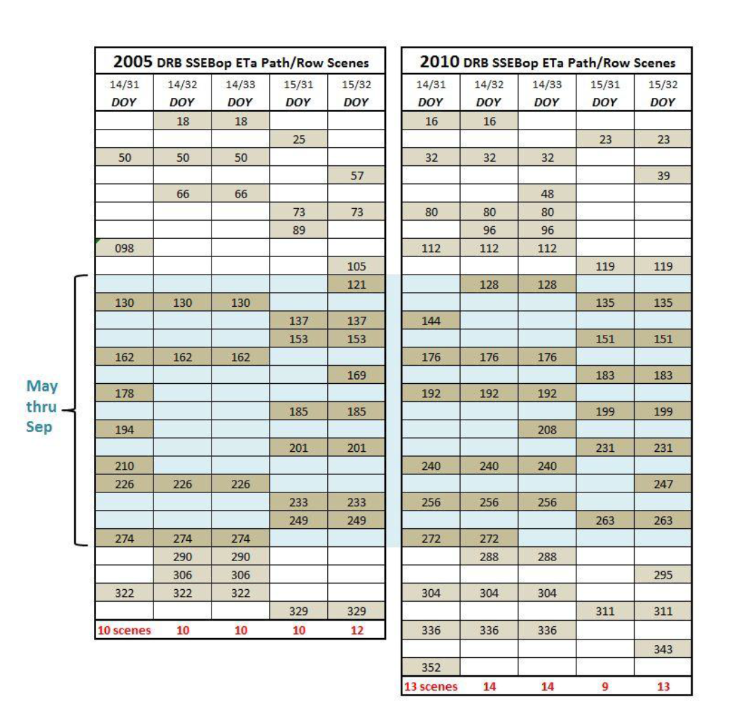

Slide 30
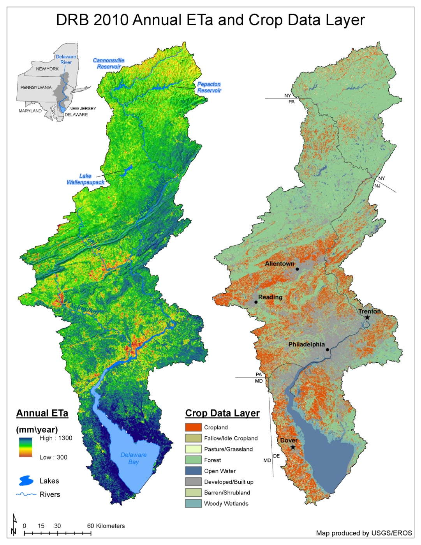

Slide 31
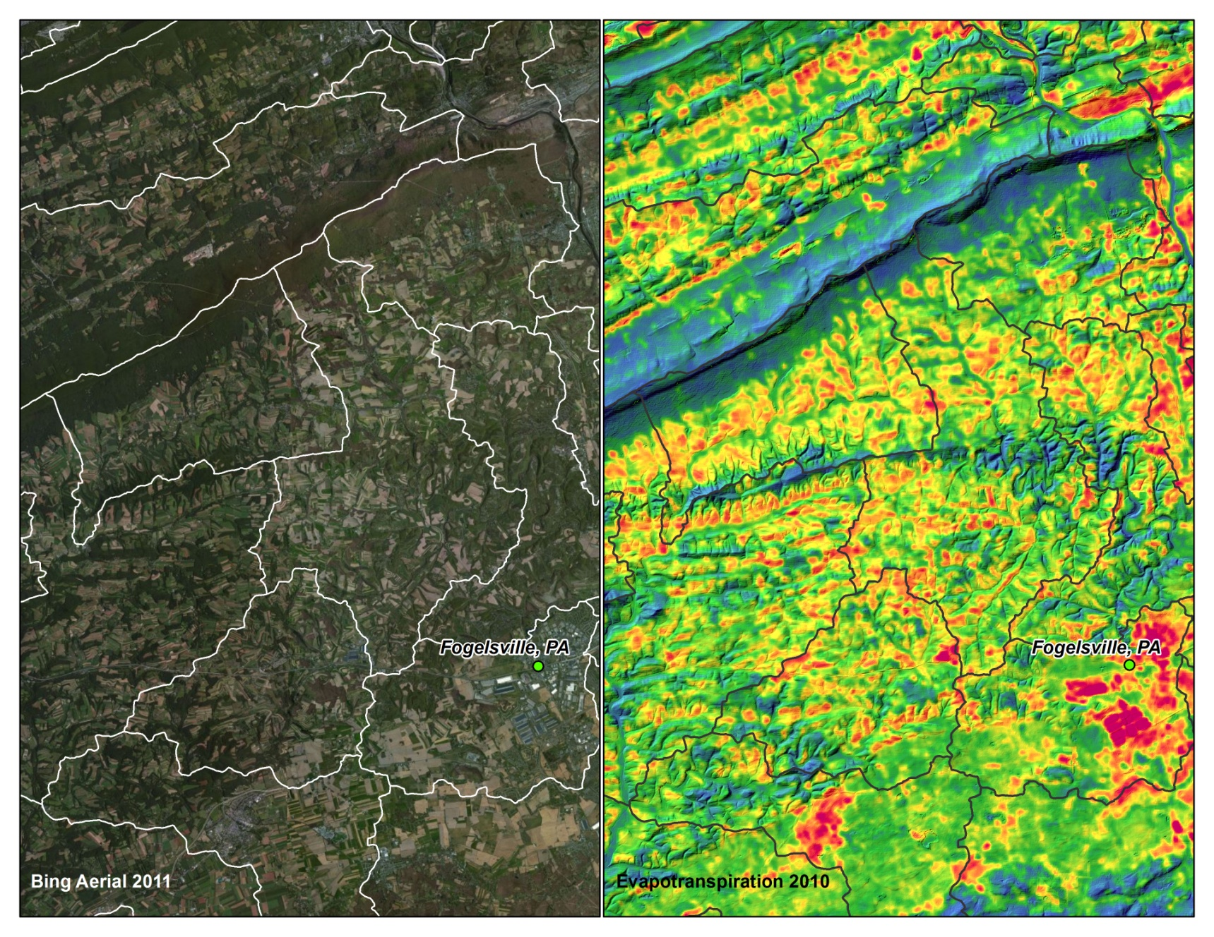
DRB Close up View, 2010

Slide 32
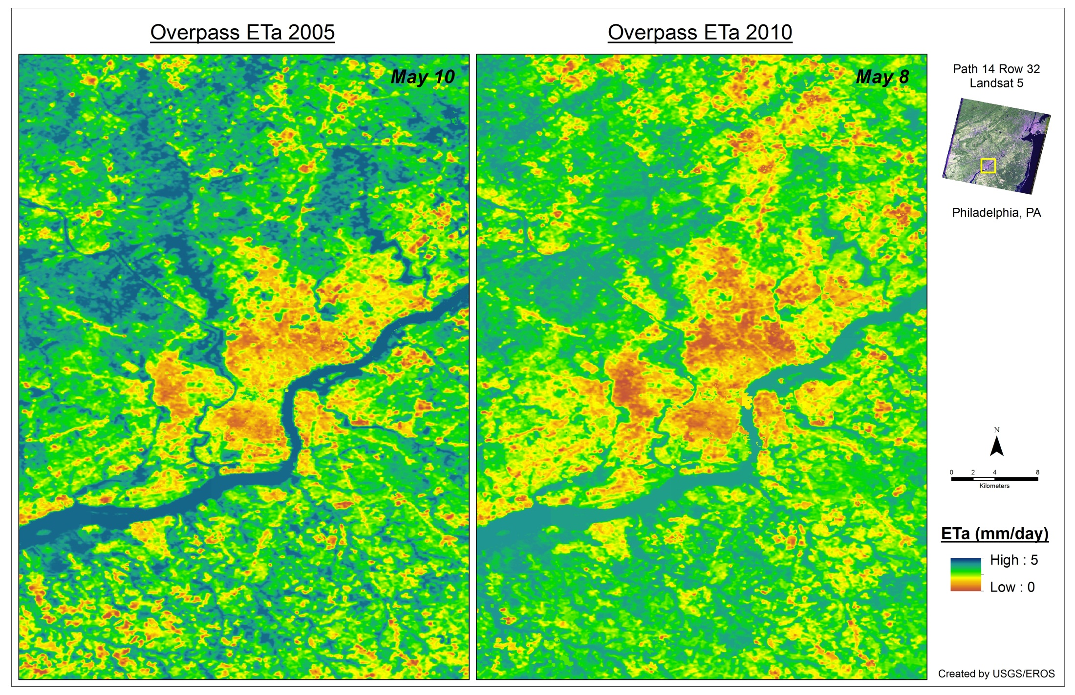
Overpass Comparison: 2005 vs 2010
Notes:
The MODIS ETa confirms a higher monthly ETa Anomaly in 2005 than 2010.

Slide 33
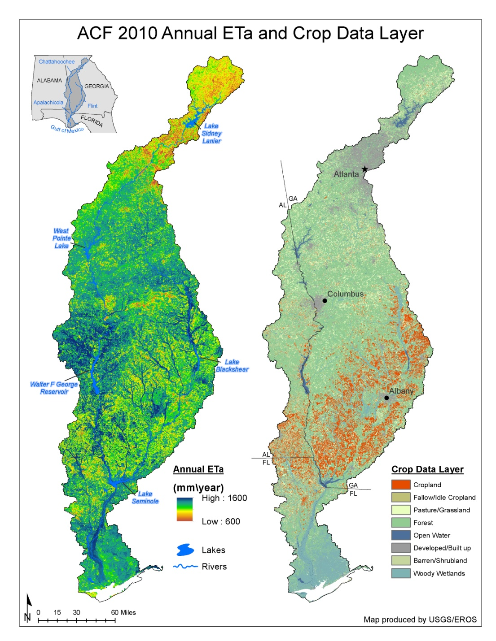

Slide 34
ET Guidelines and Requirements for the Water Census
Participation at the Palo Verdi Irrigation District:
2008 ET using Landat

Slide 35
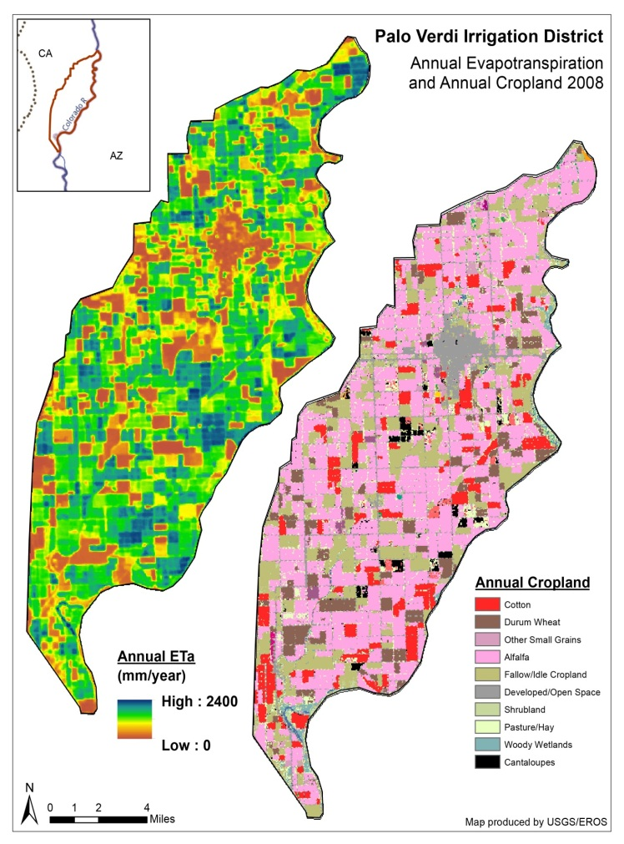
Palo Verdi Irrigation Study
Palo Verdi (CA) Irrigation District ETa model intercomparison study provides product analysis for assessing and evaluating the SSEBop ETa Landsat model within a controlled data environment.
Examines spatial accuracy and variability
Evaluates crop data and land cover relationships to water loss through ET processes
Provides continued baseline research and findings for application of Landsat ET modeling in water resource management locations at regional and field-level scales

Slide 36
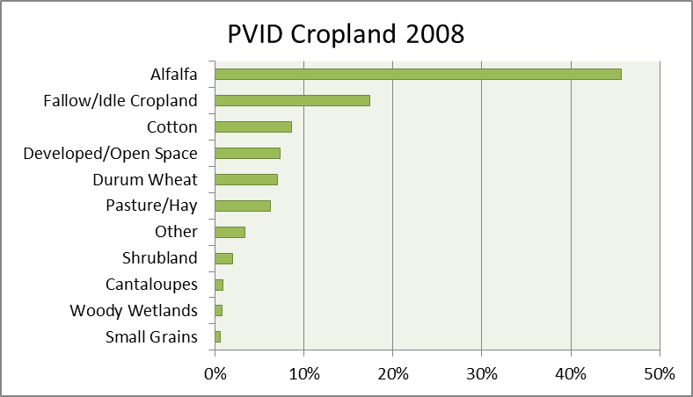
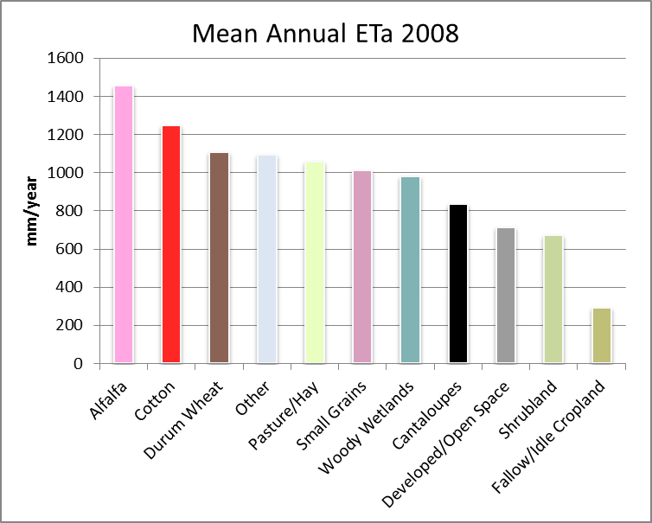

Slide 37
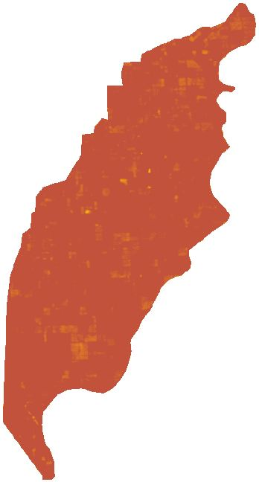
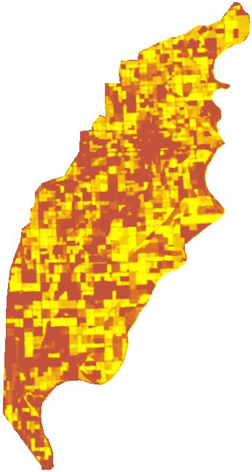
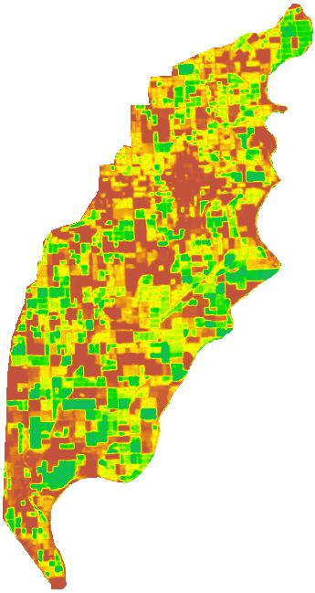
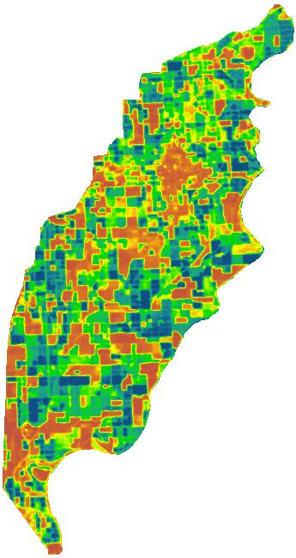
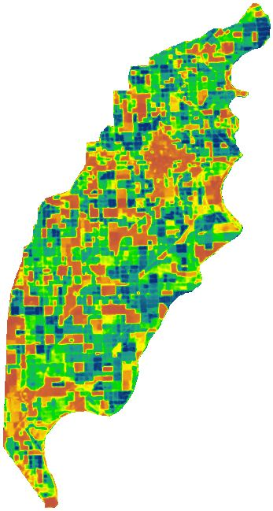
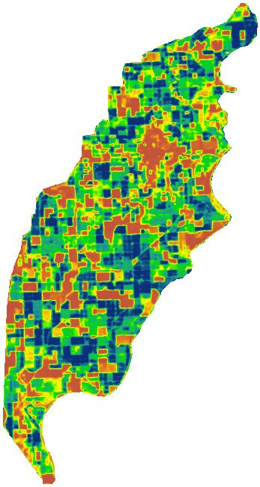
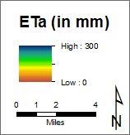
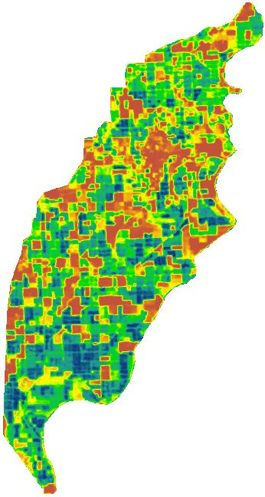
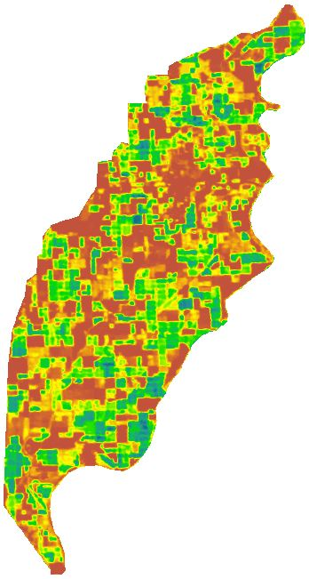
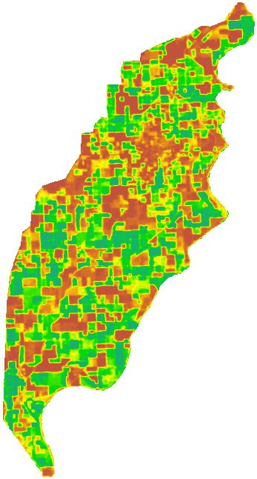
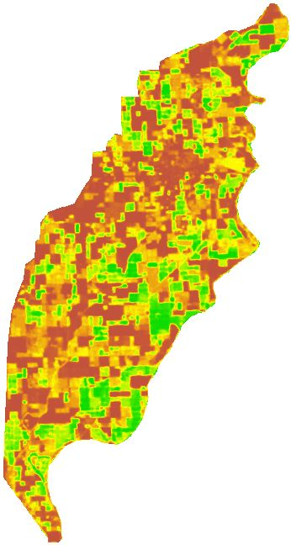
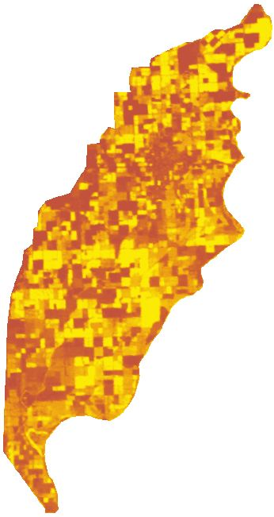
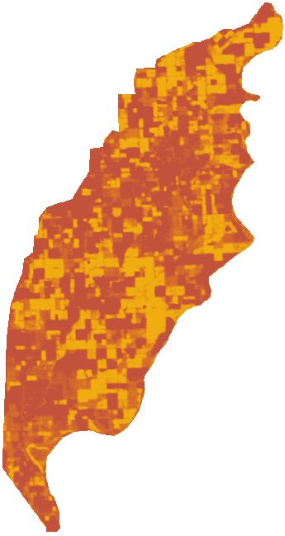
Jan
Feb
Mar
Apr
May
Jun
Jul
Aug
Sep
Oct
Nov
Dec

Slide 38
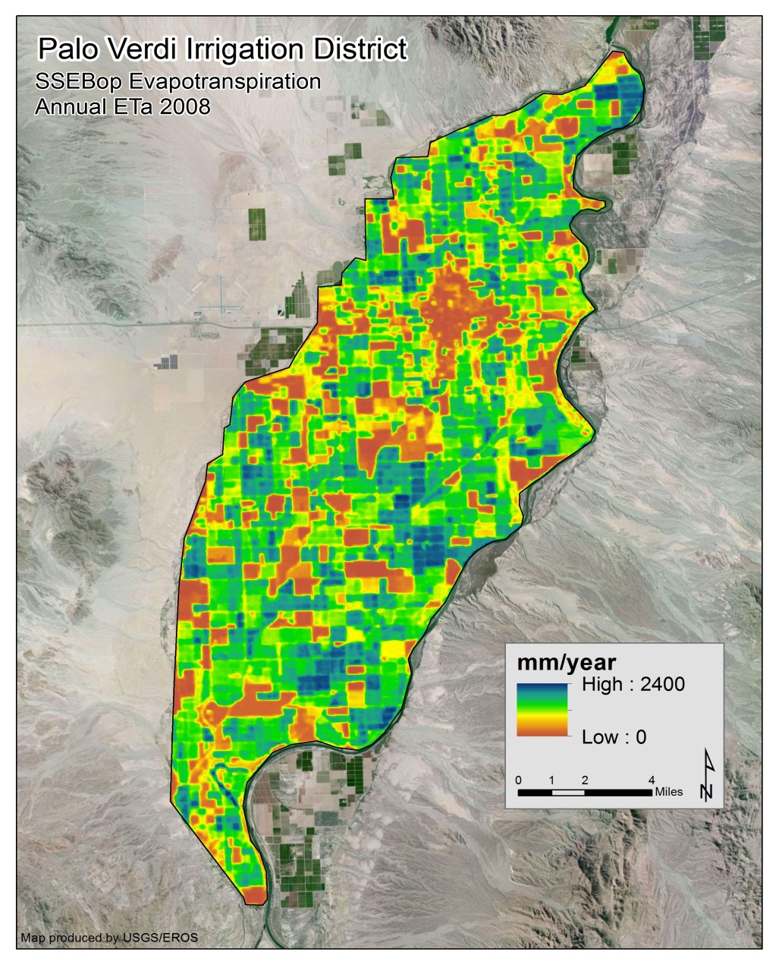
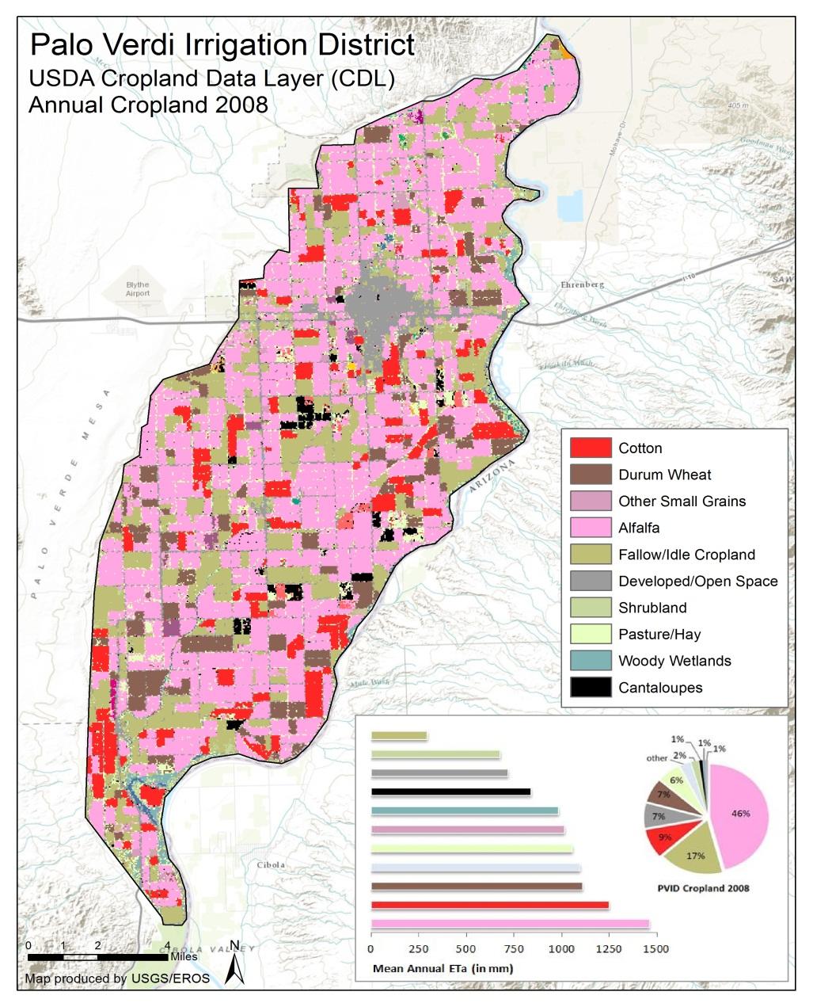
The annual spatial average ET for Palo Verde District was 1,092mm or 3.33 ft for 2008.
With an area of 106,853 ac, this comes to 355,742 ac-ft of water use for the whole basin in 2008. This includes water provided by surface diversion, ground water withdrawal and rainfall.

Slide 39
Separating ET sources
Rainfall vs non-rainfall (irrigation or GW Sources)

Slide 40
How can we identify ET sources?
Run energy balance and water balance models in parallel
Energy balance = “total” ET
Water Balance = “Rainfed” ET
Difference = irrigation/GW extraction

Slide 41
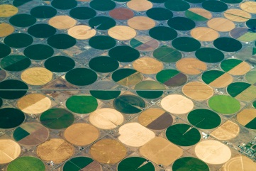
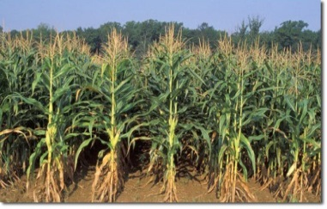




Partitioning ET sources (rain vs. non-rain) Significance
Methods to partition ET by water supply are not available
It is important to understand how much of water is being used for irrigation and where is it coming from?
Important for better management of water resources
Central Pivot Irrigation,
Colorado River Basin
Rainfed Corn,
South Dakota
Rainfed Pastures
Kansas
Supplemental Irrigation,
Delaware Basin
ET = Irrigation
ET = Rain
ET = Rain
ET = Irri + Rain

Slide 42





Identifying ET Sources: rainfall vs Irrigation
(proof-of-concept implementation)
ET difference =
Total ET – Rainfed ET
-
=
Energy Balance
Water Balance

Slide 43

Partitioning ET (rain vs. non-rain)
Initial
Results
For 2010
FY15 will expand effort to
(2000-2013)

Slide 44
Papers published and networking
CRB ET for 2010
Merging MODIS and Landsat for a monthly ET at Landsat Scale
Use of SSEBop by Bastiaanssen of IWMI to quantify Nile Basin Water consumption and production

Slide 45
Monthly AET Map of the CRB for 2010
MODIS
Downscaled

Slide 46

SSEBop ET
Bastiaanssen et al, 2014.
Remote Sensing Special issue:
Earth Observation for Water Resource Management in Africa
Distribution of the annually accumulated actual evapotranspiration across the Nile Basin averaged for the period 2005 to 2010. The pixel size is 1 km

Slide 47
Conclusion
Remote sensing and hydrologic modeling can provide globally consistent and locally relevant data and information.
1) We can monitor landscape response anomalies every 1 Km², every dekad--globally
for drought early warning
2) We can map and quantify crop water use volumes
for planning and designing irrigation systems
3) We understand better the relationships between water supply and water use
For improved basin-wide water management
4) Challenge remains for local decision makers to adopt remote sensing based tools and products for their daily operations.

Slide 48
Thank you

