Slide 1
Data Management Plans
National Water Census

Slide 2
Data Management Goals
“Preserve all data directly produced from research supported by the NWC”
Document the data
Make data available to the public when appropriate

Slide 3
purpose of plan
DMP used for both local project management and overall NWC tracking of goals and results
New projects: lay out what you plan to do in terms of data
Input data needed, what are going to do with it, expected results
Make the data available to the public; Identify any proprietary/restricted data

Slide 4
Data Management Plan
DMP: collection of DMP forms, one per dataset
Describe dataset
Quality assurance processes
Analytical workflow
Notes:
As outlined in the NWC Data Management Planning Guidance, PIs are required during the data input phase to carefully track and document the following:
Existing Dataset(s) or Data Source(s): Source for data, any restrictions on its reuse, and processing or workflow steps that transform the existing data into a new dataset.
New Dataset(s): Details on how data were collected, prepared, and reviewed.
Software or other project needs: description of software or other tools/resources needed to complete the project.
Data Outputs – description of project deliverables; for example, datasets, models, code.

Slide 5
What Needs a DMP Form?
Existing projects:
Project deliverables (datasets, models)
New projects and efforts:
Existing data to be used by project
New data to be produced
Software needed
Project deliverables (datasets, models)

Slide 6
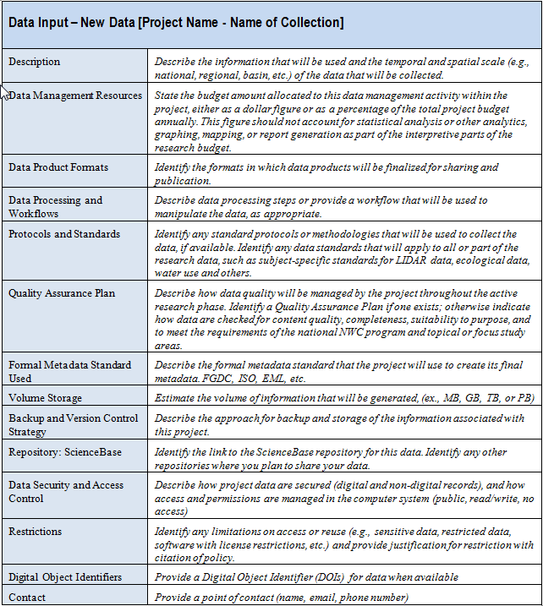
Example DMP form

Slide 7
DMP Template for New dataset
Description
Data Management Resources
Data Product Formats
Data Processing and Workflows
Protocols and Standards
Quality Assurance Plan
Formal Metadata Standard Used
Volume Storage
Backup and Version Control Strategy
Repository: ScienceBase
Data Security and Access Control
Restrictions
Digital Object Identifiers
Contact

Slide 8
What Doesn’t Go in ScienceBase?
Data that goes in NWIS, including USGS time-series database implemented in Aquarius
Data that goes in BioData or another USGS ‘corporate’ database
Items covered by other USGS data archiving policy: GW models
Still need a DMP record for the dataset

Slide 9
DMP is not Static
Start DMP forms during workplan development
Revisit as project continues
Modify as needed
Complete entries as work progresses
Build formal metadata as you go
As products are completed, DMP is finalized along with metadata

Slide 10
Build A Record of the NWC
Projects and products
Information organized in ScienceBase
Record for project
DMP record for each dataset
Datasets that don’t have another home
Metadata record goes with dataset
Link to PubsWarehouse publication records
Link to datasets archived elsewhere

Slide 11
Putting the Pieces Together

Slide 12
DMP Tools
Want to make this as easy as possible for PIs
Project record entry handled by Data Steward
DMP forms will have online forms, Data Steward will review
Formal metadata will eventually have online tool, for now have metadata assistants in ARC, etc.

Slide 13
Guidance
NWC Data Management Manual
Policy and goals
List of data standards
List of metadata standards
NWC Data Management Plan Guidance
Templates for DMPs
Linked on NWC internal page:
http://water.usgs.gov/watercensus/internal/
NWC Data Steward

