Slide 1
Water Availability and Use to Meet Competing Societal and Ecological Needs in Southeastern Atlantic Coastal Basins of the Carolinas
US Geological Survey
South Atlantic Water Science Center

Slide 2
Key Project Personnel
Chad Wagner (SW modeling; project management);
Adam Terando (population/climate change scenarios)
Jim Landmeyer (GW geochemistry, ET, tree-core analysis);
Bruce Campbell, Jason Fine (GW modeling);
Paul Conrads(SW salinity modeling/ DSS); Ana Maria Garcia (SW modeling);
Doug Smith, Fred Falls (water-use data);
Tom Cuffney, Rodney Knight, Mary Freeman (ecologic response modeling);
Ken Krauss (wetland function)

Slide 3
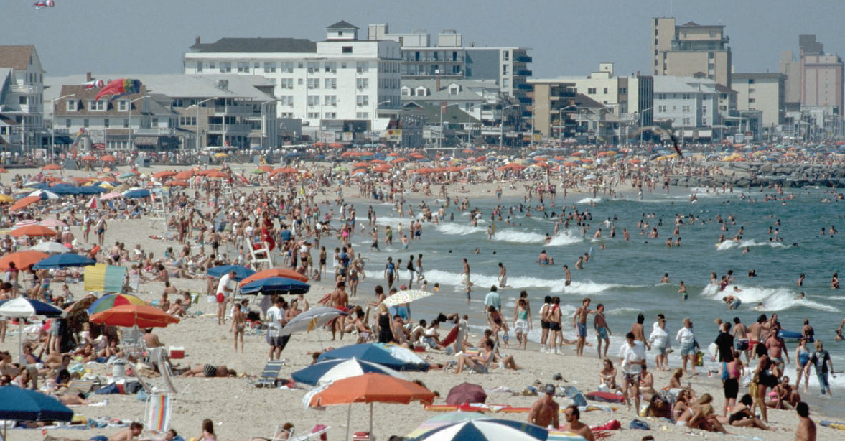
Southeastern Atlantic Coastal Basins of the Carolinas

Slide 4
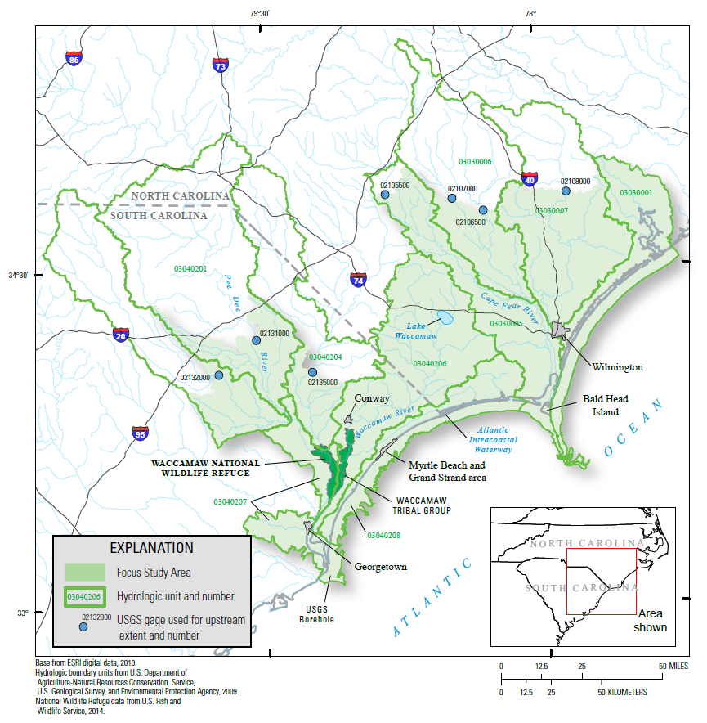
Coastal Carolinas Focus Area Study

Slide 5
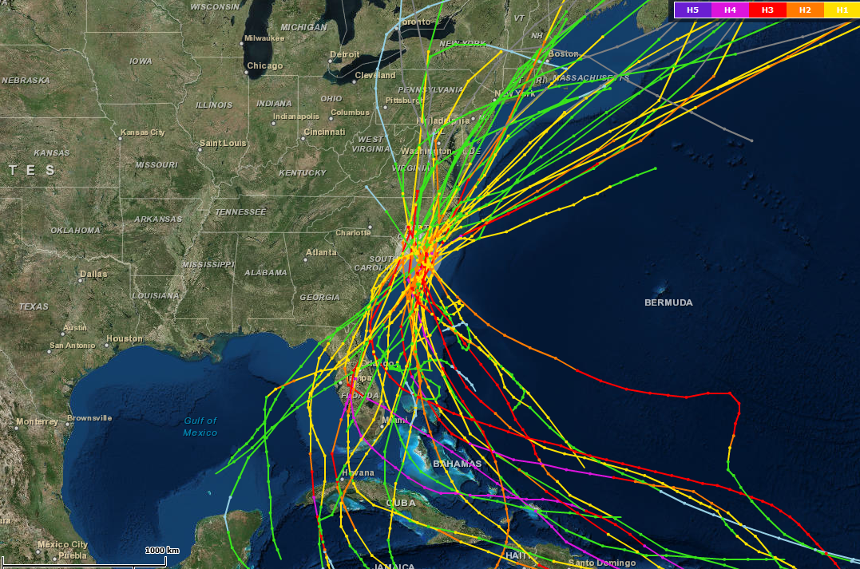
Increased hurricane risks

Slide 6
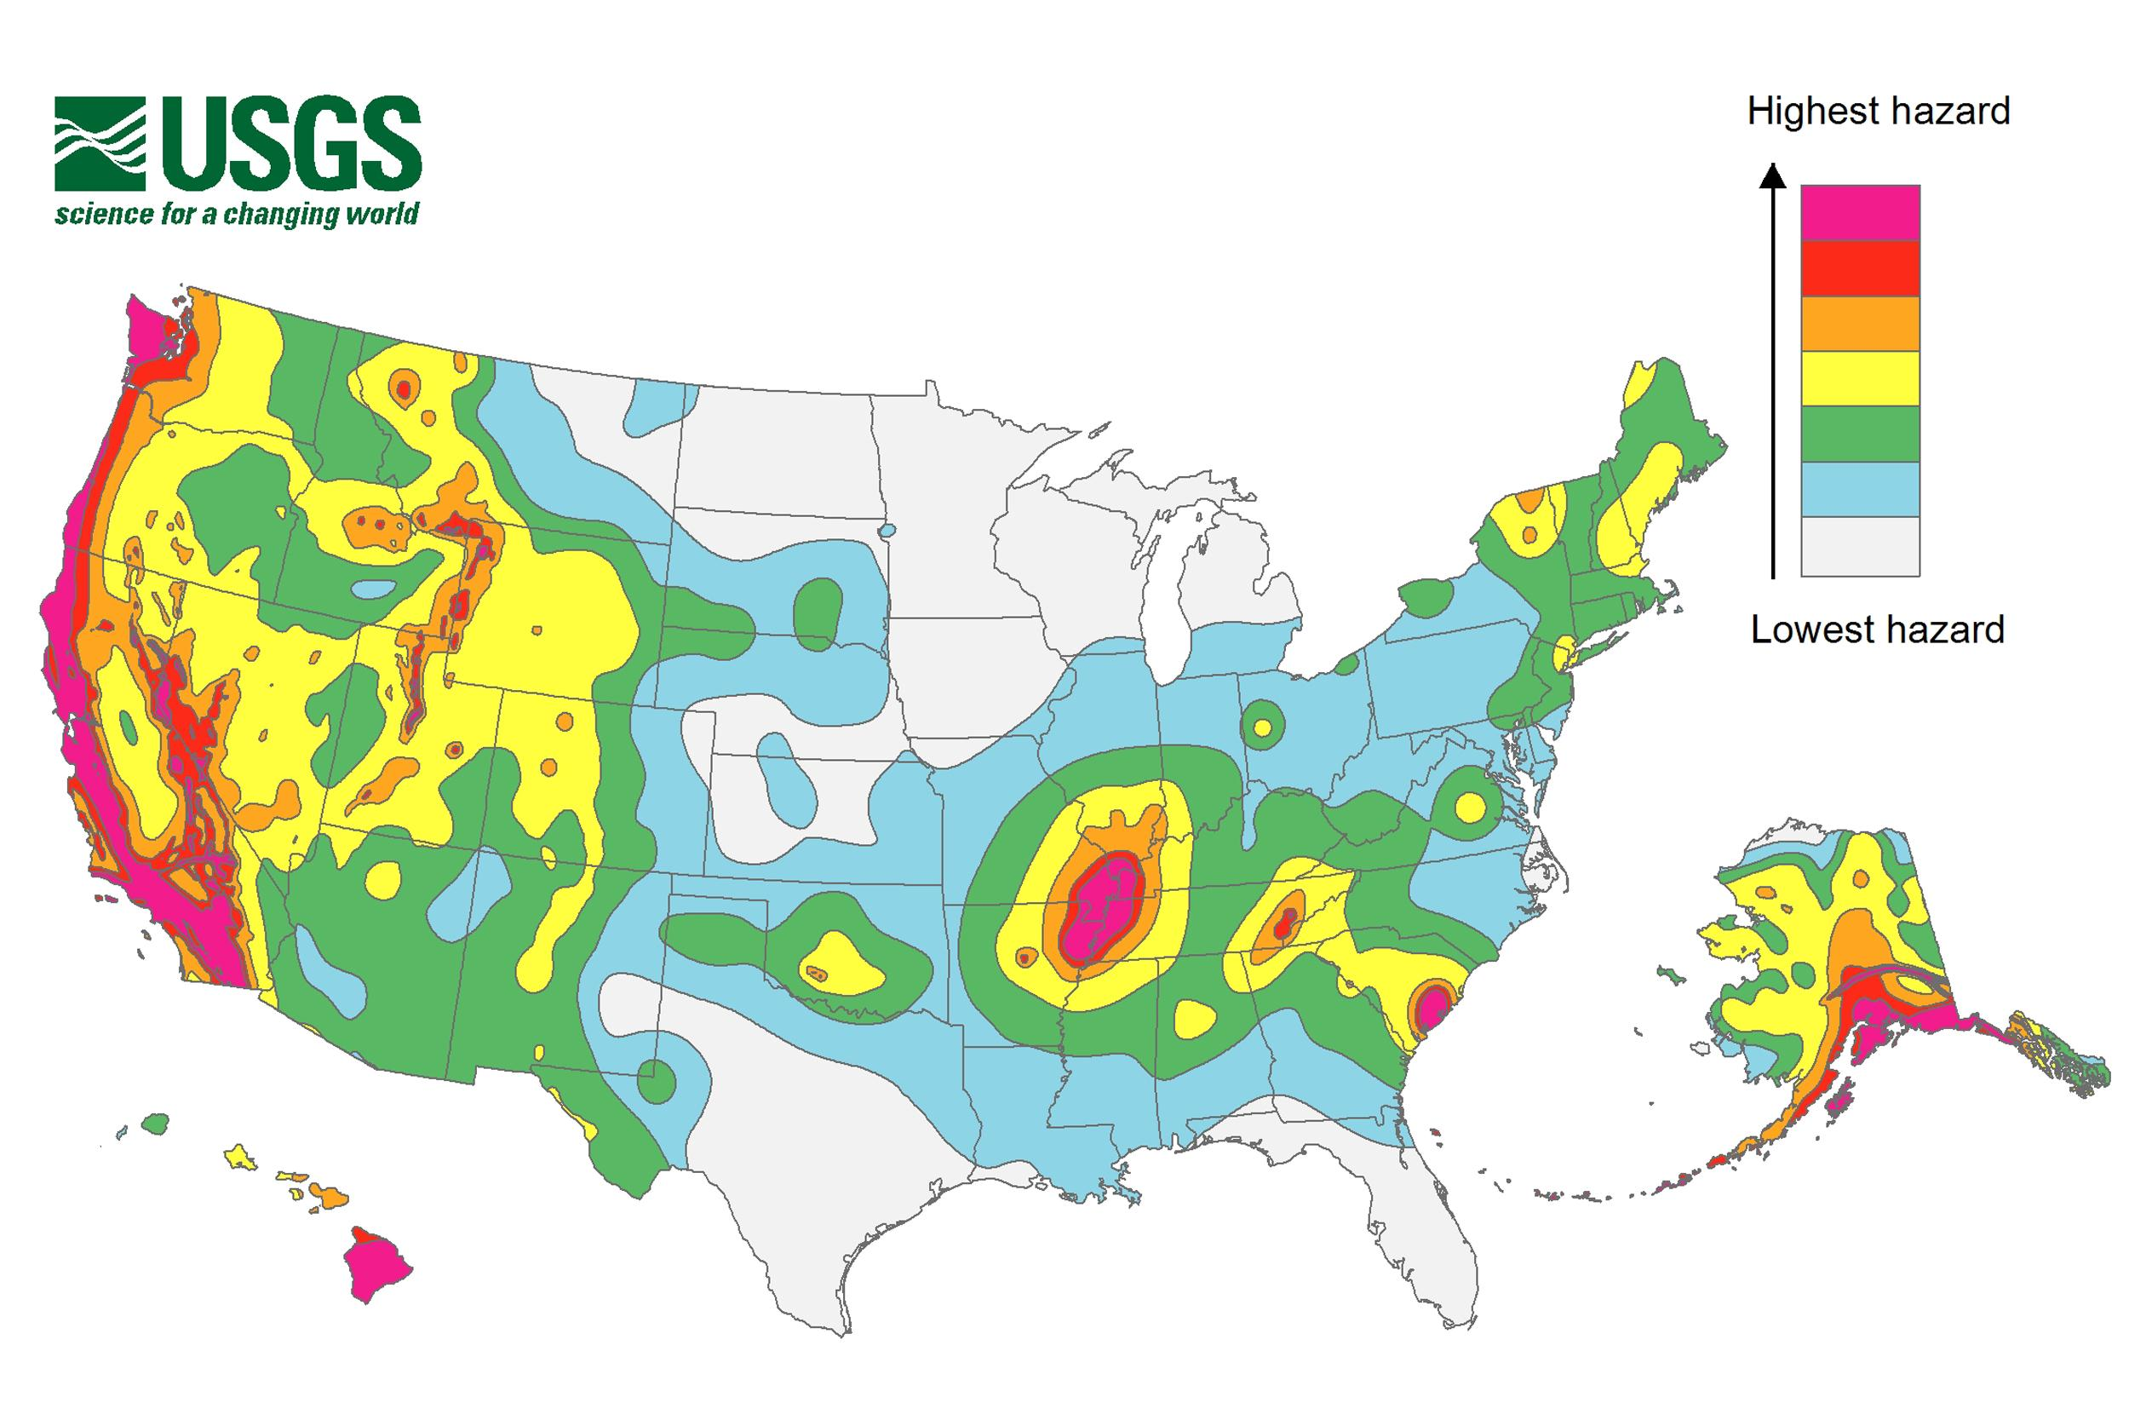
Increased earthquake risks

Slide 7
Water-Use Data Compilation
Address uncertainties related to industrial and public-supply water use data in the FAS.
Develop T&Ms to determine originating aquifer(s) of water supply using age-dating of the pumped groundwater (CFCs, ¹⁴C and ³⁷Cl).
Refining and reducing uncertainty inherent to 2005 and 2010 water-use data will be essential as these data will be used as input to drive the planned groundwater-flow model and the surface-water and water-quality models for the FAS

Slide 8
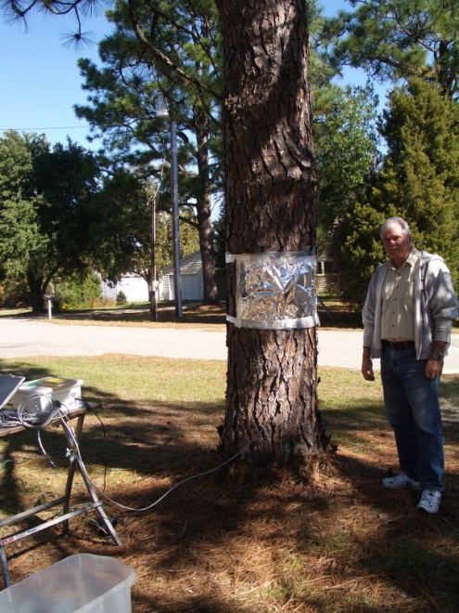
In-Situ Evapotranspiration Data
More accurate assessments of ET impacts on basin water budgets
In-field, ground-based measurements of ET will be made and compared to concurrent ET estimates derived from remote sensing.
Transpiration by herbaceous and woody plants can be directly measured using multiple in-situ thermal dissipation probe (TDP) sensors

Slide 9
Population and Climate Change Scenarios
Existing population change forecasts from the US Census Bureau (2012) or spatial urban growth scenarios based on research from NC State University and the USGS Southeast Climate Science Center (Meentemeyer et al., 2013; Terando et al., 2014) will be applied to the study area to drive various water-use scenarios.
Will employ the most current and applicable downscaled global climate models and greenhouse gas emission scenarios to project regional precipitation and temperature change, which will be necessary input to the groundwater, surface-water and ecological response models.

Slide 10
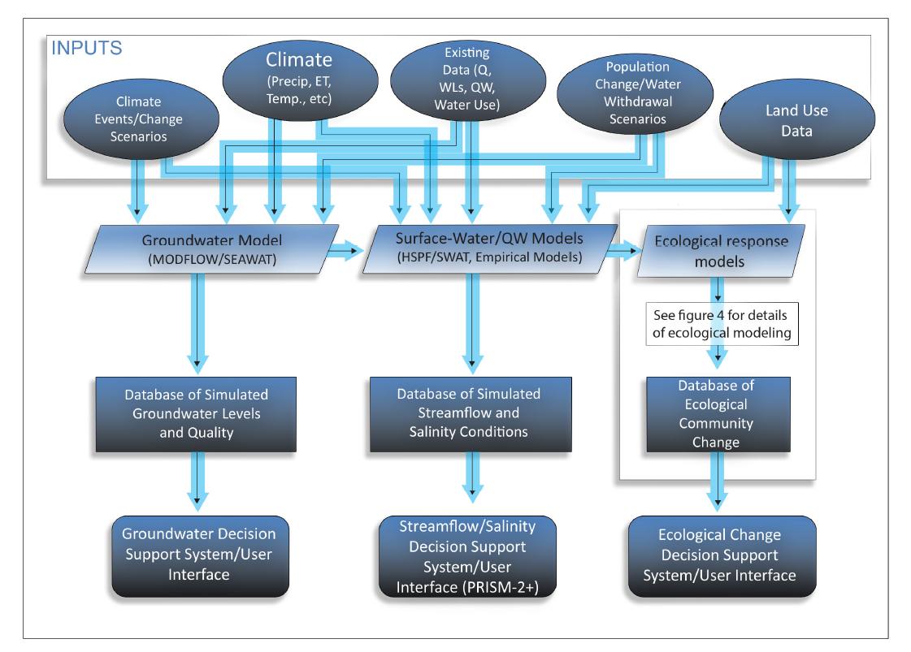
Conceptual design of model integration and decision support systems

Slide 11
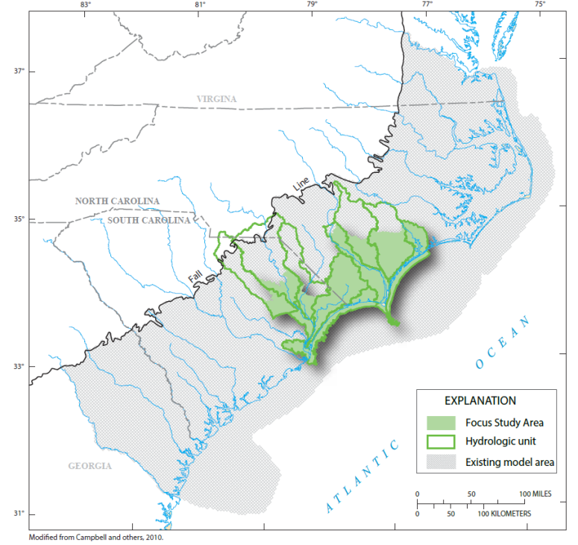
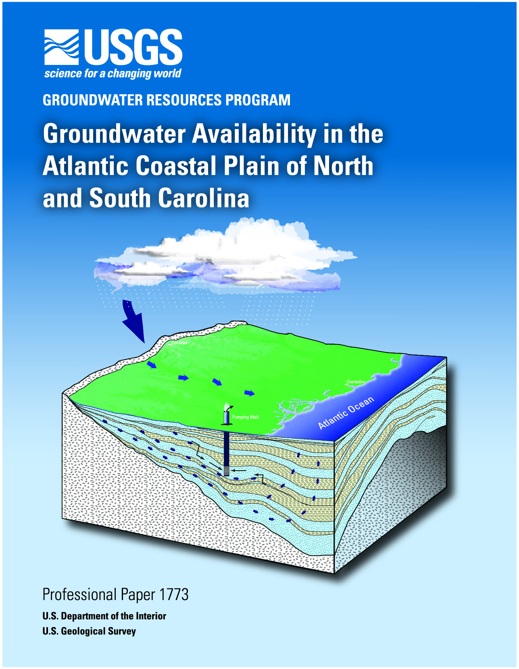
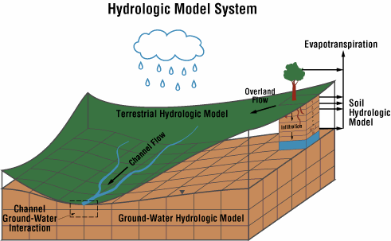
Groundwater Models and Decision Support System
Existing Coastal Plain groundwater model will be modified to include FAS specific data through 2014 and simulate groundwater-surface-water interactions.

Slide 12
Groundwater Models and Decision Support System
The new FAS model will be converted to a SEAWAT (salt-water intrusion) model for two localized population centers.
The groundwater flow/variable-density models and associated DSS will be used to:
  Simulate results of historic and future stresses on the groundwater system in the coastal areas;
  Simulate and evaluate impacts of ET and various water-use scenarios in the study area on groundwater surface-water interactions; and
  Determine potential susceptibility of the aquifers to lateral saltwater encroachment and upward leakage of brackish, deep groundwater as a result of over-pumping shallower aquifers and sea-level rise.

Slide 13
Surface-water/Water-quality Models and Decision Support System
The PRISM2-DSS (Conrads and others, 2013) will be enhanced by:
  Including new water–level and water-temperature Artificial Neural Network models;
  Adding models for a freshwater gage further upstream in the system, and
  Retraining the existing models using the additional 5 years of data from the previous DSS development.
A surface-water model will be developed and loosely coupled with output from the groundwater flow model to simulate watershed response to various scenarios of extreme climate events (droughts, hurricanes, etc.), climate and land-use changes and water-use.
The surface-water/salinity models will be used to simulate water level, streamflows and salinity, including potential effects of projected water-use and climate change, at existing USGS gaging stations and ungaged locations in the study area.

Slide 14
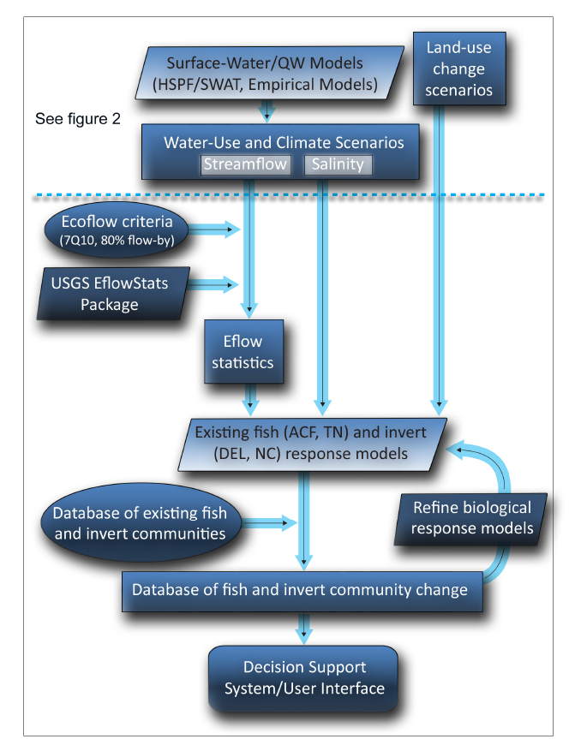
Ecological Response Modeling

Slide 15
Ecological Response Modeling and Decision Support System
Existing fish (TN and ACF River basins) and invertebrate (Delaware and NC) response models will be applied using community data obtained from NC and SC State biomonitoring programs to forecast community change associated with the various surface-water/salinity model scenarios.
Investigate the effects that implementing differing ecological flow standards (7Q10 and 80% flow-by) would have on water availability for societal purposes and on the protection of fish and invertebrates during drought.
Observed/simulated changes in riverine salinity will be used to evaluate effects on wetland vegetation, likely mature stands of baldcypress trees

Slide 16
Significant leverage from existing projects
Horry County Stormwater
Village of Bald Head Island, NC
Lower Cape Fear River Monitoring Program
USGS Southeast Climate Science Center Population Change Modeling in the SE US
National Integrated Drought Information System (NIDIS) Coastal Carolina Pilot Study
USGS Study: Assessing past/future impacts of salt-water intrusion on tidal swamp habitat

Slide 17
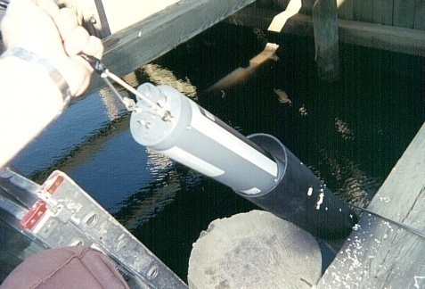
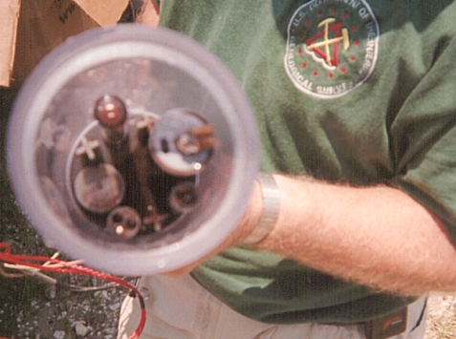
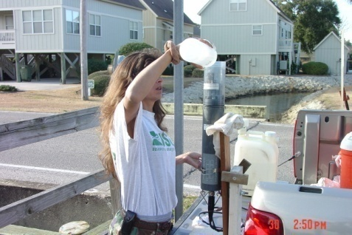
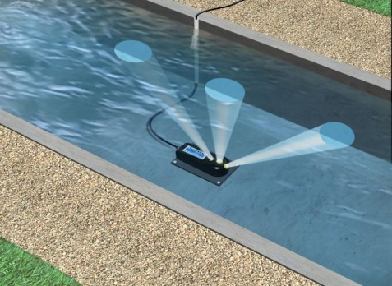
Water-Quality and Flow Sensors
Horry County, SC
Temperature
pH
Specific conductivity
DO, % sat.
ORP
Turbidity
Continuous record since
October 2005
Calibrated every 2 weeks
Rainfall
Also using “doppler effect”
to measure flow, stage

Slide 18
Schedule
October 2014 – September 2015:
  Engage stakeholders and develop final work plan for Coastal Carolinas FAS
October 2015 – March 2018:
  Develop refined water-use estimates, develop models and decision support systems
August 2017 – September 2018:
  Prepare and publish reports/journal articles documenting results and tools developed as part of the study

Slide 19
Expected Results of the New FAS:
More refined water-use estimates at the HUC-10 or -12 levels
T&M’s on age-dating approach to determine what aquifers are contributing groundwater supply
More accurate assessment of effect of consumptive water demands (ET) on water availability
Groundwater-flow/salt-transport models and surface-water and salinity models

Slide 20
Expected Results of the New FAS:
Decision Support Systems for Aquifer (GIS interface), Streamflow/Salinity (PRISM-2), and Ecological Response (DRB?) to water- and land-use scenarios from a range of population growth projections and climate/sea-level rise scenarios:
DSSs and user interfaces will allow users to select areas of interest retrieve predictions of aquifer water levels and quality (in select areas), streamflow and salinity or ecological conditions based on a predefined library of modeled water-withdrawal, ecological-flow requirement, and(or) climate change/sea-level rise scenarios.

Slide 21
Water Availability and Use to Meet Competing Societal and Ecological Needs in Southeastern Atlantic Coastal Basins of the Carolinas
US Geological Survey
South Atlantic Water Science Center

