Slide 1





National Topical Studies
Estimation of Flow in Ungaged Basins
Groundwater Information
Estimation of Evapotranspiration
Ecological Water Science
Water Use

Slide 2
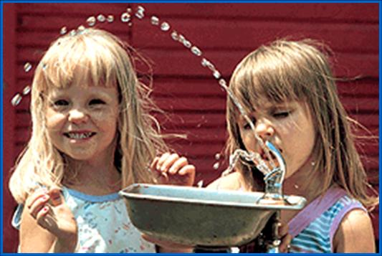
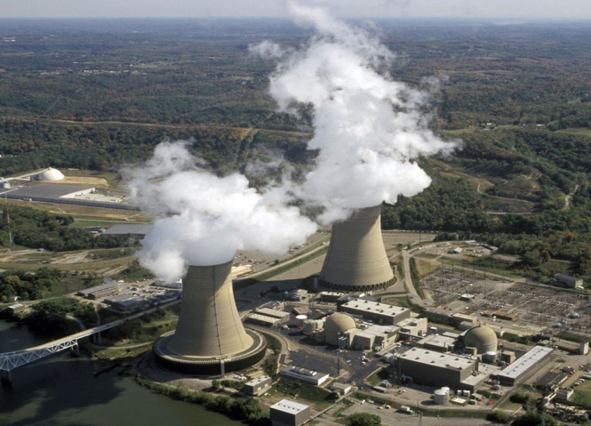
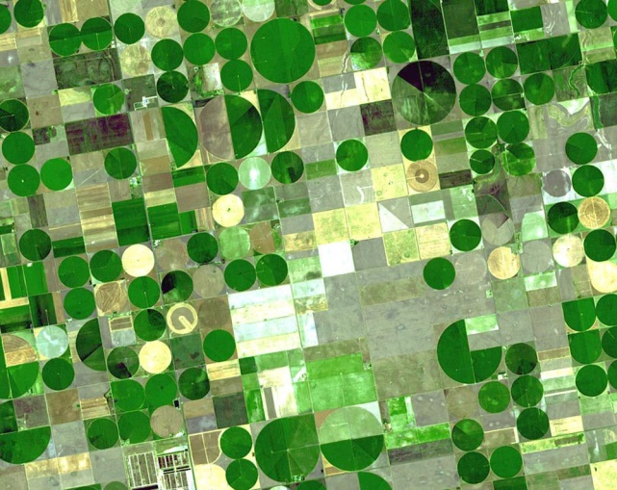
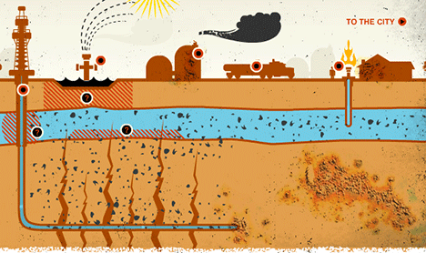
Water Use
Compilations (2010, 2015)
Unconventional Oil Gas Topical Study
Grant Program

Slide 3
Water Use
Mission: The National Water-Use Information Program is responsible for compiling and disseminating the nation's water-use data.
Goals:
Analyze the source, use, and disposition of water at different scales
Document trends in water use in the United States
Cooperate with state and local agencies on projects
Develop water-use data bases
Publish local, state, and national water-use data reports
Reply to water-use information requests from the public

Slide 4
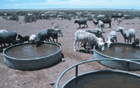
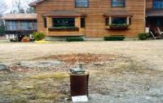
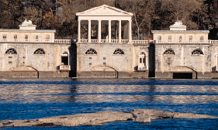
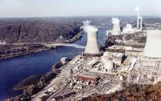
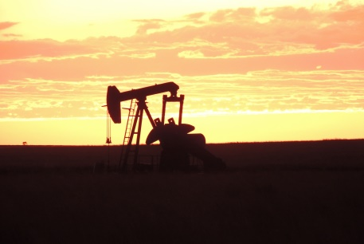
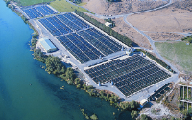
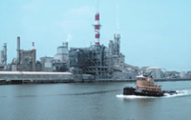
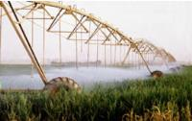
Water withdrawals by category, 2010
Livestock
Self-Supplied Domestic
Public Supply
Thermoelectric Power
1 percent
1 percent
12 percent
45 percent
1 percent
3 percent
4 percent
33 percent
Mining
Aquaculture
Self-Supplied Industrial
Irrigation
Public Supply, Thermoelectric, and Irrigation = 90% of total use
Notes:
When we talk about total water use we mean total WITHDRAWALS for these categories, either estimated or reported.
These are the categories reported in 2010 and the percentage of total that each category represents.

Slide 5
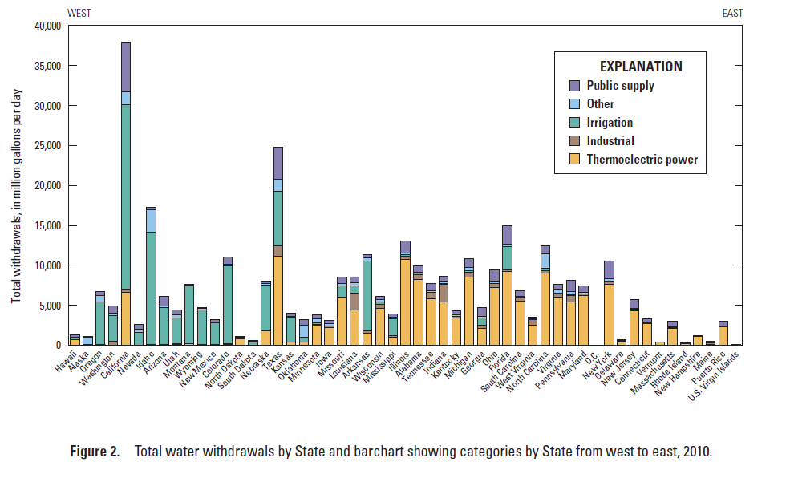
Water Withdrawals by Category by State
Notes:
This illustration shows how water withdrawals in the west are mostly for irrigation and most of the withdrawals in the east are for thermoelectric.

Slide 6
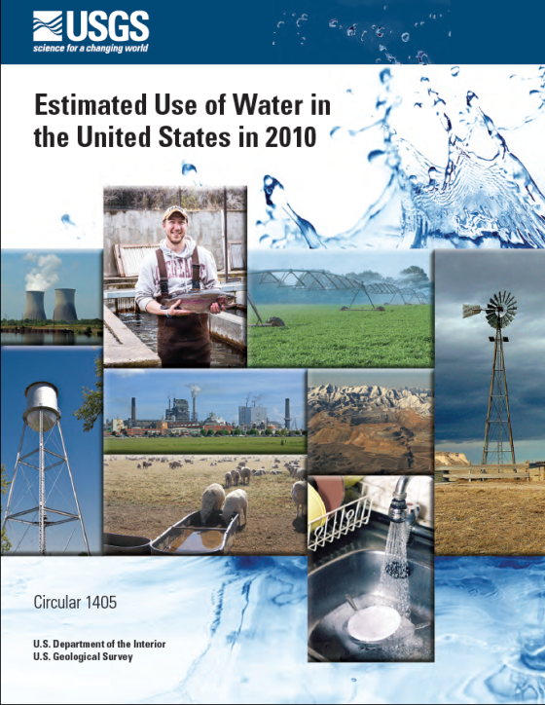
Population and Total Withdrawals
1950-2010
Billion gallons per day, BGD
Notes:
The 2010 report illustrates tables for each category, as well as trends.
In 2010 we say the largest decline in total withdrawals that has been recorded since data were collected, as population continued into increase.

Slide 7
Trends
Total water withdrawals in 2010 were 355 billion gallons per day or 13% less than in 2005, the largest percent decline reported since 1950.
Total population in 2010 was 313 million or 4% more than in 2005.
Thermoelectric withdrawals declined 20%, the largest decline since 1950 and accounted for 75% of total declines.
Irrigation withdrawals declined almost 10% and accounted for 20% of total declines.
Public supply withdrawals declined 5% for first time since 1950.
All categories of use declined in water withdrawals, except for mining and aquaculture, which saw increases of 40% and 7%, respectively.
Notes:
Total withdrawals decline 13%, the largest decline we’ve recorded in our 60 years of compilations. This level of water withdrawals was last recorded prior to 1970.
Total population increased 4%.
All categories declined except mining and aquaculture, but they are relatively small categories relative to the total of all categories.

Slide 8
Water withdrawals by category, 2015
(5-year priorities)
Thermoelectric Power include Consumptive Use
Livestock
Self-Supplied Domestic
Public Supply
Continued collaboration with US Dept. of Energy, 2013, EIA survey
Correspond with USDA Agriculture Census, 2017 survey questionnaire about source of irrigation deliveries
Irrigation include Consumptive Use
Mining
Aquaculture
Self-Supplied Industrial
Notes:
Who knows what the 2015 water-use story will tell, but we will have 2 key components that will be re-integrated back into the compilation as per 5-year and 10-year priorities.

Slide 9
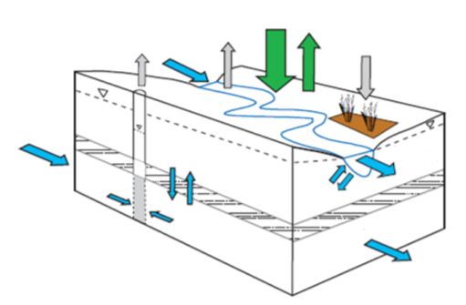
Compilation 2015
Irrigation Consumptive Use
Precipitation
+
Flow in
=
Evapotranspiration
+
Storage Change
+
Flow out
Evapotranspiration from crops and golf course = irrigation consumptive use

Slide 10
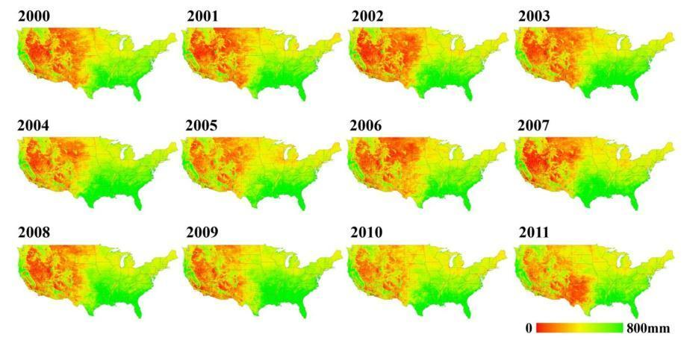
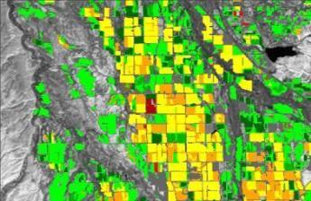
Satellite Data and ET
Annual and monthly ET from MODIS (1 km)
Watershed and county scale
Monthly ET from Landsat (30 m)
Focus Area Study, field scale
Notes:
We have now constructed a time series of monthly ET for the conterminous 48 states going back to 2000 and we are looking for opportunities to go back further in time, by using older LANDSAT images, and to go to a sub-monthly timestep. All of this is part of our commitment to providing long-term data streams of ET data for water availability analysis.

Slide 11
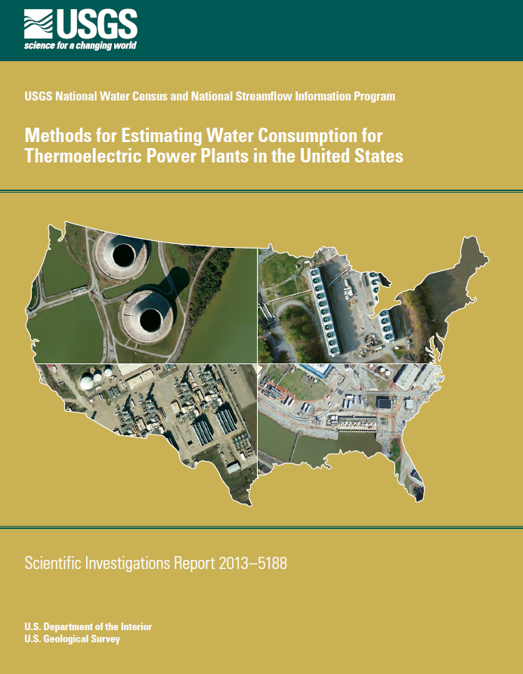
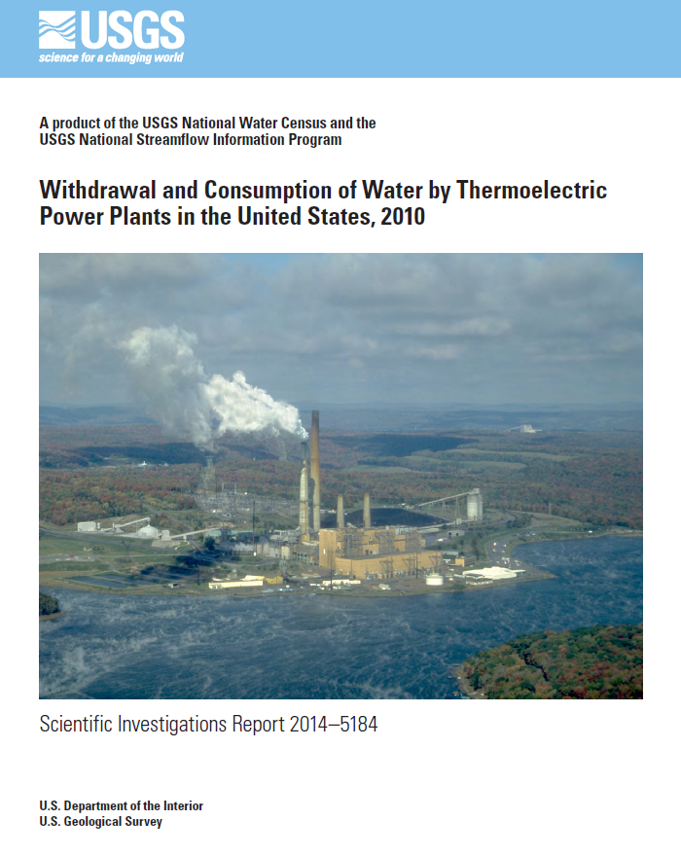

Thermoelectric, 2015

Slide 12
Unconventional Oil and Gas Topical Study
Topical study relevant to SECURE Water Acto to assess water use and availability in energy sector.
UOG- capture of oil reserves that are dispersed continuously throughout a geologic formation, via directional drilling and/or hydraulic fracturing (fracking).
Oil production from Baakan formation has skyrocketed. Impacts on water resources are largely unknown. This study will produce coefficients of use and losses for direct and indirect UOG uses.

Slide 13
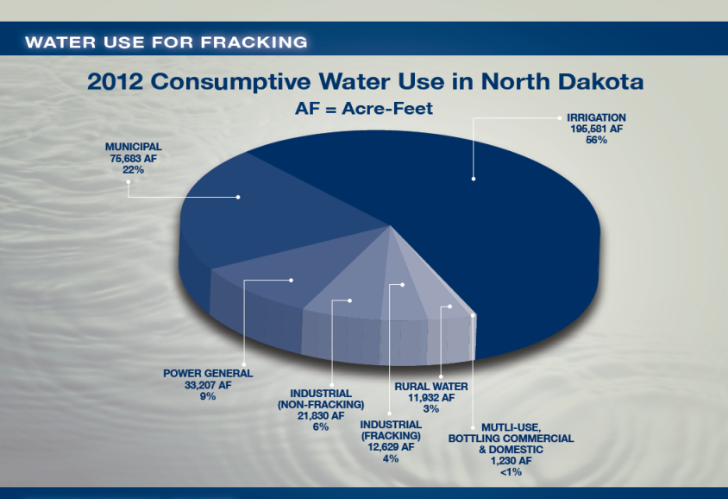
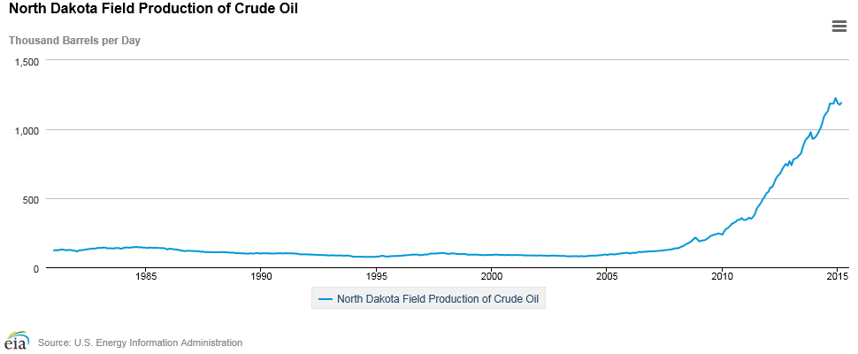
Unconventional Oil and Gas Topical Study Objectives
Direct uses (drilling, fracking, well maintenance).
Indirect uses (support services, dust suppression, municipal uses).
Develop coefficients and consumptive use with broader applications to other UOG operations outside Baakan.
Improved water-use data collection methods for UOG uses.

Slide 14
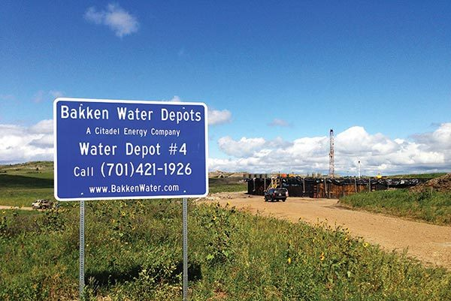
Unconventional Oil and Gas Topical Study
Notes:
Popular sight in western North Dakota – Water depots popping up every few miles in the Bakken Formation area. Some water depots operate 24 hours a day and offer showers and food for workers. (Citadel Energy, 2014)

Slide 15
State Grant Program
$12.5 million over 5 years (2015-2020 pending congressional approval)
$1.352 million for FY 2015
  Each State $26,000 to write workplan
$1.5 million for 2016 and beyond (pending)
  Competitive process
$250,000 State limit
Grant Program Guidelines provided
Office of Acquisitions and Grants (www.grants.gov)

Slide 16

State Grant Program
Interstate Council on Water Policy host 3 stakeholder meetings Aug – Nov, 2015.
Encourages cooperation and collaboration between State agency and USGS to improve and build better water-use databases.
Tiered criteria for major categories in guidelines.
Ultimate goals for site-specific, watershed (HUC 8) and aquifer-based data, including improved consumptive use.

