Slide 1
Electronic Continuous WQ Records Auto_Review - wqmreview
Wade Walker, November 7, 2013

Slide 2
Part of the Recommended Workflow
http://water.usgs.gov/usgs/owq/wqmreview/

Slide 3
What is Auto_Review?
A consolidation of programs that automates the production of time-series record packages.
Started as individual WSC scripts that have slowly been absorbed and collaborated on to build a larger, more efficient electronic review package for the most common time-series parameters (GW, SW, and WQ parameters only at this point)
Wqmreview added Dec. 2011
http://water.usgs.gov/usgs/owq/wqmreview/

Slide 4
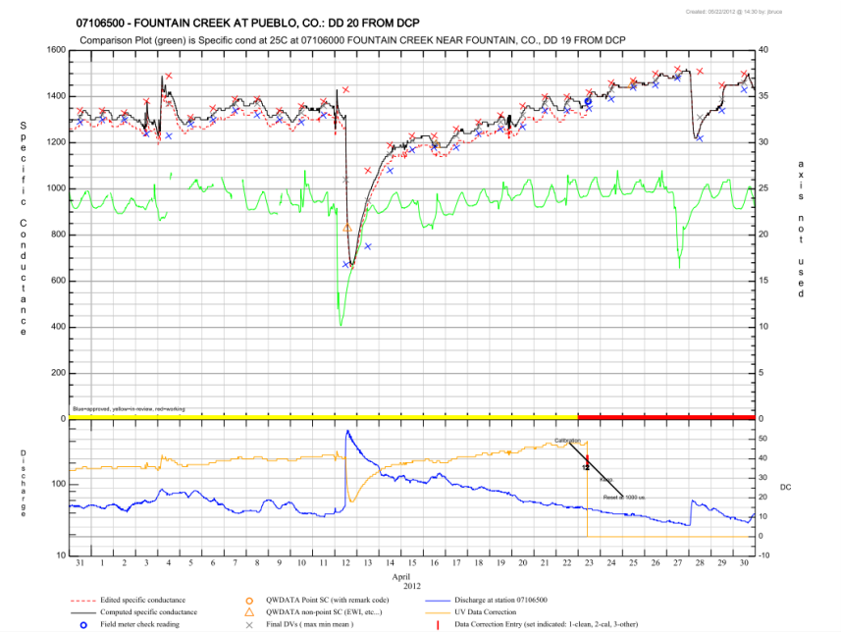
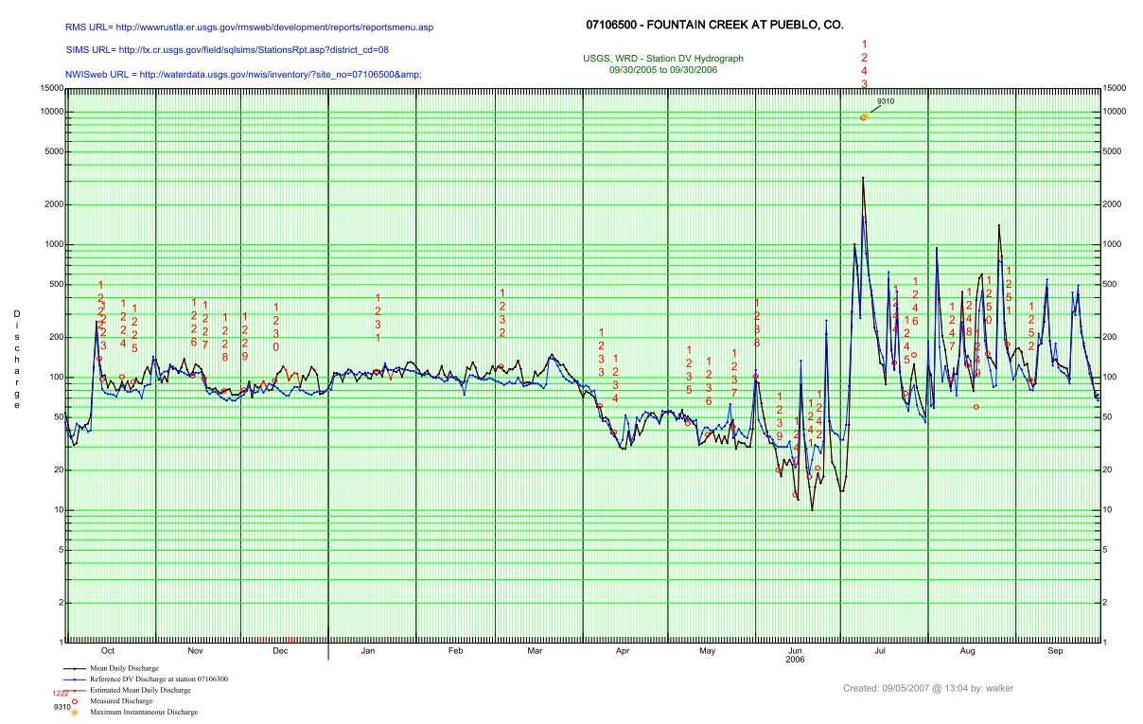
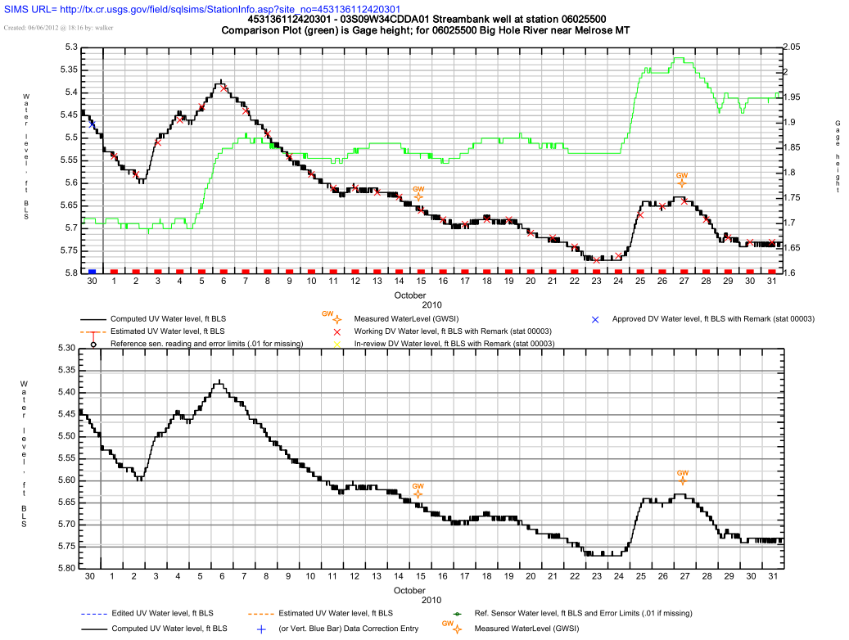
What is Auto_Review?
Tkg2 generated graphical plots combining data from ADAPS, SITEVISIT, GWSI, and QWDATA.

Slide 5
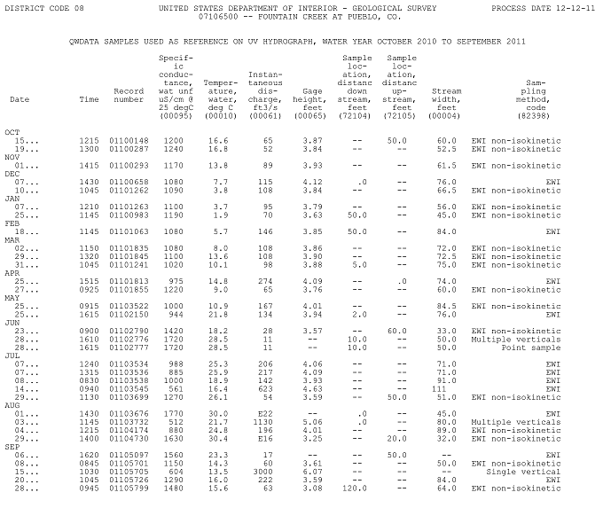
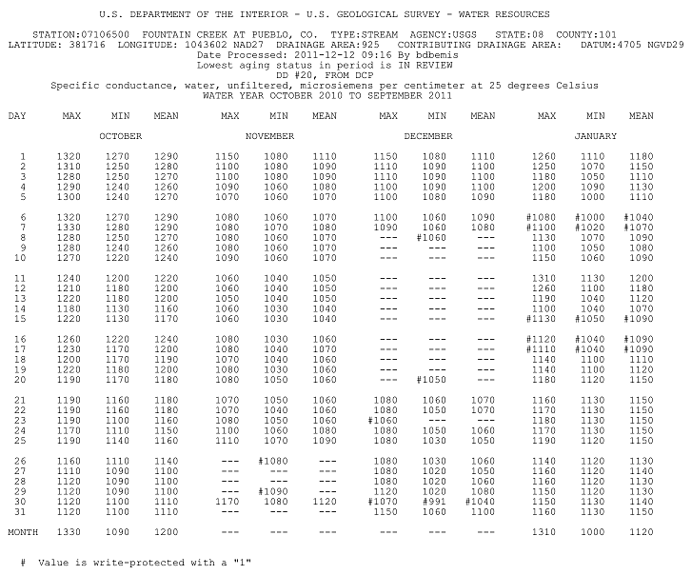
What is Auto_Review?
Commonly used ADAPS, QWDATA, and GWSI tables.
ADAPS Station Analysis, DV tables, EOY summary, Primary, UV inventory
Site Visit Reports
QWDATA publication-style tables
GWSI water level tables

Slide 6
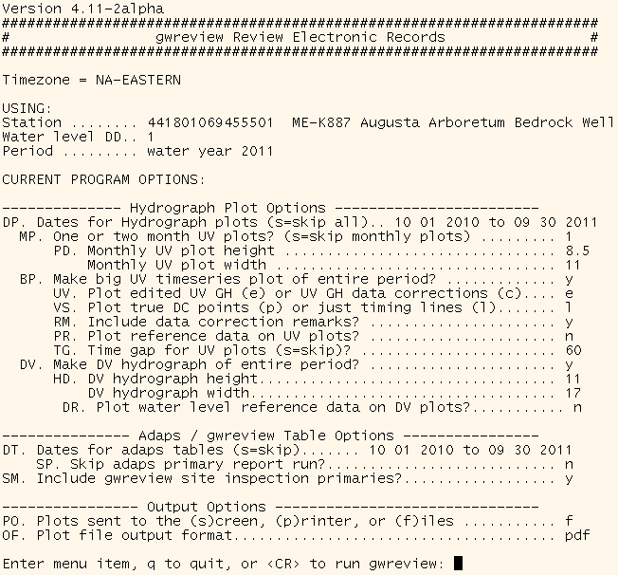
What is Auto_Review?
A (fairly) user-friendly menu for changing and saving settings at stations.

Slide 7
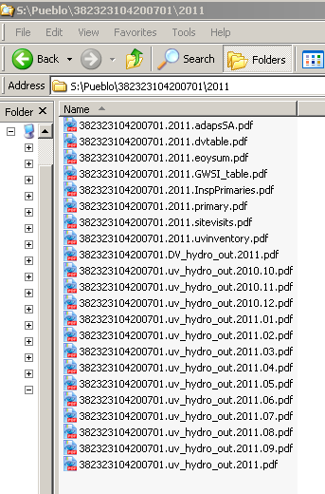
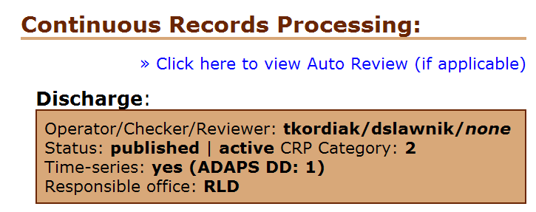
What is Auto_Review?
Final output of generated tables and plots are normally stored in a central record folder area in PDF format for electronic reference and archiving.
Default area is /SWR on NWIS servers, but WSC may place it elsewhere (ask if unsure…)
Can also be sent to the screen or straight to a printer, but not the preferred options…
Can be displayed from local WSC webserver, local websites can be developed, or links to output can be added from SIMS/RMS station pages.
Notes:
More on output options later….

Slide 8
Five Parameters Available
Temperature
Specific Conductance
Dissolved Oxygen
pH
Turbidity
We know we need more…
http://water.usgs.gov/usgs/owq/wqmreview/

Slide 9
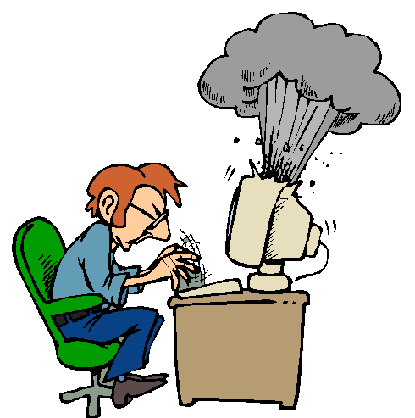
What can wqmreview do for you?
Title suggests it’s a “review script” but …
Useful for all Stages of record process!
Obviously a “Workup” or Worker tool, too.
For the Checker and Reviewer of course.
Can keep electronic records of the WY for an office or the state with ease in an easily accessible local electronic archive (or can repull them at anytime using the program as long as data still reside in database…).
http://water.usgs.gov/usgs/owq/wqmreview/

Slide 10
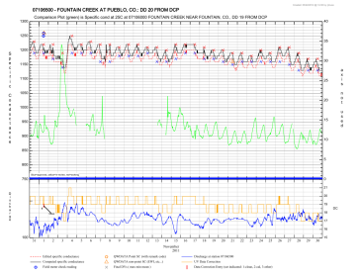
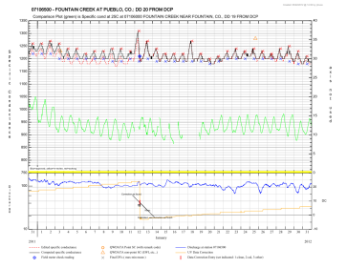
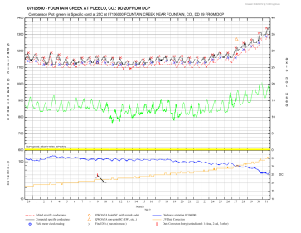
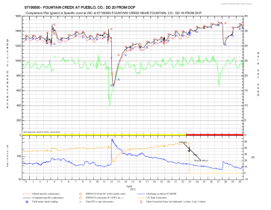
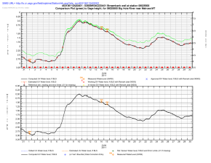
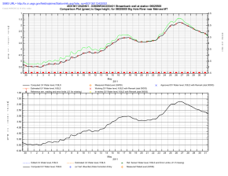
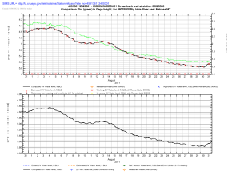
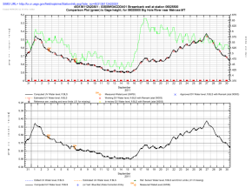
What can wqmreview do for you?
Quickly produce a base electronic record packet for your continuous WQ-monitor stations including the following output:
Unit Value Hydrograph Plots (graphical primaries…)
Computed vs. Edited UV data
Sum of UV Data Corrections from sets 1, 2, 3 on a separate axis (unit corrections, not %)
Daily value statistics (currently limited to no more than 3 stats…)
Site Visit field meter check readings
Reference data
Unit or Daily values from any station and any DD
Discharge/flow from base station or any other nearby station...

Slide 11
What can wqmreview do for you?
UV hydrographs also contain:
Data aging via color coded bars.
Date the plots were generated and user that generated them.
Optional QWDATA field measurements for that parameter.
Data correction entry indicators
ADAPS data correction remarks can also optionally be included.
Full “Key or Legend” to interpret the plots.
Can plot monthly or one large plot of the entire period.
http://water.usgs.gov/usgs/owq/wqmreview/

Slide 12
WQMReview Output: Plots
http://water.usgs.gov/usgs/owq/wqmreview/

Slide 13
Water Temperature
http://water.usgs.gov/usgs/owq/wqmreview/

Slide 14
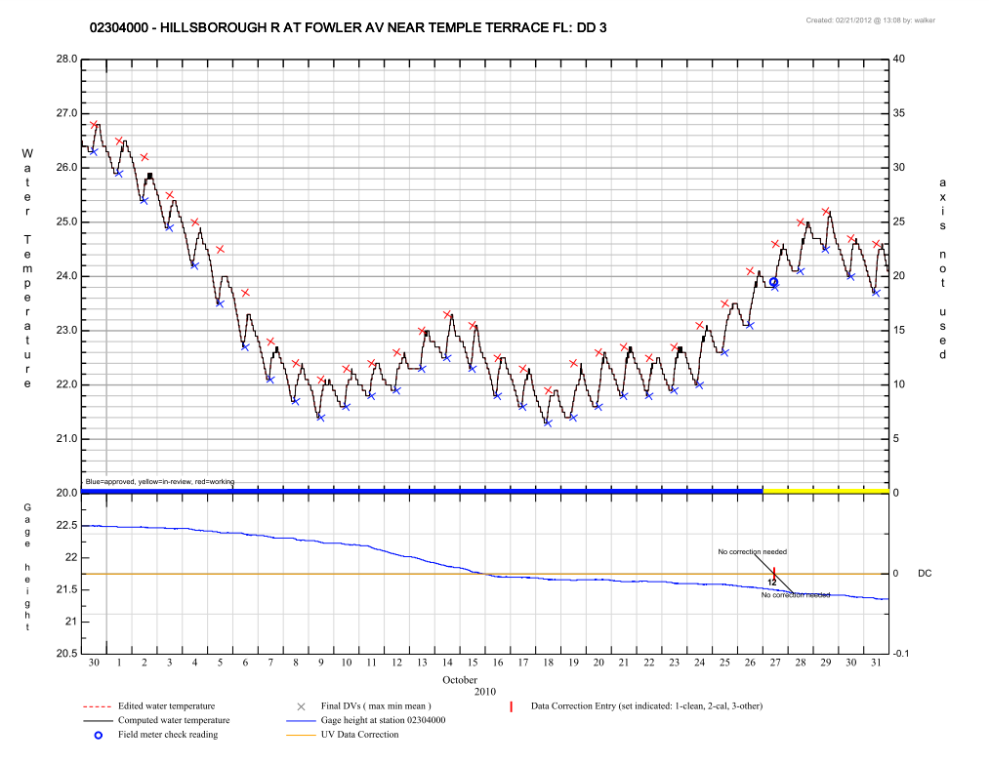

Slide 15
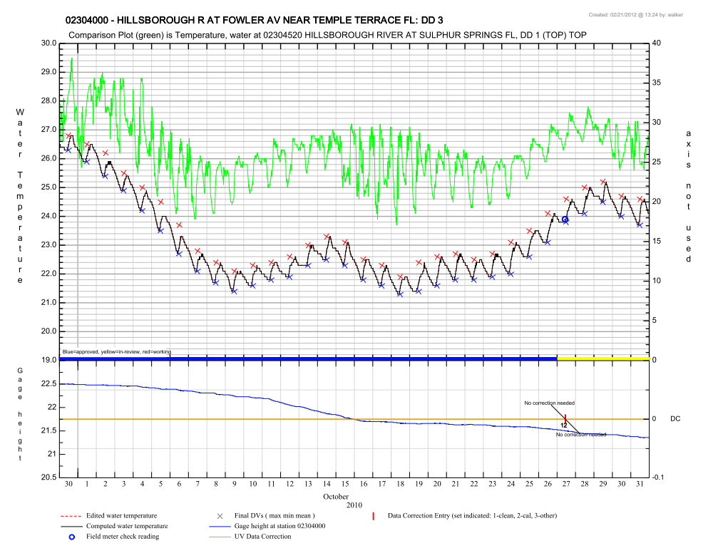

Slide 16
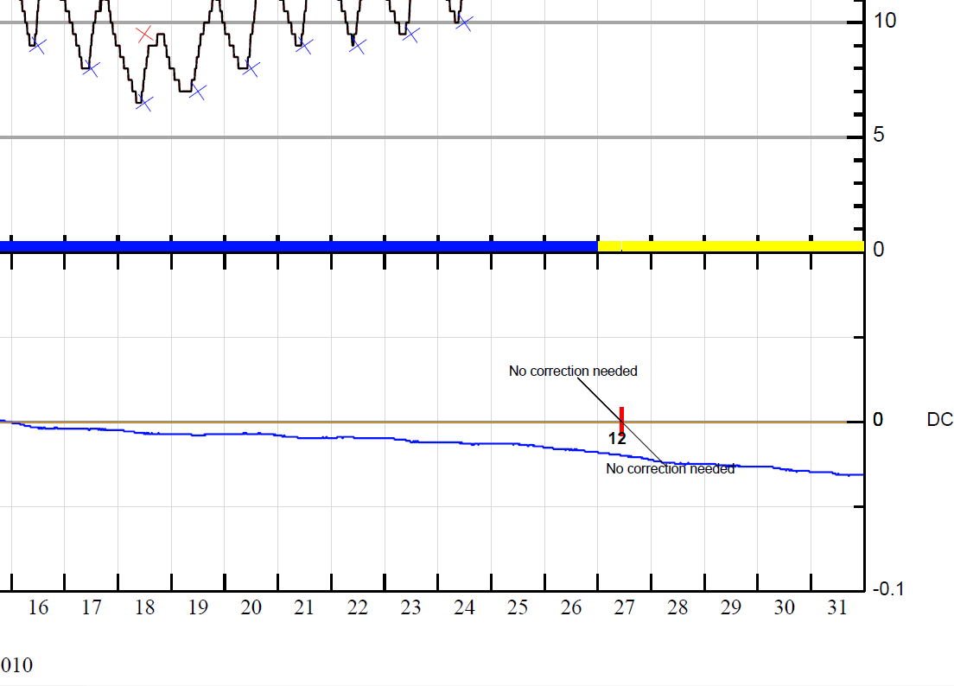
Unit-value data correction applied during this period is 0.00. If a correction is “ended” or no UV data are present, no UV data correction will be shown.
Set 1(fouling) and set 2(drift) corrections were entered at this time, both with remarks of “No correction needed”.

Slide 17
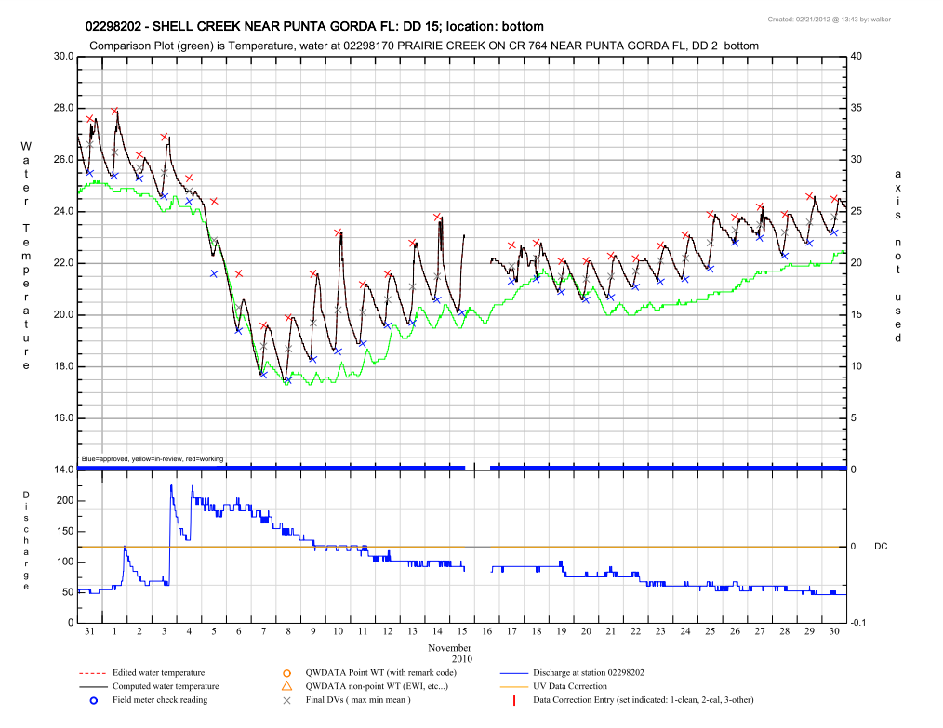

Slide 18
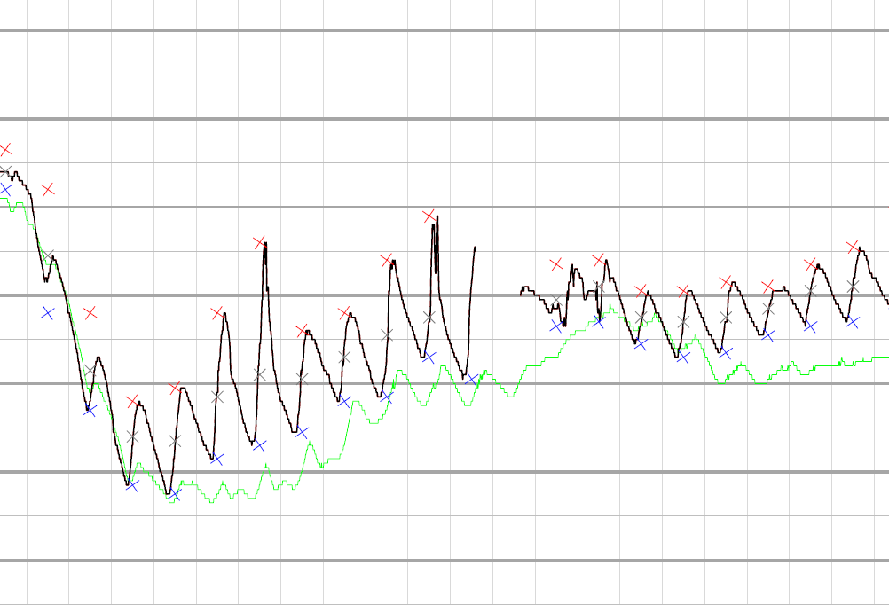

Slide 19
GHT and Discharge on the bottom Plots: Log Vs Linear
http://water.usgs.gov/usgs/owq/wqmreview/

Slide 20
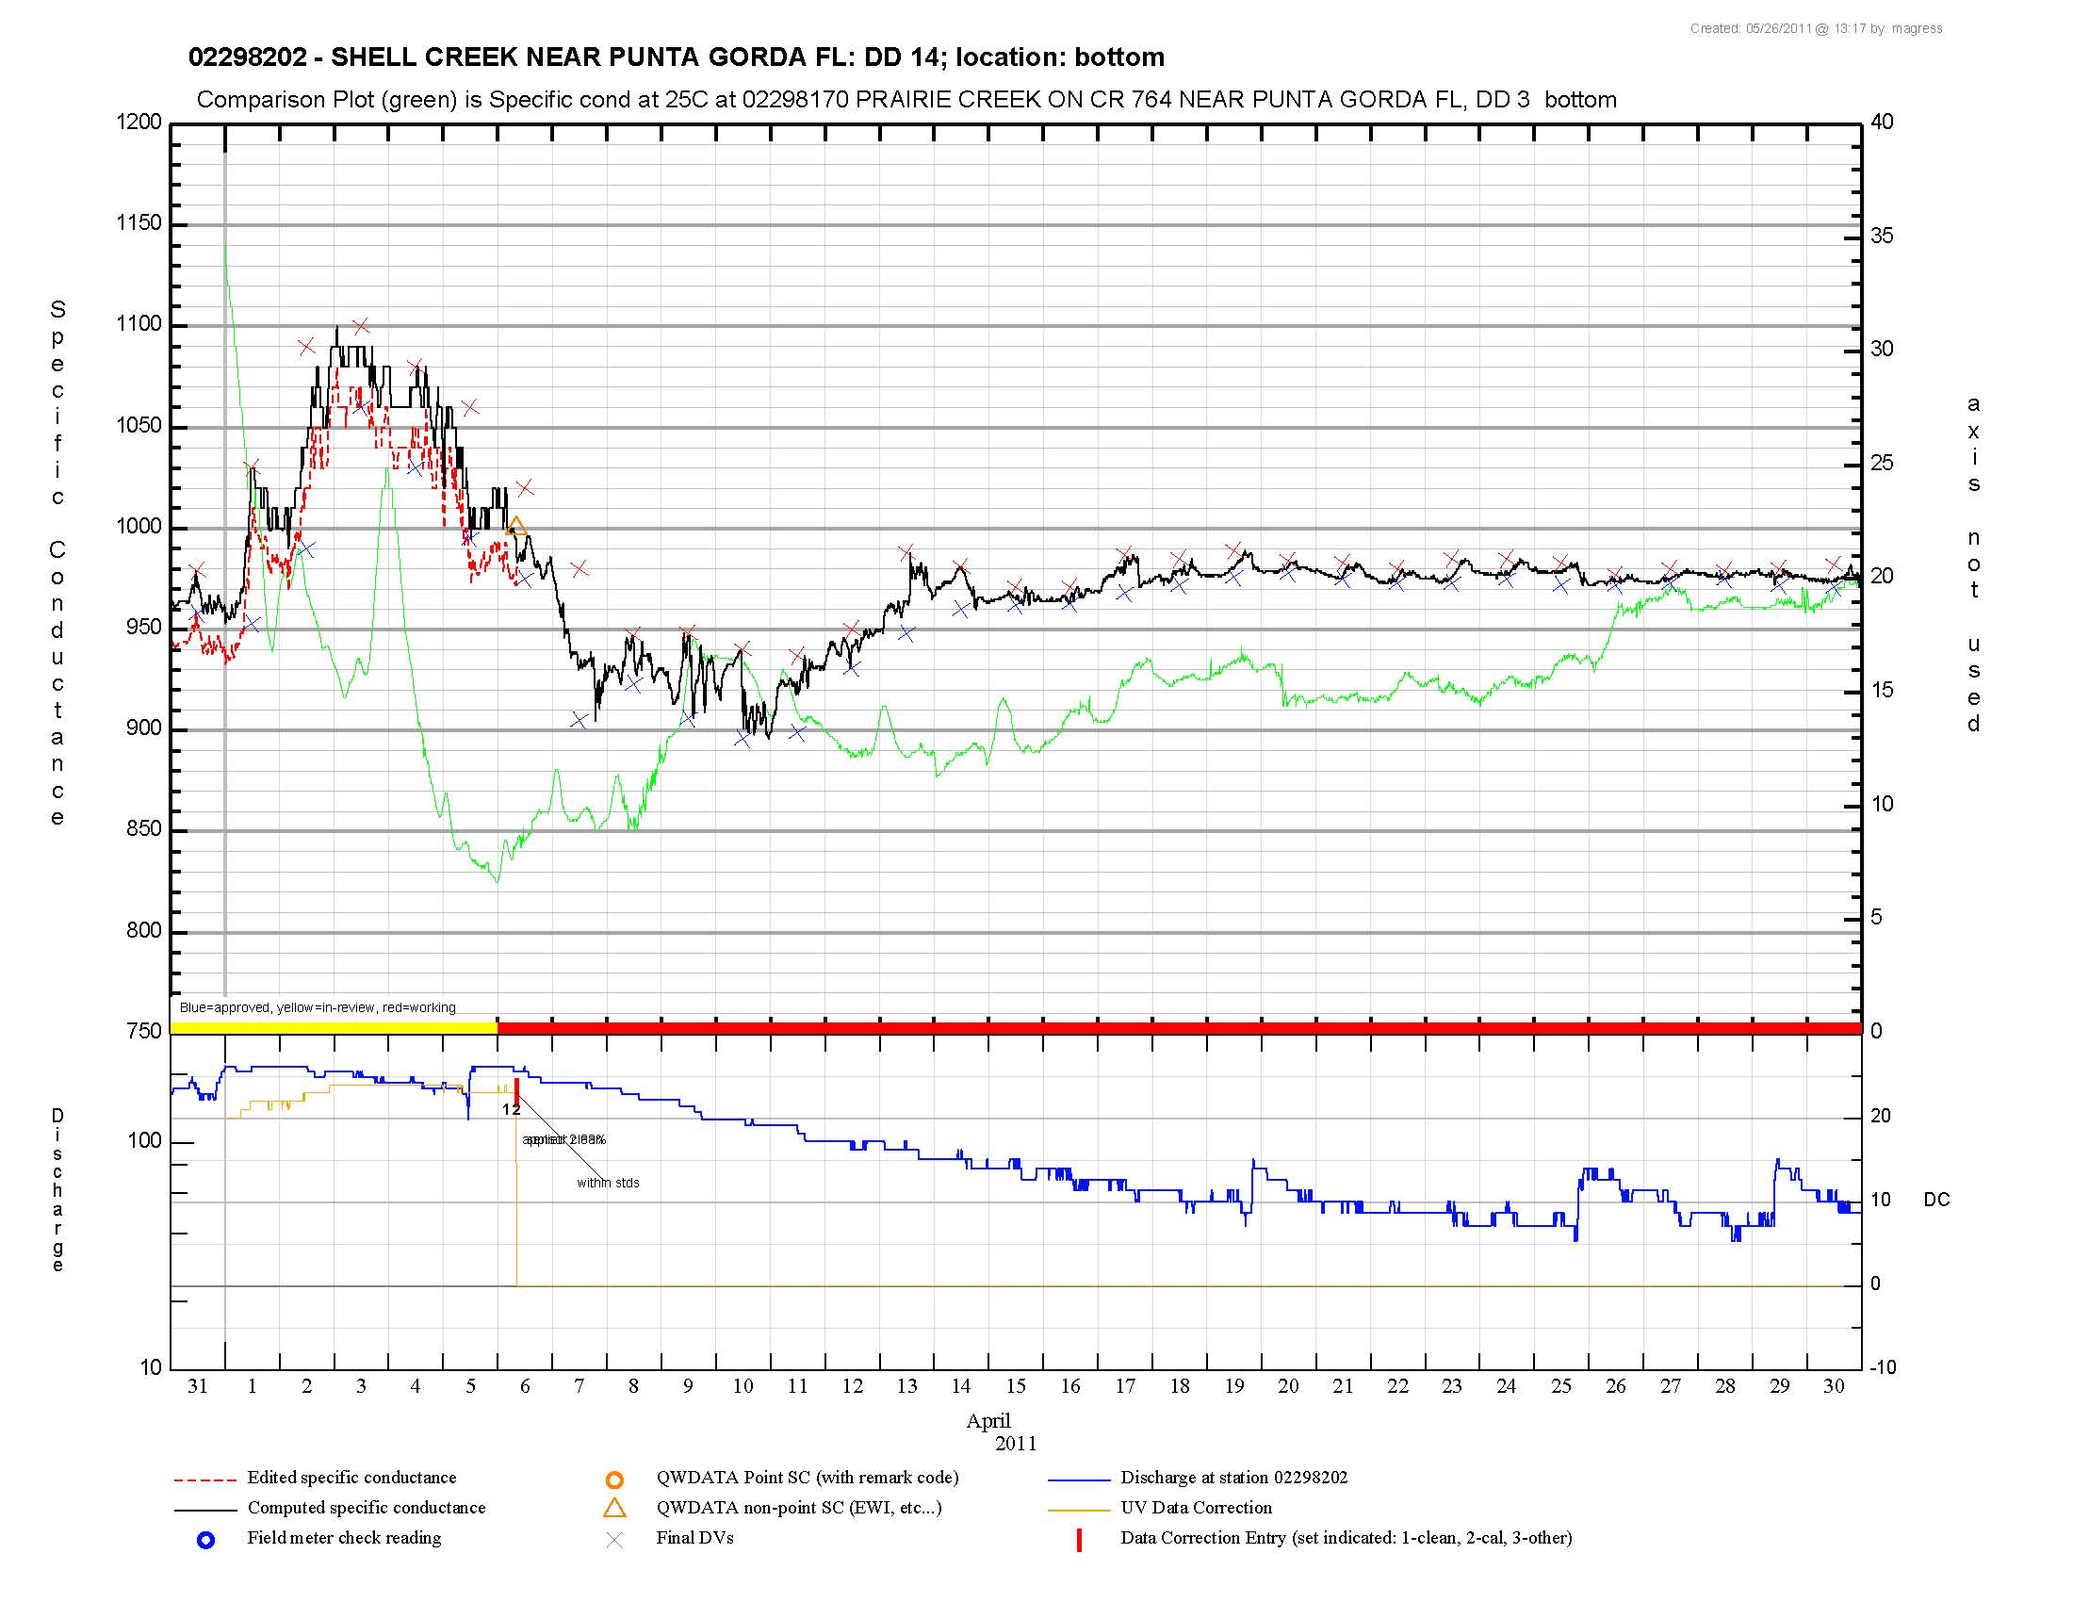

Slide 21
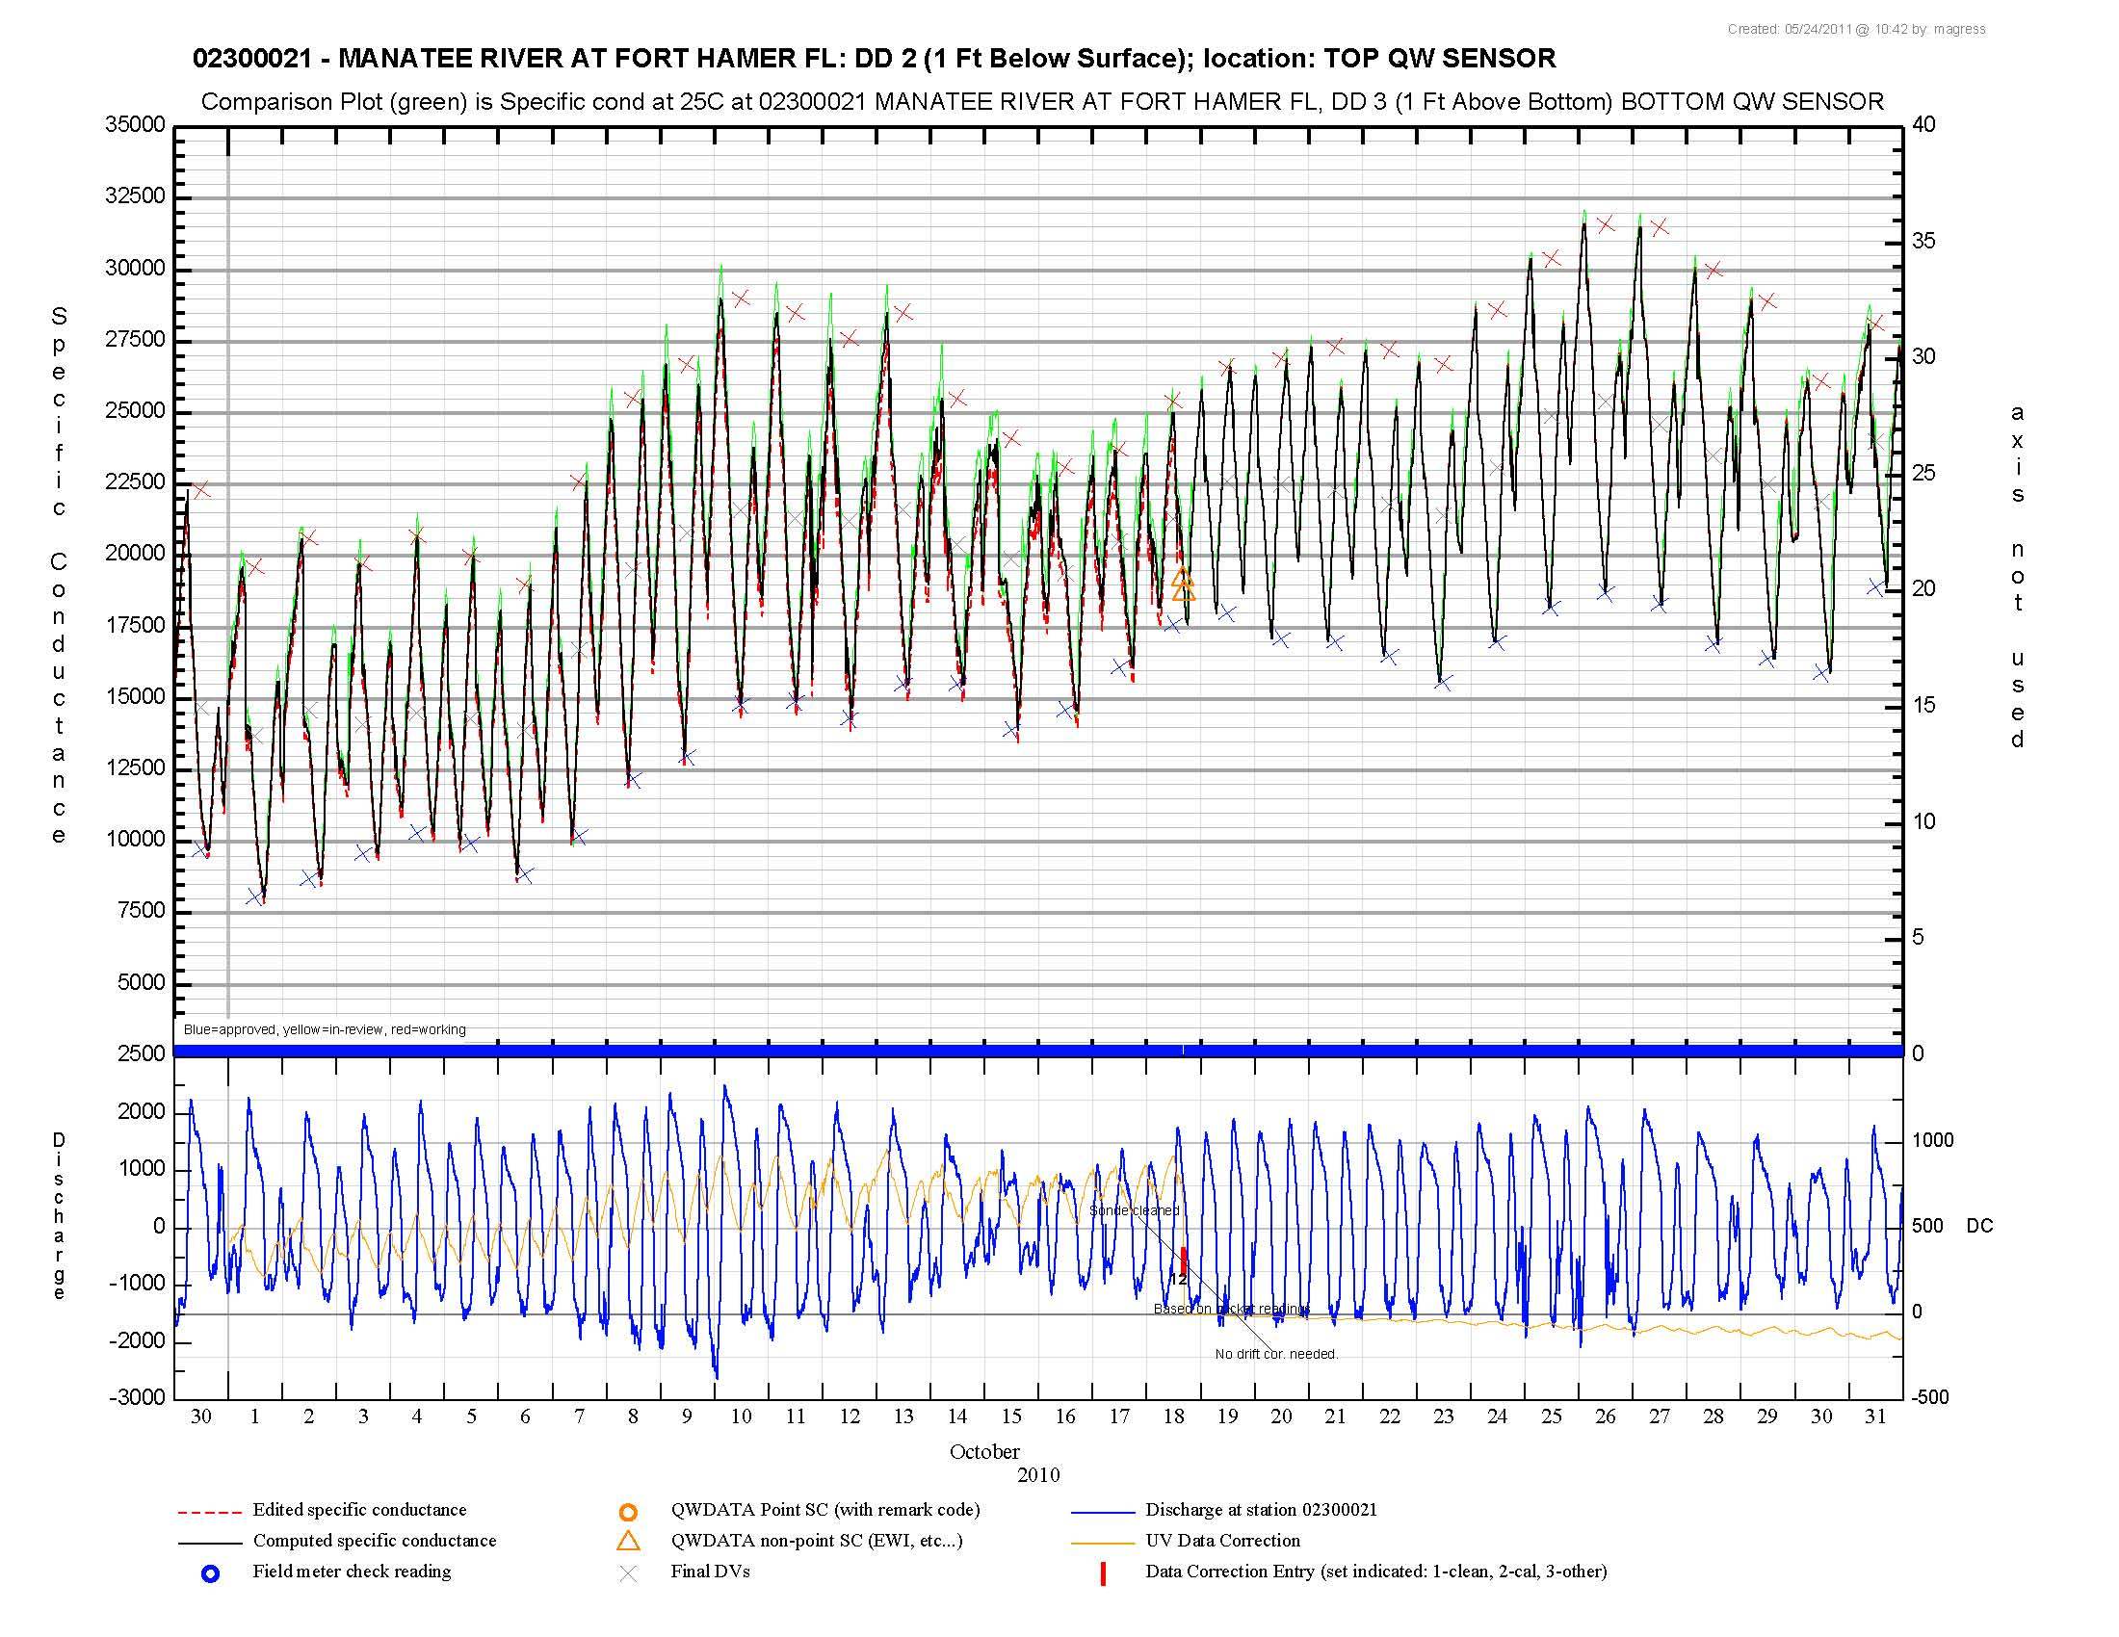

Slide 22
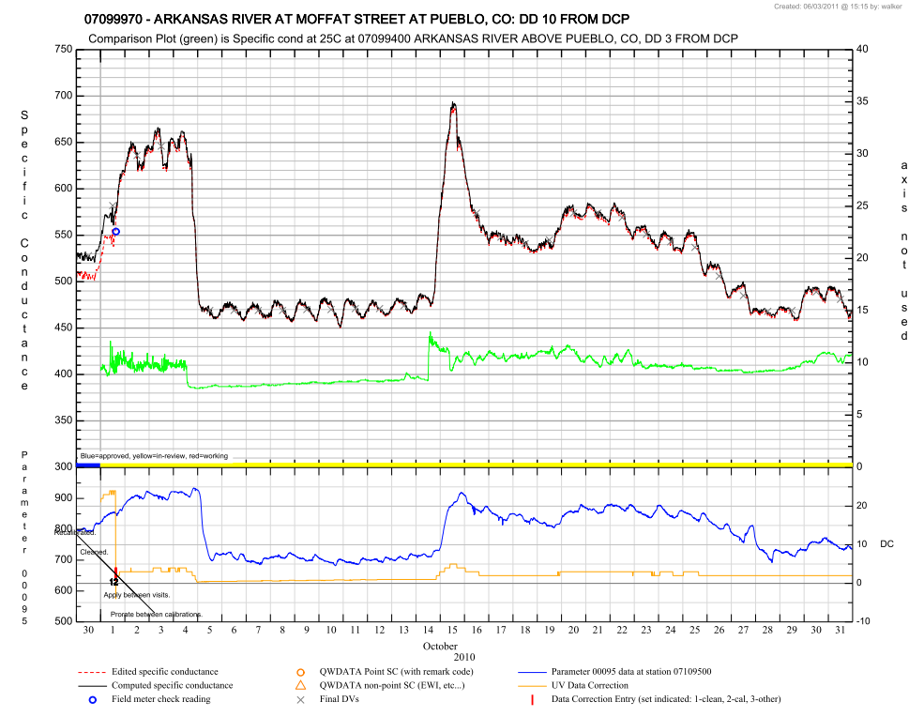
GHT and Discharge Plot:
Secret Trick…
Can actually add any parameter to the bottom plot
Useful if users don’t have a discharge/gage height reference or an additional reference besides discharge/gage height is desired. Script allows for it, but doesn’t point it out…

Slide 23
Specific Conductance
http://water.usgs.gov/usgs/owq/wqmreview/

Slide 24
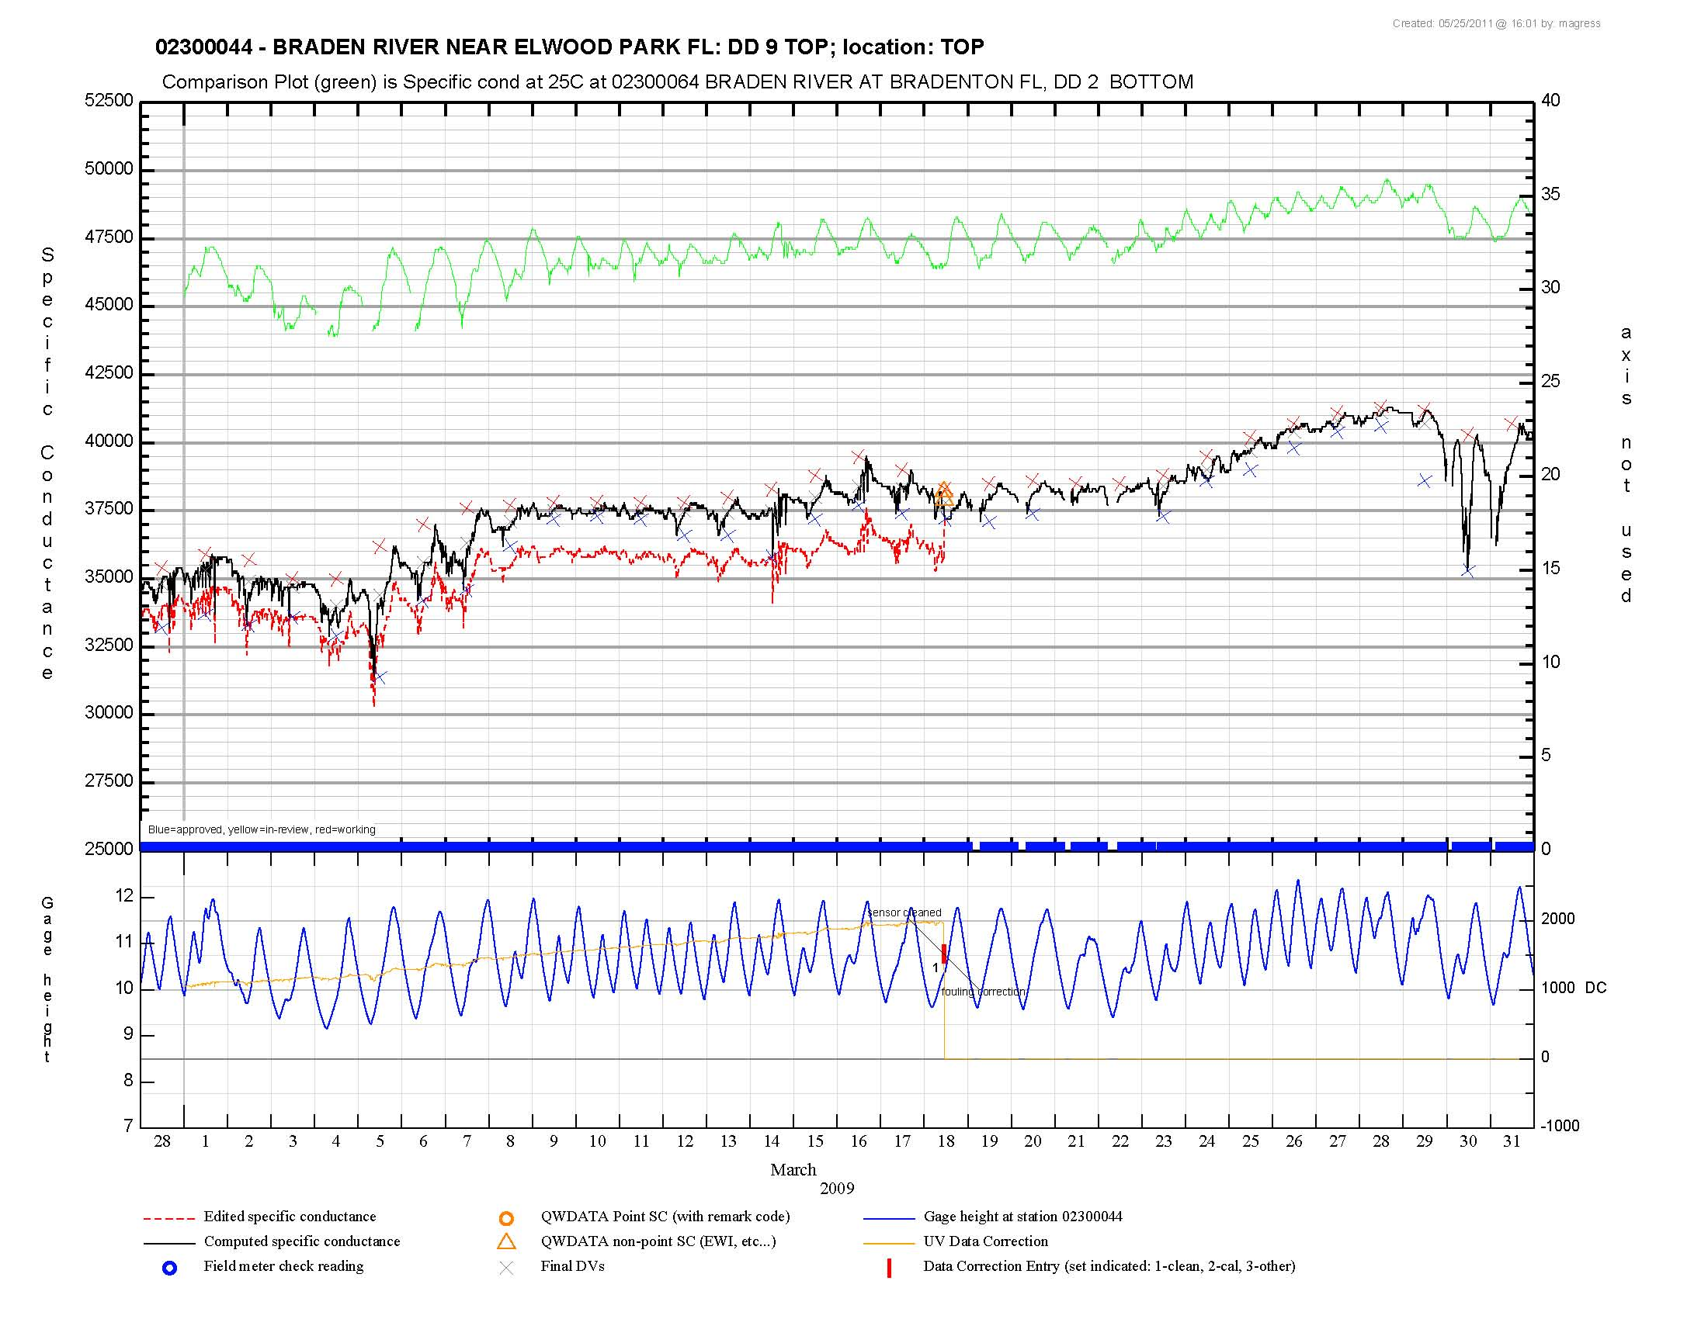

Slide 25
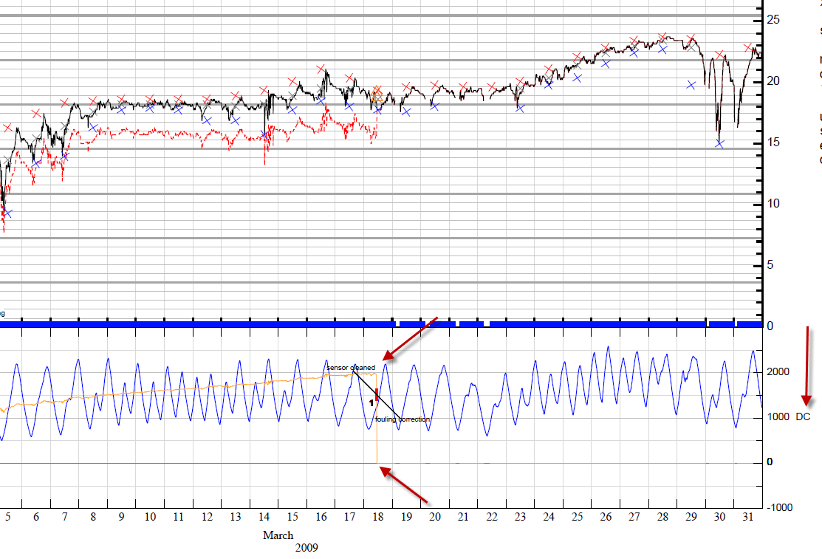
Notes:
Here, two fouling correction entries are indicated on the bottom plot via vertical red bars with associated set “1” entry labels and remarks entered for each correction. The effect of the fouling correction can be visualized both on the top plot as the difference between the edited and computed unit values, as well as on the bottom plot with the change in the unit value data correction applied. Note that in this case the correction was “zeroed” out with a second cleaning correction. Had the correction instead been ended with an end date, only one correction entry would show and the unit data correction wouldn’t show on the plot at all after that end date.

Slide 26
Dissolved Oxygen
Automatically plots inverted water temperature on the right Y-Axis
Usually available and often a good relationship
Still can add a reference site to the top plot, but must be another DO parameter
Creates 3 data sets with 2 axis
http://water.usgs.gov/usgs/owq/wqmreview/

Slide 27
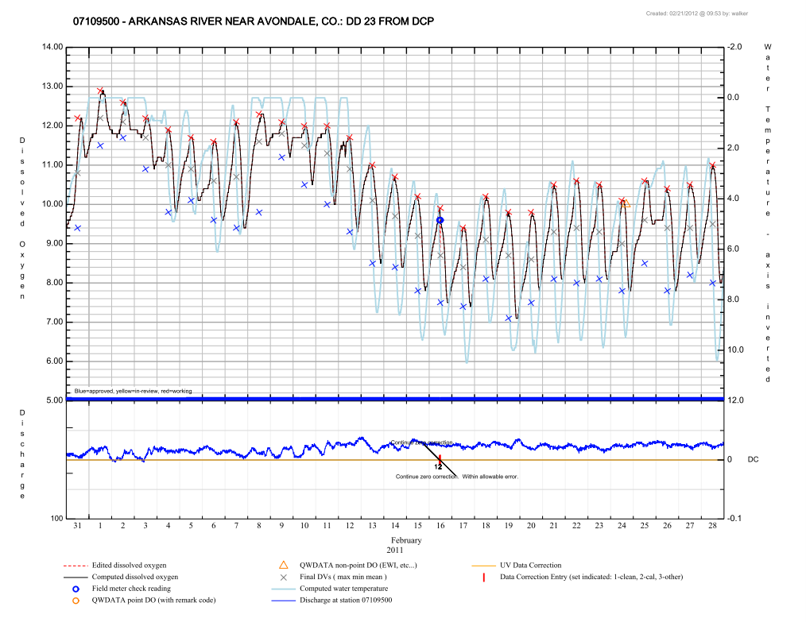

Slide 28
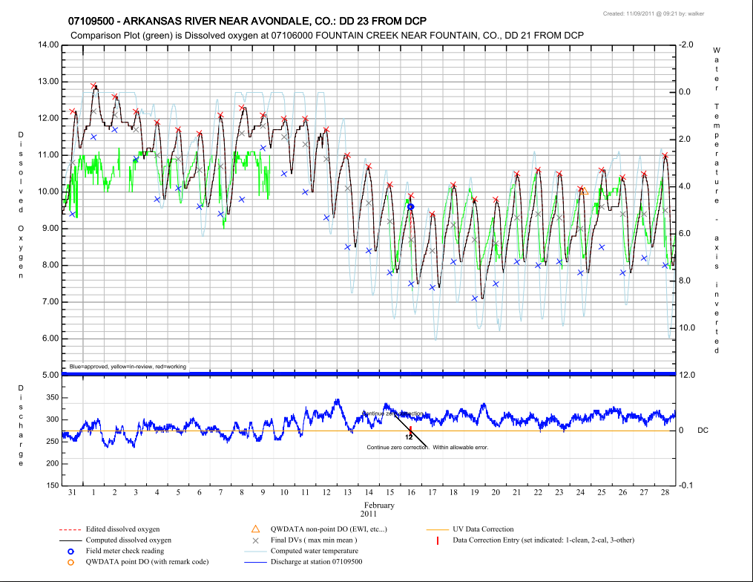

Slide 29
pH
http://water.usgs.gov/usgs/owq/wqmreview/

Slide 30
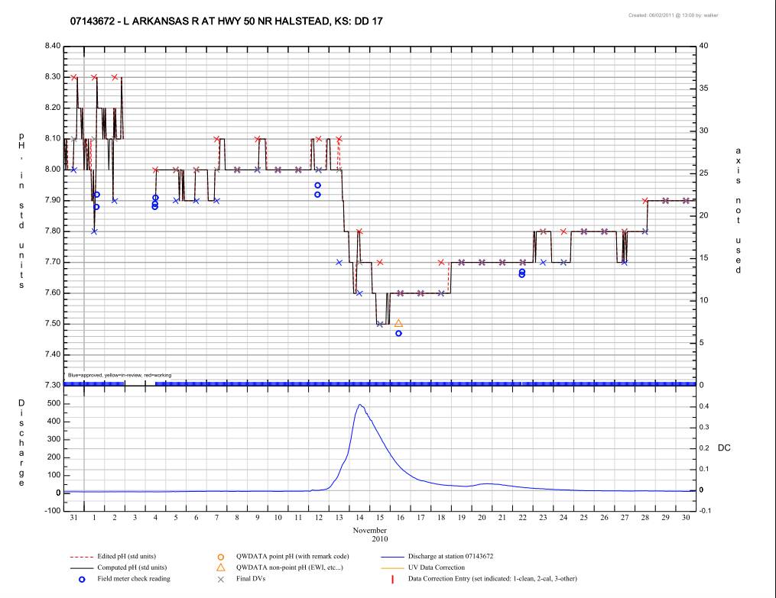

Slide 31
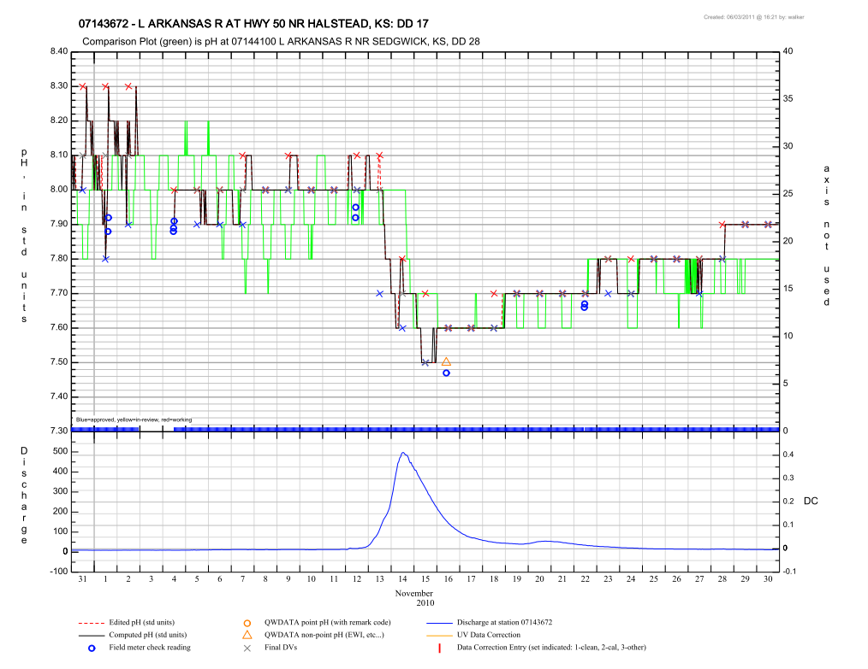

Slide 32
Turbidity
http://water.usgs.gov/usgs/owq/wqmreview/

Slide 33
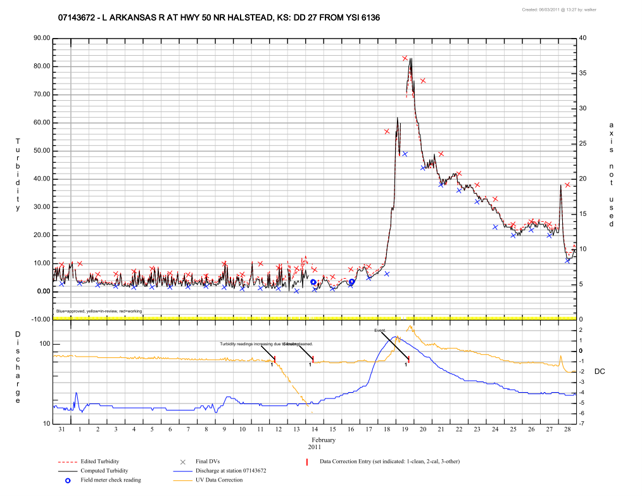

Slide 34
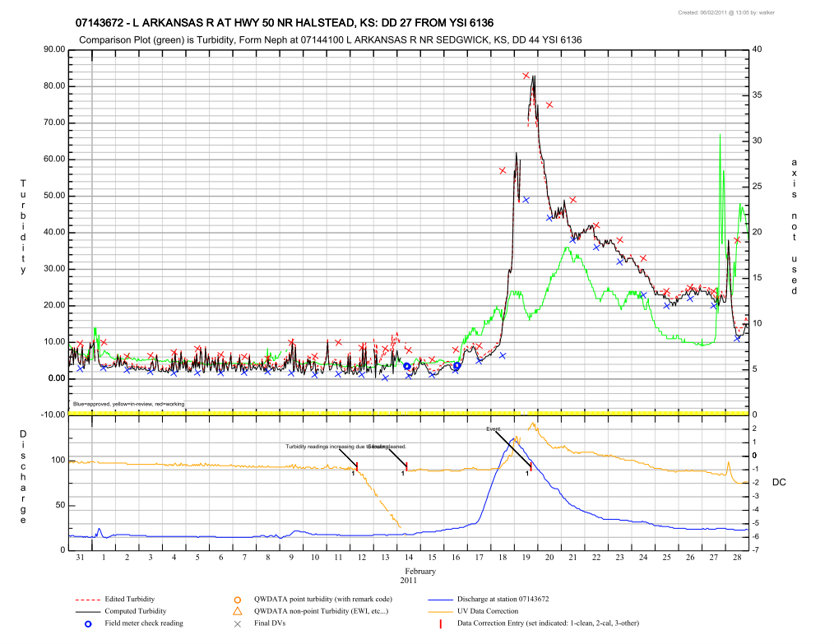

Slide 35
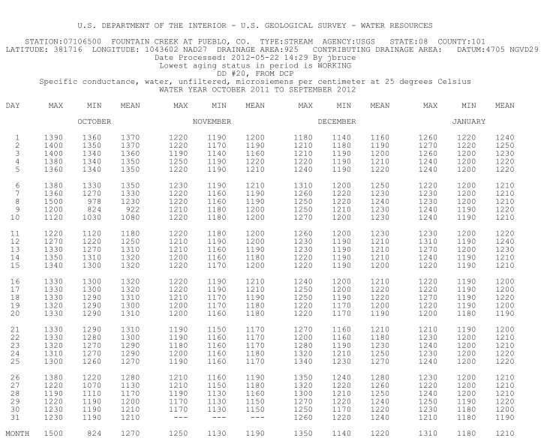
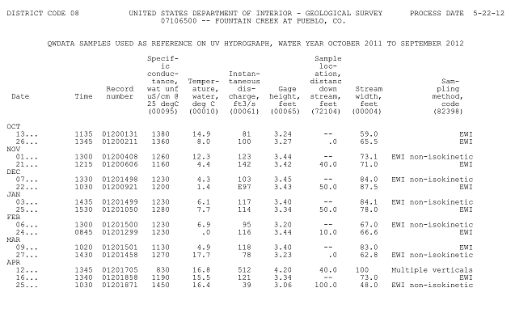
Wqmreview tables
Standard ADAPS Tables
See ADAPS documentation for full descriptions of tables – assume most users are familiar with most of these…
ADAPS DV table(s) (includes all statistics setup to be stored in the database – dvtable.pdf file)
ADAPS Station Analysis (with new dq_rating.pl addition – adapsSA.pdf file)
ADAPS Primary report (primary.pdf file)
ADAPS End of year summary (eoysum.pdf file)
ADAPS UV inventory tables for edited and computed data (inventory.pdf file – 2 pages)
QWDATA publication table (tableQWDATA.pdf file

Slide 36
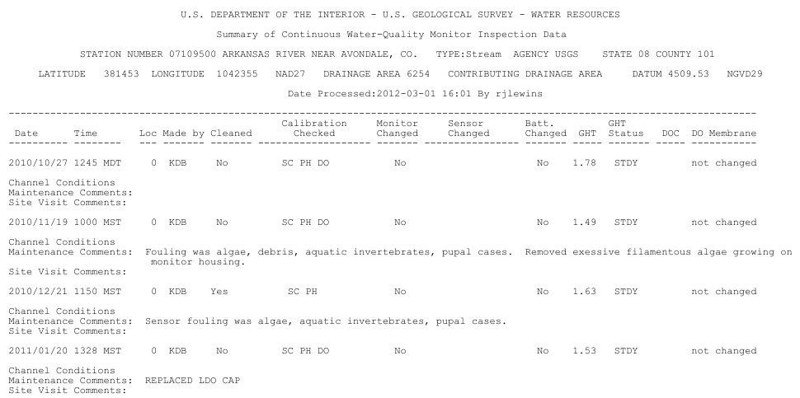
Wqmreview tables
Site Visit Reports - Continuous WQ-monitor Summary
General overview of all monitor activities
Notes:
General summary and comments

Slide 37
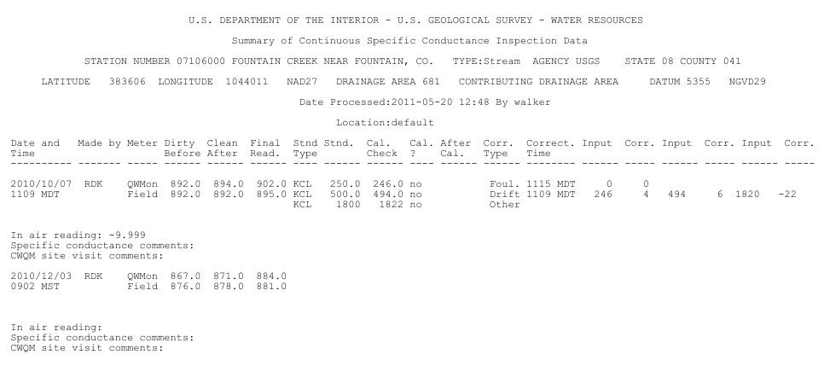
Wqmreview tables
Site Visit Sensor summary table
Can compare before/after clean readings to applied fouling corrections
can compare calibration check readings to applied drift corrections
Notes:
Entering corrections with the same values as check readings and calibration standards makes this a fairly easy comparison…

Slide 38
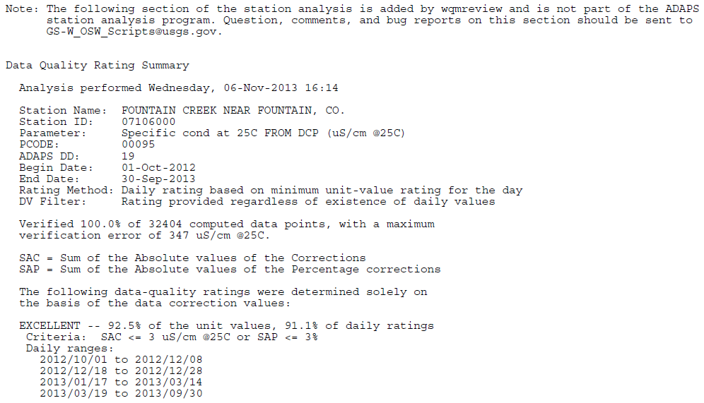
Wqmreview tables
Data Quality Rating Table Appended to ADAPS Station Analysis
Default settings only….
Notes:
This is not included yet, but will be shortly with the new release. Note that Stewart Rounds wrote and maintains the script that produces this and Stewart will be covering this output in more detail in his talk.

Slide 39
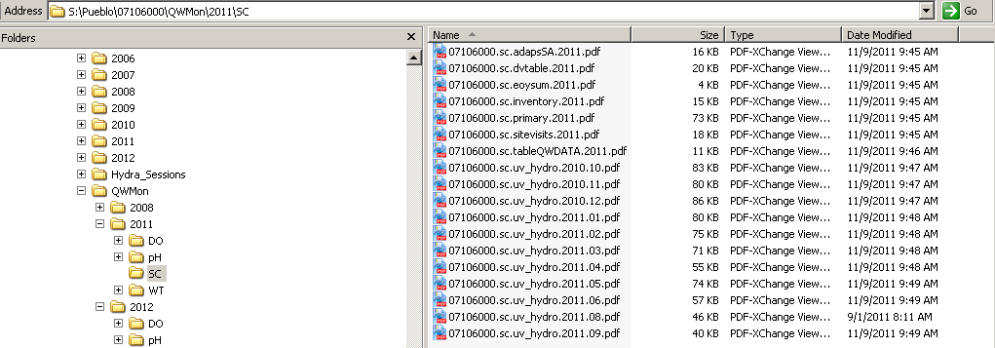
Wqmreview tables
http://water.usgs.gov/usgs/owq/wqmreview/

Slide 40
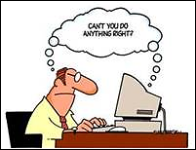
How to run the script
From NWIS prompt type:
“wqmreview”
Follow the on screen prompts and fill out working from top to bottom
Save Your Settings
DD’s, Reference stations, Reference DD’s, most settings, etc…
http://water.usgs.gov/usgs/owq/wqmreview/

Slide 41
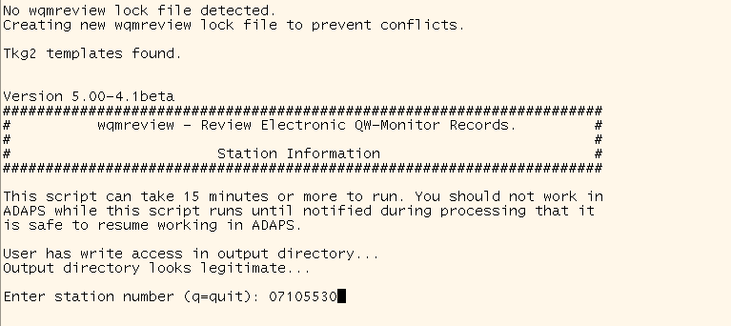
http://water.usgs.gov/usgs/owq/wqmreview/

Slide 42
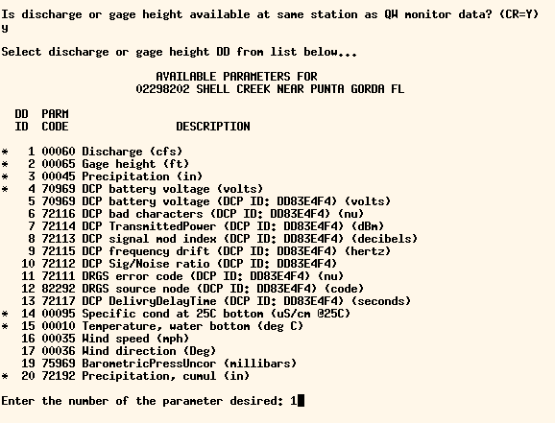
http://water.usgs.gov/usgs/owq/wqmreview/

Slide 43
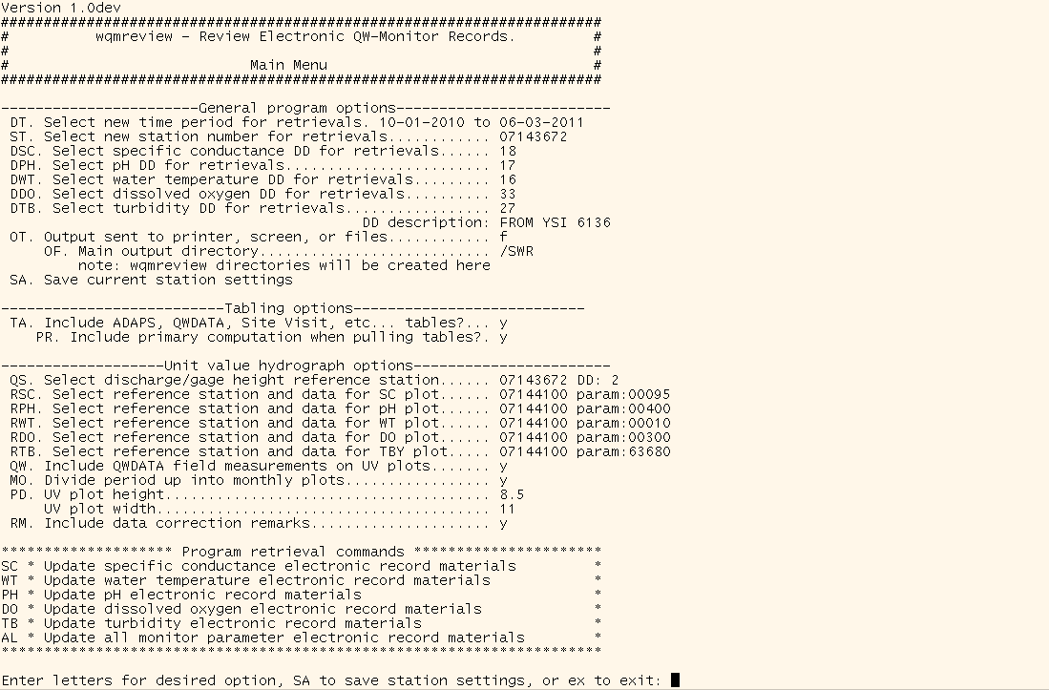
http://water.usgs.gov/usgs/owq/wqmreview/

Slide 44
Default date is the current calendar year as a water year (to today’s date) – so usually the current water year except for Oct.-Dec. when the prior water year will be the default.
Automatically finds primary DD’s for recognized parameters the first time you run it. Those can be changed or removed as necessary and then saved as the default – Sites with multiple DD’s/Sondes will have to be manually changed for each run as desired (output should be directed to folders including location name to avoid collisions…)
Output can be sent to the screen, printer, or to the designated pdf file storage location (default is the same as used for swreview output).
Save your settings!
http://water.usgs.gov/usgs/owq/wqmreview/

Slide 45
Include tables and run primaries?
Choose “bottom plot” reference data option (usually discharge or gage height, but can be anything)
Select “top plot” reference stations and data descriptors for all available parameters. Can select computed/final DV’s or any UV data type (raw, measured, edited, computed).
Include QWDATA entries on plot (if you have access…script should detect if you don’t)?
Divide period up into monthly plots or plot entire period on one plot?
http://water.usgs.gov/usgs/owq/wqmreview/
Notes:
If no reference station, you might think about plotting raw or measured values for the parameter – can sometimes be useful…

Slide 46
Plot dimensions
Include data correction remarks on data correction entry indicators (set 1, 2, and 3 remarks)
Program retrieval commands. Can run 1 parameter at a time or all parameters at once.
http://water.usgs.gov/usgs/owq/wqmreview/
Notes:
If no reference station, you might think about plotting raw or measured values for the parameter – can sometimes be useful…

Slide 47
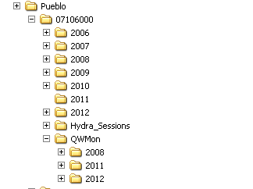
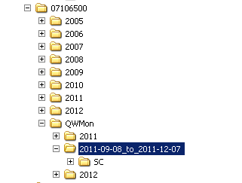
File Output
File output goes to same area as swreview (by default…) in a “QWMon”-named folder.
Water year retrievals go to a water year named subfolder with parameter folders under that
Period retrievals go to a date-to-date folder instead
http://water.usgs.gov/usgs/owq/wqmreview/
Notes:
Water-year retrievals are output into a QWMon/wateryear directory – other period retrievals are put into a QWMon/date_to_date directory. Water year handy for archival – period handy for continuous records work, especially periods crossing water year boundaries. Choice is yours… Functionality is a little different from swreview. Partly because this one isn’t automated and partly because it’s best to look at more than just the current period with discharge records to get a better idea about shift/rating trends, etc…

Slide 48
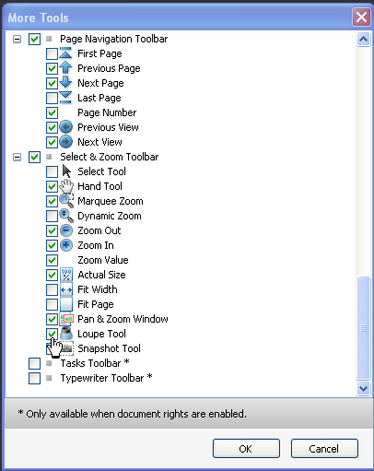
Tips and Tricks
Use Adobe Reader tools.
Default toolbar has very few of the total number of tools
Right –click anywhere on toolbar to bring up other available tools.
Loupe tool is exceptionally useful!
If viewing from SIMS/RMS links, disable view in browser option (disable pdf viewer software add-ons in your browser) to prevent output from being trapped in small window
http://water.usgs.gov/usgs/owq/wqmreview/
Notes:
The default tools in Adobe Reader that are likely showing in your toolbars are a very small subset of the total number of tools available. Right-click anywhere on the toolbar to bring up the list of available tools. Many of the Zoom tools can be extremely useful for records work so you can easily zoom in and navigate around plots with ease.

Slide 49
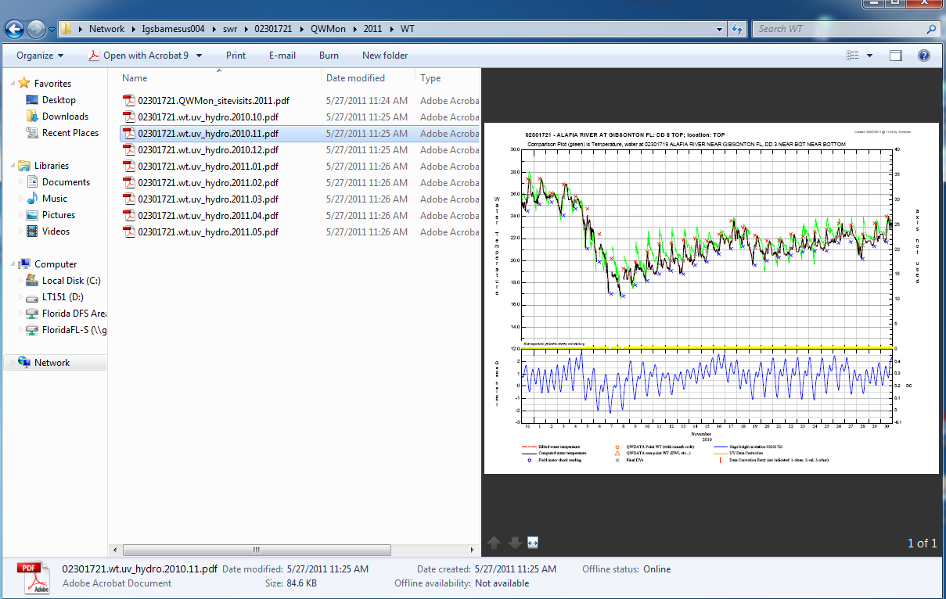
Tips and Tricks
Notes:
Note that Windows has a lot of display settings/customizations, etc… to help make it easier to find what you want to – previews, thumbnails, etc…

Slide 50
Tips and Tricks
Link to stations' Auto_Review output area available from SIMS webpages
Can increase file access speeds, but can't rename, edit, etc… pdf files
Great for remote records checking and reviewing
Can add other files to that area to assemble a complete electronic record packet available from stations' SIMS/RMS pages
Contact GS-W_Help_SIMS@usgs.gov to enable this feature on your SIMS pages (area must be setup on local webserver…)
http://water.usgs.gov/usgs/owq/wqmreview/

Slide 51
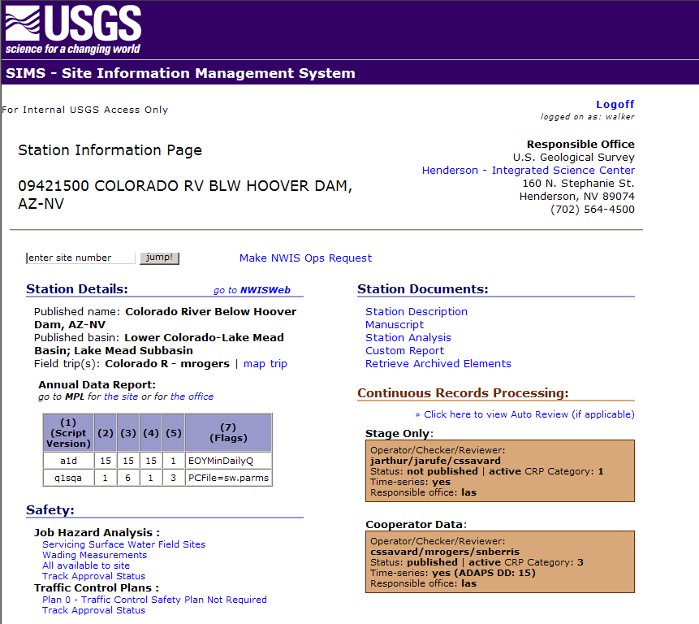

Slide 52
Desired Enhancements of WQMReview
Addition of Chlorophyll as a Data Descriptor for processing
Addition of several “generic” Data Descriptors for any parameter
Ability to have a second reference curve on the top plot
Daily value plots of the WY (like Monplot)
Max, Min, Median/Mean
Ability to run automatically (like SWReview)
Would include “batch” and command-line processing ability…
http://water.usgs.gov/usgs/owq/wqmreview/

Slide 53
Desired Enhancements of Auto_Review
“Metreview” for meteorological Data Descriptors
“Wqreview” for WQ-sampling records
Enhanced support for Index Velocity Discharge records in swreview.
New Time-Series software may incorporate current functionality before much of this gets done…
Wqmreview developed with this in mind as a stop-gap until we see what happens…
http://water.usgs.gov/usgs/owq/wqmreview/

Slide 54
Enhancement Suggestions, Problem Reports, or General Support
Contact the OSW scripts personnel @ GS-W OSW Scripts@usgs.gov
Or just shoot Wade Walker an email, IM, or call
walker@usgs.gov, 719-544-7155 x125
http://water.usgs.gov/usgs/owq/wqmreview/

Slide 55
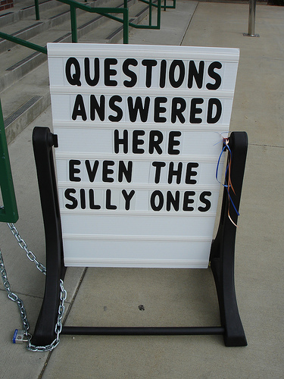
Questions?

