Slide 1
Welcome to the Continuous Water-Quality Tools webinar
Please mute your phone
Use the chat window for questions
We will get started shortly…

Slide 2
Continuous water-quality tools, 2013
Automated correction loader (ACL) Data-quality rating program
WQ monitor review (wqm_review)
OWQ Webinar
November 7, 2013

Slide 3
More webinars
Training webinars:
November 7, 2013. 12 pm Eastern
November 14, 2013. 2 pm Eastern
Question and answer webinars:
November 21, 2013, 3 pm Eastern
December 12, 2013, 12 pm Eastern

Slide 4
New WQ record tools
ACL
Corrections computed and loaded to ADAPS
http://water.usgs.gov/usgs/owq/acl/
Data-quality rating program
compute and assign categories of data quality
http://water.usgs.gov/usgs/owq/dqrating/
Wqm_review
Automates the production of record packets
http://water.usgs.gov/usgs/owq/wqmreview/

Slide 5
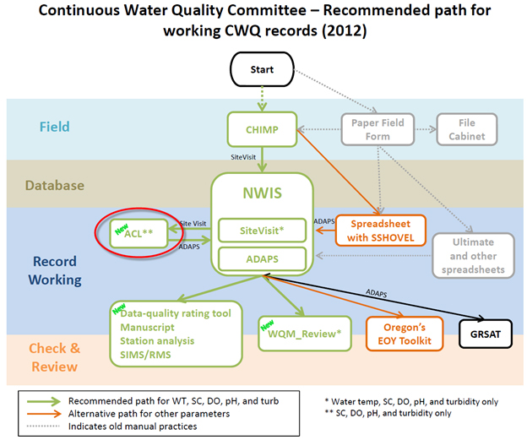
http://water.usgs.gov/usgs/owq/acl/

Slide 6
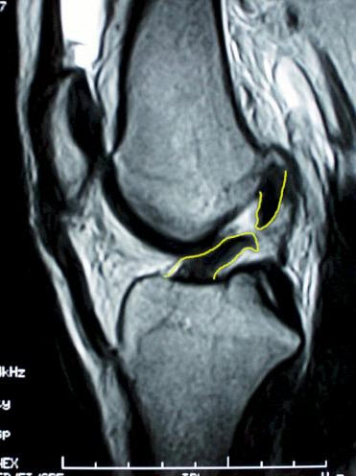
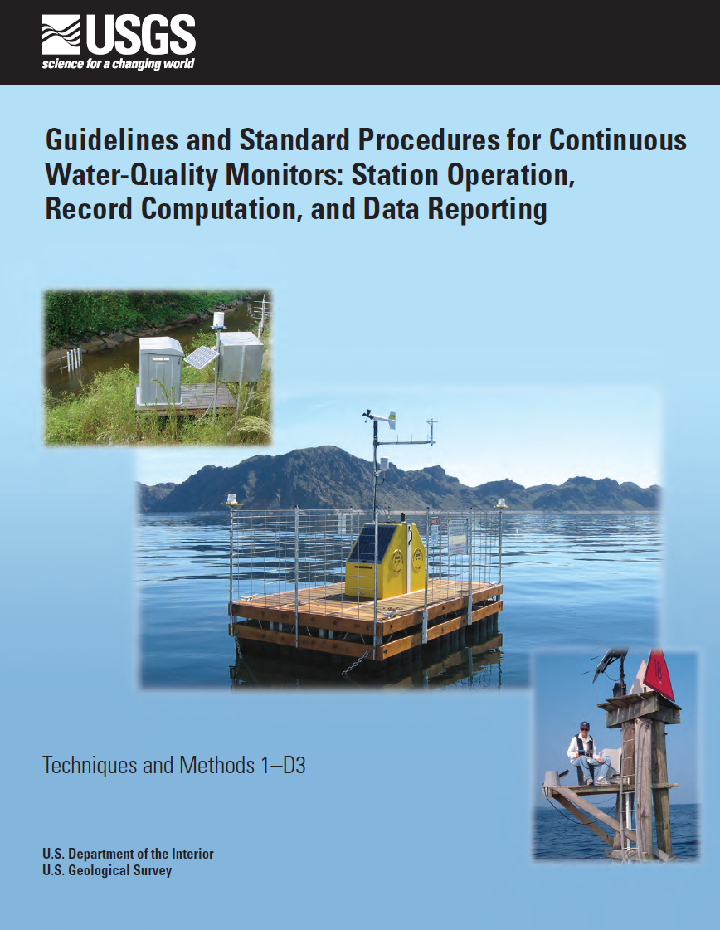
What is ACL?
A program that automatically computes fouling and drift corrections and loads them to ADAPS
Correction computations and thresholds are based on TM1D3 and the ultimate spreadsheet
http://water.usgs.gov/usgs/owq/acl/

Slide 7
Why ACL was developed
CHIMP computes, but doesn’t load DCs
Spreadsheets are a bit cumbersome
Data correction (DC) entry is archaic and clumsy in ADAPS
DCs are easily computed by the computer – most of the time
Oregon already made a script to load DCs
http://water.usgs.gov/usgs/owq/acl/

Slide 8
ACL Background
The idea has been around awhile…
Continuous water-quality committee recommended OWQ fund it in 2011
Input from Kevin Grimsley, Wade Walker, Burl Goree, and Stewart Rounds
Eric Kerner and Steve Brady developed the software
http://water.usgs.gov/usgs/owq/acl/

Slide 9
ACL Benefits
Saves record working time
Is the beginning of automating WQ record work
Starting point for a more comprehensive data correction algorithm
Runs automatically in the background, very little maintenance
Free!
http://water.usgs.gov/usgs/owq/acl/

Slide 10
Getting started
SA installs the RPM package (manual included)
WSC should select a single administrator to maintain the configuration files
Stations can be turned on/off
Declare DDs and correction setup
Included crontab file runs ACL every 15 min
Script will build a file of sites and WQ DDs
User’s manual and FAQs available
http://water.usgs.gov/usgs/owq/acl/

Slide 11
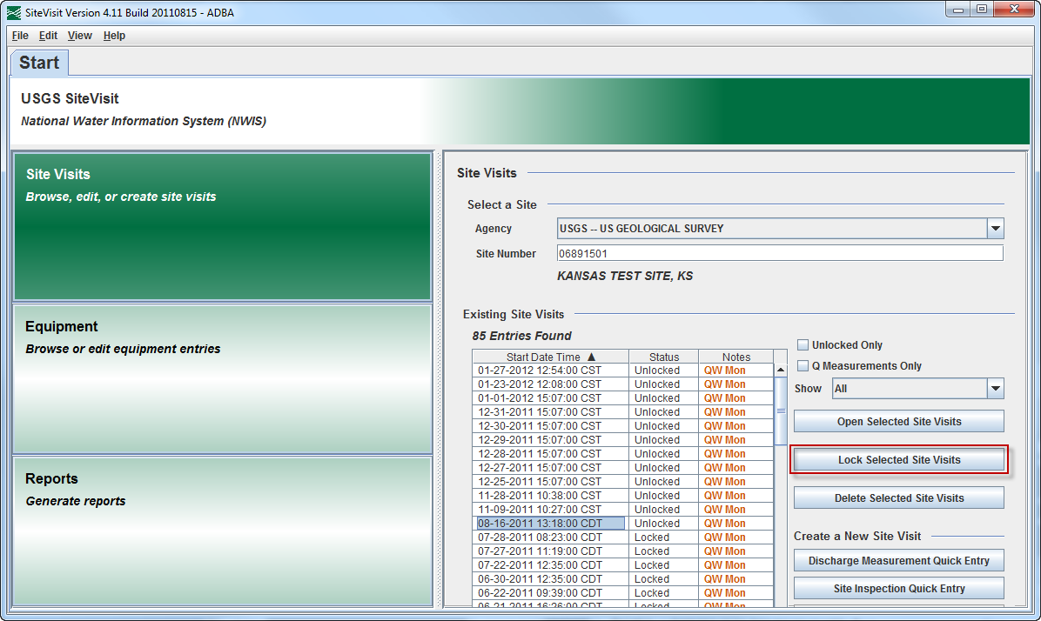
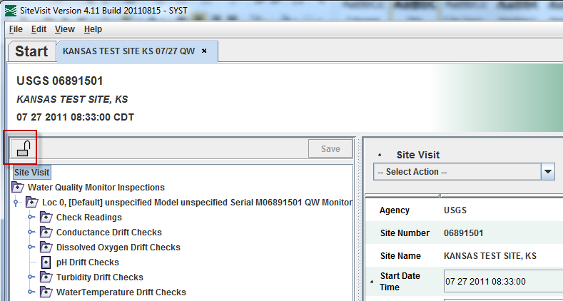
ACL workflow
ACL only processes site visits that have been locked in the last 15 minutes
http://water.usgs.gov/usgs/owq/acl/

Slide 12
ACL workflow
ACL only processes site visits that have been locked in the last 15 minutes

Slide 13
ACL workflow
ACL retrieves “before” and “after” cleaning readings from SiteVisit
ACL retrieves recalibration reading from SiteVisit
If recalibration was done, ACL will compute a DRIFT DC
If no recalibration, ACL uses the sum of the absolute values of the errors to determine if DCs are applied
http://water.usgs.gov/usgs/owq/acl/

Slide 14
ACL workflow
ACL determines if the error exceeds the correction criteria
|E_{f}| + |E_{d}| > data-correction criteria?
TM1D3 – criteria are table 10, Wagner et al, 2006
User – criteria defined in dd-config
None – criteria is zero, no DC applied
All – no criteria, all DCs applied
If “yes,” then check maximum allowable limits
http://water.usgs.gov/usgs/owq/acl/

Slide 15
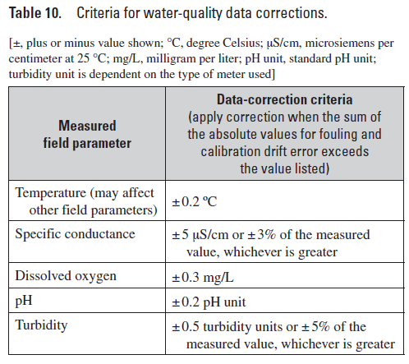
ACL workflow
http://water.usgs.gov/usgs/owq/acl/

Slide 16
ACL workflow
ACL determines if the error exceeds the correction criteria
|E_{f}| + |E_{d}| < 2 X maximum allowable limits?
Maximum allowable limits are listed in table 17, Wagner et al, 2006
The user cannot change these limits
If “yes,” then fouling and drift DCs are computed and queued for entry to ADAPS
http://water.usgs.gov/usgs/owq/acl/

Slide 17
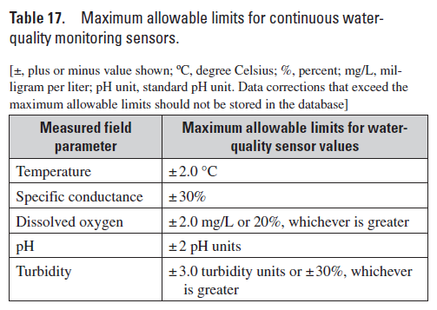
ACL workflow
http://water.usgs.gov/usgs/owq/acl/

Slide 18
ACL workflow
ACL will not overwrite or insert DCs
DCs will be prorated to previous DC
ACL loaded DCs to ADAPS have “Create User” and “Modify User” set to “aclmon”
http://water.usgs.gov/usgs/owq/acl/

Slide 19
ACL workflow
Primary flag in the dd-config
If set to “yes” – primary processes for the start of the WY to the newest DC date/time
If “no” – user must manually initiate primary
http://water.usgs.gov/usgs/owq/acl/

Slide 20
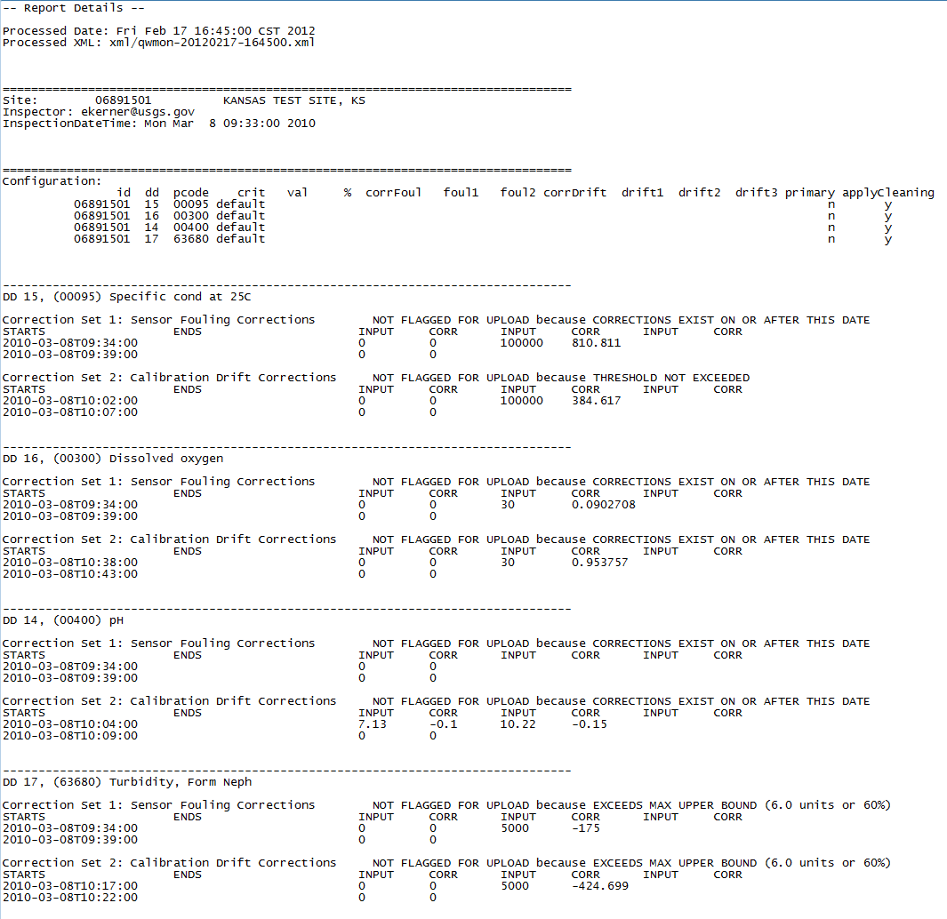
ACL workflow
Report emailed to the user that locked the site visit
Can add email recipients to site-config file
http://water.usgs.gov/usgs/owq/acl/

Slide 21
ACL workflow
Hydrographer must evaluate DCs
Hydra
Spreadsheet
GRSAT
Enter relevant DC “remarks” in ADAPS or GRSAT
When DCs are modified in ADAPS or GRSAT, “Modify User” is set to the hydrographer’s userid
Recommend always making a “remark” to update “Modify User”
http://water.usgs.gov/usgs/owq/acl/

Slide 22
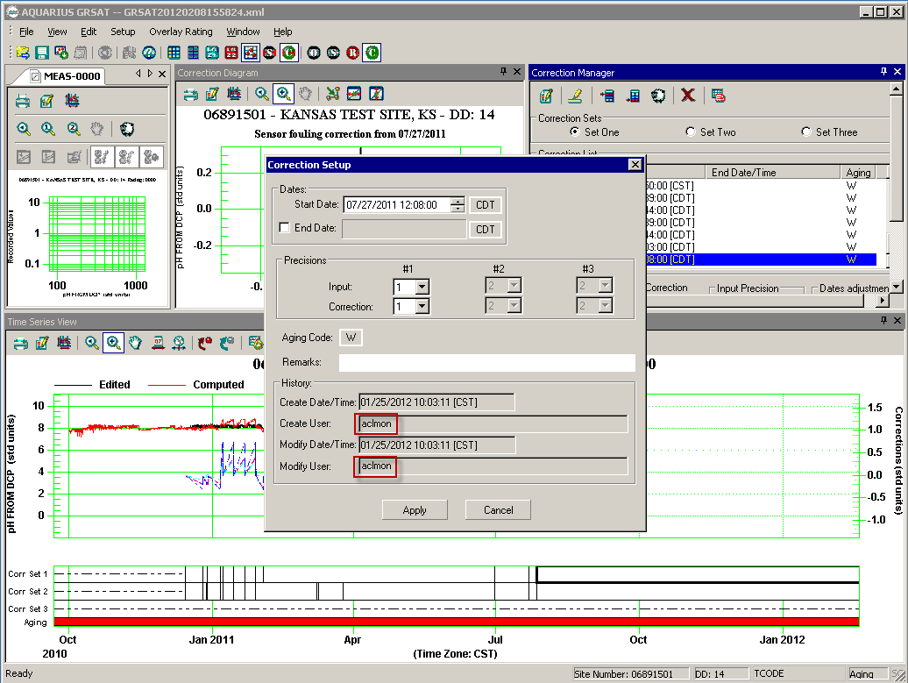
ACL workflow
http://water.usgs.gov/usgs/owq/acl/

Slide 23
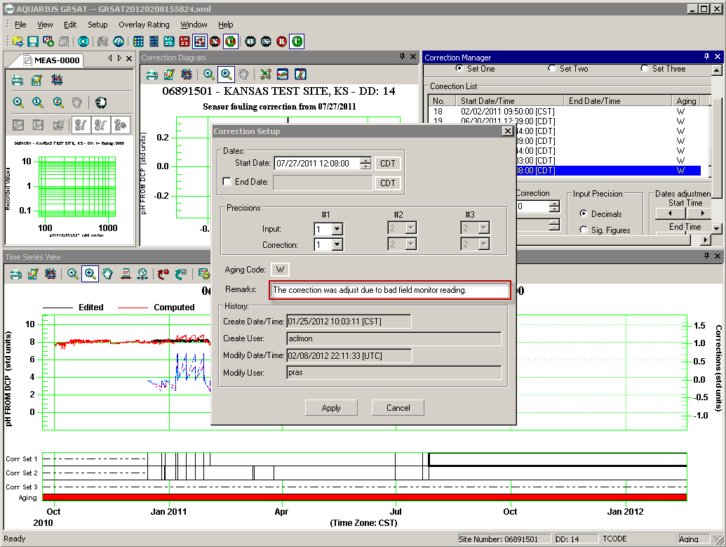
ACL workflow
http://water.usgs.gov/usgs/owq/acl/

Slide 24
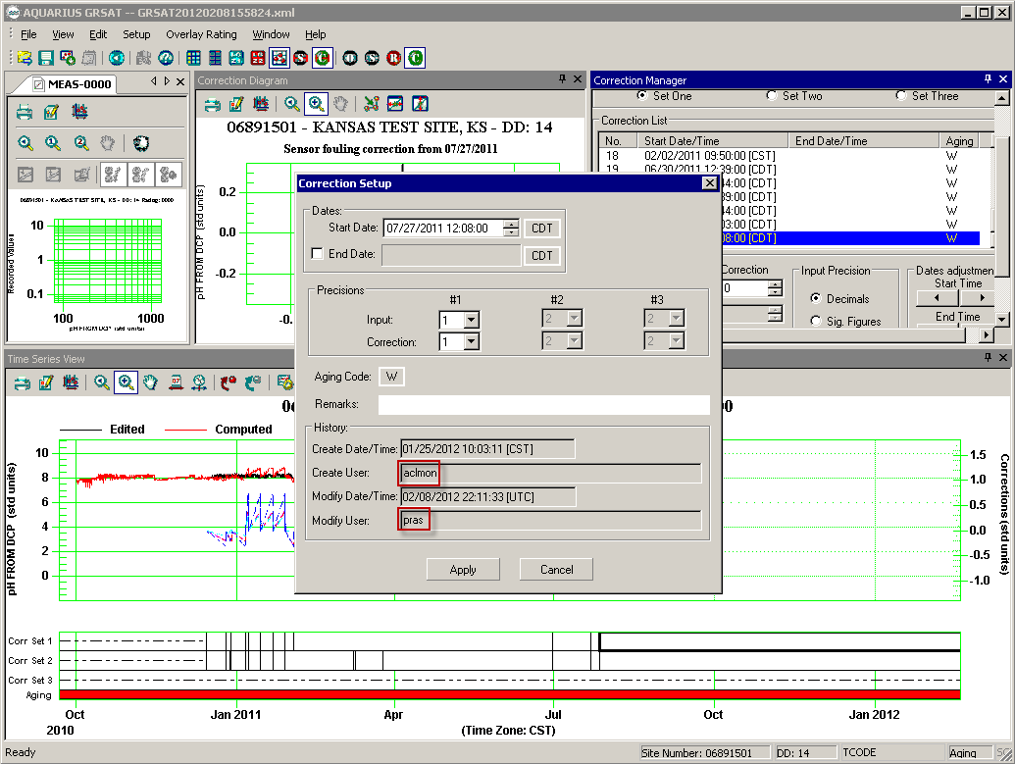
ACL workflow
http://water.usgs.gov/usgs/owq/acl/

Slide 25
ACL configuration files
File | Description
main-config | Main configuration of the entire program. Handles attributes such as the name of the NWIS database containing unit values and the name of the machine running that database.
site-config | Configure email notification lists for stations.
exclude-config | Stations listed in this file will not be processed. This file takes precedence over dd-config.
dd-config | Configure thresholds and correction types and inputs based on station, dd, and pcode
http://water.usgs.gov/usgs/owq/acl/

Slide 26
ACL – dd-config
station | dd | param code | criteria (user, TM1D3, none, all) | user value | user percent | fouling corr type (point, percent) | fouling user input 1 | fouling user input 2 | drift corr type (point, percent) | drift user input 1 | drift user input 2 | drift user input 3 | run primary (y,n) | apply cleaning (y,n)
06891501 | 14 | 00400 | TM1D3 |  |  | point | 0 |  | point | 4 | 7 | 10 | y | y
06891501 | 15 | 00095 | user | 5 | 3 | percent | 0 | 100000 | percent | 0 | 30000 |  | y | y
06891501 | 16 | 00300 |  |  |  | percent | 0 | 30 | percent | 0 | 30 |  | y | y
06891501 | 17 | 63680 | user | 0.5 | 5 | percent | 0 | 5000 | percent | 0 | 5000 |  | y | n
http://water.usgs.gov/usgs/owq/acl/

Slide 27
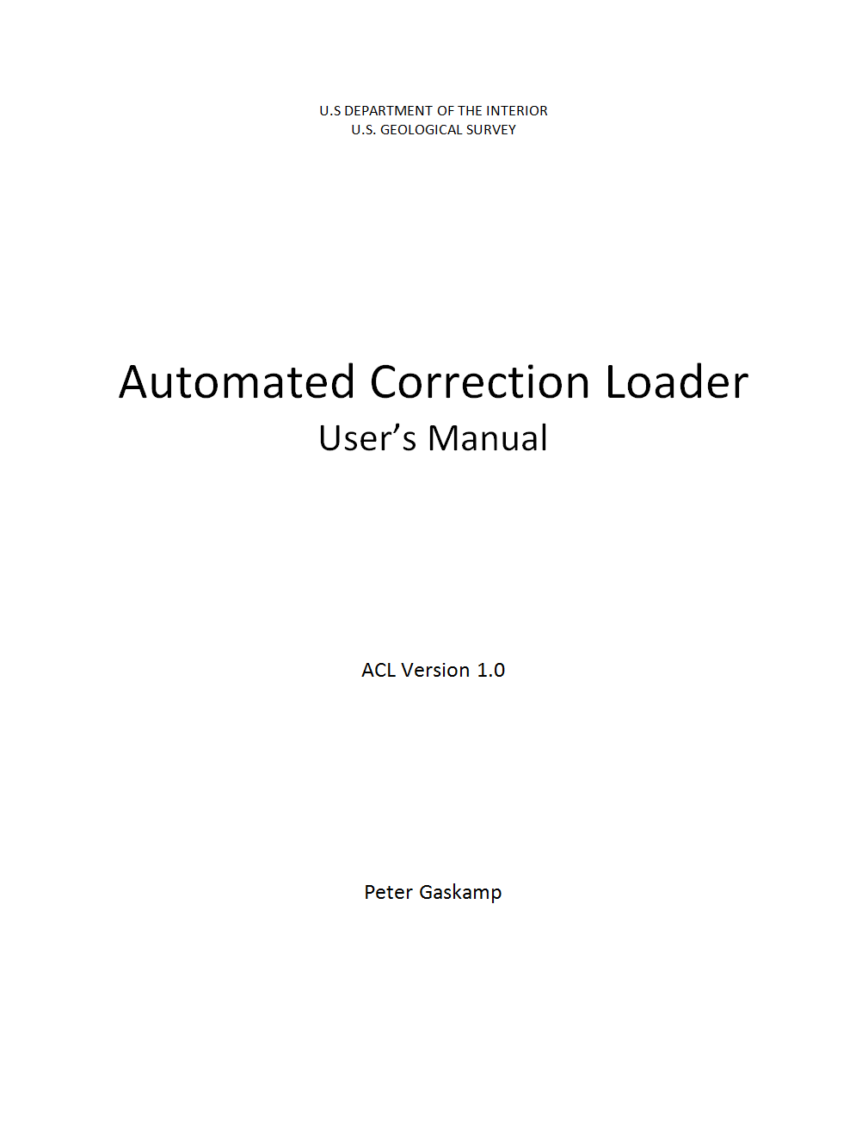
ACL at Redmine
Login with AD password
Issues
Review old issues
Submit new issues
Wiki
User’s Manual
FAQ
http://water.usgs.gov/usgs/owq/acl/

Slide 28
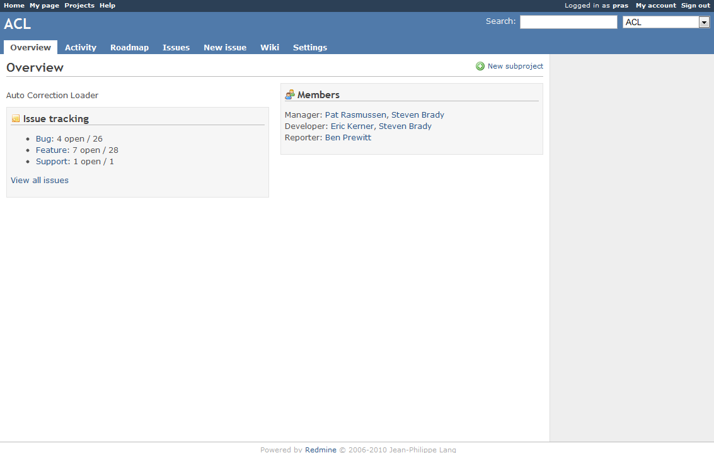
ACL at Redmine
http://water.usgs.gov/usgs/owq/acl/

Slide 29
ACL Limitations
Data must be in SiteVisit
Cannot insert or overwrite data corrections, only append
Does not process WT corrections
Is not interactive with user
Does not evaluate time-series data
http://water.usgs.gov/usgs/owq/acl/

Slide 30
Future of ACL
Superseded by functionality in AQUARIUS…
Supported until then
Help with installation
User manual
No new development
http://water.usgs.gov/usgs/owq/acl/

Slide 31
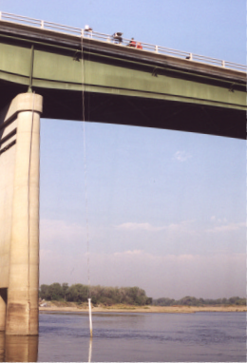
Questions?
Patrick Rasmussen
USGS, Kansas
pras@usgs.gov
785-832-3542
http://water.usgs.gov/usgs/owq/acl/

