Slide 1
Improving Regional Skew Estimation with Bayesian-GLS
Andrea G. Veilleux
Office of Surface Water
Chuck Parrett
California Water Science Center
September 26, 2011

Slide 2

Bulletin 17B: log-Pearson Type III (LP3)
LP3 distribution; 3 parameters estimated as:
Mean, μ
$μ_{x}=E\left[X\right]$, where $X=log\left(Q\right)$
Standard Deviation, σ
$σ_{x}^{2}=E\left[{\left(X−μ_{x}\right)}^{2}\right]$
Skew, γ
$γ_{x}=\frac{E\left[{\left(X−μ_{x}\right)}^{3}\right]}{σ_{x}^{3}}$

Slide 3

Bulletin 17B: Fitting LP3 Distribution
$$log\left(Q_{T}\right)=\overline{X}+S∗K_{T}\left(G\right)$$
where
$\overline{X}$ = mean
S = standard deviation
$K_{T}\left(G\right)$ = function of skew coefficient and selected exceedance probability
$Q_{T}$ = flow with the specified exceedance probability

Slide 4
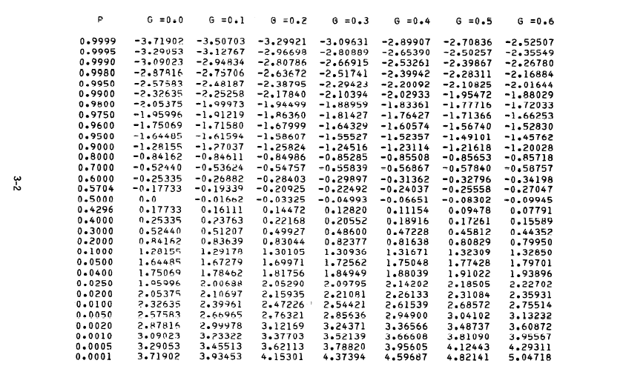
Bulletin 17B: Table of K Values
Notes:
Developed from Hardison’s skew map
Based on: 2,972 gauging stations, Drainage areas ≤ 3,000 mi^{2,} Record lengths ≥ 25 yrs
Reports generalized logarithmic skew coefficients of annual peak discharge, One degree quadrangles
Isolines describe patterns in skew coefficients

Slide 5
Weighted Skew, G_{s}
Bulletin 17B recommends weighting:
sample skew G_{s} with generalized (regional) skew G_{g}
Mean Square Error: MSE = Variance + Bias²
5

Slide 6
Bulletin 17B Skew Map
Notes:
Developed from Hardison’s skew map
Based on: 2,972 gauging stations, Drainage areas ≤ 3,000 mi^{2,} Record lengths ≥ 25 yrs
Reports generalized logarithmic skew coefficients of annual peak discharge, One degree quadrangles
Isolines describe patterns in skew coefficients

Slide 7
Overview of Bulletin 17B Skew Map
Precision of Bulletin 17 map:
Reported Std. Error (SE) = 0.55
Reported MSE[G_{g}]=0.302 = (0.55)²
Implies Effective Record Length (ERL)= 17 yrs
Concerns with Bulletin 17 map:
  Omits 35 yrs of data
  Misrepresents precision
  Did not account for low outliers or historic info
Notes:
Skew map provides information for regional/generalized skew
Update is possible due to Advances in computing power and spatial statistical methods
If you believe this mse error this implies ERL we think it is much more
Inefficient estimator did not account for cross correlation
Want skew for lp-3 after get rid of outliers
Determines shape of the density function, Greater variability than mean and std dev, sensitive to extreme events

Slide 8
Overview of Methodology
Basic Model
  Where:
  γ_{i} = skew
  β_{i} = regression parameters
  X_{i} = basin characteristics (i.e. area, slope, precip, etc)
  δ_{i} = underlying basic model error (true lack of fit)
Complication:
  We do not know the true value of, γ
  Need to generate estimate,
  Time sampling error, η_{i}
  (these time sampling errors are also often cross-correlated)

Slide 9
Overview of Methodology (cont’d)
  Model for Skew
  Generalized Least Squares (GLS) Framework Observed error combines time sampling
  model error:

Slide 10
B-GLS vs GLS
Data:
Annual Peak Flows
Basin Characteristics
Prior Dist:
Model Error Var
Regression Param
Data:
Annual Peak Flows
Basin Characteristics
Prior Dist
Posterior Dist of:
Model Error Variance
Regression Parameters
Point Estimate of:
Model Error Variance
Regression Parameters
Mean
Mode
Credible interval
Uncertainty described by
assuming the parameters are
distributed Normal
Confidence interval
Notes:
When model error is small compared to sampling error, can distort the uncertainty attributed to regional estimtator
When MEV is small (as it in the case of regional skew) MM-GLS and MLE-GLS may yield MEV =0, implying model is perfect.
causing:overestimation of precision = underestimation of uncertainty in flood quantile = too much weight on regional model over at-site info
Bayesian solves this issue because 1) it provides full posterior dist on parameters and MEV
2) describes in a more reasonable fashion possible values of model error when MLE=0
MLE is better because it is unbiased as opposed to MM (Bayesian uses MLES)
Bayesian framework does not require the normality assumption to evaluate uncertainties because it provides estimate of entire distribution

Slide 11
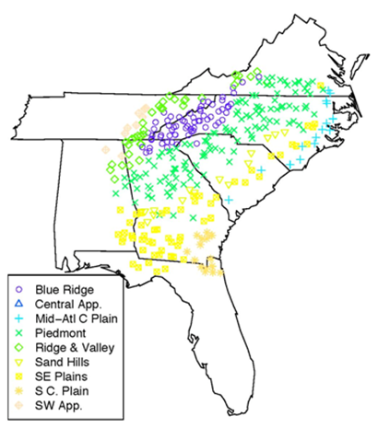
Regional Skew Examples Using B-GLS
Southeastern U.S.:
7 states, 342 sites
California:
1 state, 158 sites
Courtesy of Tim Cohn, USGS
Courtesy of Chuck Parrett, USGS

Slide 12
Regional Skew Examples Using B-GLS

Slide 13
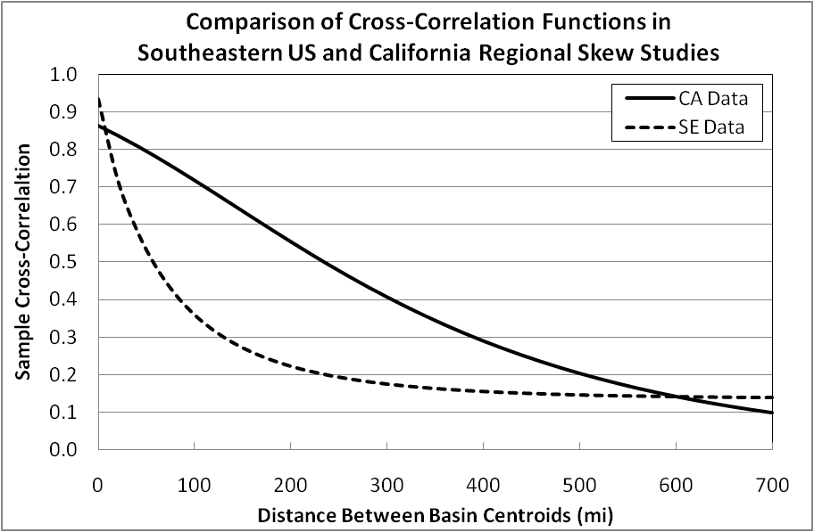
Cross-Correlation Models

Slide 14
Bulletin 17B Skew Map: Southeast U.S.
0.7
0.5
0.3
0.0
-0.1
Notes:
Developed from Hardison’s skew map
Based on: 2,972 gauging stations, Drainage areas ≤ 3,000 mi^{2,} Record lengths ≥ 25 yrs
Reports generalized logarithmic skew coefficients of annual peak discharge, One degree quadrangles
Isolines describe patterns in skew coefficients

Slide 15
Southeast U.S. Regional Skew Model

Slide 16
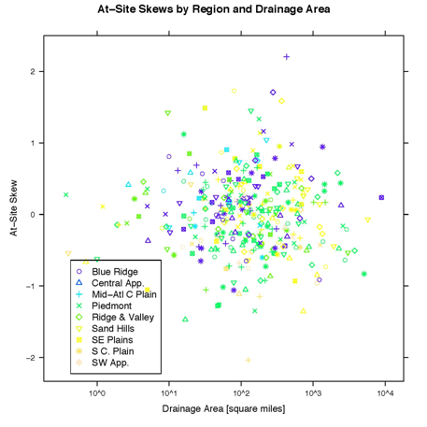
Southeast U.S. Regional Skew Model
Courtesy of Tim Cohn, USGS

Slide 17
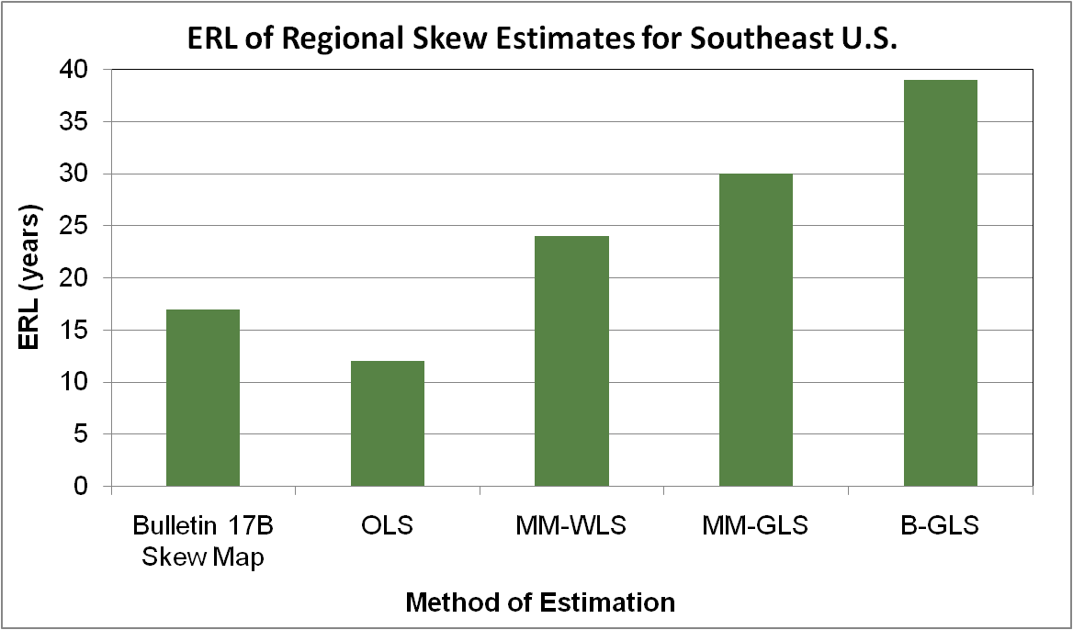
Comparison of Methods

Slide 18
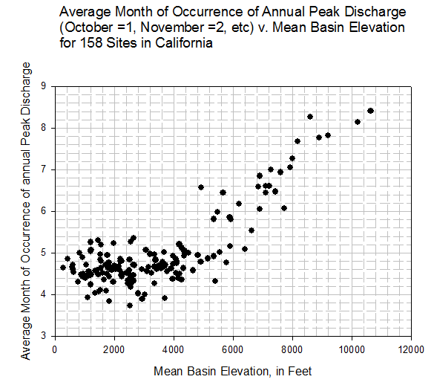
California Regional Skew Study
Spring Snow Melt
May
April
Mar
Winter Rain Storms
Feb
Jan
Lower Elev
Higher Elev
Courtesy of Chuck Parrett, USGS

Slide 19
California Regional Skew Study

Slide 20
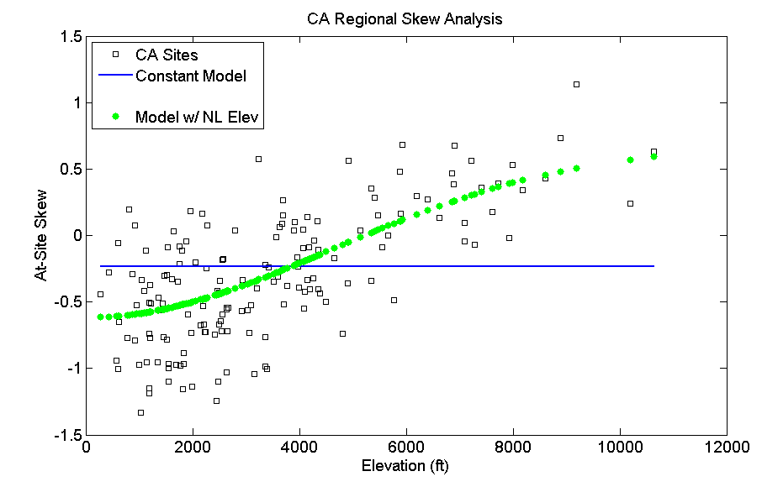
California Regional Skew Study

Slide 21
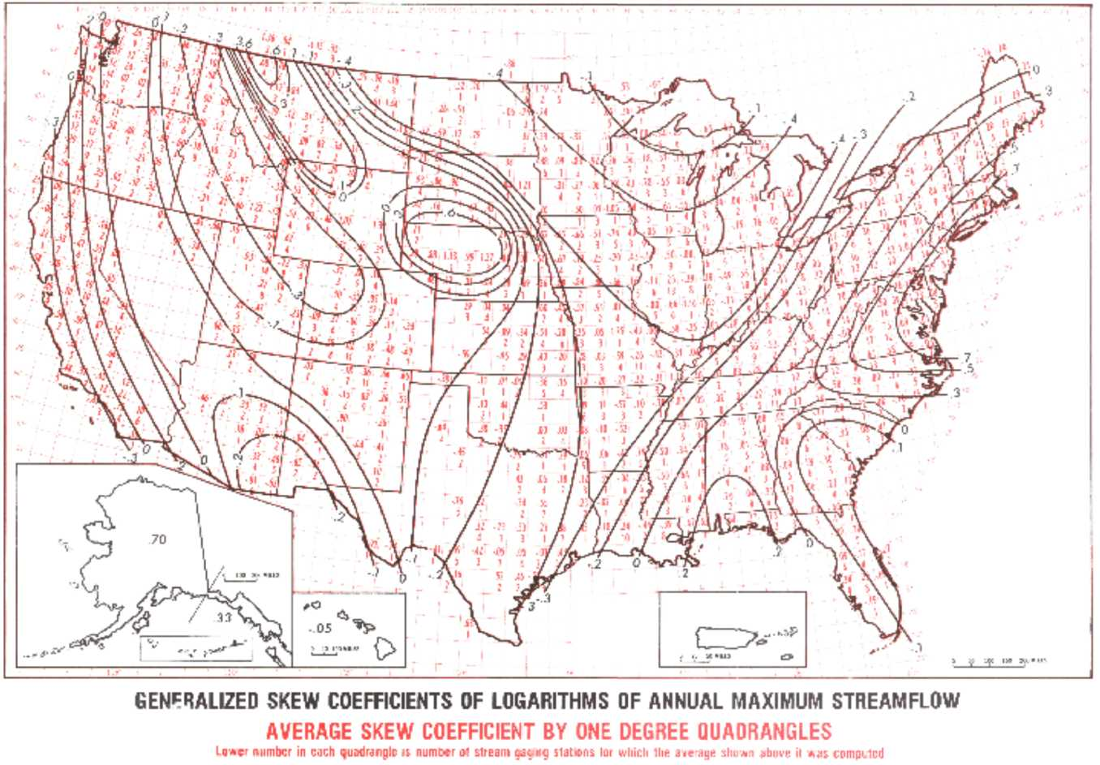
What is the Practical Effect of a New (and Improved!) Regional Skew in California?
Less variability
In Bulletin 17B
Map
Less Weight
Given To
Bulletin 17B
Skew (EYR = 17)
+0.2
-0.2

Slide 22
Expected Differences in Flood Frequency Resulting From Regional Skew Differences
Q _{1%} larger for
higher elevations
and shorter
record length
Q _{1%} smaller for
lower elevations
and shorter
record length

Slide 23
Some Real Examples
Very low elevation
AND very short
record

Slide 24
Some Real Examples
Very high elevation
AND relatively short
record

Slide 25
Some Real Examples
Moderately high
elevation AND
relatively short
record

Slide 26
Some Real Examples
Moderately low
elevation AND
very short
record

Slide 27
Conclusions
B-GLS methodology provides a stable and reliable framework for estimating regional skew with greater precision than Bulletin 17B skew map
Applied BGLS methodology to two demonstration regions in the United States: 1) Southeast 2) California

Slide 28
Conclusions
Lessons Learned
  Data Related Issues
    Low outliers/zero flows/censored flows (need EMA)
    Redundant Sites (i.e. two gages measuring essentially the same flows)
  Regression Parameters
    Not identical in all areas of country

Slide 29
Next Steps in Regional Skew Studies
Update Regional Skew for the Nation
  Hydrologic pursuit not a state-by-state pursuit
  Develop hydrologic regions that contain multiple neighboring states
  Expect that after one version is completed it will be updated throughout time
Current Plan:
  Complete ongoing regional skew study for Iowa
  Potential next study area: Missouri River Basin
  Prioritize other hydrologic regions

Slide 30
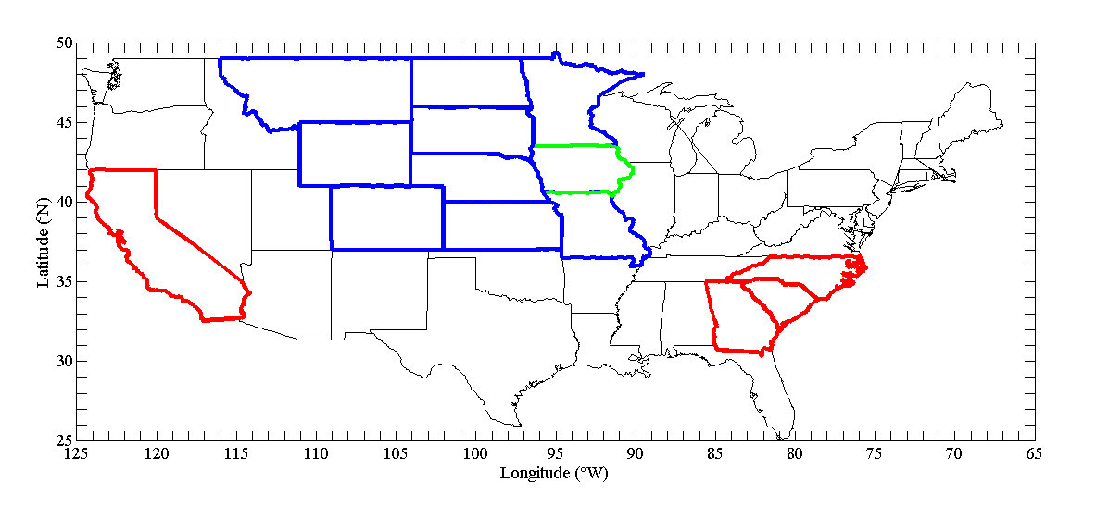
Regional Skew Studies
Missouri
River Basin
IA
CA
AZ Pilot Study
Southeast
Completed Studies
Study in Progress
Potential Next Study

Slide 31
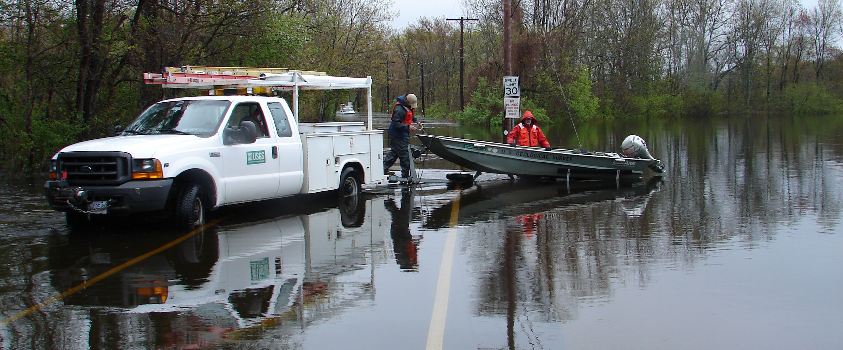
Questions?
Notes:
Ipswich River near Ipswich, MA, May 16, 2006
photo by Joe Zanca, USGS.

Slide 32
Resources
Southeastern US. Skew Study (Appendix B of)
  Gotvald, A.J., Feaster, T.D., and Weaver, J.C., 2009, Magnitude and frequency of rural floods in the southeastern United States, 2006—Volume 1, Georgia: U.S. Geological Survey Scientific Investigations Report 2009–5043, 120 p. (http://pubs.usgs.gov/sir/2009/5043/)
  Weaver, J.C., Feaster, T.D., and Gotvald, A.J., 2009, Magnitude and frequency of rural floods in the Southeastern United States, through 2006—Volume 2, North Carolina: U.S. Geological Survey Scientific Investigations Report 2009–5158, 111 p. (http://pubs.usgs.gov/sir/2009/5158/)
  Feaster, T.D., Gotvald, A.J., and Weaver, J.C., 2009, Magnitude and frequency of rural floods in the Southeastern United States, 2006—Volume 3, South Carolina: U.S. Geological Survey Scientific Investigations Report 2009–5156, 226 p. (http://pubs.usgs.gov/sir/2009/5156/)
California Skew Study:
      Parrett, C., Veilleux, A., Stedinger, J.R., Barth, N.A., Knifong, D.L., and Ferris, J.C., 2011, Regional skew for California, and flood frequency for selected sites in the Sacramento–San Joaquin River Basin, based on data through water year 2006: U.S. Geological Survey Scientific Investigations Report 2010–5260, 94 p. (http://pubs.usgs.gov/sir/2010/5260/)
California Duration Skew Study:

Slide 33
Resources
Conference Proceedings
  Gruber [Veilleux], A.M., Reis, D.S., Jr., and Stedinger, J.R., 2007, Models of regional skew based on Bayesian GLS regression, Paper 40927-3285, in Kabbes, K.C., ed., World Environmental and Water Resources Congress 2007 - Restoring our Natural Habitat, American Society of Civil Engineers, Tampa, Florida, May 15–19, 2007.
  Gruber [Veilleux], A.M., and Stedinger, J.R., 2008, Models of LP3 regional skew, data selection, and Bayesian GLS regression, Paper 596, in Babcock, R., and Walton, R., eds., World Environmental & Water Resources Congress 2008 - Ahupua‘a, American Society of Civil Engineers, Honolulu, Hawaii, May 12–16, 2008.
  Veilleux, A.G., and J.R. Stedinger. Bayesian GLS Analysis of California Regional Skew: World Environmental & Water Resources Congress 2010: Challenges of Change, Providence, Rhode Island, paper 81213, Amer. Soc. Of Civil Engineers May 16-20, 2010.
  Veilleux, A.G., J.R. Stedinger, and J.R. Lamontagne, Bayesian WLS/GLS Regression for Regional Skewness Analysis for Regiona with Large Cross Correlations among Flood Flows: World Environmental & Water Resources Congress 2011: Bearing Knowledge for Sustainability, Palm Springs, California, paper 41173, Amer. Soc. Of. Engineers, May 22-26, 2011.

Slide 34
Data/Steps for Regional Skew Studies
Select Gages to be Included:
  GAGES II database
  Non regulated/altered sites/peak flows
  CSG: include datum corrections and lower bounds
  Min record length
  Representative of regions/hydrology where regional flood model will be employed
Peak Flow Files for each site
  Also, summary spreadsheet containing
    Station number
    Ending date of peak flows
    Date peak flow files was downloaded from NWIS

Slide 35
Data/Steps for Regional Skew Studies
Run EMA with Multiple Grubbs Beck censoring
Basin Characteristics
  Lat/Lon of gage and basin centroid
  Drainage area
  Other common: slope, elevation, length, precip …
Bayesian GLS Regional Skew Analysis
  Screen for redundant site pairs
  Develop cross-correlation model
  Develop regional skew model

Slide 36
Regression Framework
Problems with B-GLS Regression
  Assumes cross-correlations are exactly correct
  Cross-correlation models describe overall structure

Slide 37
Regression Framework
Solution: B-WLS/B-GLS Regression
  Thus, use B-WLS (special case of GLS which ignores cross-correlation) to develop estimates of regression parameters, β.
  Then use B-GLS analysis to determine the precision of: 1) regression parameters, β
  2) the model

Slide 38
B-WLS/B-GLS Regression Framework

