Slide 1
Low Outliers and the Multiple Grubbs-Beck Test
Tim Cohn
29 August 2011

Slide 2
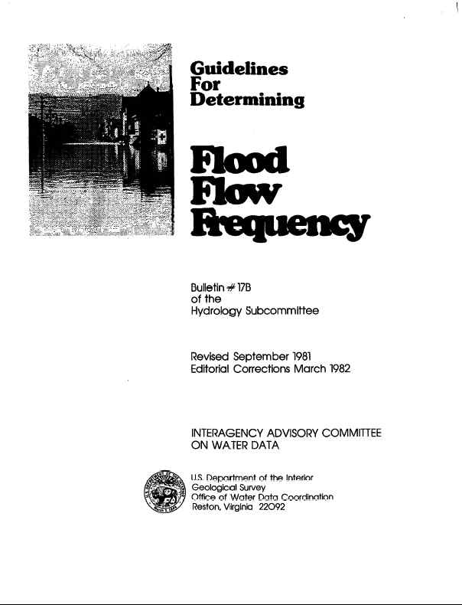
Bulletin 17B

Slide 3
Outliers
What they are
Why they matter
What we can do about them

Slide 4
Bulletin 17B Outlier Definition

Slide 5
Humid East
http://www.ecy.wa.gov/climatechange/reducedsnow_more.htm
Notes:
http://www.ecy.wa.gov/climatechange/reducedsnow_more.htm

Slide 6
Typical Data

Slide 7
…LP3 Usually Fits

Slide 8
Arid West
http://geofreekz.files.wordpress.com/2008/10/hydrologic_cycle.gif
Notes:
The Arid West
http://geofreekz.files.wordpress.com/2008/10/hydrologic_cycle.gif

Slide 9
…More Complicated

Slide 10
LP3 Cannot Capture Multiple Processes
Channel Losses
= Problems in Left-hand tail

Slide 11
Does Left-Hand Tail Matter?
Robustness of Method-of-Moments

Slide 12
Leverage and Influence
Observations with high leverage have potential to alter model results
Observations with high influence do alter model results

Slide 13
Quantifying Leverage When Conducting Flood Frequency Studies

Slide 22
What Can Be Done About It?
We now know that low outliers have very high leverage (is this bad?)
What can we do about it?
Identify influential low outliers
Take away their influence [!!??]

Slide 23
Identifying Low Outliers (B17B)
Define a critical threshold
Where K_{n} is function of sample size, n; μ and σ denote the sample mean and standard deviation
Values lower than X_{crit} are declared low outliers

Slide 24
An Example: Sacramento River at Shasta Dam (1932-2008)

Slide 25
How Many Low Outliers?

Slide 26
How Many Low Outliers?
Grubbs-Beck (B17B) identifies one (1) low outlier [??]
=> Grubbs-Beck (B17B) has problem
General: Grubbs-Beck test seldom identifies more than one low outlier even when multiple low outliers are obviously present

Slide 27
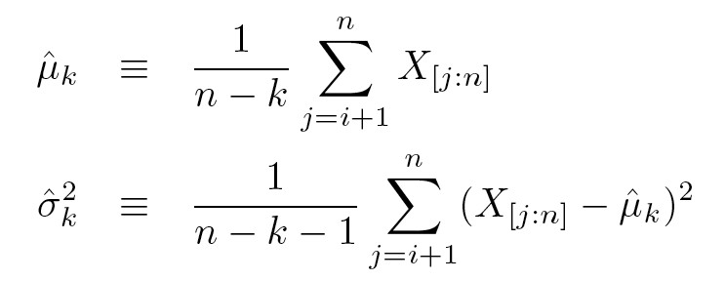
Generalizing the Grubbs-Beck Test

Slide 28
We Need to Compute a Probability

Slide 29
…some algebra…and…voila!

Slide 31
What Now?
If P[ω_{[k:n]} < η_{[k:n]}] < 0.01, then the smallest k observations are declared low outliers
If X_{[k:n]} is a low outlier and P[ω_{[k+1:n]}<η_{[k+1:n]}] < 0. 1, then X_{[k+1:n]} is also declared to be a low outlier, and k is incremented by one
Once process is complete, all k low outliers are recoded as interval observations: 0 < X_{[j:n]} < X_{[k+1:n]} j=1,k
~

Slide 32
Does MGB Work? (Type I error rates when H0 true)
α=50%
α=10%
α=1%

Slide 33
An Example: Sacramento River at Shasta Dam (1932-2008)

Slide 34
Sacramento River at Shasta Dam (1932-2008)

Slide 35
Orestimba Creek (1932-1973)

Slide 36
Orestimba Creek (1932-1973)

Slide 37
Orestimba Creek (1932-1973)

Slide 38
Orestimba Creek (1932-2009)

Slide 39
Orestimba Creek (1932-2009)

Slide 40
Orestimba Creek (1932-2009)

Slide 41
Is Orestimba Unique
?

Slide 42
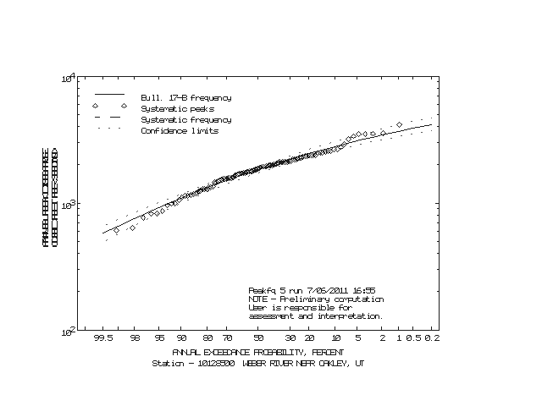
Comparison of GB/PEAKFQ and MGB/EMA Weber River (10128500)

Slide 43
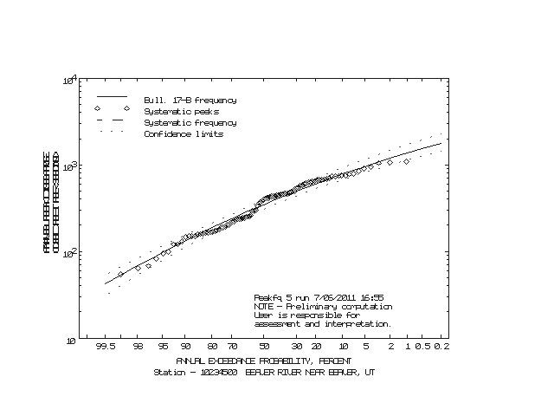
Comparison of GB/PEAKFQ and MGB/EMA Beaver River (10234500)

Slide 44
Conclusions
Multiple Grubbs-Beck test correctly identifies “low outliers” based on assumption that data are drawn from (log)normal population.
MGB can be applied when smallest observations are below gage-base discharge or censored for other reasons
MGB can be combined with either EMA or PEAKFQ to address low-outlier problems

Slide 45
Conclusions (Cont’d)
However: Hydrological judgment is still required when dealing with low outliers

Slide 46
Thank You!

Slide 47
Still Interested?

Slide 48
Questions?

Slide 49
Statistical Basis

