Slide 1
Electronic Continuous WQ Records Auto_Review - wqmreview

Slide 2
What is Auto_Review?
A consolidation of programs that automates the production of time-series record packages.
Started as a small collection of tkg2 utility scripts (vshiftplot, uv_hydro), which were combined and enhanced into swreview, and then other programs for other record types were added into an overall Auto_Review software package containing swreview, wqmreview, and gwreview (currently).
Originally collaboration between Wade Walker (CO), Joe Nielsen (OSW), Brian Loving (KS), Ed Fischer (IA/OWI) – with much of output based on other programs (Baseplot-Lamar Sanders, Shifplot-Wil Sadler, and others).

Slide 3
What is Auto_Review?
Assists with record checking and reviewing (and working…).
Provides a local electronic archive for multiple record types.
Released as an OSW_Script with funding for support and enhancements provided by whoever is willing (OSW, OWQ, OGW, WSC’s, coders volunteering for science, etc…).
Of original collaborators, Wade Walker is left as current primary developer/maintainer.

Slide 4
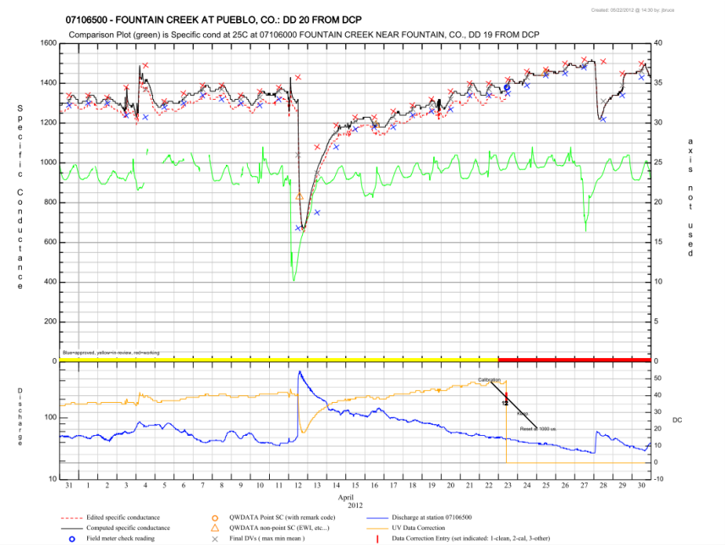
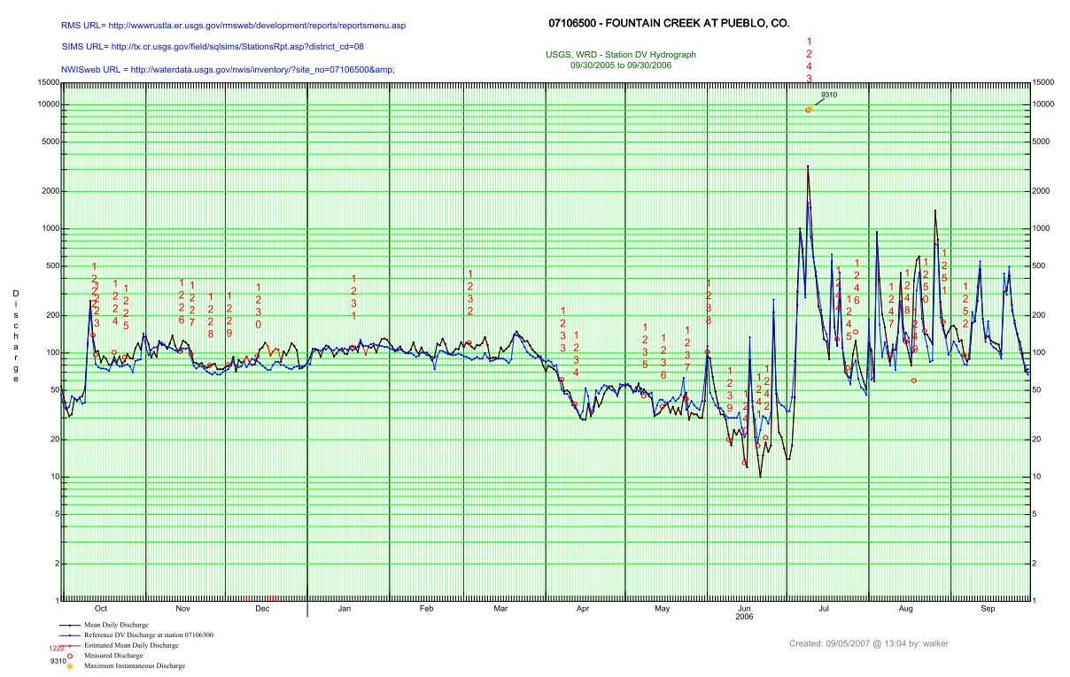
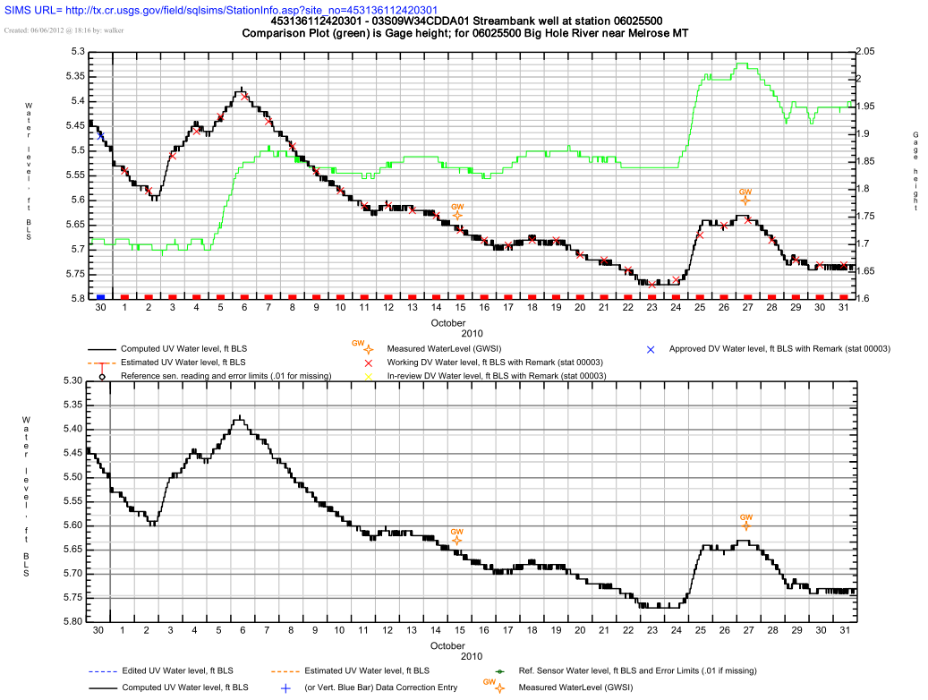
What is Auto_Review?
Tkg2 generated graphical plots combining data from ADAPS, SITEVISIT, GWSI, and QWDATA.

Slide 5
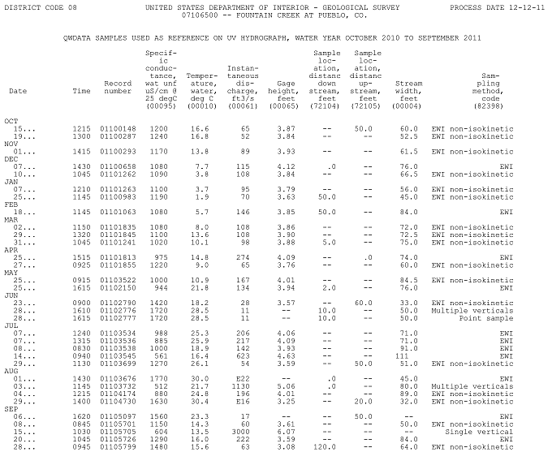
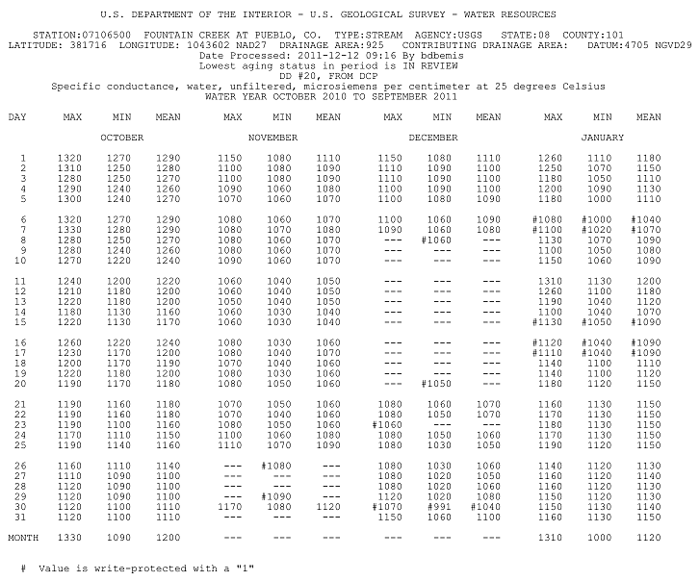
What is Auto_Review?
Commonly used ADAPS, QWDATA, and GWSI tables.
ADAPS Station Analysis, DV tables, EOY summary, Primary, UV inventory
Site Visit Reports
QWDATA publication-style tables
GWSI water level tables

Slide 6
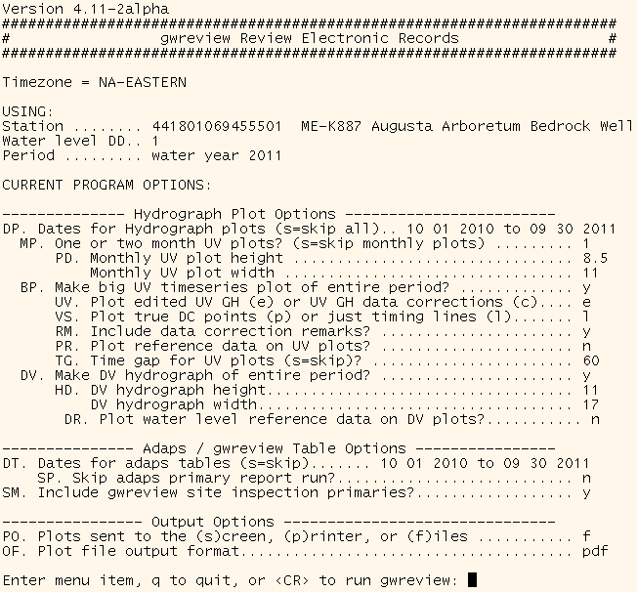
What is Auto_Review?
A (fairly) user-friendly menu for changing and saving settings at stations.

Slide 7
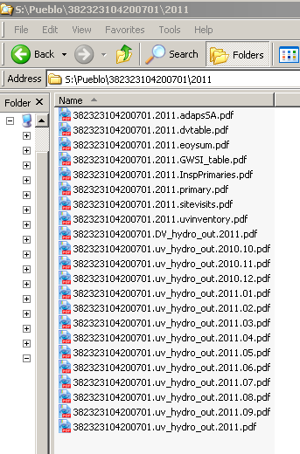
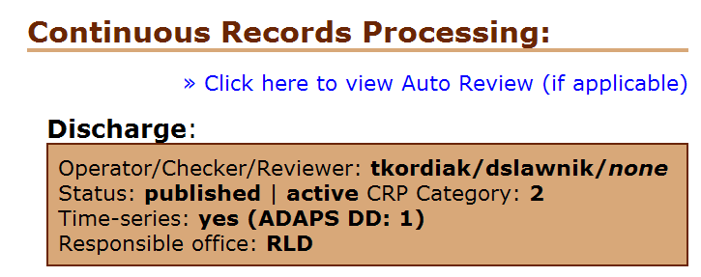
What is Auto_Review?
Final output of generated tables and plots are normally stored in a central record folder area in PDF format for electronic reference and archiving.
Default area is /SWR on NWIS servers, but WSC may place it elsewhere (ask if unsure…)
Can also be sent to the screen or straight to a printer, but not the preferred options…
Can be displayed from local WSC webserver, local websites can be developed, or links to output can be added from SIMS/RMS station pages.
Notes:
More on output options later….

Slide 8
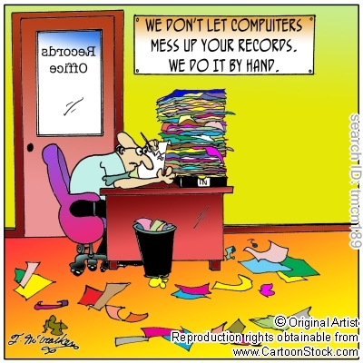
Electronic Records? Why?
Automatic Electronic Package
Ensures output being checked/reviewed is current (and complete) and helps keep record fully processed (as long as primary computations aren’t skipped…)
Helps reduce discrepancies between what’s in folder and what’s in database (which is what counts…)
Convenient, easy to access local archive
Helps enable inter-office/WSC work, check and review
Helps enable telework
Saves on paper, ink, printer wear and tear, and printer support

Slide 9
Electronic Records? Why?
Notes:
Which, yes, ties us to our computers just that much more, but is paper really any better? It should be worth it regardless…

Slide 10
History of Auto_Review and continuous WQ monitors
Not initially supported (only continuous discharge really supported for first 6 years of existence).
2nd newest addition to auto_review package (gwreview is newest – out soon…)
Initial script, QW_UV was created in response to the need for unit value plots from ADAPS with QWDATA field values displayed
The OWQ’s Continuous Water-Quality Committee recommended to rewrite this script to Auto_Review quality and add tabling
Auto_Review version containing wqmreview released Dec. 2011.

Slide 11
Ken Hyer, VA WSC – Chair
Jim Caldwell, ME WSC
Mark Gress, FL WSC
Kevin Grimsley, FL WSC, SWUG
Stewart Rounds, OR WSC
Callie Oblinger, OWQ representative
Tim Oden, TX WSC
Pat Rasmussen, KS WSC, SWUG
Kevin Richards, WI WSC
Rick Wagner, WA WSC

Slide 12
Five Parameters Available
Temperature
Specific Conductance
Dissolved Oxygen
pH
Turbidity
We know we need more…

Slide 13
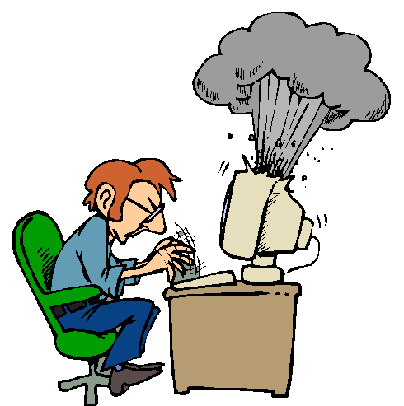
What can wqmreview do for you?
Title suggests it’s a “review script” but …
Useful for all Stages of record process!
Obviously a “Workup” or Worker tool, too.
For the Checker and Reviewer of course.
Can keep electronic records of the WY for an office or the state with ease in an easily accessible local electronic archive (or can repull them at anytime using the program as long as data still reside in database…).

Slide 14
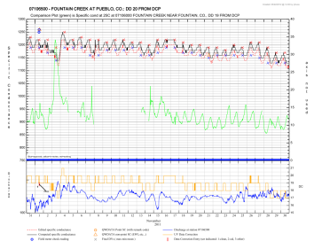
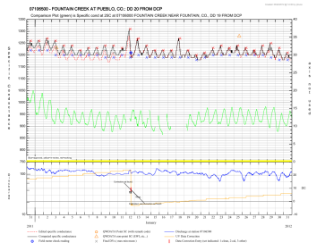
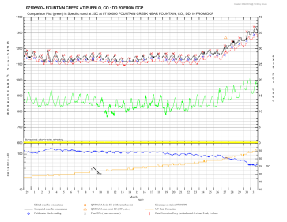
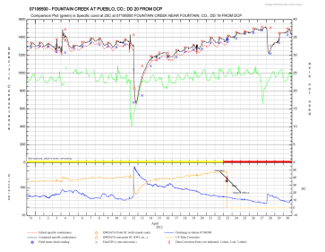
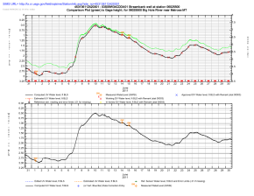
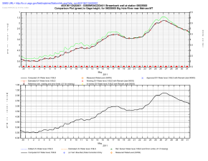
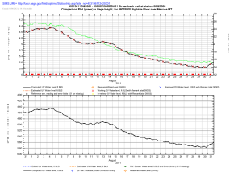
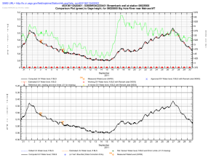
What can wqmreview do for you?
Quickly produce a base electronic record packet for your continuous WQ-monitor stations including the following output:
Unit Value Hydrograph Plots (graphical primaries…)
Computed vs. Edited UV data
Sum of UV Data Corrections from sets 1, 2, 3 on a separate axis (unit corrections, not %)
Daily value statistics (currently limited to no more than 3 stats…)
Site Visit field meter check readings
Reference data
Unit or Daily values from any station and any DD
Discharge/flow from base station or any other nearby station...

Slide 15
What can wqmreview do for you?
UV hydrographs also contain:
Data aging via color coded bars.
Date the plots were generated and user that generated them.
Optional QWDATA field measurements for that parameter.
Data correction entry indicators
ADAPS data correction remarks can also optionally be included.
Full “Key or Legend” to interpret the plots.
Can plot monthly or one large plot of the entire period.
Notes:
Estimated record was a remnant from the SW-processing side of things, but was kept as a check to make sure no estimates are present…

Slide 16
WQMReview Output: Plots

Slide 17
Water Temperature

Slide 18
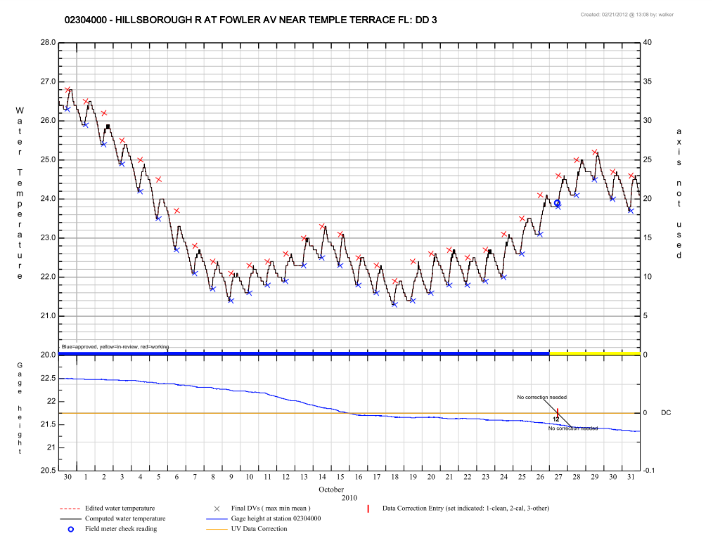

Slide 19
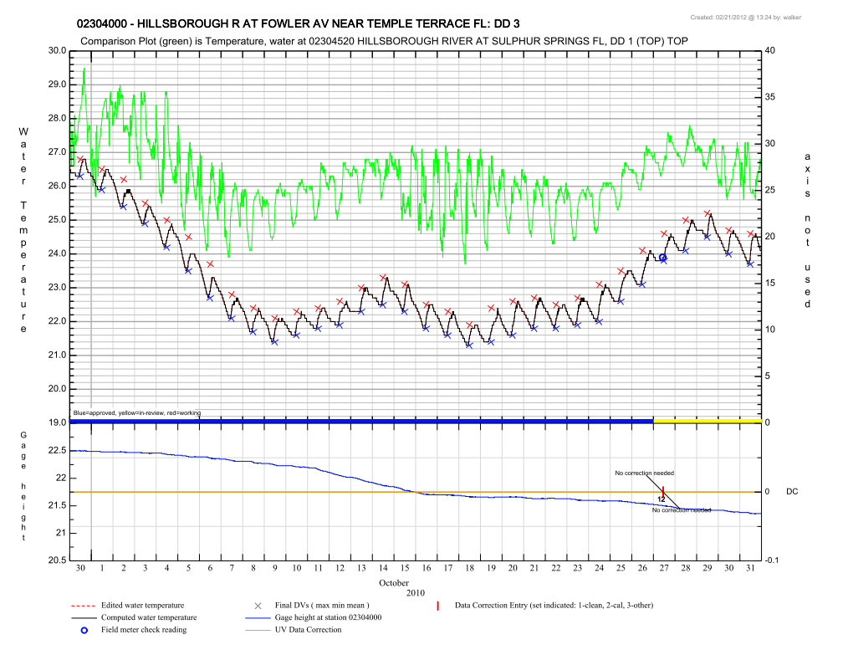

Slide 20
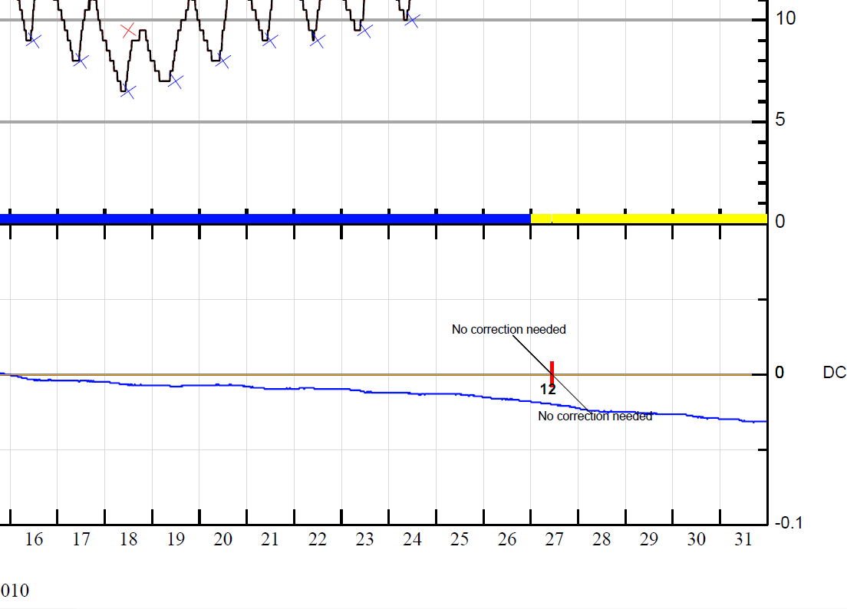
Unit-value data correction applied during this period is 0.00. If a correction is “ended” or no UV data are present, no UV data correction will be shown.
Set 1(fouling) and set 2(drift) corrections were entered at this time, both with remarks of “No correction needed”.

Slide 21
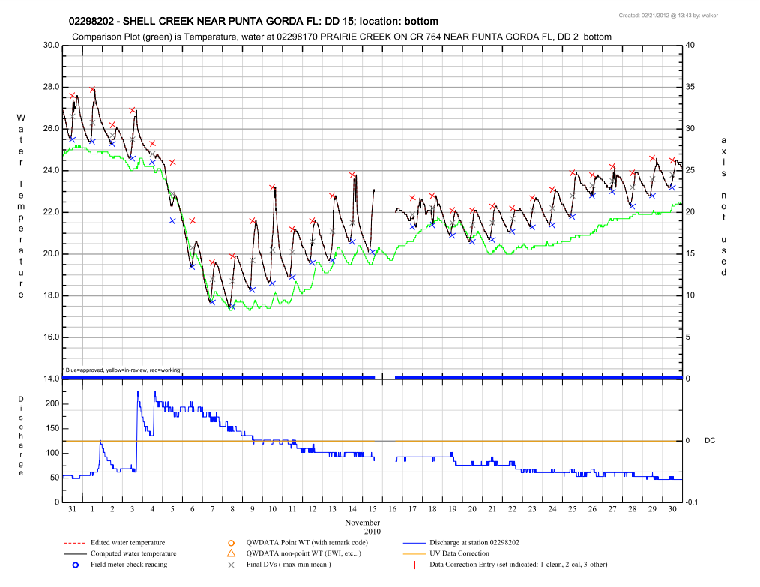

Slide 22
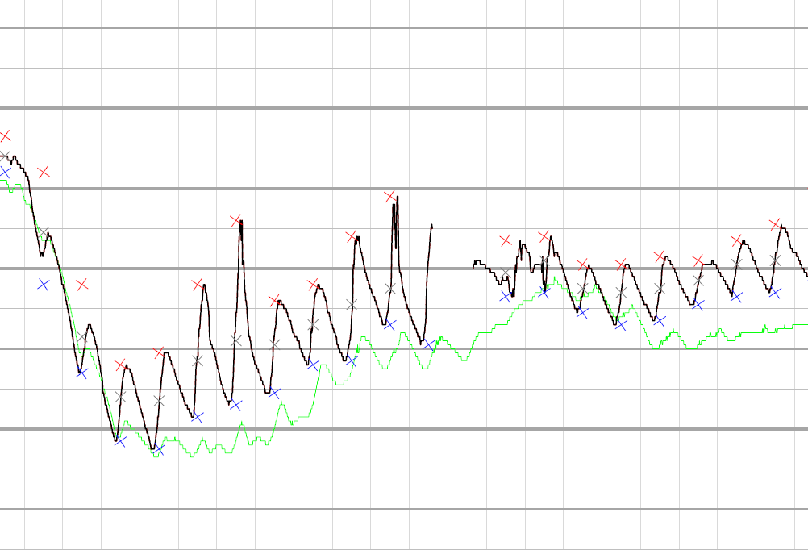

Slide 23
GHT and Discharge on the bottom Plots: Log Vs Linear

Slide 24
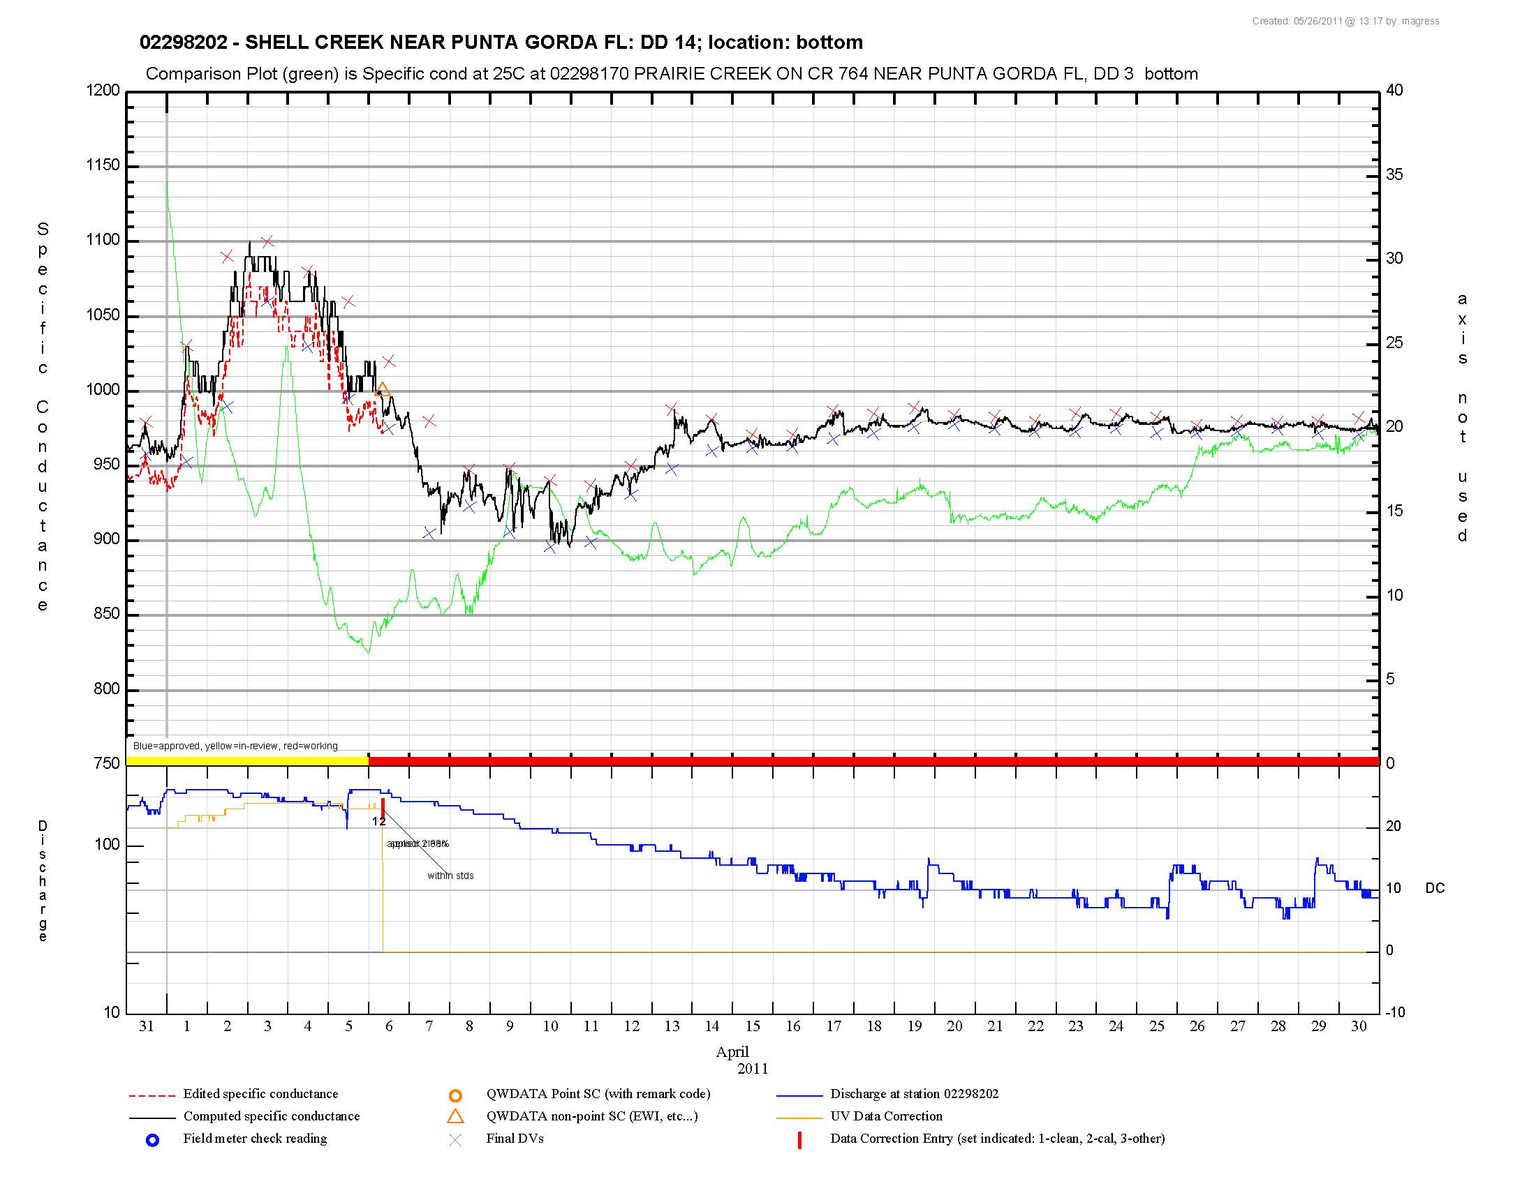

Slide 25
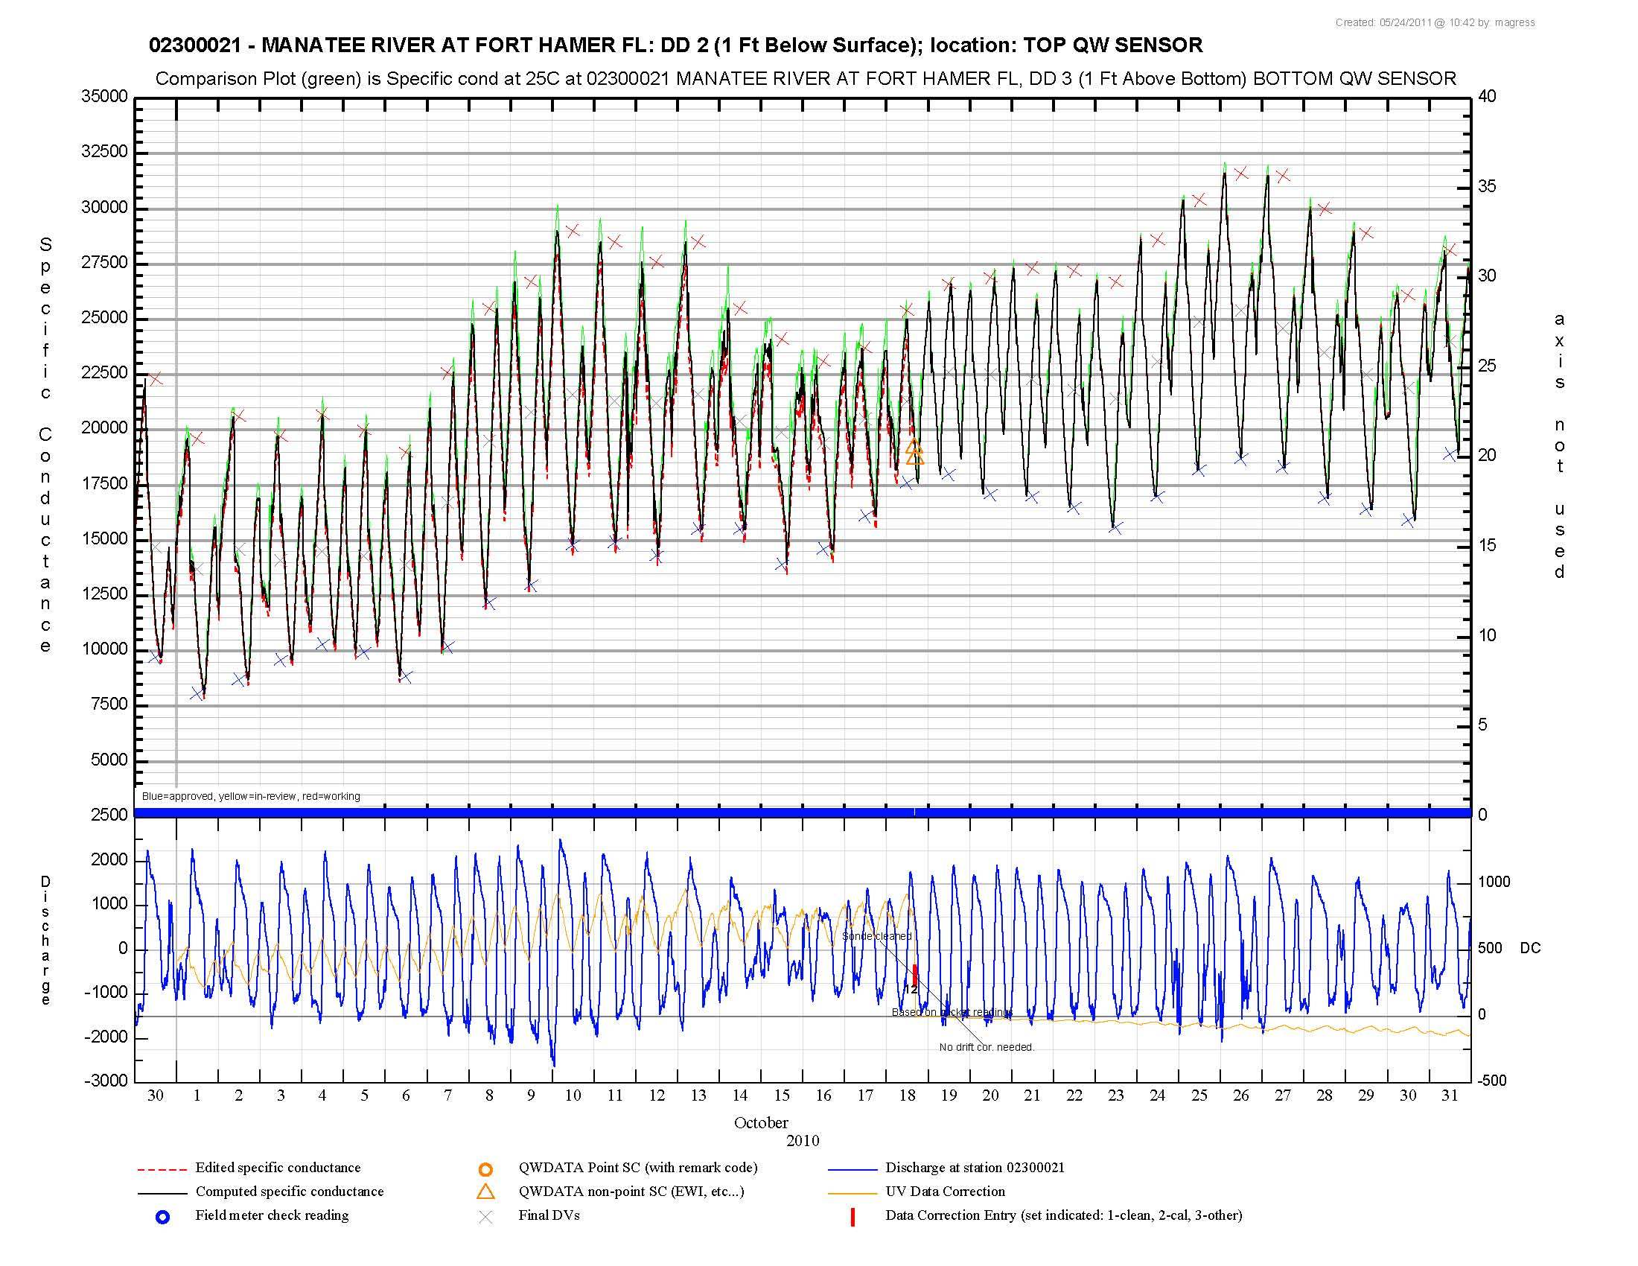

Slide 26
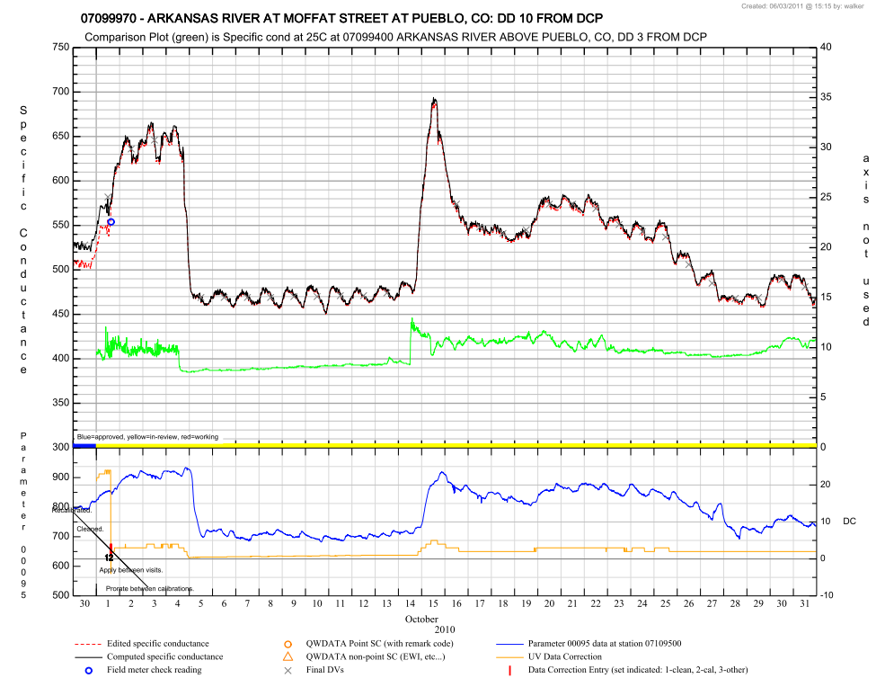
GHT and Discharge Plot:
Secret Trick…
Can actually add any parameter to the bottom plot
Useful if users don’t have a discharge/gage height reference or an additional reference besides discharge/gage height is desired. Script allows for it, but doesn’t point it out…

Slide 27
Specific Conductance

Slide 28
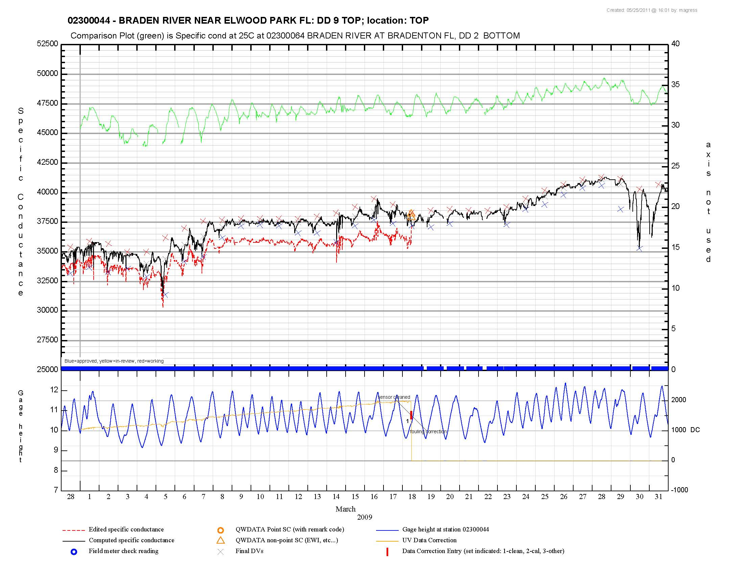

Slide 29
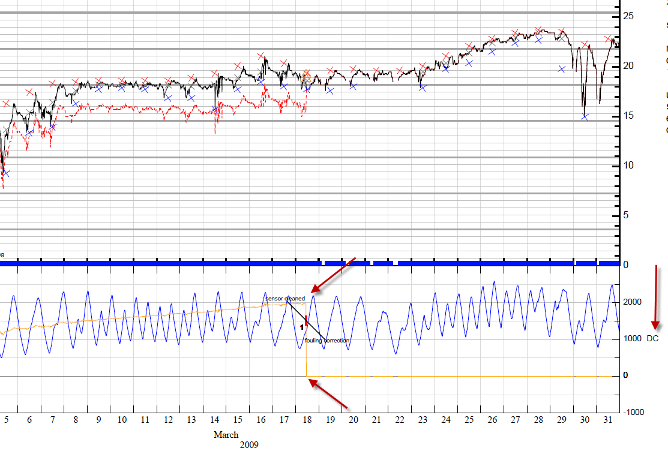
Notes:
Here, two fouling correction entries are indicated on the bottom plot via vertical red bars with associated set “1” entry labels and remarks entered for each correction. The effect of the fouling correction can be visualized both on the top plot as the difference between the edited and computed unit values, as well as on the bottom plot with the change in the unit value data correction applied. Note that in this case the correction was “zeroed” out with a second cleaning correction. Had the correction instead been ended with an end date, only one correction entry would show and the unit data correction wouldn’t show on the plot at all after that end date.

Slide 30
Dissolved Oxygen
Automatically plots inverted water temperature on the right Y-Axis
Usually available and often a good relationship
Still can add a reference site to the top plot, but must be another DO parameter
Creates 3 data sets with 2 axis

Slide 31
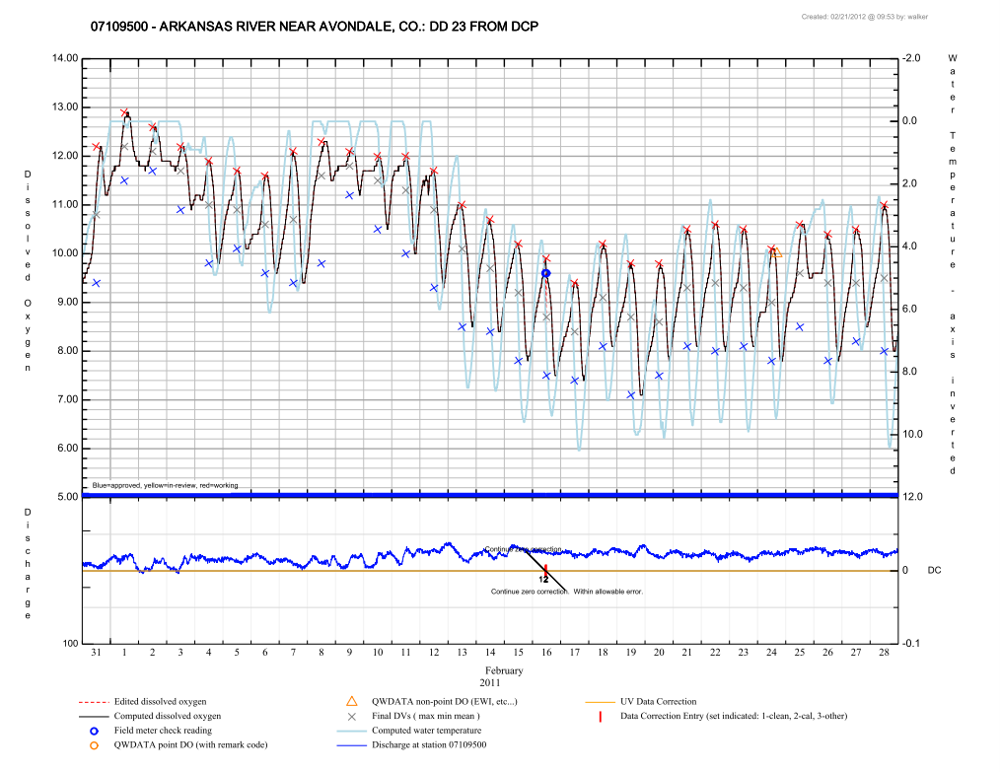

Slide 32
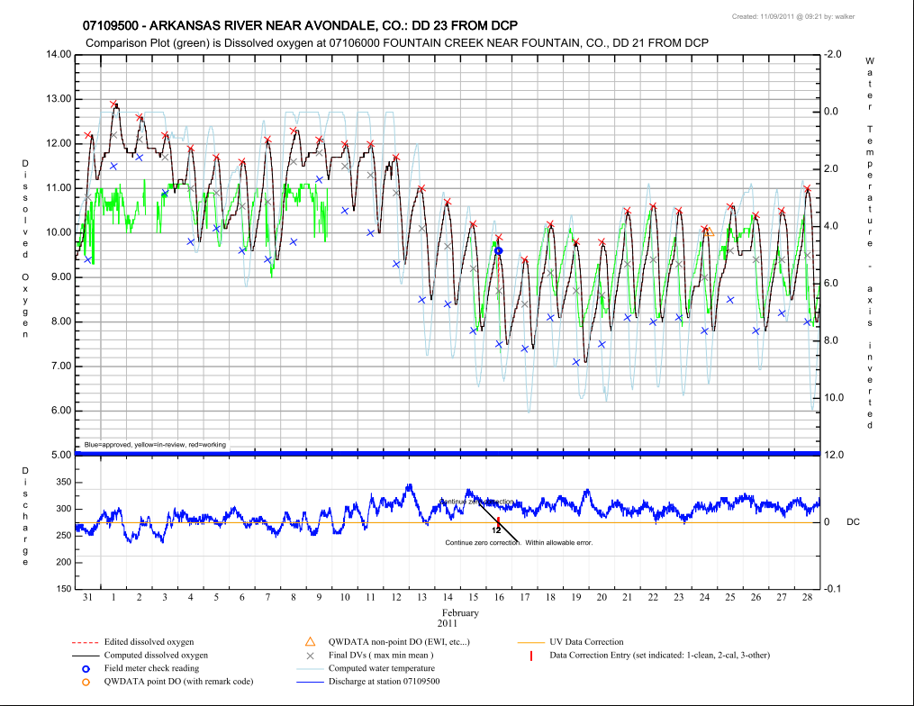

Slide 33
pH

Slide 34
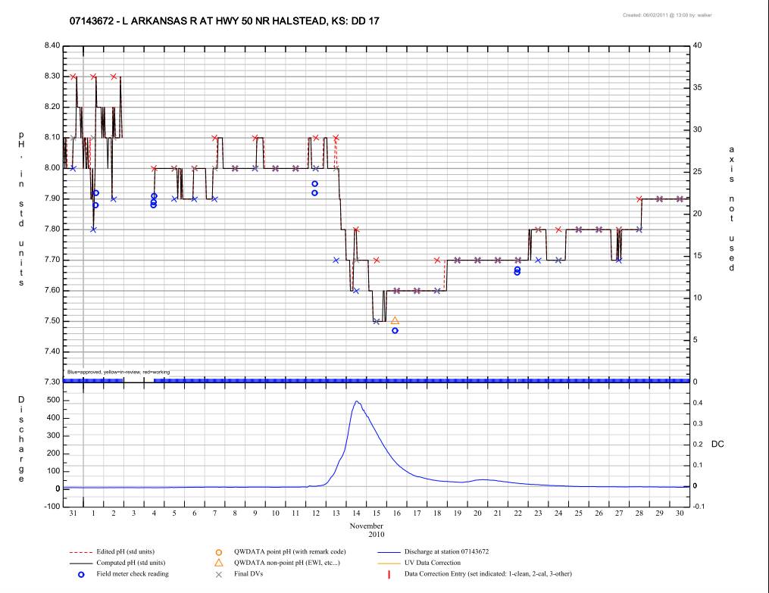

Slide 35
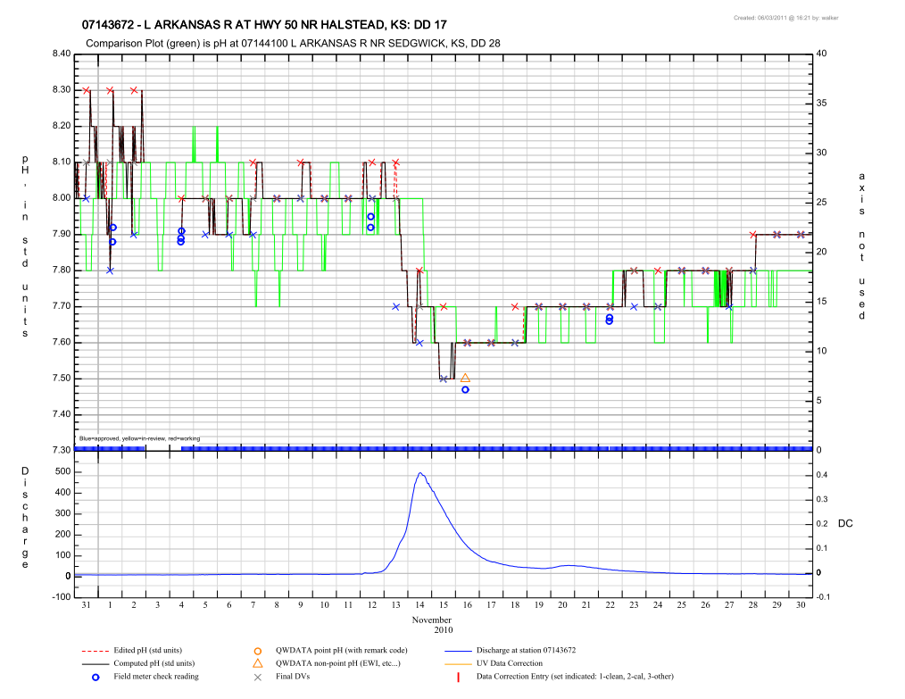

Slide 36
Turbidity

Slide 37
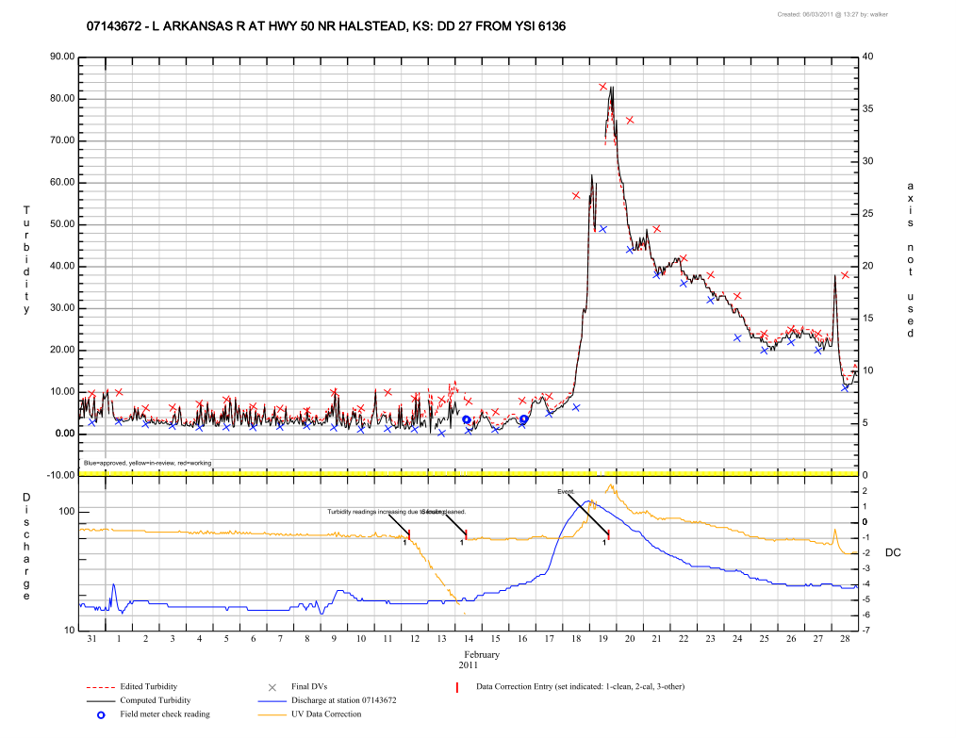

Slide 38
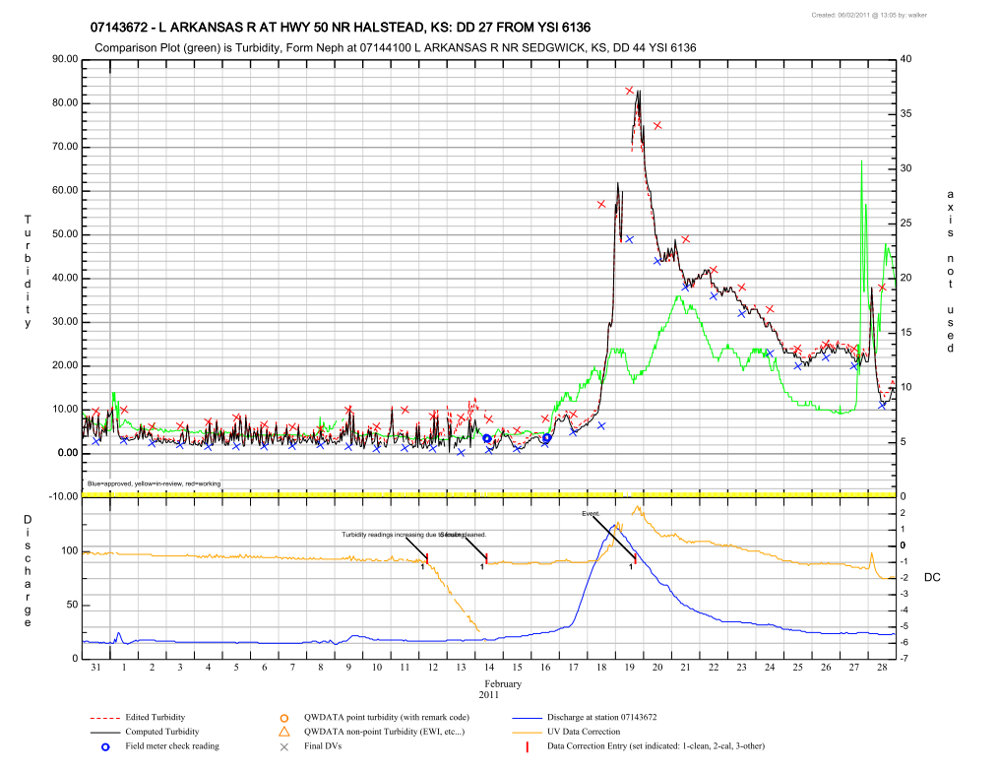

Slide 39
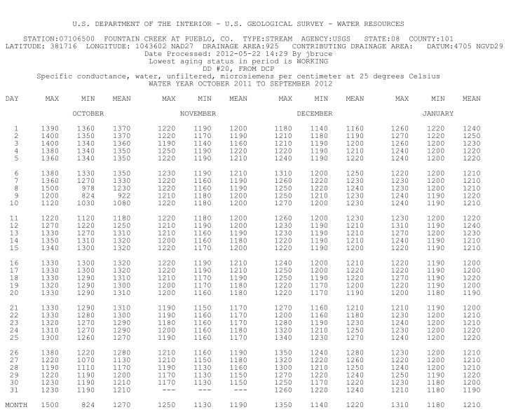
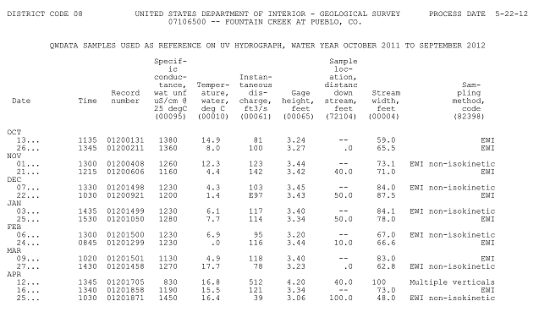
Wqmreview tables
Standard ADAPS Tables
See ADAPS documentation for full descriptions of tables – assume most users are familiar with most of these…
ADAPS DV table(s) (includes all statistics setup to be stored in the database – dvtable.pdf file)
ADAPS Station Analysis (adapsSA.pdf file)
ADAPS Primary report (primary.pdf file)
ADAPS End of year summary (eoysum.pdf file)
ADAPS UV inventory tables for edited and computed data (inventory.pdf file – 2 pages)
QWDATA publication table (tableQWDATA.pdf file

Slide 40
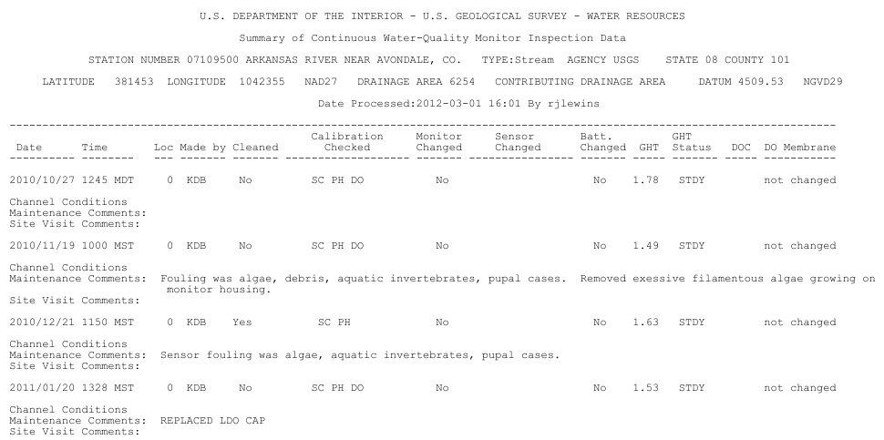
Wqmreview tables
Site Visit Reports - Continuous WQ-monitor Summary
General overview of all monitor activities
Notes:
General summary and comments

Slide 41
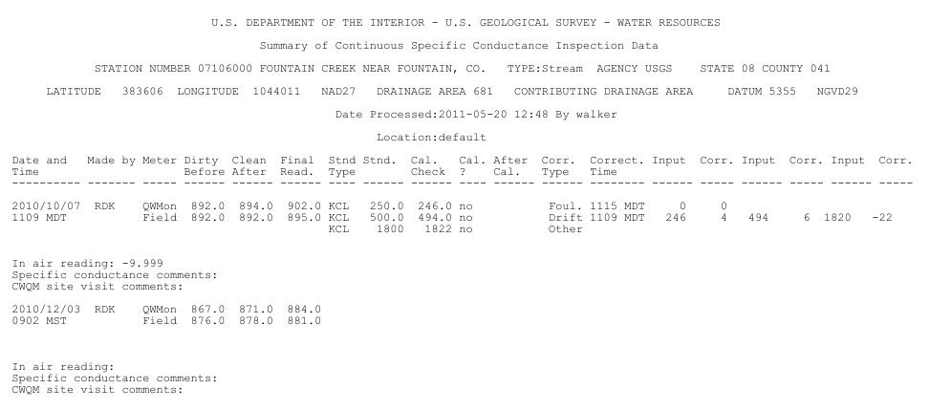
Wqmreview tables
Site Visit Sensor summary table
Can compare before/after clean readings to applied fouling corrections
can compare calibration check readings to applied drift corrections
Notes:
Entering corrections with the same values as check readings and calibration standards makes this a fairly easy comparison…

Slide 42
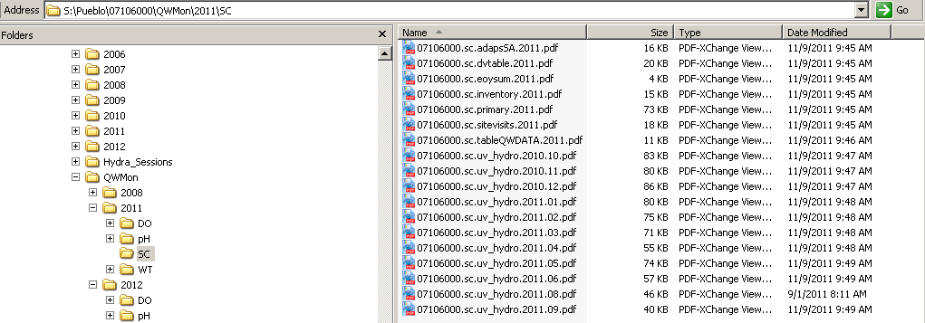
Wqmreview tables

Slide 43
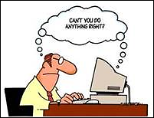
How to run the script
From NWIS prompt type:
“wqmreview”
Follow the on screen prompts and fill out working from top to bottom
Save Your Settings
Primary DD’s, Reference stations, Reference DD’s, etc…

Slide 44
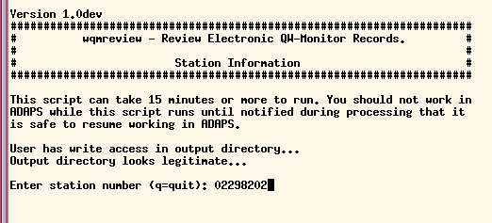

Slide 45
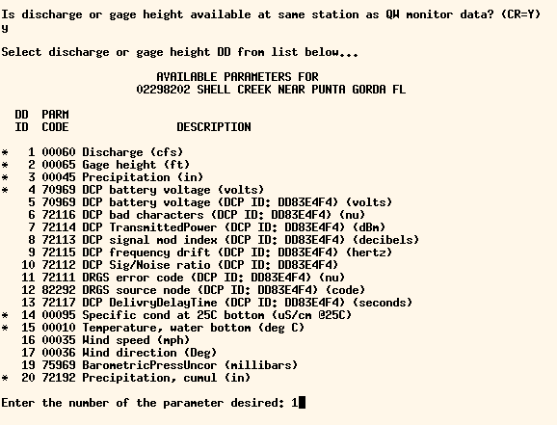

Slide 46
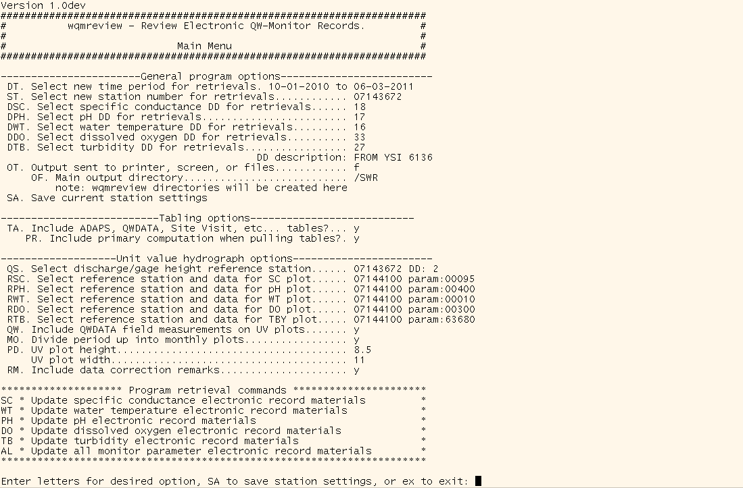

Slide 47
Default date is the current calendar year as a water year (to today’s date) – so usually the current water year except for Oct.-Dec. when the prior water year will be the default.
Automatically finds primary DD’s for recognized parameters the first time you run it. Those can be changed or removed as necessary and then saved as the default – Sites with multiple DD’s/Sondes will have to be manually changed for each run as desired (output should be directed to folders including location name to avoid collisions…)
Output can be sent to the screen, printer, or to the designated pdf file storage location (default is the same as used for swreview output).
Save your settings!

Slide 48
Include tables and run primaries?
Choose “bottom plot” reference data option (usually discharge or gage height, but can be anything)
Select “top plot” reference stations and data descriptors for all available parameters. Can select computed/final DV’s or any UV data type (raw, measured, edited, computed).
Include QWDATA entries on plot (if you have access…script should detect if you don’t)?
Divide period up into monthly plots or plot entire period on one plot?
Notes:
If no reference station, you might think about plotting raw or measured values for the parameter – can sometimes be useful…

Slide 49
Plot dimensions
Include data correction remarks on data correction entry indicators (set 1, 2, and 3 remarks)
Program retrieval commands. Can run 1 parameter at a time or all parameters at once.
Notes:
If no reference station, you might think about plotting raw or measured values for the parameter – can sometimes be useful…

Slide 50
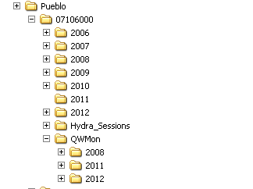
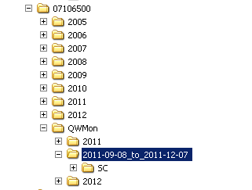
File Output
File output goes to same area as swreview (by default…) in a “QWMon”-named folder.
Water year retrievals go to a water year named subfolder with parameter folders under that
Period retrievals go to a date-to-date folder instead
Notes:
Water-year retrievals are output into a QWMon/wateryear directory – other period retrievals are put into a QWMon/date_to_date directory. Water year handy for archival – period handy for continuous records work, especially periods crossing water year boundaries. Choice is yours… Functionality is a little different from swreview. Partly because this one isn’t automated and partly because it’s best to look at more than just the current period with discharge records to get a better idea about shift/rating trends, etc…

Slide 51
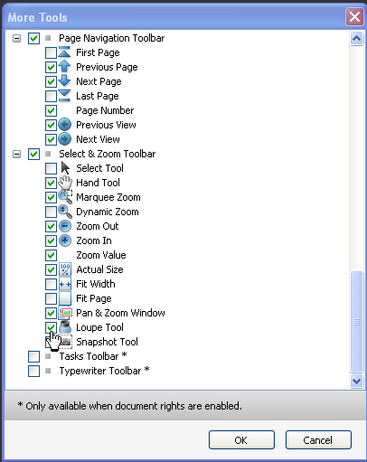
Tips and Tricks
Use Adobe Reader tools.
Default toolbar has very few of the total number of tools
Right –click anywhere on toolbar to bring up other available tools.
Loupe tool is exceptionally useful!
If viewing from SIMS/RMS links, disable “view in browser” option in Edit>Preferences> Internet to prevent output from being trapped in small window
Notes:
The default tools in Adobe Reader that are likely showing in your toolbars are a very small subset of the total number of tools available. Right-click anywhere on the toolbar to bring up the list of available tools. Many of the Zoom tools can be extremely useful for records work so you can easily zoom in and navigate around plots with ease.

Slide 52
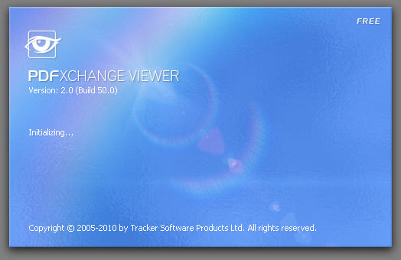
Tips and Tricks
PDF XChange Viewer
Alternative free pdf viewer with the same zoom/display features but also has editing features.
Notes:
Demo PDF XChange Viewer editing options.
PDF XChange Viewer is another free pdf viewing option with some other features not available in Adobe Reader as well as loupe tool and pan/zoom like Adobe Reader. Foxit is another one but lacks the loupe and other zoom tools.
Significant edits/commentary should be archived – likely best to leave significant content in RMS, station analysis, etc…, but these can be useful for simple checking tracking, etc… Just be sure to rename files so future swreview file updates don’t overwrite edited files.

Slide 53
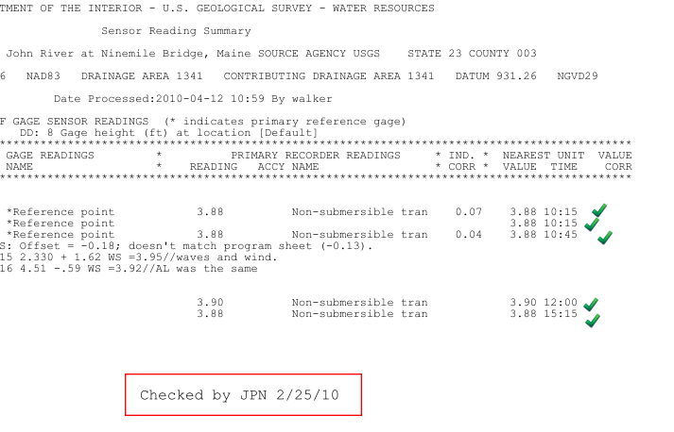
Tips and Tricks
PDF XChange Viewer
Can add notes to files, text directly, arrows, etc…
Can also use loupe tool and pan/zoom
Notes:
Minor editing features let you add notes, text, arrows, highlight text, etc... directly on the plot and save those edits (see examples in slides)...
Significant edits/commentary should be archived – likely best to leave significant content in RMS, station analysis, etc…, but these can be useful for simple checking tracking, in remote check and review to share issues via email, etc… Just be sure to rename files if you want to keep the edits so future gwreview file updates don’t overwrite edited files.

Slide 54
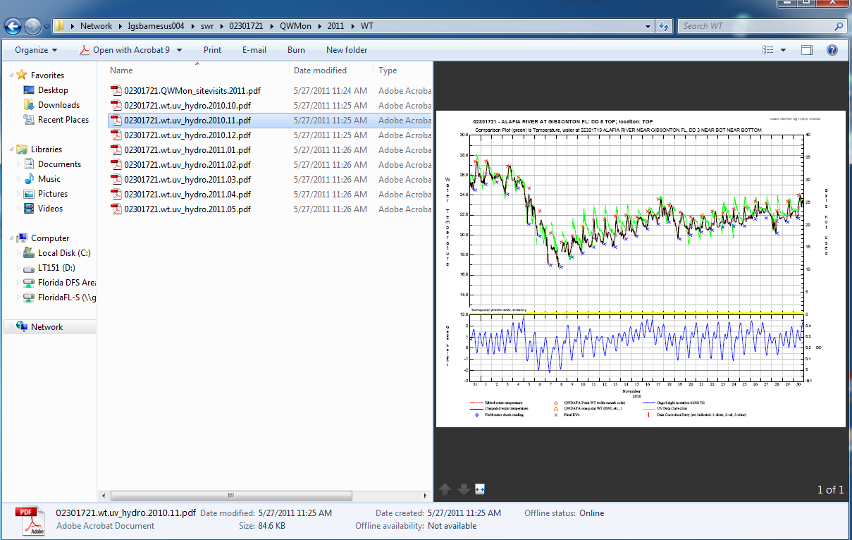
Tips and Tricks
Notes:
Windows 7 provides nice previews of output, which can make it easier to find what you’re looking for.
PDF XChange Viewer is another free pdf viewing option with some other features not available in Adobe Reader as well as loupe tool and pan/zoom like Adobe Reader. Foxit is another one but lacks the loupe and other zoom tools.
Significant edits/commentary should be archived – likely best to leave significant content in RMS, station analysis, etc…, but these can be useful for simple checking tracking, etc… Just be sure to rename files so future swreview file updates don’t overwrite edited files.

Slide 55
Tips and Tricks
Link to stations' Auto_Review output area available from SIMS webpages
Can increase file access speeds, but can't rename, edit, etc… pdf files
Great for remote records checking and reviewing
Can add other files to that area to assemble a complete electronic record packet available from stations' SIMS/RMS pages
Contact GS-W_Help_SIMS@usgs.gov to enable this feature on your SIMS pages (area must be setup on local webserver…)

Slide 56
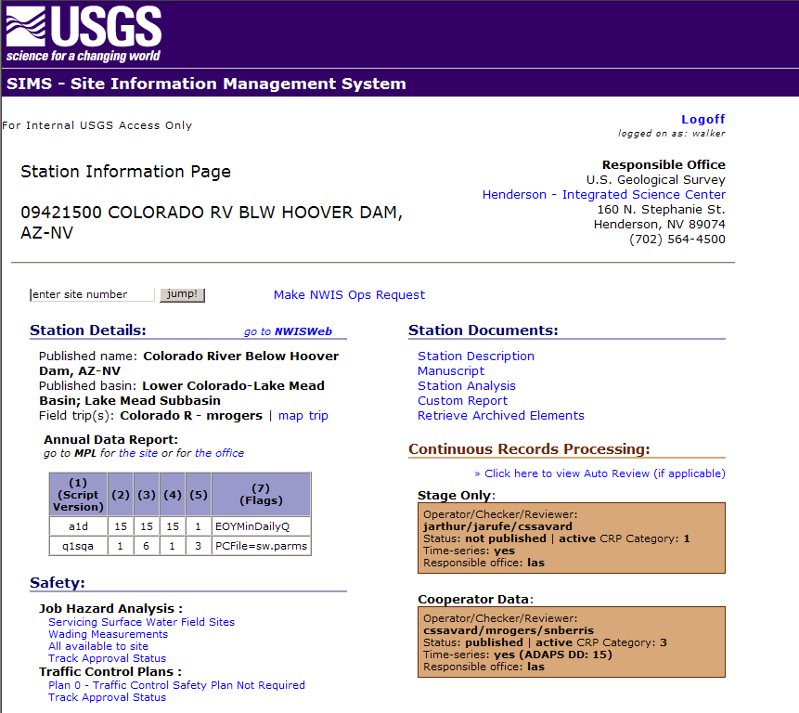

Slide 57
Release Schedule
Auto_Review version containing wqmreview OUT NOW!
Was announced to all DBA’s and Data Chiefs in Jan. 2012 (released in Dec. 2011).
Already on many servers (type wqmreview from Unix prompt on server to find out…).
5-10 minute update process if not – instructions available here: http://water.usgs.gov/usgs/osw/adaps/swreview.html
Have received usage reports from 22 servers so far (July 2012 - reports not emailed until used for 30 days…)
Usage has varied from a few runs to hundreds over 30 day period
Still trying to get word out (July 2012) – let folks from other WSC’s know…

Slide 58
Desired Enhancements of WQMReview
Addition of Chlorophyll as a Data Descriptor for processing
Addition of several “generic” Data Descriptors for any parameter
Ability to have a second reference curve on the top plot
Daily value plots of the WY (like Monplot)
Max, Min, Median/Mean
Ability to run automatically (like SWReview)
Would include “batch” and command-line processing ability…

Slide 59
Desired Enhancements of Auto_Review
“Metreview” for meteorological Data Descriptors
“Wqreview” for WQ-sampling records
Enhanced support for Index Velocity Discharge records in swreview (please send suggestions!)
Enhanced support for continuous GW-level records (coming any day now…)
New Time-Series software may incorporate current functionality before much of this gets done…
Wqmreview developed with this in mind as a stop-gap until we see what happens…

Slide 60
Enhancement Suggestions, Problem Reports, or General Support
Contact the OSW scripts personnel @ GS-W OSW Scripts@usgs.gov
Or just shoot Wade Walker an email, IM, or call
walker@usgs.gov, 719-544-7155 x125

Slide 61
Questions?

