Slide 1
Electronic Continuous GW Records Auto_Review - gwreview 2012 USGS National Data Conference, Portland, OR

Slide 2
What is Auto_Review?
A consolidation of programs that automates the production of time-series record packages.
Started as a small collection of tkg2 utility scripts (vshiftplot, uv_hydro), which were combined and enhanced into swreview, and then other programs for other record types were added into an overall Auto_Review software package containing swreview, wqmreview, and gwreview (currently).
Originally collaboration between Wade Walker (CO), Joe Nielsen (OSW), Brian Loving (KS), Ed Fischer (IA/OWI) – with much of output based on other programs (Baseplot-Lamar Sanders, Shifplot-Wil Sadler, and others).

Slide 3
What is Auto_Review?
Assists with record checking and reviewing (and working…).
Provides a local electronic archive for multiple record types.
Released as an OSW_Script with funding for support and enhancements provided by whoever is willing (OSW, OWQ, OGW, WSC’s, coders volunteering for science, etc…).
Of original collaborators, Wade Walker is left as current primary developer/maintainer.

Slide 4
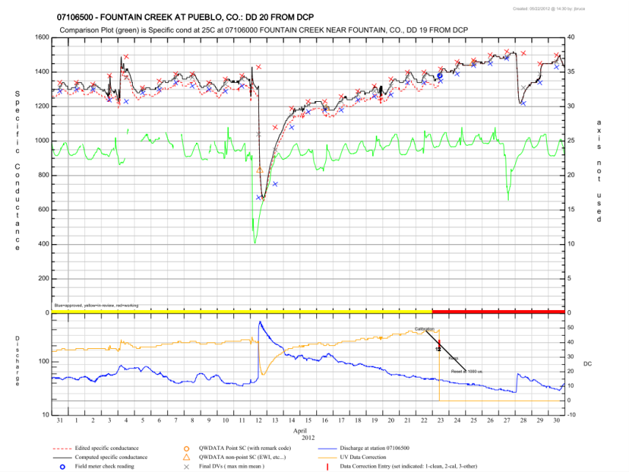
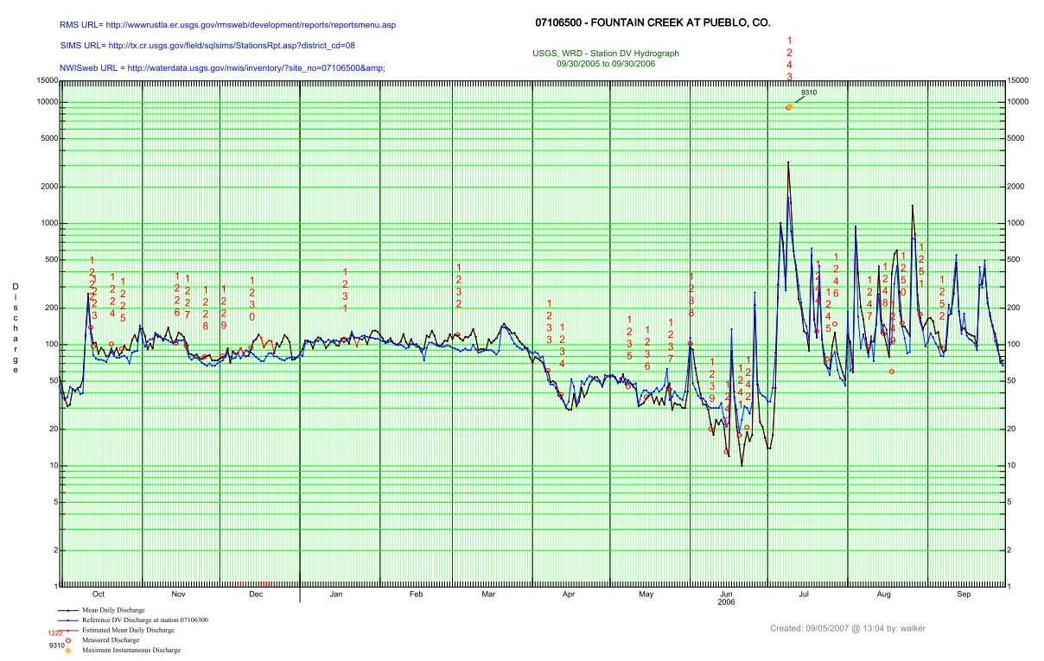
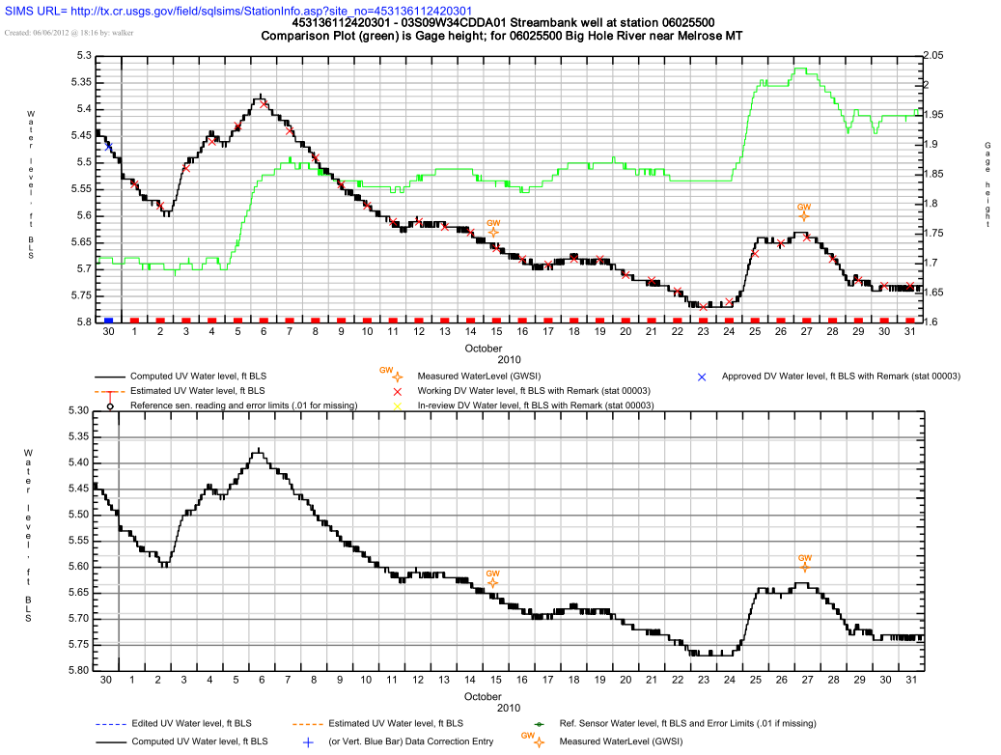
What is Auto_Review?
Tkg2 generated graphical plots combining data from ADAPS, SITEVISIT, GWSI, and QWDATA.

Slide 5
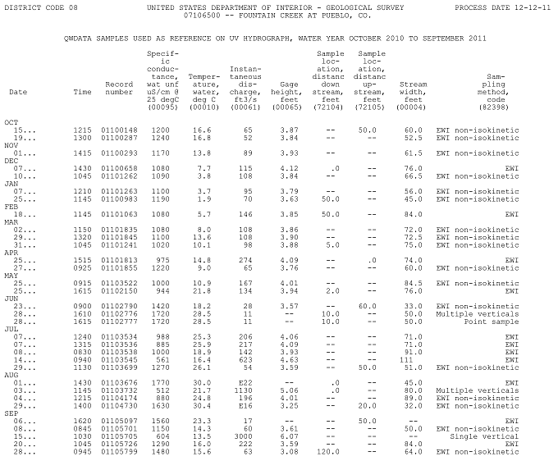
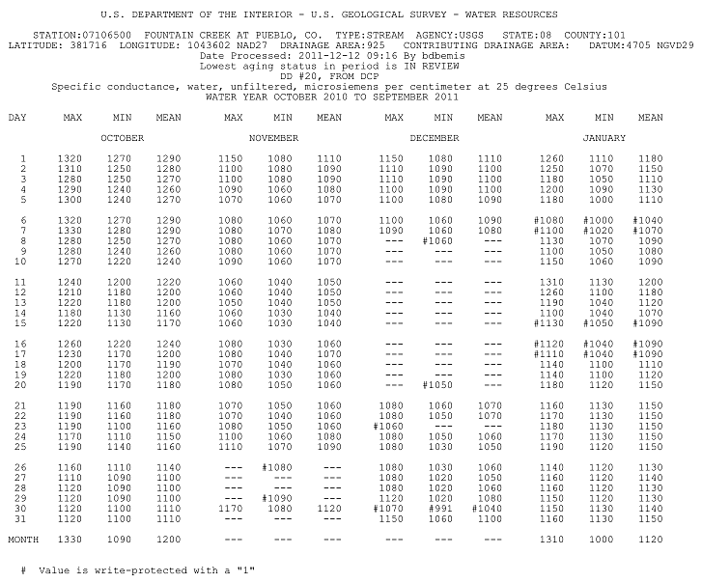
What is Auto_Review?
Commonly used ADAPS, QWDATA, and GWSI tables.
ADAPS Station Analysis, DV tables, EOY summary, Primary, UV inventory
Site Visit Reports
QWDATA publication-style tables
GWSI water level tables

Slide 6
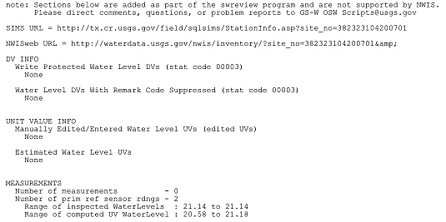
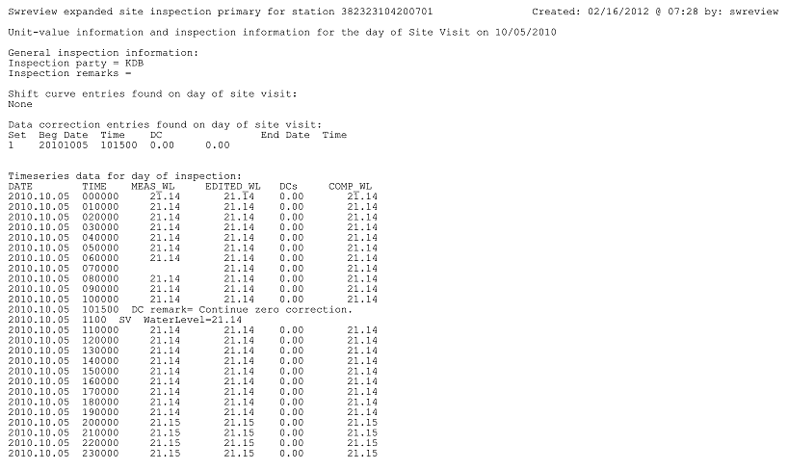
What is Auto_Review?
A few Auto_Review program generated tables (and additions to NWIS program tables…).
Inspection primaries (showing almost complete summary of time-series data on days of Site Visits)
Added section to Adaps Station Analysis for some parameters…

Slide 7
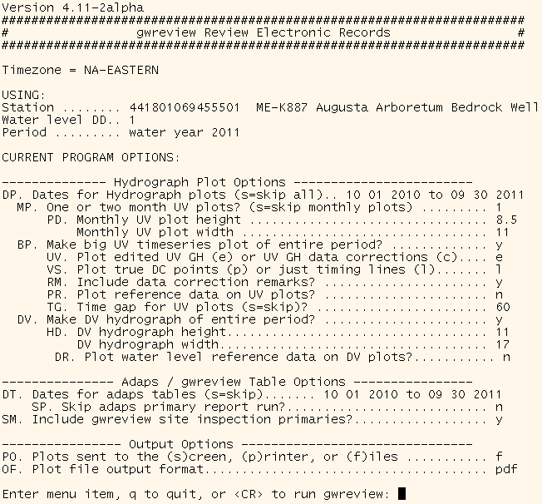
What is Auto_Review?
A (fairly) user-friendly menu for changing and saving settings at stations.

Slide 8
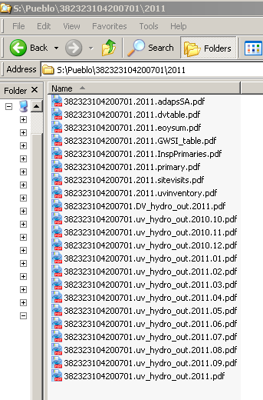
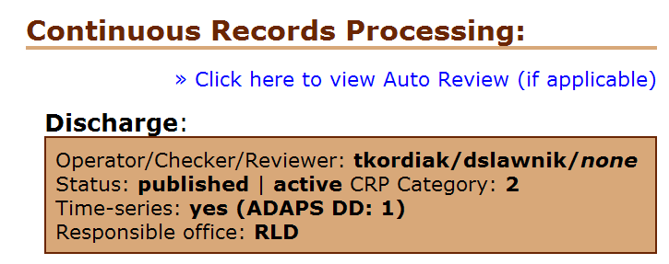
What is Auto_Review?
Final output of generated tables and plots are normally stored in a central record folder area in PDF format for electronic reference and archiving.
Default area is /SWR on NWIS servers, but WSC may place it elsewhere (ask if unsure…)
Can also be sent to the screen or straight to a printer, but not the preferred options…
Can be displayed from local WSC webserver, local websites can be developed, or links to output can be added from SIMS/RMS station pages.
Notes:
More on output options later….

Slide 9
Electronic Records? Why?
Automatic Electronic Package
Ensures output being checked/reviewed is current (and complete) and helps keep record fully processed (as long as primary computations aren’t skipped…)
Helps reduce discrepancies between what’s in folder and what’s in database (which is what counts…)
Convenient, easy to access local archive
Helps enable inter-office/WSC work, check and review
Helps enable telework
Saves on paper, ink, printer wear and tear, and printer support

Slide 10
Electronic Records? Why?
Notes:
Which, yes, ties us to our computers just that much more, but is paper really any better? It should be worth it regardless…

Slide 11
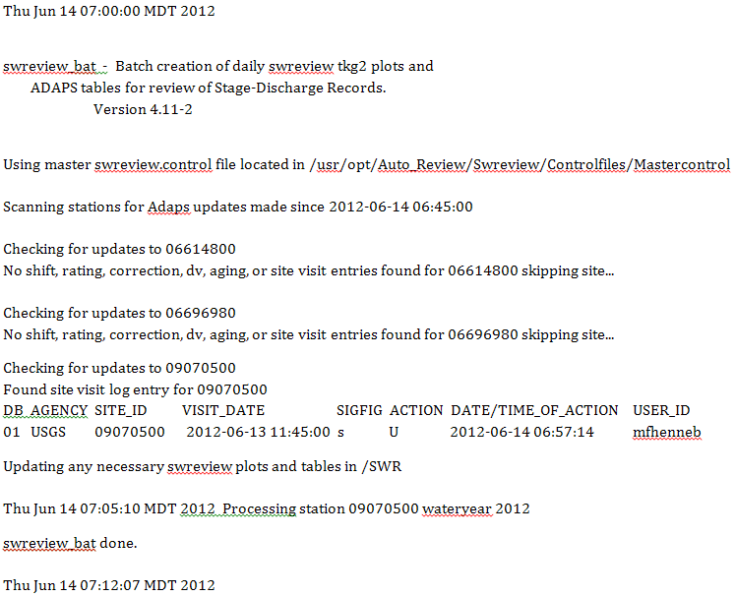
What is Auto_Review?
Ability to run a group of stations in “batch” mode and run a regularly scheduled process to update output at stations with changes detected in the database since the last time it was run (currently not functional for WQ monitors at this point…).
Users can create personal site lists or use “master” site list to run all stations/years/DD’s in list or only those with updates detected in NWIS since it last ran.
Use “auto_control_builder to create/manage lists.

Slide 12
History of Auto_Review and continuous GW levels
Not initially supported (only continuous discharge really supported for first 6 years of existence).
Oregon WSC provided funding to Wade to improve support for stage-only and reservoir stations (2010 – Thanks, OR!).
Since GW-level processing so similar to stage-only processing, Wade added rough initial GW-level capabilities to swreview script at that time.
Knew further enhancements would be necessary, but hoped it would pique interest and at least be usable…
OGW agreed to fund further enhancement requests submitted by Chuck Schalk (ME WSC/GWUG) and development of “gwreview” program for inclusion in package (which really just runs swreview, but changes some labeling and makes it look like you’re running a different program…).
Auto_Review version containing gwreview released July 2012.

Slide 13
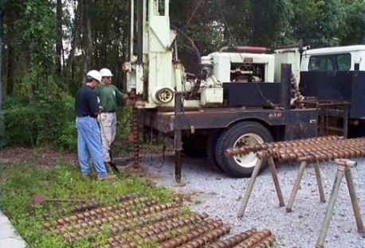
Twelve GW Parameter Codes Supported
30210-Depth to water level, below land surface datum (LSD), meters
61055-Water level, depth below measuring point, feet
62600-Water level elevation above NGVD 1929, corrected for barometric pressure, feet
62601-Water level elevation above NGVD 1929, inclined (non-vertical) well, feet
62610-Groundwater level above NGVD 1929, feet
62611-Groundwater level above NAVD 1988, feet
62612-Groundwater level above NGVD 1929, meters
62613-Groundwater level above NAVD 1988, meters
72019-Depth to water level, feet below land surface
72020-Elevation above NGVD 1929, feet (if station has GW site type)
72109-Depth to water level from a measuring point (ft)-note, not for new entry…
72150-Groundwater level relative to Mean Sea Level (MSL), feet
Do we need to add any others?

Slide 14
What can gwreview do for you?
Title suggests it’s a “review script” but …
Useful for all Stages of record process!
Obviously a “Workup” or Worker tool, too.
For the Checker and Reviewer of course.
Can keep electronic records of the WY for an office or the state with ease in an easily accessible local electronic archive (or can repull them at anytime using the program as long as data still reside in database…).

Slide 15
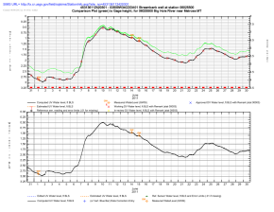
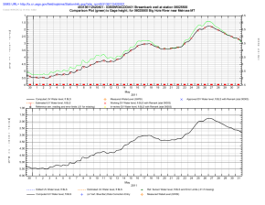
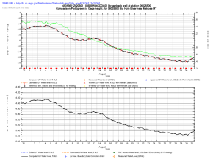
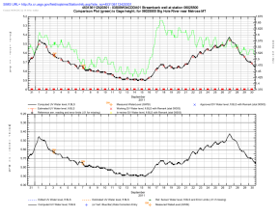
What can gwreview do for you?
Quickly (and optionally automatically…) produce a base electronic record packet for your continuous GW-level stations including the following output:
Unit Value Hydrograph Plots (graphical primaries…)
Computed vs. Edited UV data (or UV data corrections instead of edited data…)
Daily value statistics (currently limited to one main stat…)
Site Visit primary reference sensor readings
GWSI water levels
Reference data
Unit or Daily values from any station and any DD
Reference data axes should automatically reverse appropriately allowing quick and easy comparison of bank wells and associated SW stations, mixed water level/elevation stations, etc...

Slide 16
What can gwreview do for you?
UV hydrographs also contain:
Estimated record is also indicated, but there should NOT be any in GW level records
Data aging via color coded bars and DV symbols.
Date the plots were generated and user that generated them.
Link to station’s SIMS page if enabled for WSC.
Data correction entry indicators - simple timing lines or specific time/correction points plotted with the corresponding point correction applied indicated.
ADAPS data correction remarks can also optionally be included.
Full “Key or Legend” to interpret the plots.
Can plot monthly/bimonthly and/or one large plot of the entire period.
Notes:
Estimated record was a remnant from the SW-processing side of things, but was kept as a check to make sure no estimates are present…

Slide 17
gwreview plots: UV hydrographs (uv_hydro_out files)

Slide 18
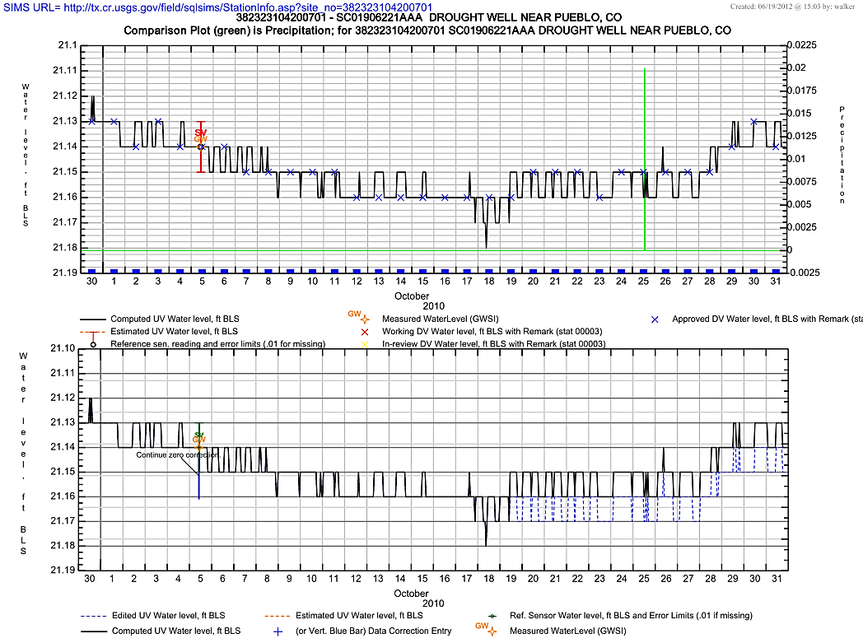
Notes:
Here again, think of these as “graphical primaries” with manual GW-level measurements plotted on them instead of added to them by hand (as was historically done in many WSC’s…)
This is an example UV hydrograph for a continuous GW-level station with manually measured water levels entered in both GWSI and as primary reference sensor readings in Site Visit (site visit entries will include error limits corresponding to associated accuracy of entered sensor reading - or 0.01 ft if missing).
Note that the hydrograph is split into two plots to keep one from getting too “busy”. Top plot is meant to review final output data and daily statistics in relation to reference data, manual measurements, etc…, while bottom plot is meant more to review correct data correction application. There are options to display data correction entries as simple timing lines as shown, or as specific point pairs entered into the system if non-linear corrections are used or additional details are desired on the plots (if using the point pair option, note that the range of points entered will be used to scale the axis, so ranges of points should be close to range of data during period or scales will be blown…). Data correction timing can also be represented as the difference between edited and computed data (as shown here – difference between solid black line and dotted blue line), or as actual unit-value data corrections plotted on the plots. Edited data plotting gives additional benefit of being able to review questionable edited data “X’d” out of the record in hydra, but UV data corrections can be better for viewing minor detail when data corrections are small and range of data is large (and can also be useful if very bad values are “x’d” out instead of deleted from the edited data set, which can cause scaling issues…).

Slide 19
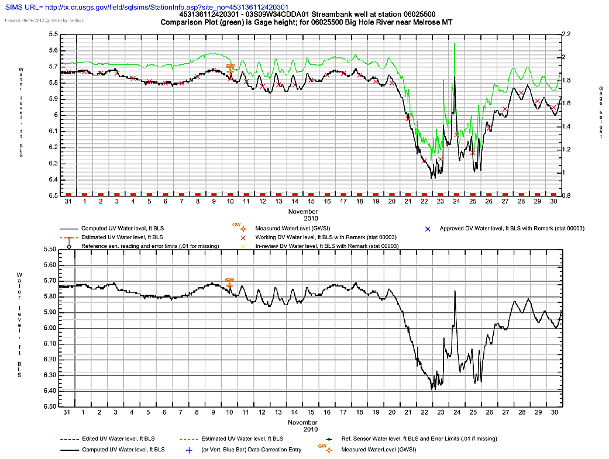
Notes:
This is an example UV hydrograph for a continuous GW-level station with manually measured water levels entered only in GWSI. Note that the well is a shallow streambank well co-located with a continuous discharge station and both can be plotted together with axes reversing appropriately to allow easy interpretation of the relationship between them.

Slide 20
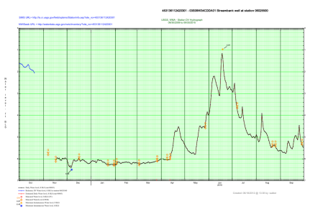
gwreview output cont’d…
Daily Value Annual/Period Hydrograph Plots
Daily value statistics for the entire plotted period (currently limited to one main stat…)
Site Visit primary reference sensor readings
GWSI water levels
Links to station’s SIMS and NWISWeb inventory pages (if enabled in WSC)
Water level DV reference data
Currently restricted to same axis as base data…
Max and min instantaneous water level during period
Estimated record is also indicated, but there should NOT be any in GW level records

Slide 21
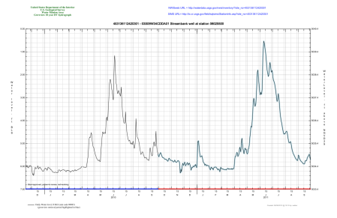
gwreview output cont’d…
Daily Value 10-year/Period of Record Hydrograph Plots
Daily values for the last 10 years (or period of record if shorter)
Current retrieval period highlighted in blue
Data aging indicated by color coded “rugging” at bottom of plots
Links to station’s SIMS and NWISWeb inventory pages (if enabled in WSC)
2nd Y-axis should show elevation for “below xxx” parameters with an altitude in sitefile or meters to feet conversion for metric parameters

Slide 22
gwreview plots: DV hydrographs (DV_hydro_out files Page 1=Annual hydrograph Page 2=10yr (or POR) hydrograph)

Slide 23
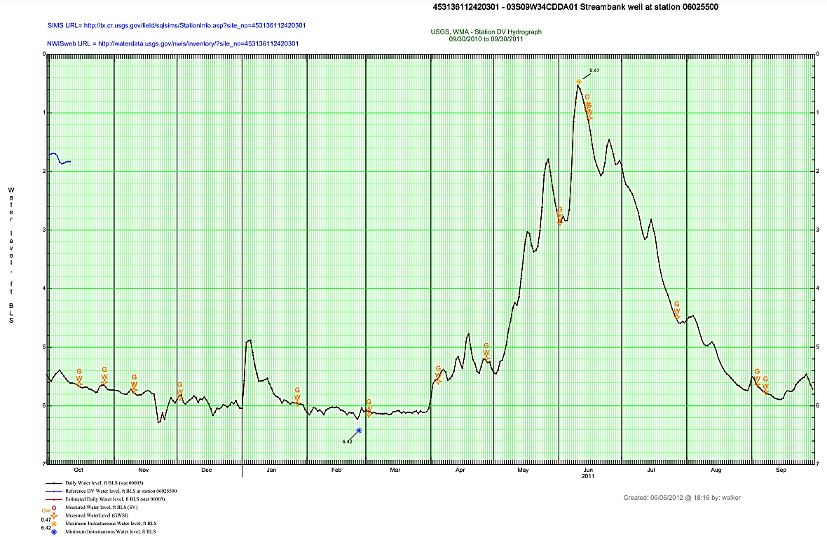
Notes:
This is the annual (or retrieval period…) DV hydrograph. Page one of the DV_hydro_out pdf files produced by gwreview. Good for getting a little bigger picture view of the period than the UV hydrographs provide. Note instantaneous maxes and mins are plotted and should reverse appropriately depending on whether a depth below parameter or an elevation parameter.

Slide 24
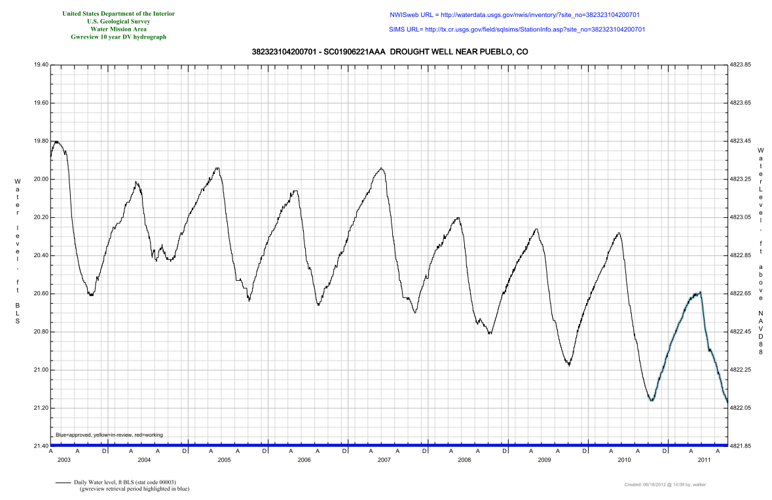
Notes:
This is the 10-year (or period of record if shorter…) DV hydrograph to get a bigger, simplified historical “big picture” view (DV’s only…). Note here that a computed elevation appears on the 2nd y-axis based on the computed water level data and the altitude value entered in the site file for the station. For metric elevation parameter codes, the 2nd y-axis should indicate elevation in feet. Note that we may need to do more work here – testing has been a little limited, so let us know if you have problems or notice anything that doesn’t look right…

Slide 25
What can gwreview do for you?
Standard ADAPS Tables
See ADAPS documentation for full descriptions of tables – assume most users are familiar with most of these…
ADAPS DV table(s) (includes all statistics setup to be stored in the database – dvtable.pdf file)
ADAPS Primary report (primary.pdf file)
ADAPS End of year summary (eoysum.pdf file)
ADAPS UV inventory tables for edited input data and computed output data (uvinventory.pdf file – 2 pages)
Notes:
Not going to spend much time on these, just want to mention what is included…

Slide 26
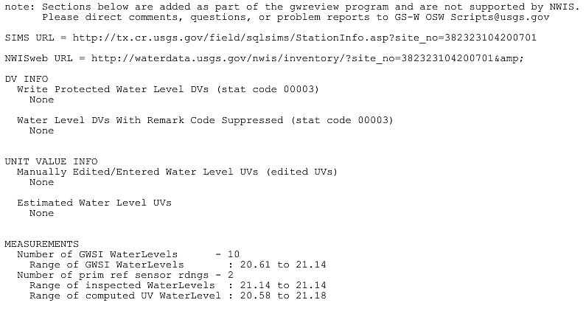
What can gwreview do for you?
Enhanced ADAPS Tables and gwreview tables
ADAPS Station analysis with additional data added by gwreview (adapsSA.pdf file).
gwreview adds information below:
Notes:
Links to station’s SIMS and NWISWeb Inventory pages (if enabled for the WSC)
List of days with write-protected daily values (“1” remark codes)
List of days with remark code printing suppressed on DV tables (“2” remark codes)
Manually edited or entered instantaneous values in edited UV data set
Any estimated UV’s (again – should NOT be any for water levels…)
Number and range of GWSI water levels
Number and range of Site Visit primary reference sensor readings (more on that later…)
Range of computed UV water levels

Slide 27
What can gwreview do for you?
Enhanced ADAPS Tables and gwreview tables
GWSI water level table
Possible to install customized control file for GWSI tabling – contact Wade if desired…
Notes:
Here’s an example table – pretty basic

Slide 28
What can gwreview do for you?
Site Visit Reports (GW-level summary and sensor reading summary)
Gwreview doesn’t enhance these, but did want to go over them a little as many GW users likely aren’t familiar with them or their capabilities as they relate to a continuous GW station…
Notes:
2 GW-level site visit reports will be included in the output if Site visit is used as part of continuous GW level processing – the GW-level summary and the sensor reading summary. We’ll go over each in the next few slides.

Slide 29
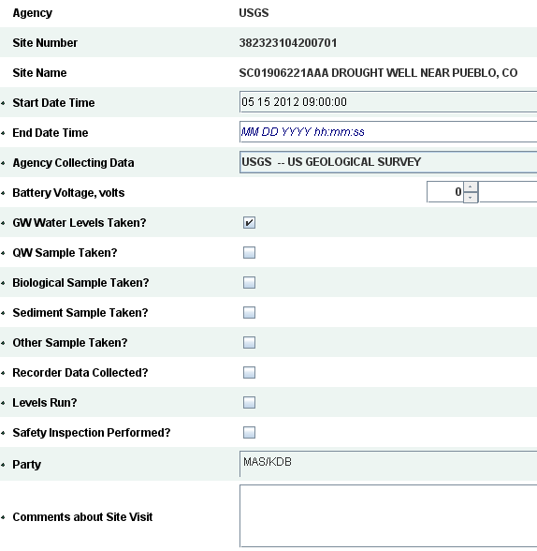
What can gwreview do for you?
Site Visit GW-level summary
Includes GWSI water levels
Require a visit be entered in Site Visit with “GW Water Levels Taken” box checked.
Can use SWAMI in field and check box to do this, hand enter in Site Visit, or convert Monkes output to xml file that can be imported into Site Visit that will do this for you.
Notes:
Adding data to Site Visit is optional (GW level measurements have to go into GWSI…), but use does allow you to more fully document the visit to a continuous time-series station by allowing you to enter readings for you recording sensor(s), reference sensor(s) (steel tape, e-tape, etc…), along with a host of additional comment fields and entry options. Current recommendation is to use MONKES in field, then convert monkes output to Site Visit xml using FCIS utility that will quickly import into Site Visit and create a visit on that date with the “GW Water Levels Taken?” box checked. The benefit of this is that the MONKES xml gets archived into the NWIS database in the process and having the GW Water Levels Taken box checked causes Site Visit to basically pull in the GWSI water level data, allowing you to view the GWSI water level information in Site Visit and produce the GW Levels Summary Report seen here. Users can then manually enter additional visit details, sensor readings, etc… in Site Visit (or they can use SWAMI in the field simultaneously with MONKES – switching back and forth between the programs as needed, which is a fairly easy process in Windows Mobile or the Windows Mobile emulator). WSC’s typically having more SW-oriented personnnel running continuous GW stations may wish to just use SWAMI in the field, entering measured water levels as primary recorder readings and then entering those into GWSI ASAP after the visit. Further integration of GWSI, Site Visit, and SV Mobile (upcoming field app which will contain functionality of MONKES and SWAMI) are planned, although the functionality of the eventual Adaps replacement coming from the CARP (Commercial Adaps Replacement Project) may cause changes to plans…

Slide 30
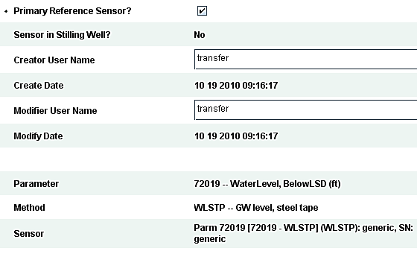
What can gwreview do for you?
Site Visit Reports sensor reading summary)
Requires primary reference sensor (steel tape, e-tape, etc…) and primary recording sensor (pressure sensor, encoder, etc…) be setup in Site Visit and readings entered for them (manual entry in Site Visit or field entry in SWAMI).
Very useful for checking data correction application
Notes:
Again, use of Site Visit is optional, but does help to more fully document the visit to a time-series GW station, in this case by allowing users to enter recording sensor readings and primary reference sensor readings into the database. If this is done, the user will be able to use the Site Visit “Sensor Reading Summary” at their continuous GW stations, which lists all primary recorder and primary reference readings along with remarks, entered accuracies, computed corrections based on the difference between the reference and recorded readings, whether the recorded reading is within the accuracy of the reference reading, the nearest recorded unit value in the database, and the correction applied at that time in the database. Very useful for checking data correction application.

Slide 31
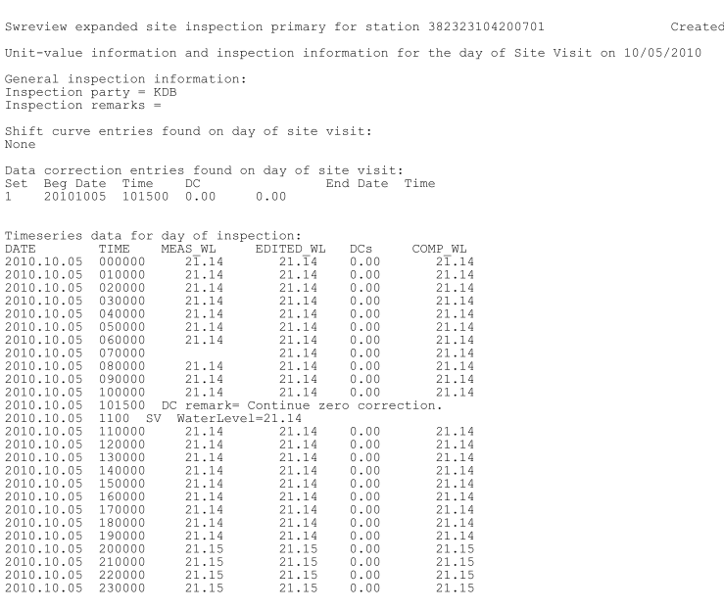
What can gwreview do for you?
Gwreview inspection primaries
Nearly complete summary of data on days of Site Visits
Produced for all days with Site Visit primary reference sensor readings
Not updated to key off of GWSI water levels yet…
Notes:
These reports are a little rough and need updated to key off of GWSI water level measurement entries in addition to just Site Visit reference sensor entries and still need some updates for Site Visit itself (will give you separate reports for each reference sensor reading instead of concatenating into one report), but are still useful in their current form. Primarily used when the UV hydrographs don’t show the resolution desired on the day of a visit. Gives an almost complete summary of data from start to finish, including measured UV data, edited UV data, UV data corrections applied to get to computed UV data along with any primary reference sensor readings and any data correction entries that day, all listed in order by time on days with primary reference sensor readings entered into site visit (again, can enter those manually or use SWAMI in the field depending on processes in place in WSC).

Slide 32
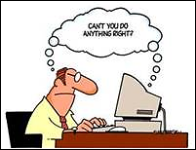
How to run the script
From NWIS prompt type: “gwreview”
Note that you can run swreview, too – either will actually work…
Follow the on screen prompts and fill out working from top to bottom
Save Your Settings
Reference data options, desired default settings, etc…
Will be prompted if you want to save settings after changing any that can be saved and trying to continue with retrieval

Slide 33
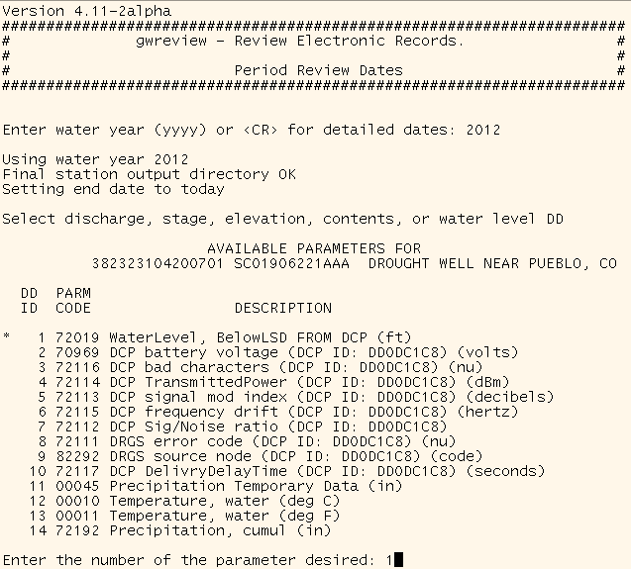
How to run the script
Just follow the prompts and enter the required information to get to the main menu
Can run for water year or specific dates (but shouldn’t exceed 2 water years due to some limitations with Adaps tabling of periods over 365 days and some file-naming issues…

Slide 34
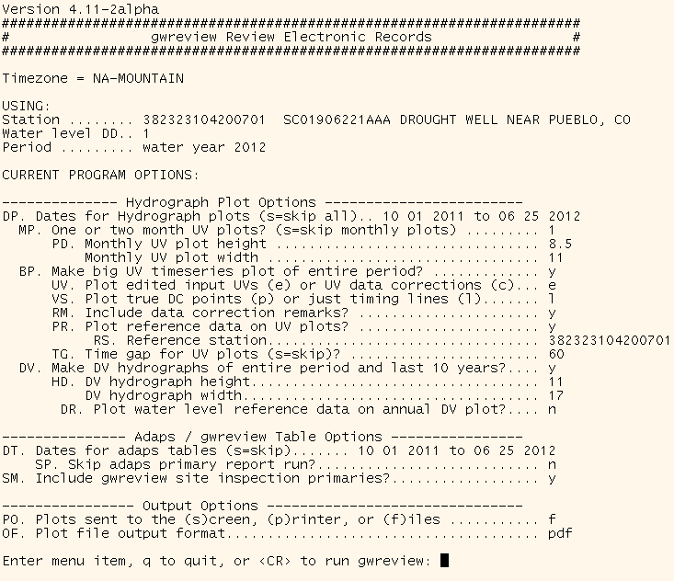
How to run the script The Gwreview Main Menu
Notes:
And that should get you to the main menu, which we’ll go over in more detail over the next few slides…

Slide 35
Can reset dates for hydrographs and for tables (both separately…).
Monthly hydrographs for the period can be split up into 1 month or 2 month plots or skipped altogether.
Plot dimensions for the monthly plots in inches.
Plot a large UV hydrograph of the entire period (not divided up into monthly/bimonthly periods). Large, fixed dimensions are used on this plot, primarily intended to be viewed electronically.
Plot edited UV water levels or UV data corrections.

Slide 36
Plot data correction entry indicators as simple timing lines or discrete entry points with corrections labeled.
Included adaps data correction entry remarks or not.
UV hydrograph reference data option.
Tell the program to “lift the pen” on the UV data trace when a gap in data exceeds this many minutes (indicate a gap in data when more than this many minutes are missing…).
Plot DV hydrographs and set dimensions of each plot (2 pages with each individual plot sharing the specified dimensions in inches when outputting to file)
Annual DV hydrograph reference data option (does not appear on 10-yr DV hydrograph…).

Slide 37
Can skip all tabling or skip all hydrograph plotting with these options, too, not just for resetting dates…
Skip primary computations (running primaries is good, but may be times you don’t want to or can’t…).
Include gwreview site inspection primaries or not.
Output options:
File and file type (pdf, pnf, mif, ps, tkg2 – tables output as text for all options except pdf…)
Print and printer options for both tables and plots separately.
Screen display (tig2 plots/text tables.
Notes:
Tabling options.

Slide 38
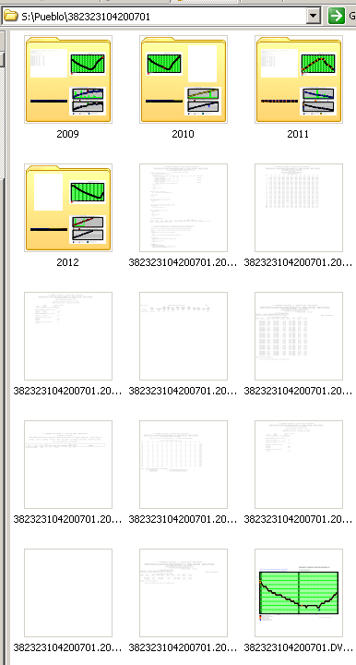
Output
File output goes to same area as all other Auto_Review output (usually /SWR)
Water year retrievals go to a water year named subfolder
Other period retrievals go into the top station-level directory
WSC may optionally divide up output by field office or any other desired division of stations
WSC may have output setup on local website, links to output enabled in SIMS, etc…
Notes:
Water-year retrievals are output into a wateryear directory – other period retrievals are put into the top station level directory. Water year handy for archival and automated/batch retrievals will only pull by water year – period handy for continuous records work, especially periods crossing water year boundaries. Suggest normally using water year output as data-aging is normally pretty clearly indicated on most output to help key in on period of interest, but use specific period when working period crossing water year boundary if desired to avoid having to jump back and forth between 2 folders.

Slide 39
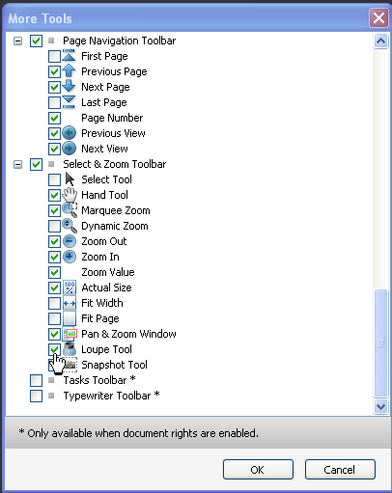
Tips and Tricks
Use Adobe Reader tools.
Default toolbar has very few of the total number of tools
Right –click anywhere on toolbar to bring up other available tools.
Loupe tool is exceptionally useful!
If viewing from SIMS/RMS links, disable “view in browser” option in Edit>Preferences> Internet to prevent output from being trapped in small window
Notes:
The default tools in Adobe Reader that are likely showing in your toolbars are a very small subset of the total number of tools available. Right-click anywhere on the toolbar to bring up the list of available tools. Many of the Zoom tools can be extremely useful for records work so you can easily zoom in and navigate around plots with ease.

Slide 40
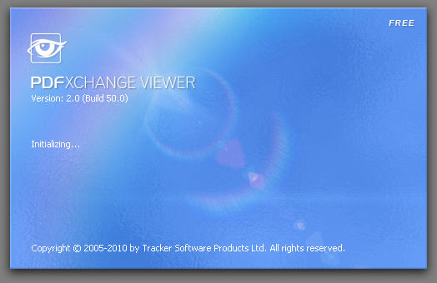
Tips and Tricks
PDF XChange Viewer
Alternative free pdf viewer with the same zoom/display features but also has editing features.
Notes:
Demo PDF XChange Viewer editing options.
PDF XChange Viewer is another free pdf viewing option with some other features not available in Adobe Reader as well as loupe tool and pan/zoom like Adobe Reader. Foxit is another one but lacks the loupe and other zoom tools.
Significant edits/commentary should be archived – likely best to leave significant content in RMS, station analysis, etc…, but these can be useful for simple checking tracking, etc… Just be sure to rename files so future swreview file updates don’t overwrite edited files.

Slide 41
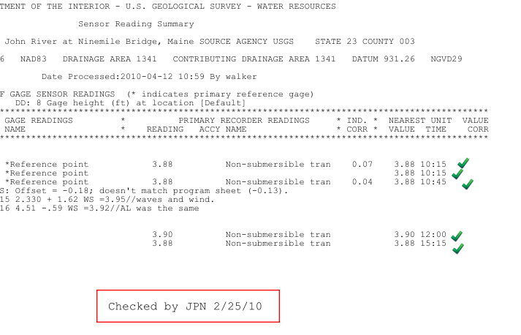
Tips and Tricks
PDF XChange Viewer
Can add notes to files, text directly, arrows, etc…
Can also use loupe tool and pan/zoom
Notes:
Minor editing features let you add notes, text, arrows, highlight text, etc... directly on the plot and save those edits (see examples in slides)...
Significant edits/commentary should be archived – likely best to leave significant content in RMS, station analysis, etc…, but these can be useful for simple checking tracking, in remote check and review to share issues via email, etc… Just be sure to rename files if you want to keep the edits so future gwreview file updates don’t overwrite edited files.

Slide 42
Tips and Tricks
Link to stations' Auto_Review output area available from SIMS webpages
Can increase file access speeds, but can't rename, edit, etc… pdf files
Great for remote records checking and reviewing
Can add other files to that area as necessary to assemble an even more complete electronic record packet available from stations' SIMS/RMS pages
Contact GS-W_Help_SIMS@usgs.gov to enable this feature on your SIMS pages (area must be setup on local webserver first…)
Sites can be added to the WSC’s master swreview.control file to enable automated updates (if WSC has them enabled).
Will automatically update output anytime a significant change to the station is detected in ADAPS or GWSI.
Timing depends on how busy server is and timing of automated process in WSC.
Continuous GW sites may already be included (was an installation step in the release prior to this one…).

Slide 43
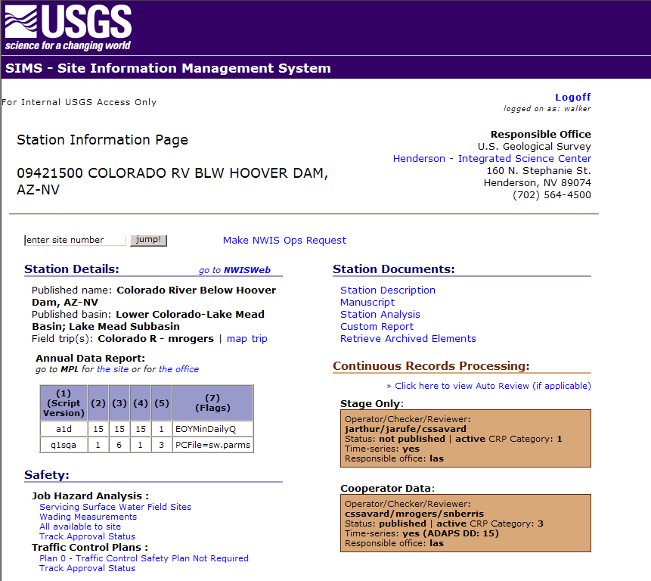

Slide 44
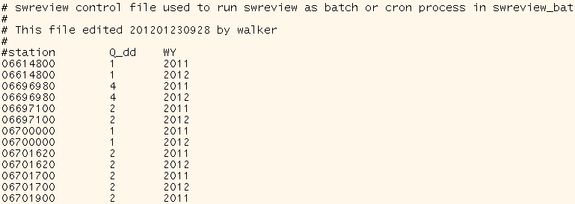
Tips and Tricks
Sites can be added to the WSC’s master swreview.control file to enable automated updates (if WSC has them enabled).
Will automatically update output anytime a significant change to the station is detected in ADAPS or GWSI.
Timing depends on how busy server is and timing of automated process in WSC.
Continuous GW sites may already be included (was an installation step in the last release…).
Notes:
Note that gwreview can only process one station at a time and each station can take up to 10 minutes to process, so updates may not be immediate depending on how busy the server is, where your station falls in the list of sites to update, etc… But you can manually pull output at any time and the automated updates are still useful to ensure updates don’t get lost due to users forgetting to pull things, forgetting to run primaries first, etc…

Slide 45
Release Schedule
Released July 2012.
Available in Auto_Review package on OSW_Scripts website: http://water.usgs.gov/usgs/osw/adaps/swreview.html
May already be installed on your server (type gwreview to find out…)
Even if using last version, you should still be able to run continuous GW stations in swreview… Upgrade will just make output better and more complete.

Slide 46
Desired Enhancements of Auto_Review
“Metreview” for meteorological Data Descriptors
“Wqreview” for WQ-sampling records (different beast here and author has no great ideas at this point…would likely need to abandon tkg2 plotting…)
Enhanced support for Index Velocity Discharge records in swreview.
Perhaps support for periodic GW-level stations?
New Time-Series software may incorporate current functionality before any of this gets done…

Slide 47
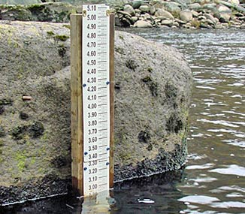
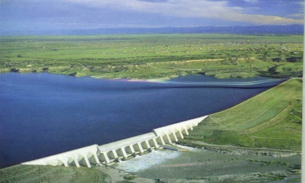
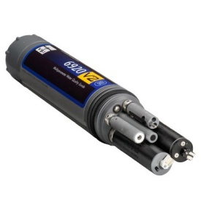
Don’t forget Auto_Review can also process:
Stage only sites (swreview)
SW partial-record/CSG sites (swreview)
Reservoir & Lake Contents and Elevations (swreview)
Continuous water quality monitor records (wqmreview)

Slide 48
Enhancement Suggestions, Problem Reports, or General Support
Contact the OSW scripts personnel @ GS-W OSW Scripts@usgs.gov
Or just shoot Wade Walker an email, IM, or call
walker@usgs.gov, 719-544-7155 x125

Slide 49
Questions?

