Slide 1

Branch of Regional Research (ER) National Research Program January 2008 All-Hands Meeting
1/3/2008

Slide 2
Outline
Branch & NRP budget issues
Chief Scientist: State of the NRP
Branch News
Admin and Internal Controls
BC/ABC Additional duties
Branch Recognition
Miscellaneous
Questions?

Slide 3
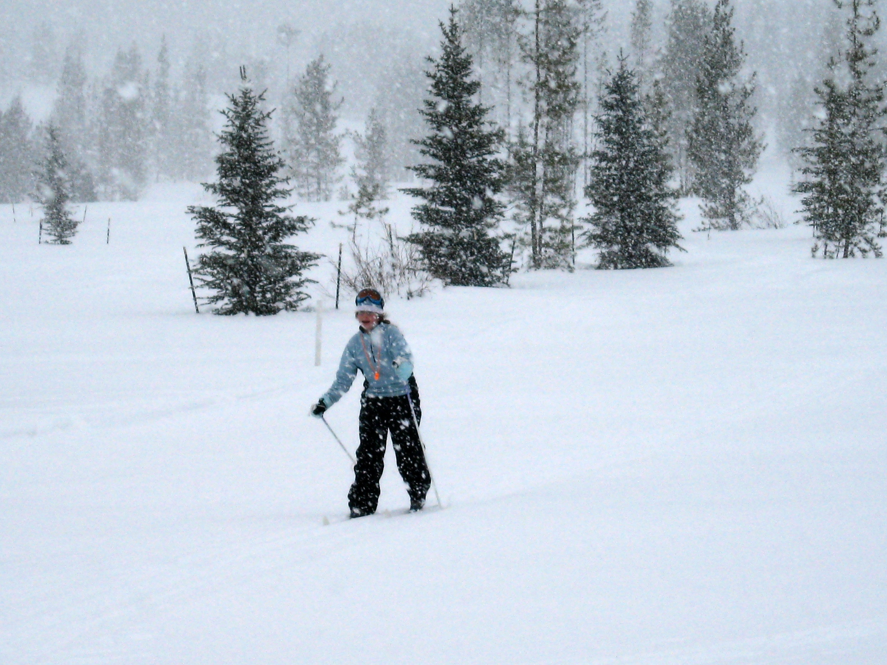

Slide 4
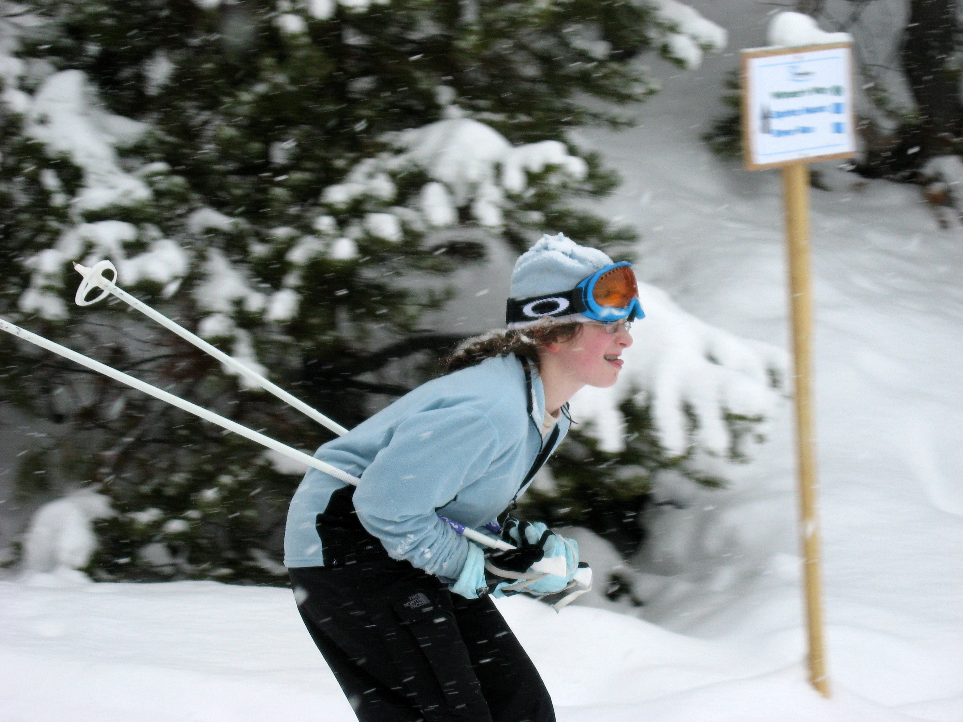

Slide 5
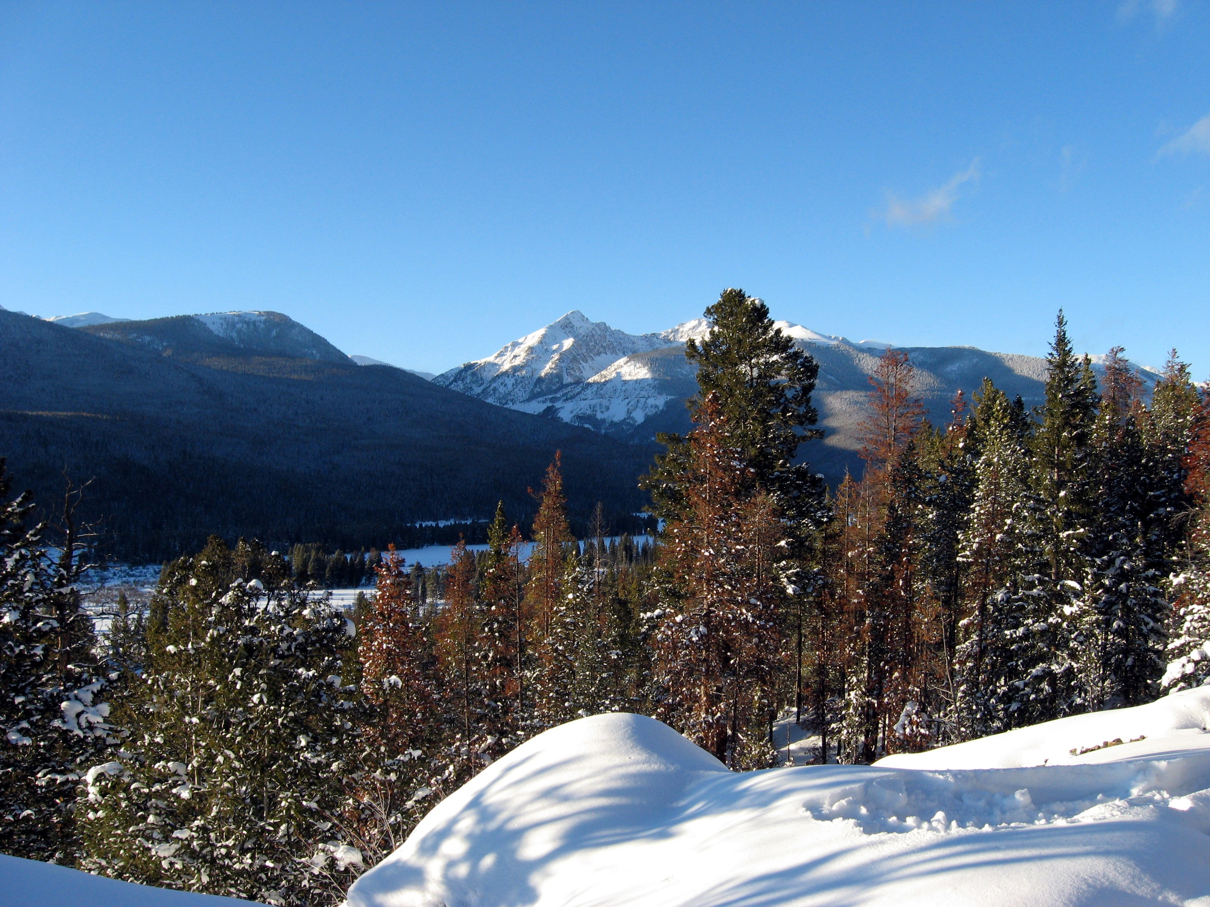

Slide 6
Branch/NRP Budget FY08
Looking good overall for this year. Possible 20% decrease in PES funding for FY09 (pull-out of GAM program).
Two-year funding passed: will come with additional admin requirements and mandatory “internal controls”.
Uncertainties: earmarks (e.g. LEAG), VSIP/VERA enrollments...

Slide 7
Chief Scientist: State of the NRP
Potential new funding for USGS: climate change and C sequestration; water availability; ocean science.
Four to five hires envisioned for 2008.
Projections indicate minimal OE hold-backs (0-20%). Latest info: funding for NRP initiatives (climate change, water availability, etc...) is anticipated this year.
Keep seeking reimbursable funding. Each NRP RGE scientist is asked to bring in a portion of their own salary and support staff salary. In FY07, almost half of NRP RGE scientists brought in outside funding.
$1.4 Million additional funds provided by CS/H in 2007. Submit your 2008 requests through the Branch.
New SWC ARA: Colleen Rostad
Two new potential ST’s in NRP (under DOI review).

Slide 8
Branch News
Hydrologist GS-11 Term position closing today.
Project Assistant Vacancy announcement coming soon.
Other good news:
Barbara Cardellichio is now Barbara Wainman’s Executive Assistant.
Emerson is now a BRR/ER Project Assistant (Keith Burrell can do scanning & copying)
EPN costs more reasonable (let us know if you need any EPN work).
No “Competitive Sourcing” for RGE scientists!

Slide 9
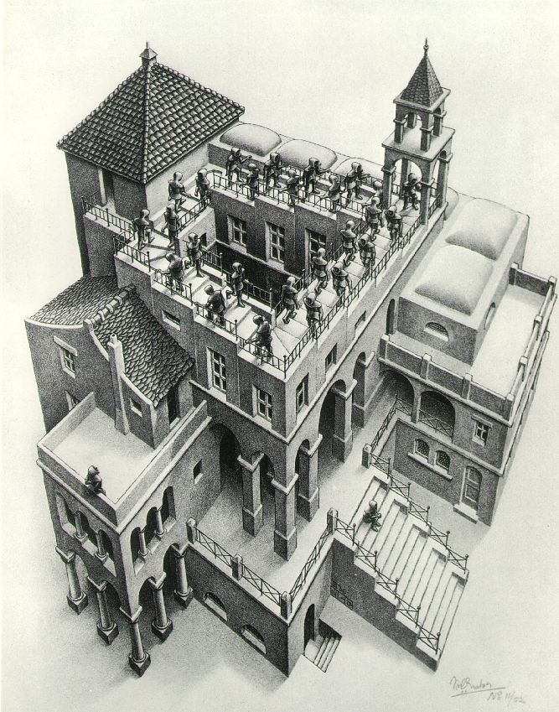

Slide 10
Admin and Internal Control stuff
NRP “in-kind” contributions such as NRP salary incentives. Do account for them in reimbursable funding proposals. E.g. you should show “In-kind OE contributions”.
IPDS: the new report tracking system. ⇒ Lots of email. Kim Griffin finds Skipper!
Bank Card receipts (you now need to provide them, or travel voucher number).

Slide 11
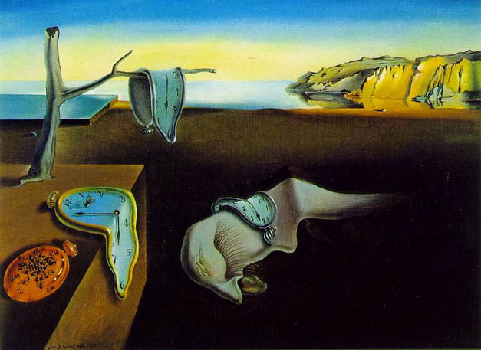

Slide 12
Admin and Internal Control stuff (2)
Gov-trip problems. Provide more lead time on arranging trips. Generally true also for anything requiring admin review.
Reimbursable training amended by BRR/ER (135 Flash Player “animated” slides down to 5 informational slides). Proposal review checklist being developed:
Is it in the NRP’s mission?
Are the right Authorities cited?
Do you have sufficient PI and support staff salaries? Are financial estimates reasonable?
Are overhead calculations accurate?
Reimbursable info, training course & checklist to be placed on Branch web site

Slide 13
BC & ABC additional duties
Pierre:
LEAG earmark & Lower Mississippi issues
Klamath Lake
Perchlorate IWG
ORSANCO (Ohio River Sanitary Commission)
ISCMEM (environmental modeling)
FY2008 Research Committee Meeting
Harry:
Computer Advisory Board
Library Committee (Reston Chair)
WRD Instrumentation Committee
National Center Environmental Management Committee

Slide 14
Internal web site & Pubs
Internal Branch Web site: http://water.usgs.gov/usgs/nrp/brrer/
Getting more use (also used by the other branches and by ER WSCs)
Pdf library/archive added to internal NRP web site:
http://water.usgs.gov/usgs/nrp/publications/.
Give your pdf files to Emerson and Linda Friedman (CD’s or USB key preferred).
Need to forward important articles to Matt & Earl. Please give us 2 hardcopies and the pdf, and we will forward the articles.
Branch hardcopy archive is located in the file cabinets next to the color printer in MS432.

Slide 15
BRR/ER calendar 2007 Pubs (only BRR/ER authors listed)
Chesapeake and Everglades PES
Baldizar, Rybicki: Restoration potential of SAV in the tidal Pocomoke…
Kroes, Hupp, Noe: Sediment, nutrient & vegetation trends along the tidal forested Pocomoke…
Noe: Phosphorus budgets in Everglades wetland ecosystems: effects of hydrology & nutrient enrichment.
Noe, Harvey: Characterization of suspended particles in Everglades wetlands.
Noe, Hupp: Seasonal variation in nutrient retention during inundation of a short-hydroperiod floodplain.
Rybicki, Landwehr: Long-term changes in abundance & diversity of macrophyte and waterfowl populations…
Rybicki, Yoon, Schenk, Baldizar: Distribution of SAV in the fresh & oligohaline tidal Potomac…
Simon: Processes affecting phosphorus & copper concentrations and their relation to algal growth in two supply reservoirs….
Climate, floods, droughts
Eng, Milly: Relating low-flow characteristics to the base-flow recession time constant at partial record stream gauges.
Eng, Milly, Tasker: Flood regionalization: a hybrid geographic & predictor-variable region-of-influence regression method.
Milly: Modeled impact of anthropogenic land cover change on climate.
Milly: Stationarity is dead.

Slide 16
2007 Pubs (only BRR/ER authors listed)
GW gases, tracers, & geochemical modeling
Böhlke: Vertical gradients in water chemistry and age in the Northern High Plains aquifer, NE.
Plummer, Busenberg: Transport and degradation of CFCs in the pyritic Rabis Creek aquifer, Denmark.
Busenberg, Plummer: Evidence of CFC degradation in gw under pyrite-oxidizing conditions.
Plummer: Recharge area, base-flow & quick-flow discharge rates & ages & general water quality of Big Spring, Missouri.
Plummer, Busenberg: Evidence for terrigenic SF₆ in gw from basaltic aquifers.
Plummer: Origin of halite brine in the Onondaga trough …: modeling geochemistry & flow.
Plummer: Origin of halite brine in the Onondaga trough …: characterization & simulation of variable-density flow.
Microbiology
Kirshstein, Voytek: Quantitative PCR detection of Batrachochytrium Dendrobatidis DNA from sediments & water.
Kirshstein, Voytek: Ammonia-oxidizing bacterial community composition in estuarine and oceanic environments assess using a functional gene microarray.

Slide 17
2007 Pubs (only BRR/ER authors listed)
GW flow and transport
Konikow, Neuzil: A method to estimate gw depletion from confining layers.
Sanford: Effect of an offshore sinkhole perforation in a coastal aquifer on submarine gw discharge.
Sanford: 3-D flow in the Florida platform: theoretical analysis of Kohout convection…
Sanford: A new focus on gw-seawater interactions.
Sanford: Investigation of the gw system at Masaya Caldera, Nicaragua, using transient electromagnetics and numerical simulation.
Shapiro: Contamination in fractured-rock aquifers – Research at the NAWC site, NJ.
Shapiro: Publishing our “ugly babies.”
Shapiro: Integrated multi-scale characterization of gw flow and chem transport…Mirror Lake site.
Voss: Heat transport in the Red Lake bog, glacial lake Agassiz peatlands.
Voss: Gw flow with energy transport & water-ice phase change: numerical simulations, benchmarks, & application to freezing in peat bogs.
Voss: Freshwater-saltwater transition zone movement during aquifer storage and recovery cycles in Brooklyn and Queens, NYC.
Zinn, Konikow: Effects of intraborehole flow on gw age distribution.
Zinn, Konikow: Potential effects of regional pumpage on gw age distribution.

Slide 18
2007 Pubs (only BRR/ER authors listed)
Isotope techniques and applications
Böhlke, Hannon: Analysis of N & O isotopes in nitrite & nitrate by sequential selective bacterial reduction to N₂O.
Böhlke: Oxygen and chlorine isotopic fractionation during perchlorate biodegradation: laboratory results & implications for forensics and …
Tobias, Böhlke, Harvey: ¹⁸O isotope approach for measuring aquatic metabolism in high-productivity waters.
Casciotti, Böhlke, Mroczkowski, Hannon: Oxygen isotopes in nitrite: analysis, calibration and equilibration.
Coplen: Calibration of the calcite-water oxygen isotope geothermometer at Devils Hole, NV, a natural laboratory.
Révész, Coplen: Methods of the Reston Stable Isotope Laboratory.
Révész, Casciotti: Determination of ¹⁵N/¹⁴N of nitrate in solids.
Révész, Casciotti: Determination of ¹⁵N/¹⁴N & ¹⁸O/¹⁶O of nitrate in solids.
Révész, Casciotti: Determination of ¹⁵N/¹⁴N of nitrate in water.

Slide 19
2007 Pubs (only BRR/ER authors listed)
Nutrient transport and transformations
Böhlke: GW stratification & delivery of nitrate to an incised stream under varying flow…
Böhlke, Kraemer: Effects of sw irrigation on sources, fluxes & residence times of water, nitrate and uranium in an alluvial aquifer.
Böhlke: Aquifer-scale controls on distribution of nitrate & ammonium in gw near La Pine, OR.
Scott, Harvey: Dominance of organic nitrogen from headwater streams to large rivers across the conterminous US.
Simon: Quantifying the benthic source of nutrients to the water column of Upper Klamath Lake.
Contaminant geochemistry:
Cozzarelli: Centimeter-scale characterization of biogeochemical gradients at a wetland-aquifer interface using capillary electrophoresis.
Cozzarelli: Evaluation of sulfate reduction at experimentally induced mixing interfaces using small-scale push-pull tests in an aquifer-wetland system.
Cozzarelli, Weiss: Biogeochemistry of aquifer systems.
Landa: Naturally occurring radionuclides from industrial sources: characteristics & fate in the environment.
Révész: Natural gases in gw near Tioga Junction, PA

Slide 20
2007 Pubs (only BRR/ER authors listed)
Ecohydrology, Tuscan rivers, Cloud water, Bromine vapors, Impact Craters, History of Science, fractal topography…
Harvey: Fractal topography and subsurface water flows from fluvial bedforms to the continental shield.
Hupp: Riparian vegetation patterns in relation to fluvial landforms and channel evolution along selected rivers of Tuscany.
Landa: From agricultural geology to hydropedology: forging links within the 21st century geoscience community.
L. Larsen, Harvey: A delicate balance: ecohydrological feedbacks governing landscape morphology in a lotic peatland.
Noe: Voulunteer monitoring demonstrates tree planting help stream ecosystems.
Sanford: Site report for USGS test holes drilled at Cape Charles, VA.
Scholl: Cloud water in windward and leeward mountain forests: the stable isotope signature of orographic cloud water.
Wood, Sanford: Atmospheric bromine flux from the coastal Abu Dhabi sabkhat: a gw mass balance investigation.

Slide 21
Branch Recognition
Few SSA and MSA awards this year. DSA given to Ralph Cheng. SSA to Dorothy Tepper.
BRR/ER Length of Service awards to Ed Landa (30 yrs), Marge Shapira and Julian Wayland (20 yrs), Kathy Conko and Stan Mroczkowski.
Dave Shultz award to Linda Friedman.
Latest GEM awards: Nosheen Anwar and Irene Myers.
More nominations needed! For internal and external awards & recognition of USGS scientists.

Slide 22
Miscellaneous
Become an NRC post-doc advisor (and encourage post-docs to apply).
Get student help (minority programs, volunteers…). We will try to fund student help before equipment this summer.
RGE cycle starting soon (all online; only pdf files accepted).
NRP and WRD volunteers for WRD lecture Series and for RGE panels
Notes:
RGE: Research Grade Evaluation Process.

Slide 23
Miscellaneous (2)
USGS Manager’s meeting (2nd or 3rd week of April).
Branch Chief attending Federal Executive Institute (3rd and 4th weeks of April and July).
Research Committee Meeting (May 20-22 near Leetown, WV).
Office of Ground Water meeting (week of August 4th).
Flint River and Great Valley/Potomac Valley are possible study sites for Water Availability funding, if ER has a say.
Notes:
RGE: Research Grade Evaluation Process.

Slide 24
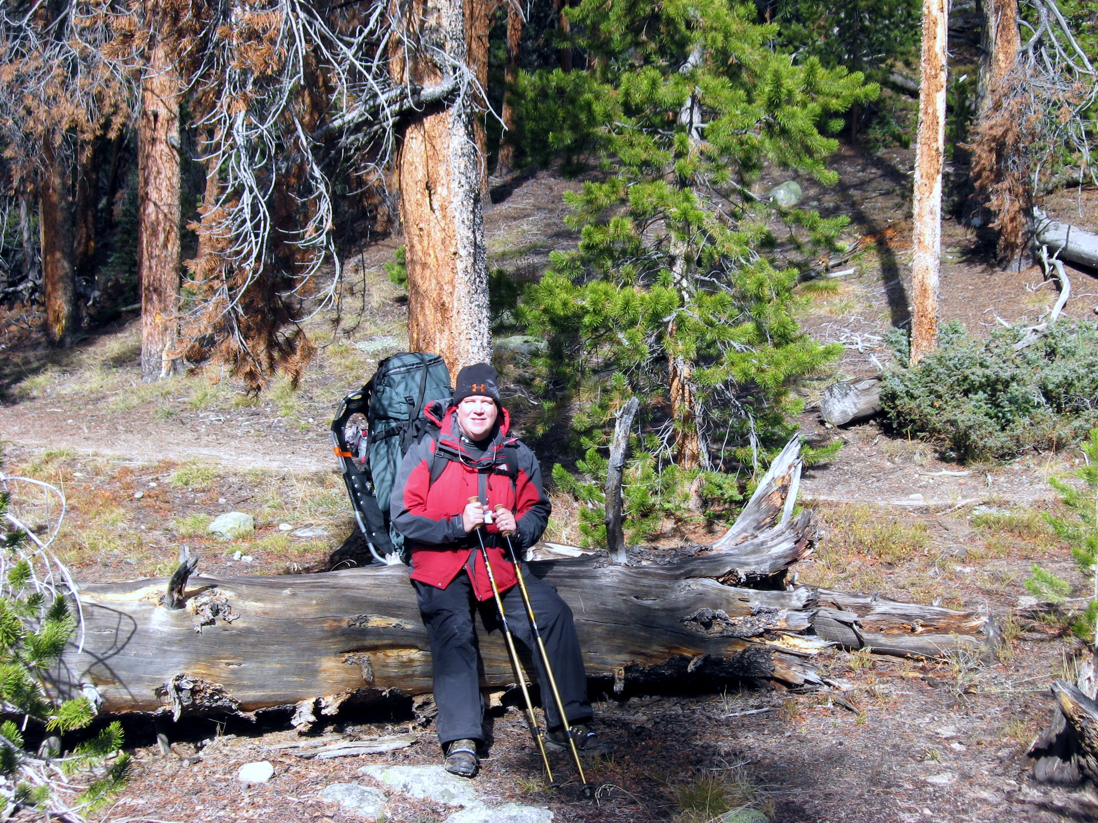

Slide 25
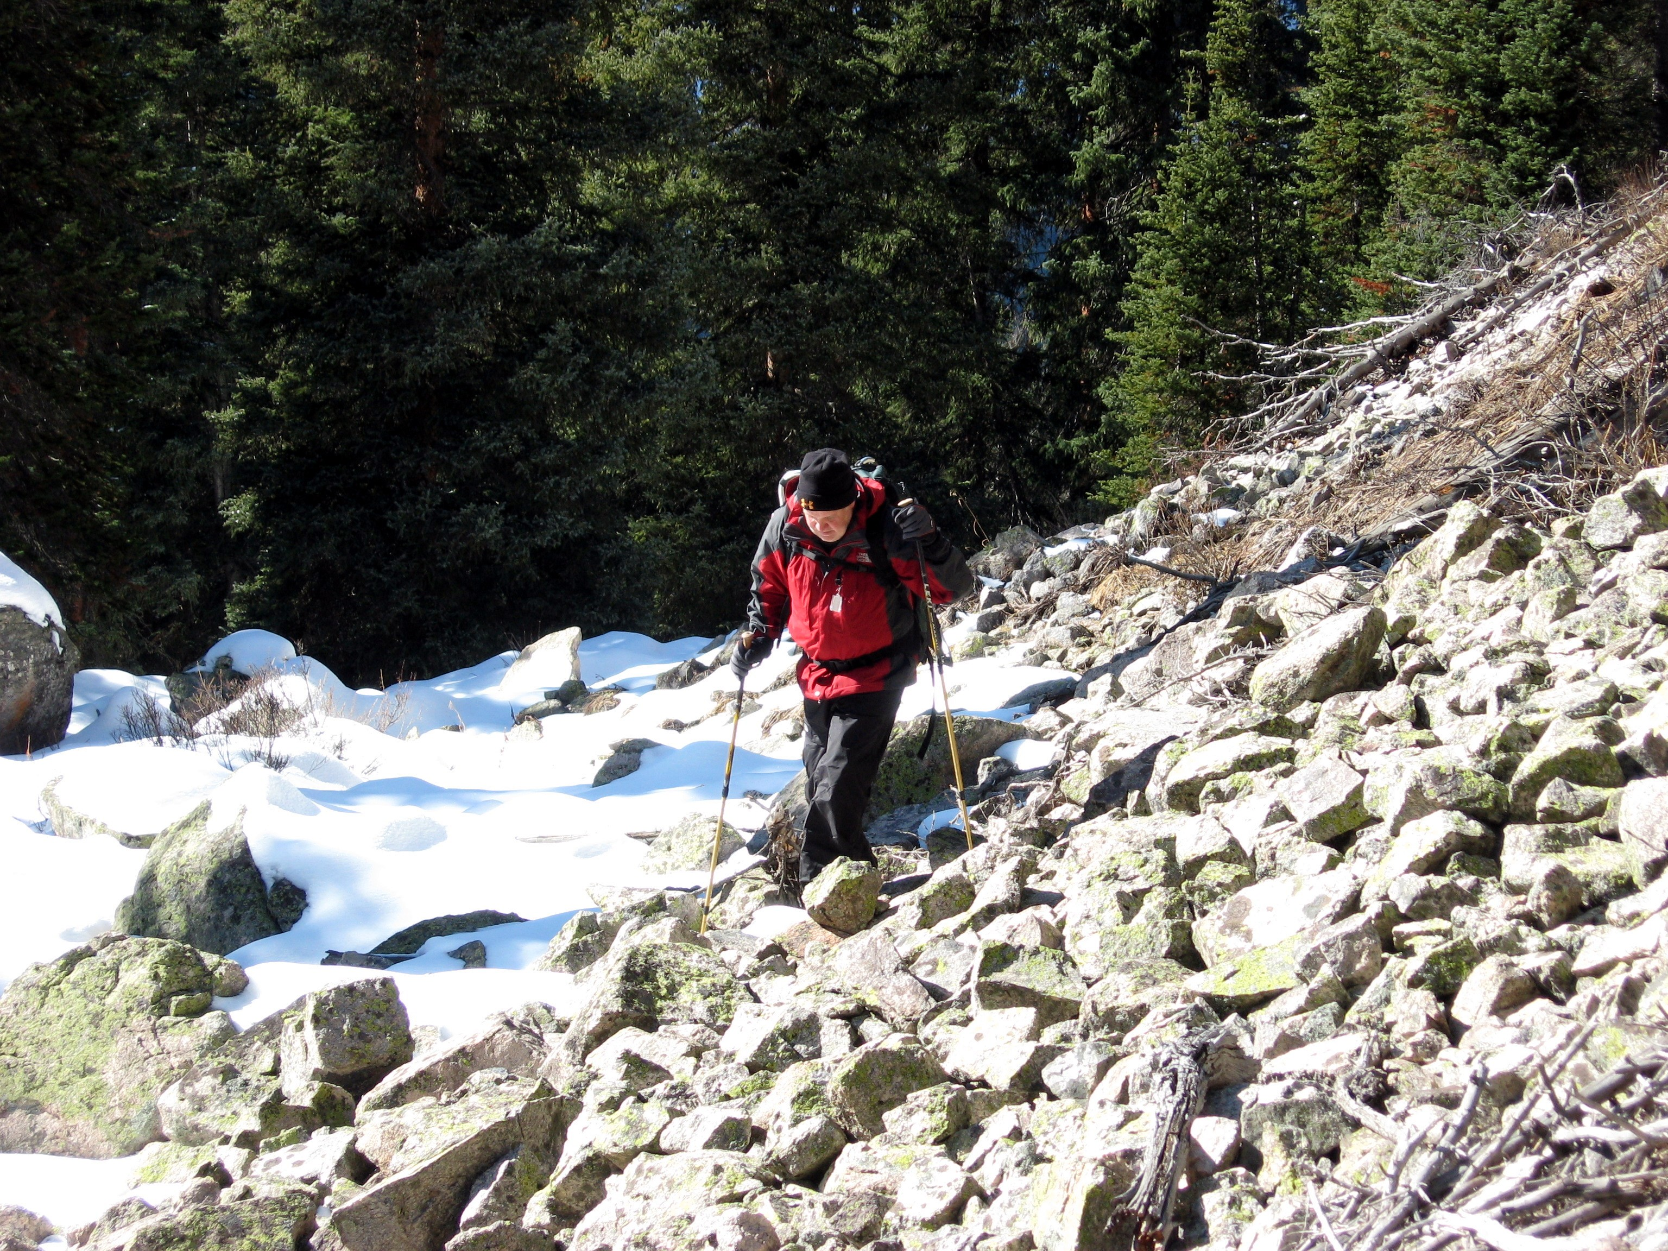

Slide 26
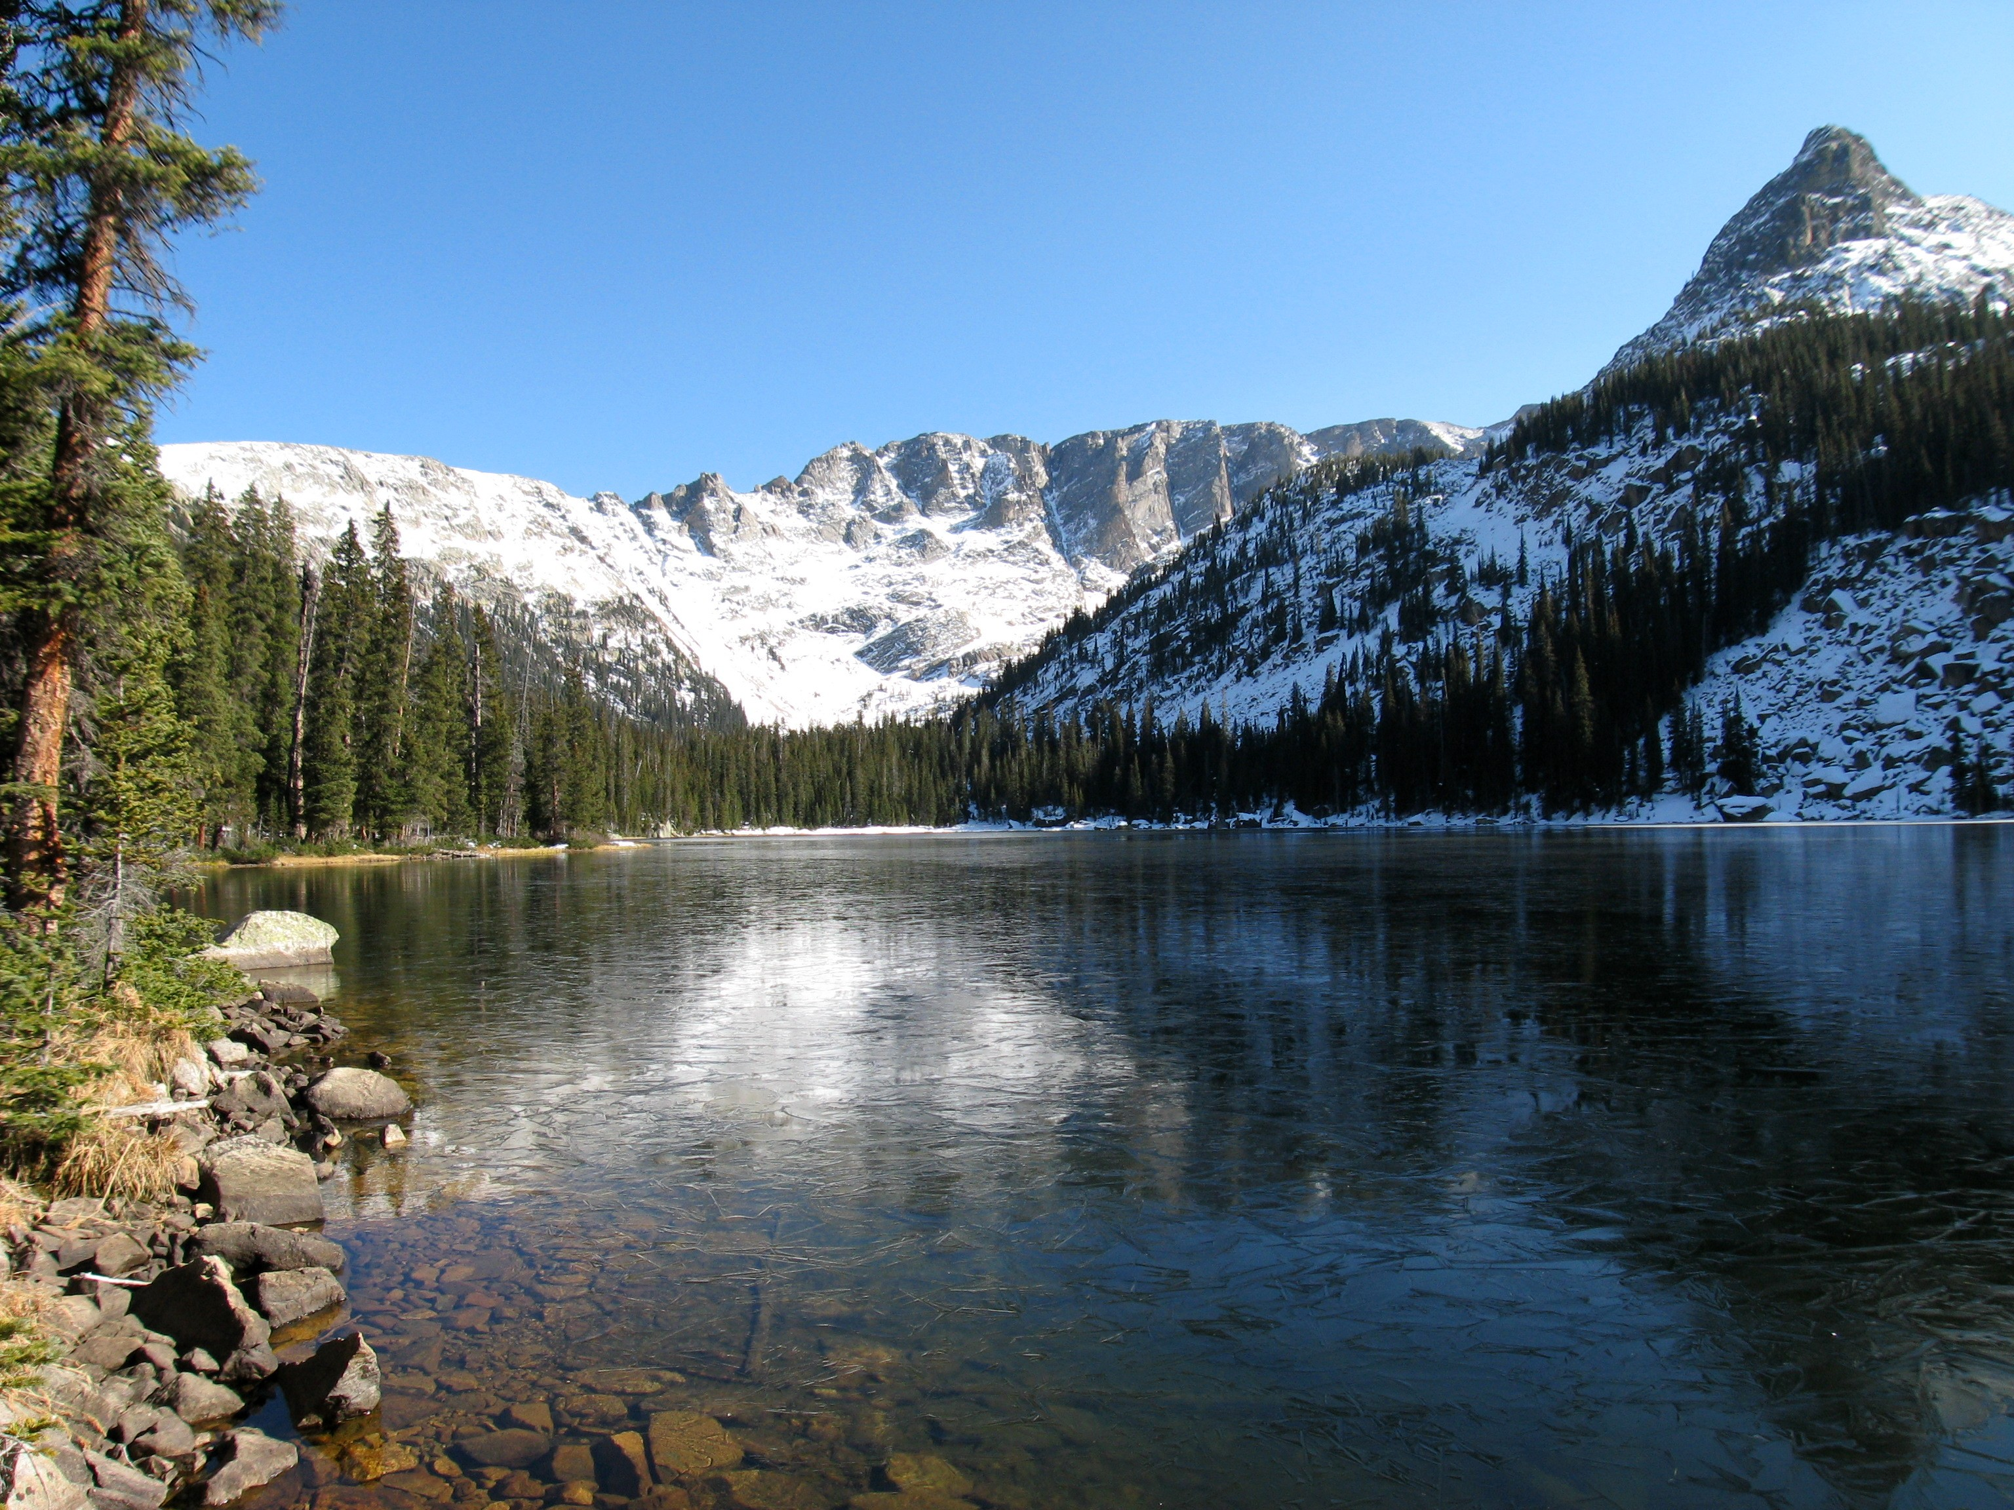

Slide 27
Questions?

