Slide 1
Network & Security Session
Telecom Operations Manager Tim H. Lee
Wide Area Network Support GS Help Wan
Network Operation Security Center (NOSC) 1-866-376-6672 (1-866-ESN-NOSC)
NOC@Lists.mci.com
Security Operations Manager Alan Wiser
Firewall Issues GS Help Firewall
Security Issues GS_ITSOT@USGS.GOV
DNS Support GS Help DNS
Service Desk 1-703-648-HELP (4357) Servicedesk@usgs.gov

Slide 2
Today’s Agenda
Network Topology
Switch Configuration “Best Practices”
ESN Security Gauntlet
MRTG Graphs
Top Talker & Netflow Reports
Contacting the NOSC
General Question & Answer

Slide 3



USGS Site Network
1000 MB
100 Meters

Slide 4
Network “Best Practices”
Turn off Telnet
Turn on SSH
Rename SNMP Community String
Turn on SSL for HTTP
Shut Down Unused Ports
Spanning Tree
Rename Default User Accounts
Set Inactivity Timers
Setup Logging/Graphing

Slide 5
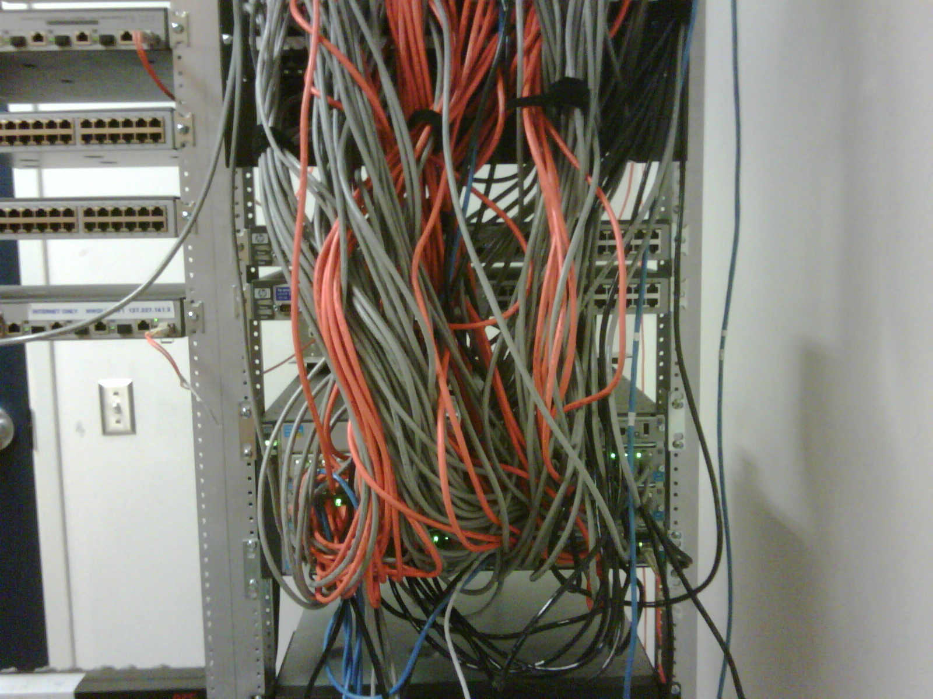

Slide 6
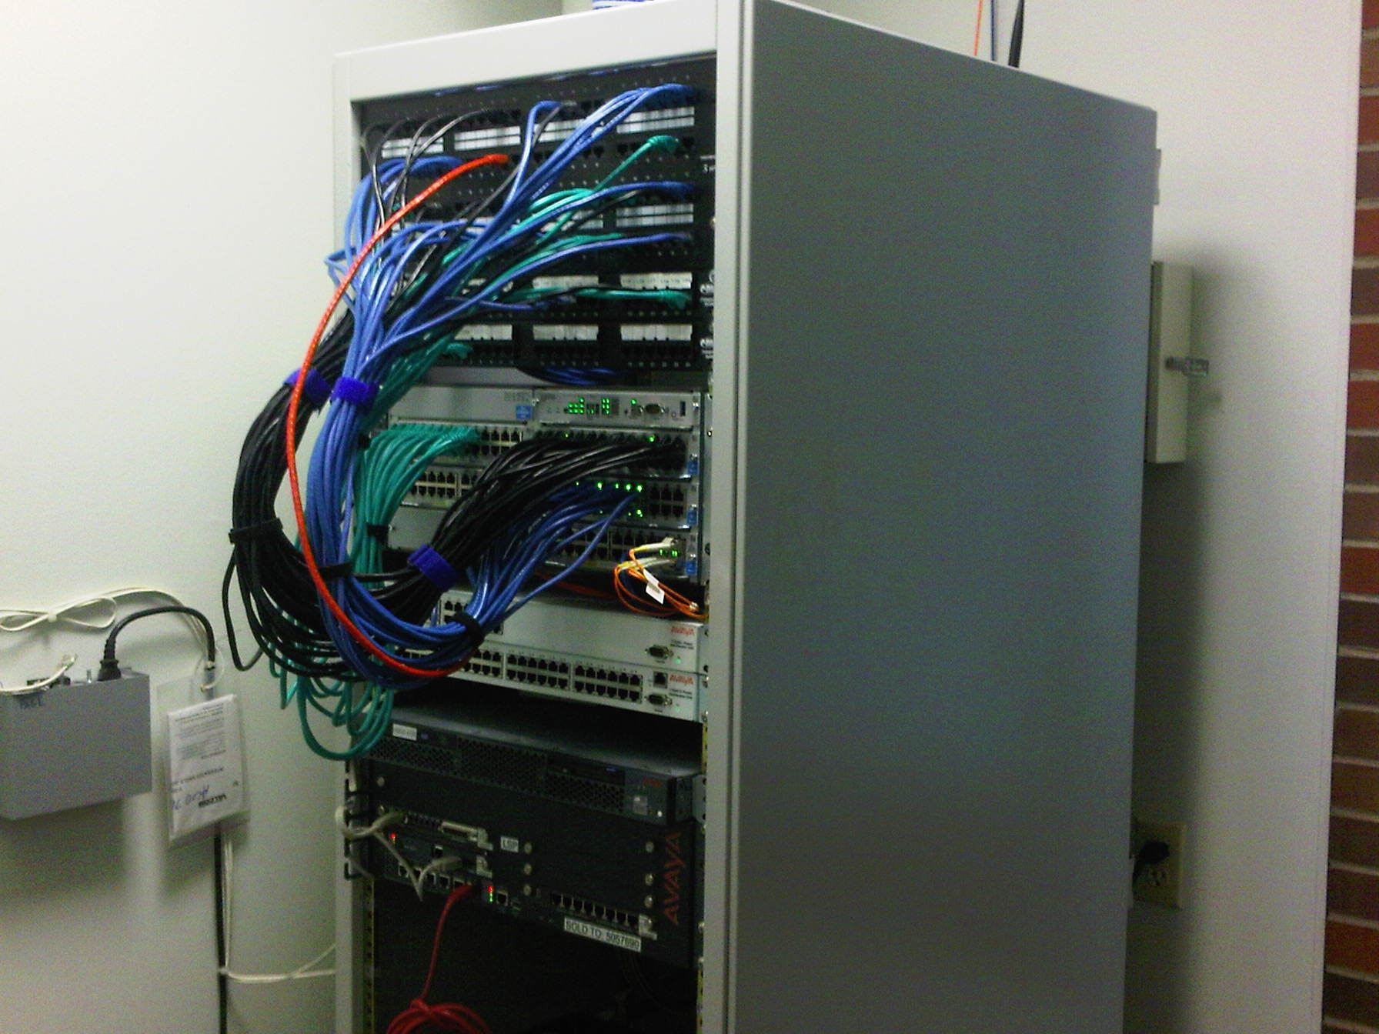

Slide 7

USGS Site Network
10.x

Slide 8

USGS Site Network
137.227.x
10.x

Slide 9
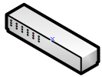
USGS Site Network
137.227.x
Internet Only
10.x

Slide 10

USGS Site Network
137.227.x
137.227.x
Internet Only
10.x
10.x
T1, DS3, Frac DS3
T1 - 1.544 megabits per second
Frac DS-3 3 to 45 meg (in 3 meg increments)
DS-3 - 45 megabits per second)
OC3 - 155 megabits per second
OC12 - 622 megabits per second

Slide 11

USGS Site Network
137.227.x
Internet Only
OC-12
10.x

Slide 12


USGS Site Network
137.227.x
137.227.x
Internet Only
10.x
10.x
100 MB
1000 MB
Sensitive
ESN Security Gauntlet
OC-12

Slide 13




USGS Site Network
137.227.x
137.227.x
Internet Only
10.x
10.x
ESN Security Gauntlet
Sensitive

Slide 14
USGS Site Network - Site-to-Site
Internet Only
A
Intranet
Internet Only
ESN Security Gauntlet
Sensitive
B

Slide 15
USGS Site Network - Site-to-Internet
Internet Only
A
Intranet
Internet Only
ESN Security Gauntlet
B

Slide 16
USGS Site Network - Site-to-Intranet
Internet Only
A
Intranet
Internet Only
ESN Security Gauntlet
B

Slide 17
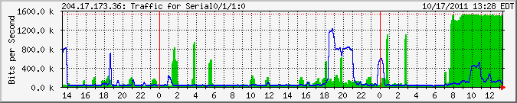
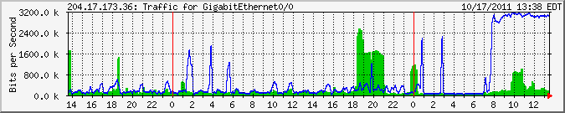
MRTG
Serial 0/0 Site with T-1 Circuit
Ethernet 0/0

Slide 18
MRTG SITE
To get to the MRTG web pages
http://gsnet.er.usgs.gov/
To look at the Daily Alert page
http://gsnet.er.usgs.gov/mrtg/play/list_active_alerts.php

Slide 19
Contacting the NOSC
Name and USGS Location
Trace Route and Pings from source to destination.
Make sure you get a Ticket #
You can call back for status or request they call you.

Slide 20
TOP Talkers Report
A traffic report can be obtained by contacting the NOSC.
If you are having an emergency you can ask the NOSC to fax the report to you. Otherwise they will post to a location that can only be accessed by one of my staff. We are working to make this process easier.
A Netflow report can be created by Tom Vandreser that may also be helpful.

Slide 21
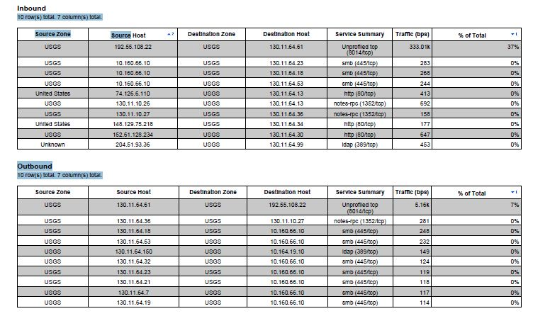
Top Talkers (Cont)

Slide 22
Netflow Reports
Top source addresses:
2861.82MB 192.55.108.22 IGSAAAEIAVS01.er.usgs.gov
175.37MB 74.63.47.82
41.36MB 130.11.64.61 igsahoewlt11.er.usgs.gov
35.30MB 130.11.10.27 gspahrbm02.er.usgs.gov
22.04MB 130.11.10.26 gspahrbm01.er.usgs.gov
19.22MB 140.90.33.23 nos-ssmc2.woc.noaa.gov
16.57MB 74.125.224.118
Top destination addresses:
2707.27MB 130.11.64.61 igsahoewlt11.er.usgs.gov
182.99MB 130.11.64.27 igsahoewws27.er.usgs.gov
152.15MB 130.11.64.58 igsahoewlt08.er.usgs.gov
90.66MB 130.11.64.66 igsahoewlt16.er.usgs.gov
87.47MB 130.11.64.28 igsahoewws28.er.usgs.gov
45.96MB 130.11.64.20 igsahoewws20.er.usgs.gov
44.60MB 192.55.108.22 igsaaaeiavs01.er.usgs.gov
29.71MB 130.11.64.5 igsahoewws05.er.usgs.gov
Top address pairs
192.55.108.22 -> 130.11.64.61 2707.24MB
74.63.47.82 -> 130.11.64.27 175.37MB
192.55.108.22 -> 130.11.64.58 141.59MB
130.11.64.61 -> 192.55.108.22 41.35MB
140.90.33.23 -> 130.11.64.66 18.78MB
74.125.224.118 -> 130.11.64.28 16.53MB
130.11.10.27 -> 130.11.64.66 11.99MB
209.165.150.26 -> 130.11.64.58 10.02MB

Slide 23
Misc Topics
Quality of Service (QOS)
Networx
Trusted Internet Connection (TIC)
Lan-2–LAN service
eRAS
Wireless Waivers
Menlo OC-3 Upgrade
IT Transformation

Slide 24
Questions

