Slide 1
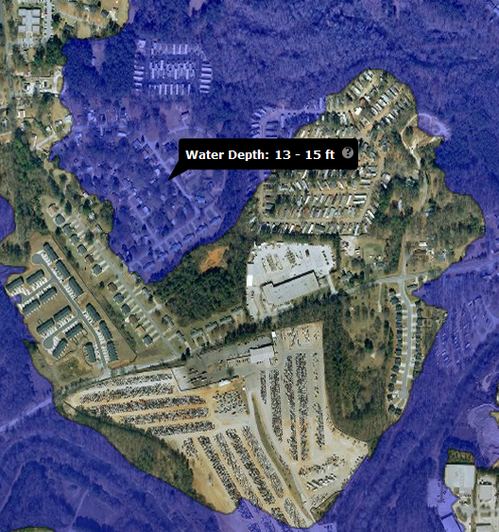

Flood Inundation
Mapping
Program
Project needs overview
Marie C. Peppler
USGS FIM Coordinator
Notes:
Feel free to call anytime if you have any questions. Marie Peppler, 703.648.5314

Slide 2
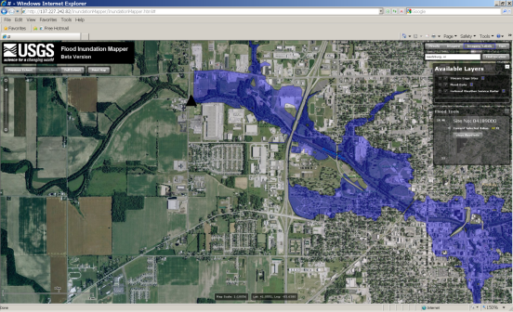
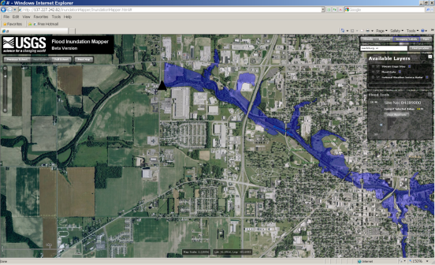
Flood Inundation Maps translate a hydrograph into operational maps that communicate risk and consequences
Notes:
Translates a hydrograph (vertical stage point information) into a series of concentric inundation maps (area based information) that have many uses.
Focus on deterministic mapping for all flood stages – NOT probabilistic mapping (ie 1% chance floodway, etc.)

Slide 3
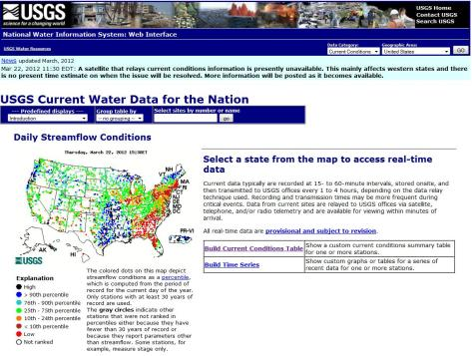
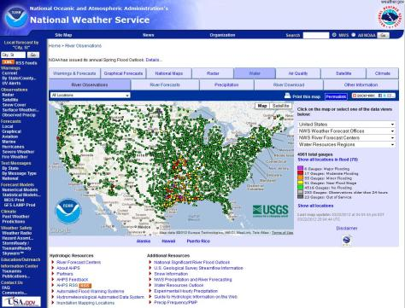
USGS and NWS Data Networks
The FIM Program is built upon these existing data and all of the expertise that is required to develop and maintain them.
Over 8,000 USGS Gages reporting current stream conditions in NWIS
Over 4,000 NWS Flood Forecast/Warning locations in AHPS
Notes:
USGS handles 93% of the nation’s real-time river gages.

Slide 4
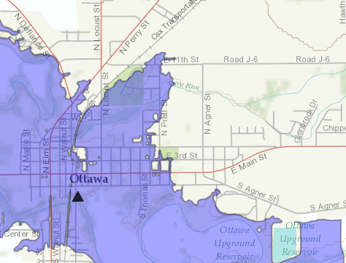
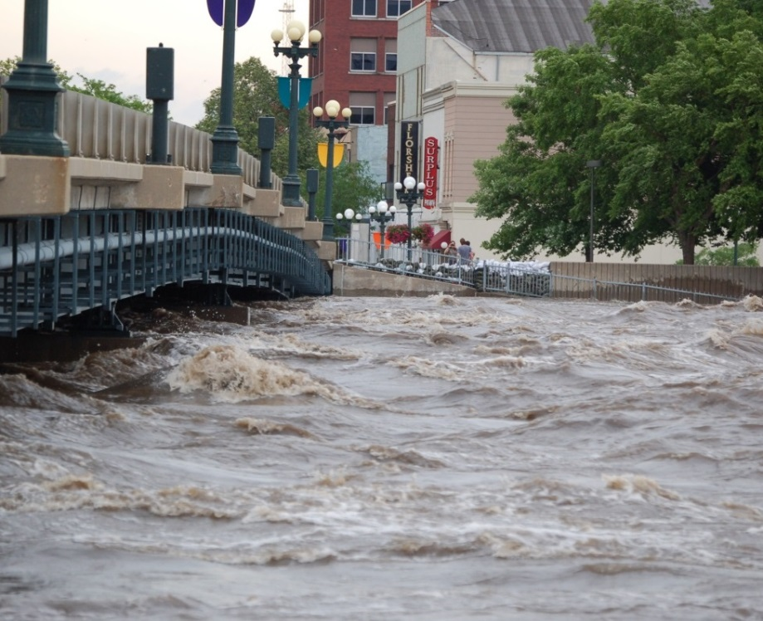
Creation of Flood Inundation Map Libraries
Stream Selection
Model Flood Heights
Delineate Flood Extents
Compute Flood Depths
Process Map Library
Notes:
Overview of the 5 Easy Steps!
Waterloo IA 2008, USGS photo archive

Slide 5

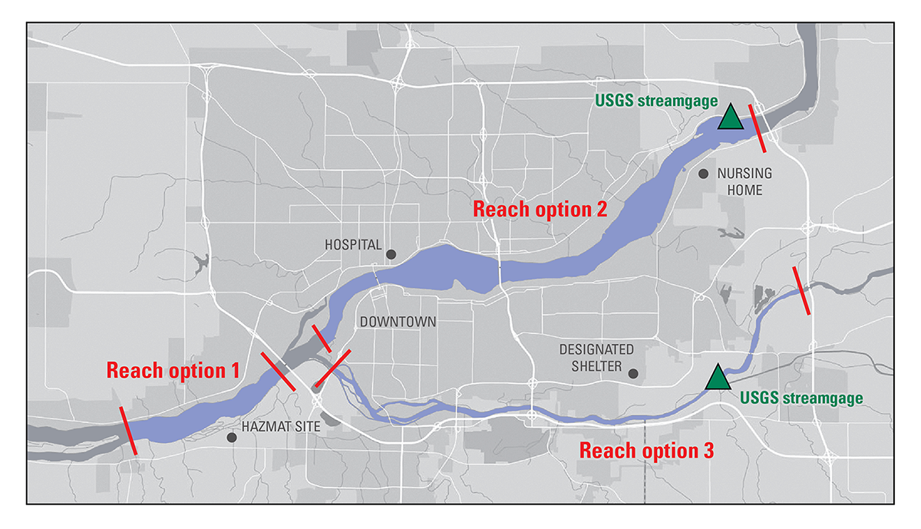
1. Stream Selection
Streamflow information
Flood Forecast information
Elevation data availability
  Topography
  Bathymetry
  Structural
  surveys
Flood Impact Locations
  Critical infrastructure
  Routes of egress
  Populations
Notes:
Gage location in the reach and ensuring that the reach covers the area of interest/DEM availability are key
The process begins with a local community that is interested in determining its flood risk. The first step is to identify the location where the flood modeling will be performed. The best locations are streams or rivers located in a populated area. Ideally, the chosen section will be near an existing USGS streamgage, but a gage can be installed if needed. If the community is also interested in real-time flood monitoring and response activities, the streamgage should also be a National Weather Service (NWS) forecast location. The NWS produces flood forecasts at about half of existing USGS streamgages, and the community can work with them to establish forecasting if their gage is not currently served.

Slide 6
Gather Data
Real-time streamflow information from a gage within the selected reach
  Historical flood levels at that gage
  Current and historical rating curves at that gage
Short-term probabilistic forecasts at that gage
High-resolution elevation data (dictates the quality of the maps more than any other factor)
Existing hydraulic models (if available and recent)

Slide 7

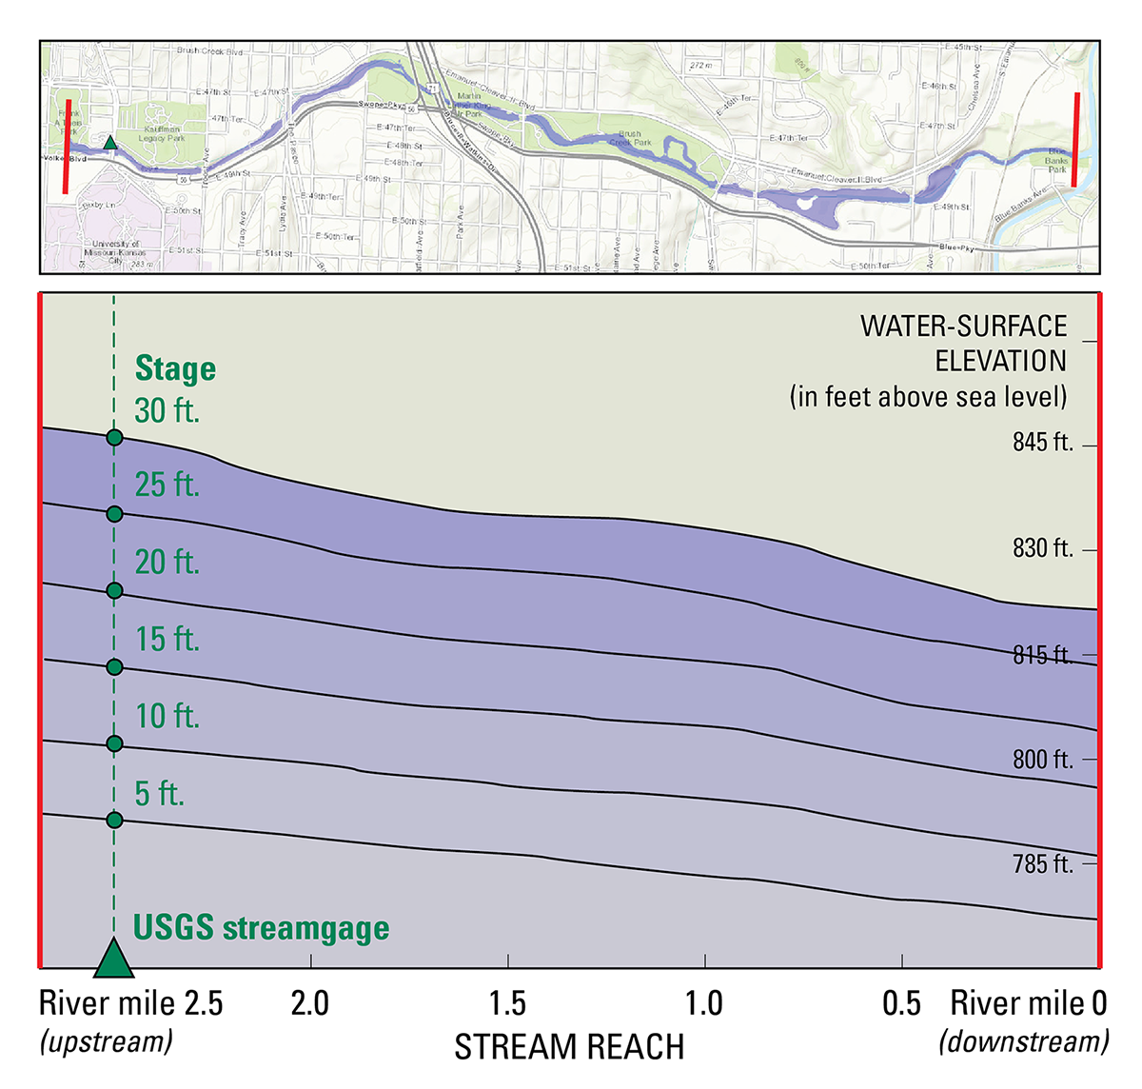
2. Model Flood Heights
Hydraulic model calibrated to a USGS gage rating curve
Rating curve extensions possible
Can be any generally accepted appropriate model
Notes:
The model is run multiple times at incremental stream stages over the range of flooding conditions from near-bankfull to record flooding levels, producing a series of water-surface profiles that define flood heights throughout the reach.
USGS gage or qualified transmitting furnished record with rating curve required
Rating curve extensions must follow USGS policy (see memo)

Slide 8
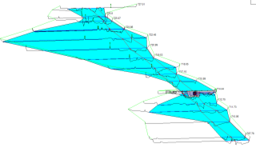
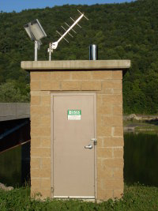
Hydraulic Modeling details
Hydraulic Modeling
  Calibrate model to streamgage record and current land cover
    Well developed rating curves are crucial
  Any appropriate model is accepted
    USACE HEC-RAS is common
    Model must be peer-reviewed and documented
Modeled flood scenarios are chosen to reflect local conditions (bridge conditions, levees, temporary structures, etc.)
In highly complex flow situations, a 2D model might be warranted

Slide 9

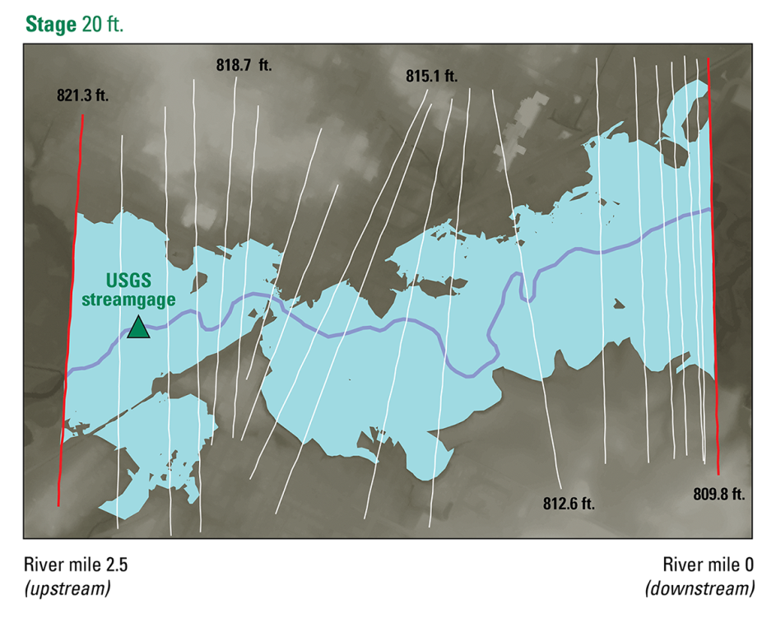
3. Delineate Flood Extents
Geospatial Processing
  Create TIN models using cross sections and the modeled water surface profile
  Intersect the TIN with the DEM to generate predicted inundated areas depth grids
  Clean up and QA data
Repeat for all modeled water surface profiles to generate a library of maps

Slide 10

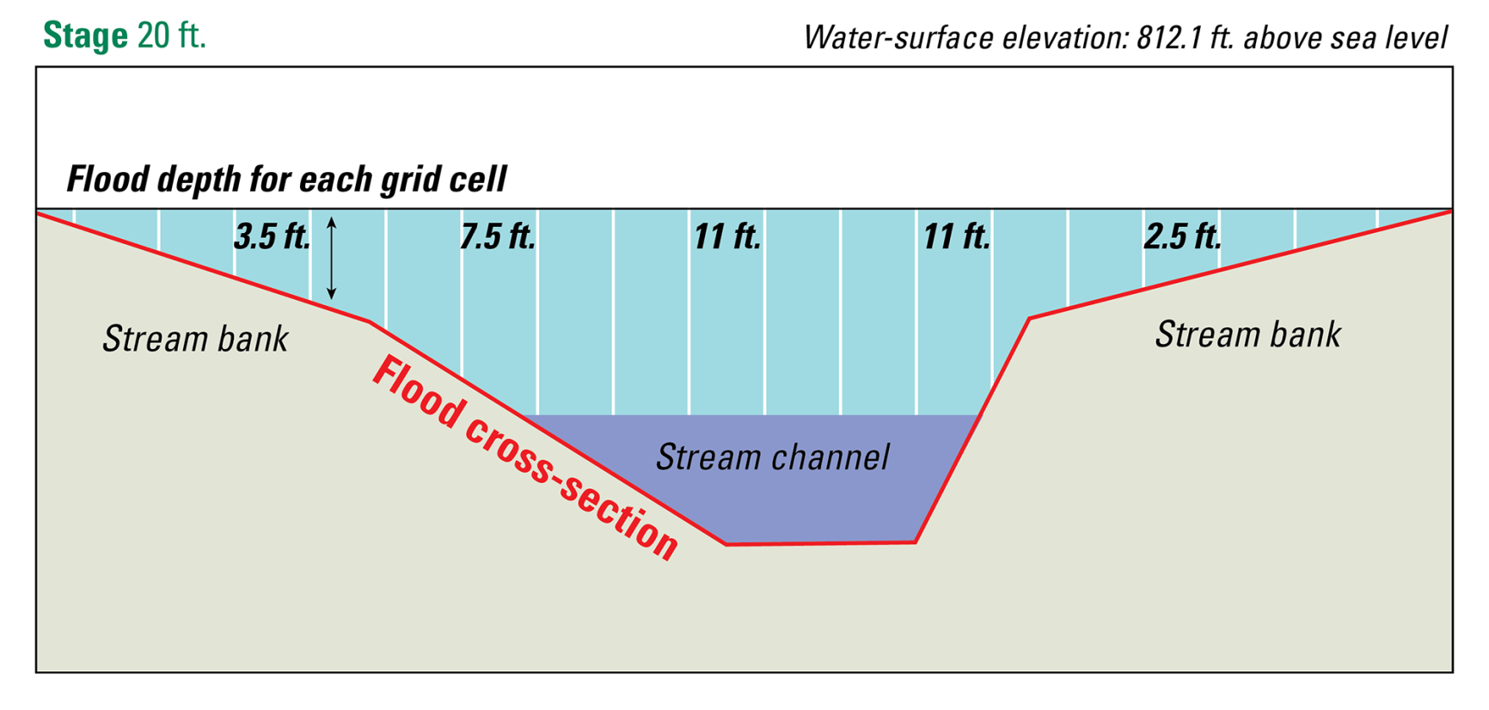
4. Compute Flood Depths
Flood extents are processed with the topographic data to produce estimated depths across the floodplain
Notes:
The next step is to model how deep the flooding would be for each grid cell in the inundation area. Once the depth grids have been determined, surface and inundation extents are calculated for all flood levels along the reach. Each extent represents a single flood inundation map, and provides a full picture of the flooding scenario - both how far and how deep the flood waters could reach. Each library’s modeling and development process is documented and reviewed by other flood scientists to ensure the modeling was done correctly and produced valid results.
Depths in the stream channel are usually estimated.
Depths are presented as a range based on the uncertainty of the model layers (hydraulic calibration and DEM uncertainty)

Slide 11

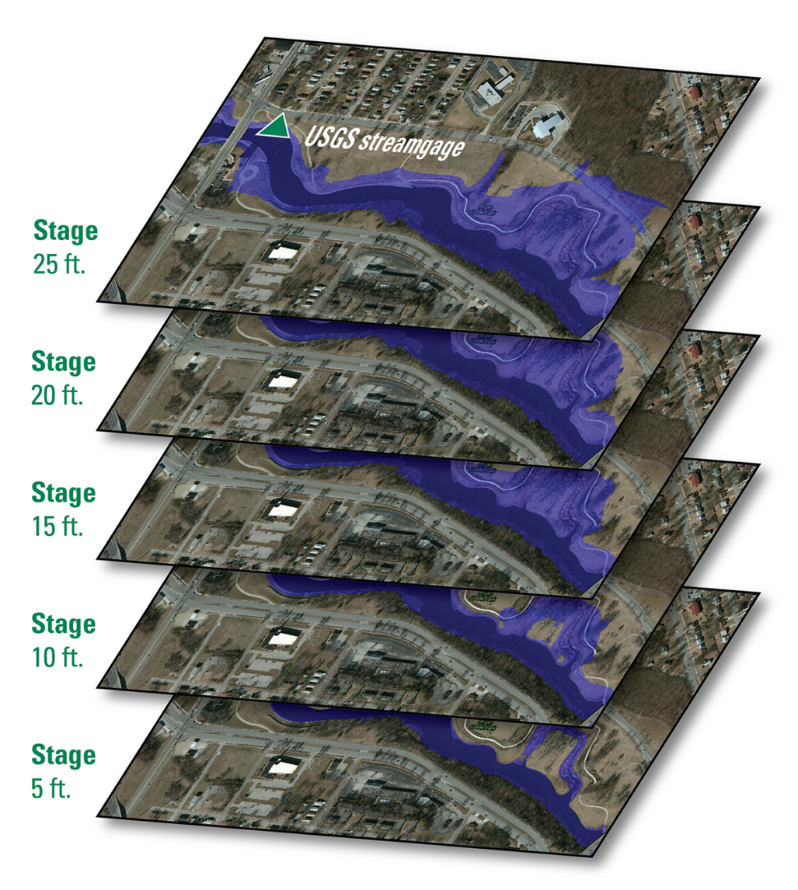
5. Process Map Library
The hydraulic model, flood extents and flood depths are peer reviewed and documented
Maps are overlaid onto city maps to aid in planning and response
Notes:
The last step is to overlay the probable areas of floodwater inundation onto city maps, which helps communities visualize, plan, and respond to floods. A flood inundation map library is the full set of maps showing flood inundation from near-bankfull river levels to record flooding levels. Once the map library is reviewed and approved, it is published and uploaded to the USGS Flood Inundation Mapper where it can be seen and utilized by the public.
The documentation and approval is necessary for all maps published to the USGS mapper. Minimum documentation standards and approval/submission guidelines are available on the webpage.

Slide 12
Peer-Reviewed Documentation
Required:
  Uncertainty and Use Limitations
  Study area and scope
  Hydrologic data
  Hydraulic model calibration and performance
  Accuracy assessment
  Metadata
Recommended:
  Technical Summary Notebook of the hydraulic model
  Project QA/QC checklist completed by the project team
Published to a public website
http://water.usgs.gov/osw/flood_inundation/toolbox/librarytools.html

Slide 13
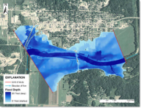
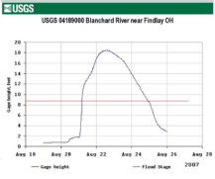
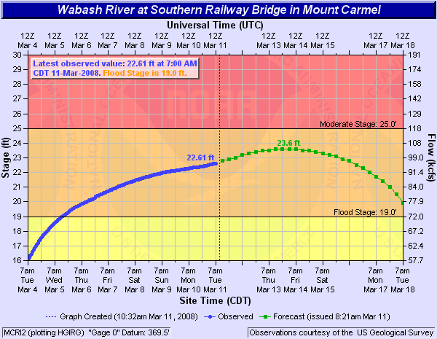
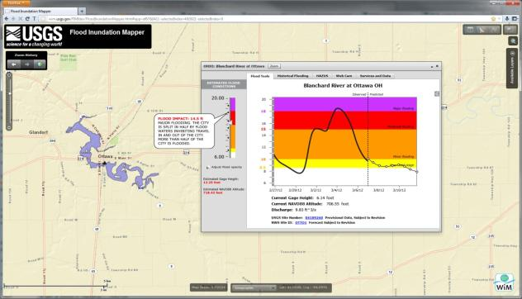
FIM Mapper – more than just maps
Turns the modeled map data into an operational tool by combining data together with tools that enhance the utility and don’t require any Modeling or GIS software or skills
+
+
Flood Library
USGS Real-time streamgage
NWS Flood Forecast

Slide 14
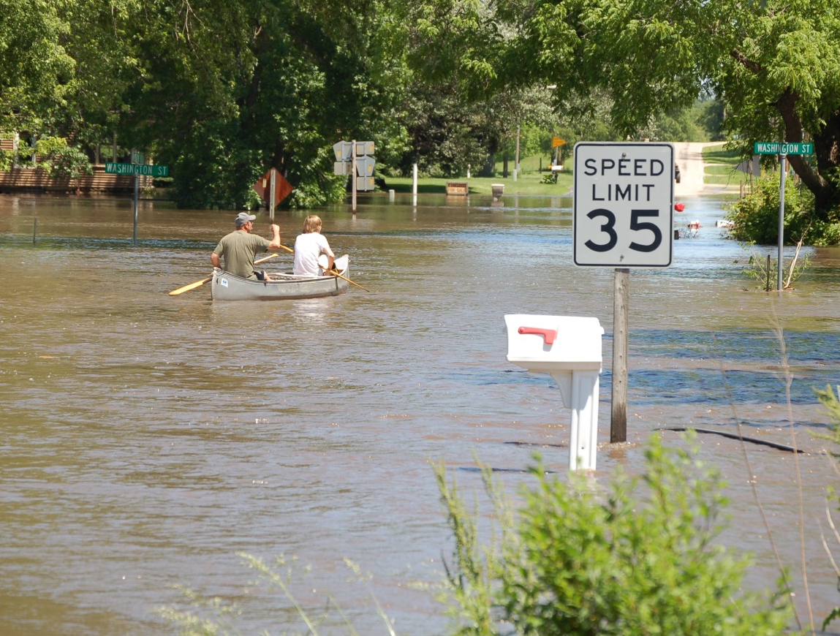
Questions
Marie C. Peppler
USGS Office of Surface Water
mpeppler@usgs.gov
http://water.usgs.gov/osw/flood_inundation/
Notes:
Title: Flooding in Finchfield, IA
Description: Flooding level shown against a speed limit sign
Location: Finchfield, IA, USA
Date Taken: Jun 10 2008
Photographer: Don Becker , U.S. Geological Survey

