Slide 1
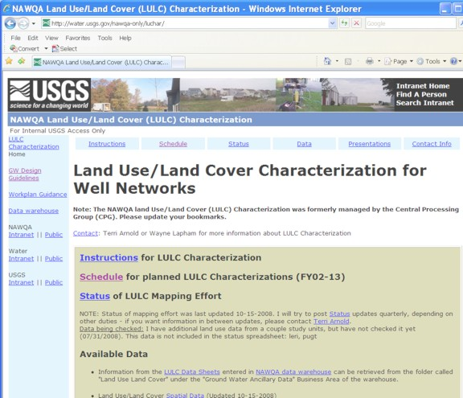
Planning a Land-Use Characterization (LULC) of NAWQA LUS
Wells For New
Or Resampled
Networks
Presented by Terri Arnold
01/2011
Notes:
Refer to the LULC web page (http://water.usgs.gov/nawqa-only/luchar/) for complete instructions on collecting and submitting LULC data for archival. There are also resources and tools available here. You can download previous LULC data and maps of previous LULC efforts.

Slide 2
Agenda
Description of a land-use characterization (LULC)
  Timing of office and field work steps
  Requirements and resources for mapping LULC
  Mapping LULC for a new network and Updating LULC for a resampled network
Spatial data requirements: format and naming conventions, spatial data coordinate system, and metadata
Entering field sheet data into Data Warehouse
How to submit your LULC data
Where to get help

Slide 3
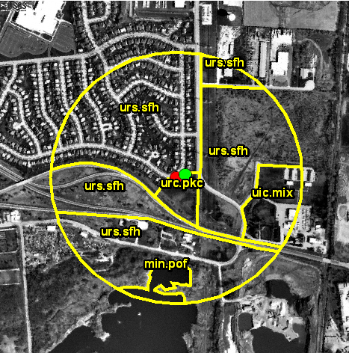
What is LULC?
LULC is a land-use characterization of the area within 500-meters of a well.
Provides a context for interpreting water-quality conditions at the time of sampling and any changes in water quality over time.
Required for all land-use study wells and associated reference wells when the land-use network is sampled for the first time or is resampled in its entirety (about once every 10 years).
Tasks include compiling information about land use, irrigation, drainage, and potential point sources of contamination within 500-meters of the well; digitizing the land use using ArcGIS and documenting the land-use data with metadata; entering data about potential point-sources of contamination into an on-line database; and submitting the LULC data for archiving.

Slide 4
A Good Source of Aerial Imagery
ESRI World Imagery from ESRI ArcGIS Resource Center
  free download
  composite from federal sources
  In ArcGIS, this layer can be added to ArcMap under file menu --> Add data from resource center
Notes:
There are several sources for the latest aerial imagery – there are links to some on the LULC web page. Try to get the newest imagery that is available; but, a good source is the ESRI World Imagery layer. It’s free.
Use the NAWQA point geodatabase of all NAWQA sampling sites to plot the location of your wells. This data is made directly from the information in NWIS and Data Warehouse.

Slide 5
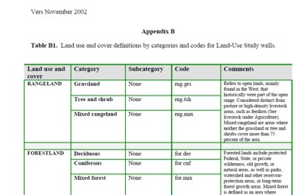
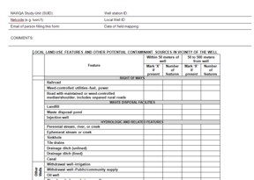
Before you go to the field…most of the work can be done
  Read the instructions on the LULC web page.
  Ensure all well IDs are in NWIS and Project
  Networks.
  Get login to LULC area of Data Warehouse.
Print paper copies of:
  LULC categories/definitions,
  Field data sheet – one for each well.
Download spatial data resources listed on LULC
web page (NAWQA well point geodatabase and
any previous LULC).
Make a preliminary map the land use for each well using the latest imagery for each well – use the previous LULC as a
base if it exists.
Notes:
Most of your work can be done in the office before you go into the field. To make sure you are ready to enter your data in Data Warehouse when you get back, get your login ahead of time and make sure all of your sites are in NWIS and in Project Networks. If they are not in Project Networks, then you cannot enter data for them.

Slide 6
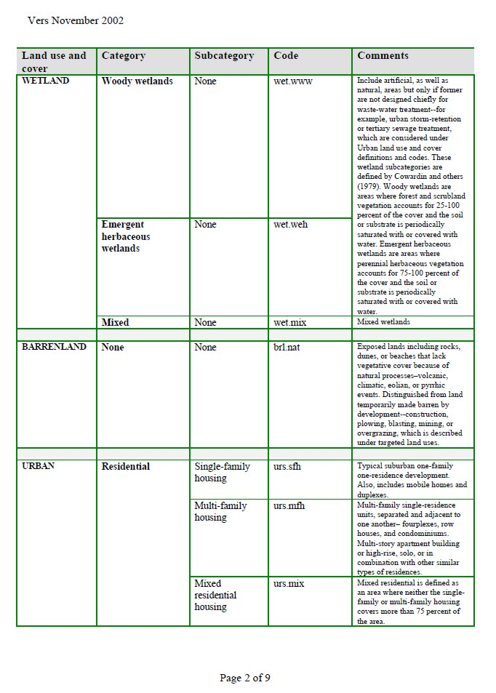
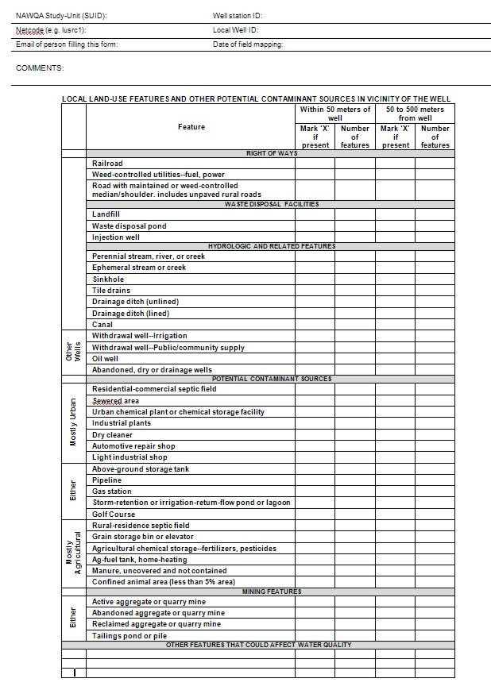
Download the LULC codes with descriptions and the Field Data Sheet from the LULC web page
LULC Codes and Descriptions
Field Data Sheet

Slide 7
While you are in the field…
Take with you paper copies of the preliminary land-use maps and field data sheets for each well, and the land use category descriptions.
Verify the land-use polygons and categories that were mapped for each well while in the office. Take this time to field-check land use that you could not easily identify from the aerial imagery or Google maps.
Update the land use on the paper maps if needed.
Take notes of the presence of any irrigation and drainage features within 500-m of the well.
Fill out the Field Data Sheet for each well to indicate any potential point sources of contamination.

Slide 8
The Field Data Sheet indicates potential point sources of contamination near the well
Notes:
Field data sheet layout has been simplified for easier use in the field. You can pre-fill the form for staids and network information before going to the field. Fill out your field data sheets while you are at the well.

Slide 9
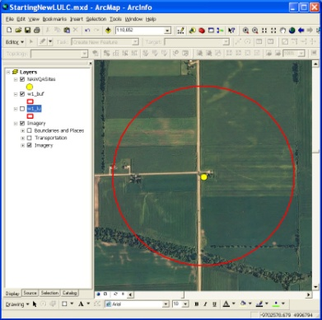
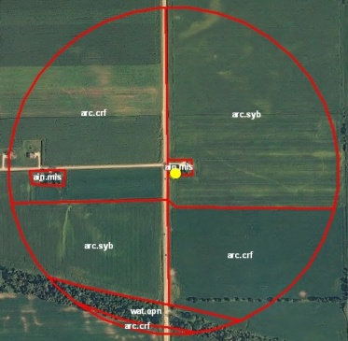
First-time LULC for a new network
Read the LULC web page instructions http://water.usgs.gov/nawqa-only/luchar/ .
Make sure your sites are in Project Networks.
Download the spatial data resources from the LULC web page.
Make a preliminary map of land use around each well. Use ArcGIS to make a new geodatabase for your LULC data, create a 500-meter buffer around the well point, delineate the land use as shown on the aerial imagery. Use only approved land use codes.
Apply 5% rule – Map features if they occupy at least 5% of the buffer. See web page instructions about mapping roads.
Verify and check your land-use mapping while you’re in the field.
Fill out field data sheet while you’re in the field.
If needed, update land-use spatial data in ArcGIS after field
checking it and write metadata for the LULC data.
Enter field data sheet data into Data Warehouse.
Send your spatial data to Terri Arnold to Archive.
Notes:
Sites have to be in project networks and NWIS to be loaded into Data Warehouse and added to the geodatabase of points

Slide 10
Updating LULC for Resampled Network
Read the LULC web page instructions
http://water.usgs.gov/nawqa-only/luchar/ .
Make sure any replacement wells are in Project Networks.
Download previous LULC geodatabase and other
spatial data resources from the LULC web page.
Map the land use around each well using the previous LULC mapping as a base along with the latest aerial imagery. Use ArcGIS to update the land use polygons and codes. Use only approved land use codes.
Apply 5% rule – Map features if they occupy at least 5% of the buffer. See web page instructions about mapping roads.
Verify and check your land-use mapping while you’re in the field.
Fill out field data sheet while you’re in the field.
Update land-use spatial data in ArcGIS after field checking it. Write metadata for LULC data.
Enter field data sheet data into Data Warehouse.
Send your spatial data to Terri Arnold to Archive.
Notes:
More about the LULC mapping toolbar in later slides.

Slide 11
About Digitizing the LULC in ArcGIS
Digitizing should be completed by a GIS-skilled person.
LULC Digitizing Quick-Start guide is on LULC web page.
Use any previous LULC mapping as a base for mapping land use.
Use latest aerial imagery, Google Maps, and National Landcover dataset to help you map and identify land use while digitizing.
Options:
  Start with blank map document and use standard editing toolbars.
  Start with CPG map document that has custom LULC toolbar. You can still use standard editing toolbars if you select this option. Instructions are included when you download the map document from the LULC web page.

Slide 12
ArcGIS LULC mapping toolbar
Custom toolbar written by Leon Kauffman that has been tested in ArcGIS v 9.3.
Available inside an ArcGIS Map Document that you can download from the LULC web page.
Incorporates editing tools, attribution forms, and percent area calculations.
Functional, but still in development.
You can use the ArcGIS built-in editing toolbars even if you use the LULC toolbar.

Slide 13
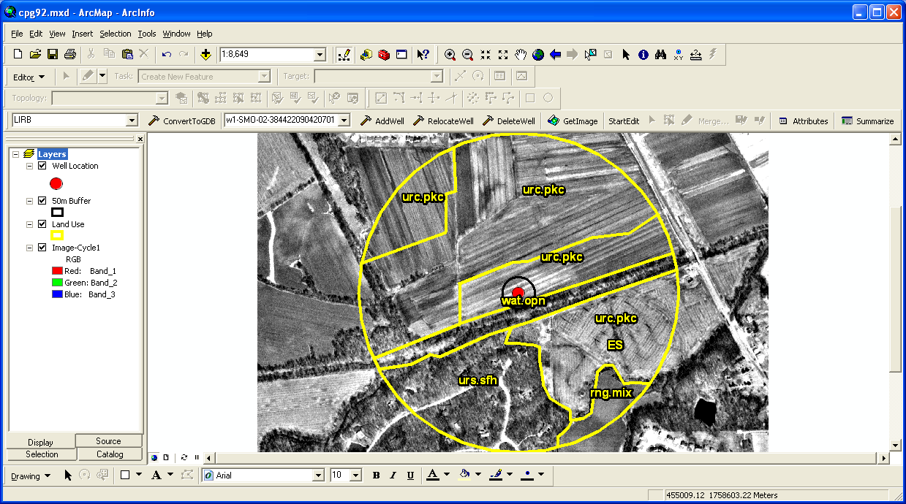
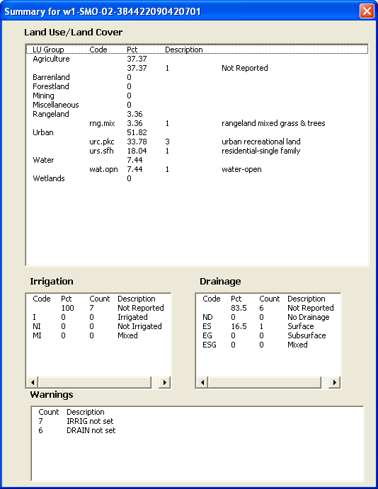
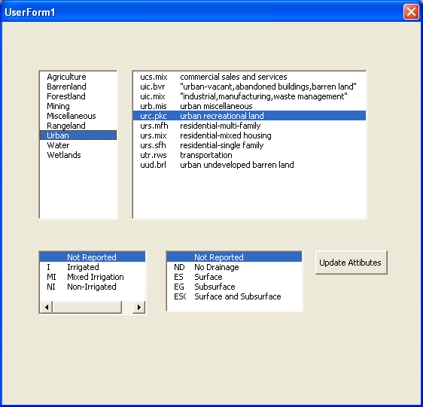
ArcGIS toolbar for LULC mapping
Use the Attribute and Summarize buttons to ensure proper attribution
Notes:
Select the attributes button then you get a cursor to select the polygon. When you select a polygon, the forms window pops up for you to select the attributes.
Select the summarize button and a window pops up to display the percent of the 500-m buffer for each land use category.

Slide 14
Requirements for Data Archival
– see web page
  Spatial data format and naming convention
  Projection in National Albers
  Required attributes
  Simple metadata for the network
  Enter your LULC field data sheet information in NAWQA Data Warehouse
  Notify Terri Arnold (tlarnold@usgs.gov) of the network sucode and date the LULC data sheet information was entered into the data warehouse and submit your LULC spatial data

Slide 15
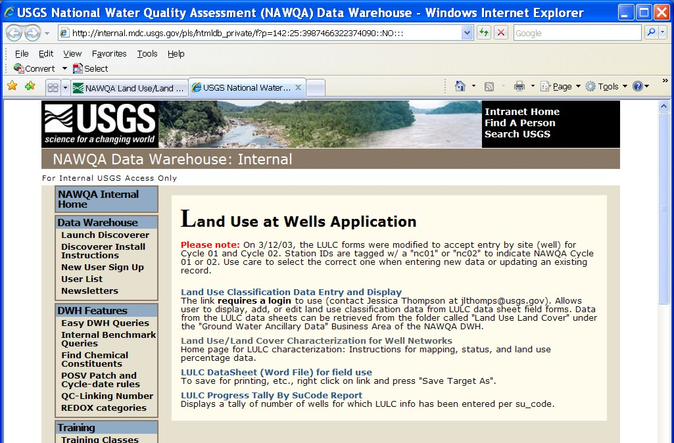
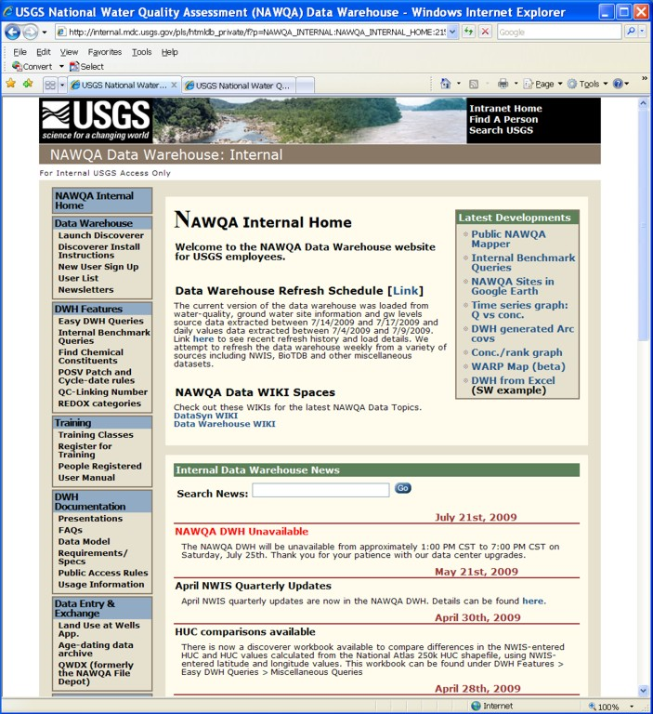
Enter field data sheets in Data Warehouse
Make sure your sites are in NWIS and in Project Networks.
Get a login for LULC area from Jessica Thompson.
Enter data from Field Data Sheets for each site.

Slide 16
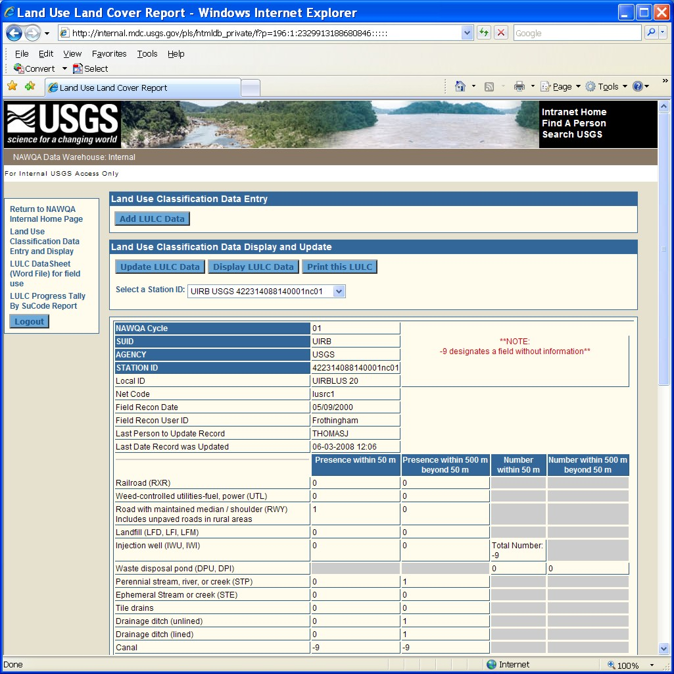
Field Data Sheet form in Data Warehouse
Select the correct well number and Cycle.
Cycle 2 sites have STAIDs ending in ‘nc02’
Notes:
Be sure to select the correct well number for Cycle 2!! Look for station ID numbers ending in ‘nc02’. If your site does not show up in the list then check if the site is in Project Networks.

Slide 17
A few examples of updated LULC, recommendations, things to be aware of

Slide 18
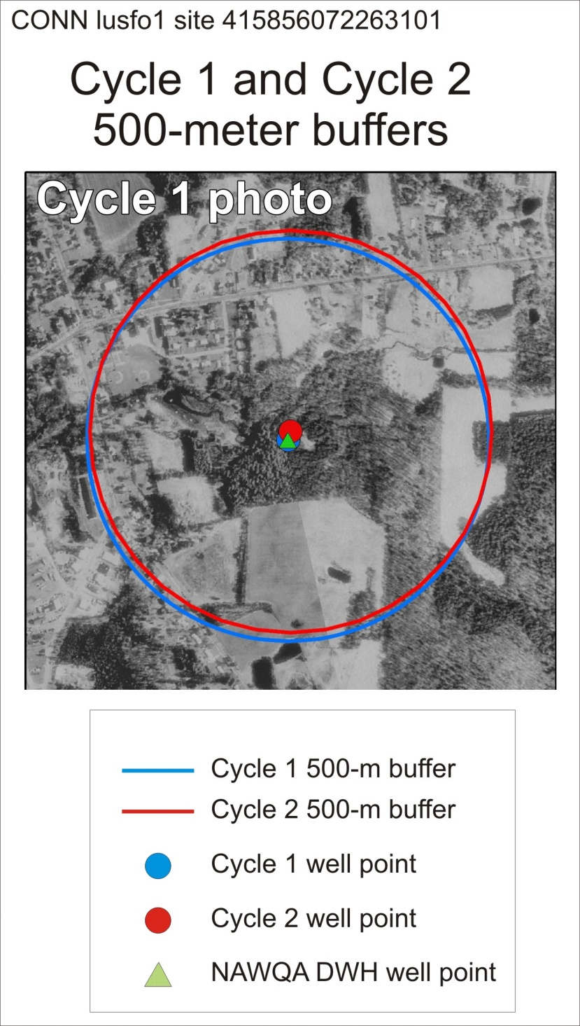
Sometimes the cycle 1 and cycle 2 well points and buffers do not overlay
Use the NAWQA sites geodatabase from Data Warehouse for well locations.
Cycle 1 spatial data may be offset from correct location.
  Use all the line work and land use attributes from the previous LULC mapping in the overlapping area that you can.
  If areas do not overlap, start with a new buffer area and map the land use over the latest aerial imagery.
  Explain in the metadata what you did and why.
Notes:
Use NAWQA point coverage from Data Warehouse to get the best well location
Make sure the well coordinates are correct in NWIS. Were they updated on paper with coordinates from the plugger and never updated in NWIS? The STAID does not always represent the exact coordinates.
When you update the land use for cycle 2, use as much of the line work and attributes from the previous LULC in the areas of overlap that you can. Make sure to document in the metadata what you did to update the land use and to describe the problems you found with the cycle 1 data.

Slide 19
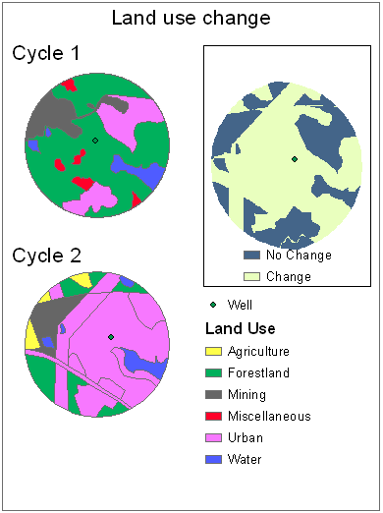
What happens when you don’t use the previous LULC as a base
Different descriptions of land use by different people make it appear as if there was a change in land use when there might not have been…..

Slide 20
If land use was coded inaccurately in cycle 1 but there has not likely been an actual land use change since then
  Example: For an agricultural site, the land use in one area was coded as ‘residential single family dwelling’ (an urban category) in cycle 1 but in cycle 2 you see it is actually ‘farm residence/structures’ (an ag category).
  Action:
  Review the approved LULC codes and descriptions.
  Use the correct LULC codes for cycle 2 and make note in the metadata why the cycle 1 data is incorrect for that site and that you changed the land use code for cycle 2. List the cycle 1 code and the corrected cycle 2 code.

Slide 21
If there has been an actual land use change
  Example: Land use was coded as ‘corn’ in cycle 1 but in cycle 2 it is now ‘residential single family dwelling’ and you are in an urbanizing area.
  Action: Just use the correct approved LULC code for cycle 2. There is no need to put this information in the metadata.

Slide 22
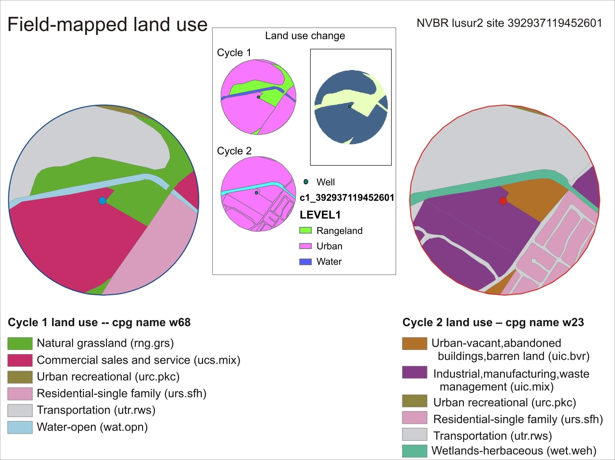
Notes:
An example of a site in an Urban network (NVBR) with both cycle 1 and cycle 2 land use data. Cycle 1 ‘commercial sales and services’ (magenta color) probably did not change to ‘industrial, manufacturing, waste management’ (dark purple color). The differences are subtle – they are both urban categories but have different definitions. Refer to the descriptions of the approved LULC codes and make your best judgment.

Slide 23
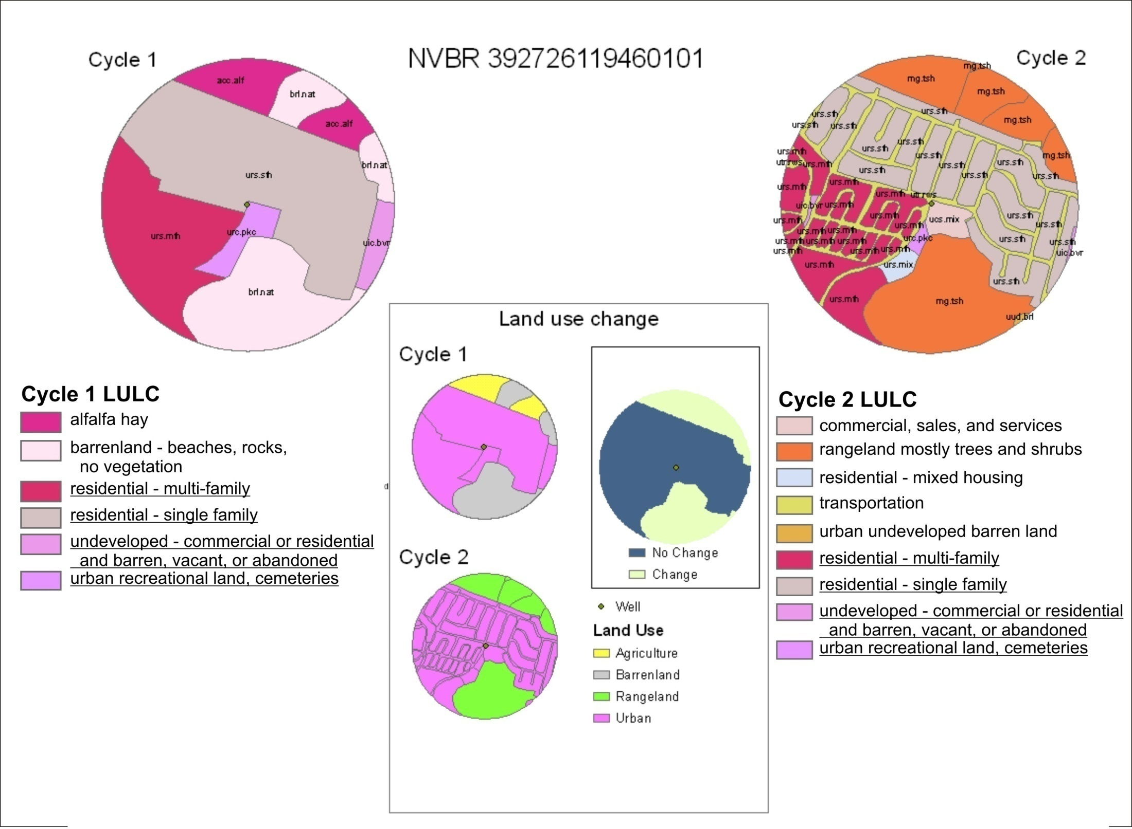
Notes:
The roads in cycle 2 LULC are not necessary. Follow the 5% rule. Most roads can be included with surrounding land use with half the road in one polygon and the other half of the road in the adjacent polygon. The cycle 1 code of ‘barren land– beaches, rocks, no vegetation’ (light pink color) probably did not change to ‘rangeland mostly trees and shrubs’ (orange color) but you guys in the field have to use your best judgment. In this case, a change in land use is indicated. Is the change real? What we are describing has consequences in how the data is used to explain water quality.

Slide 24
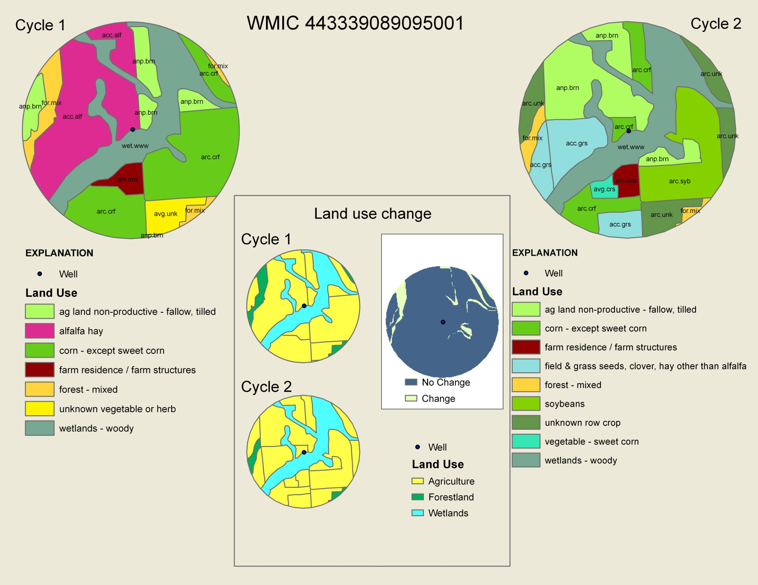
Notes:
An example of a site in an Ag network with both cycle 1 and cycle 2 land use data. (WMIC). This is a pretty good example of how to update a LULC. You can see that the polygons are similar shapes and sizes and the coding is the same for polygons that did not likely change land use (for example: farm residence/farm structures, wetlands-woody).

Slide 25
How long will it take (rough estimate)?
1 to 3 weeks—Hydrologist or Hydrologic technician
  Organize/plan field work, pre-fill out forms, establish any replacement wells.
1 hour—Database person
  Ensure all network sites are in Project Networks.
1 to 2 weeks—GIS person
  Read the instructions on the LULC web page . Download spatial data resources from web page, update or delineate land use in ArcGIS using the latest aerial imagery, Google maps, and any previous LULC, print maps out to have field-checked.
2 to 3 weeks—Hydrologist or Hydrologic technician
  Field check the land-use mapping provided by the GIS person. Plan to check 2 to 4 wells per day, considering time for travel.
2 to 5 days—GIS person
  Update LULC spatial data after field check if needed, write metadata, make sure spatial data meets the requirements specified on the LULC web page, and send to Terri Arnold for archive.
1 to 2 days—Database or GIS person
  Enter field data sheet data into Data Warehouse.

Slide 26
Where to get help http://water.usgs.gov/nawqa-only/luchar
Resources and guidelines for mapping
Mapping tools (ArcGIS toolbar (and FAQ), LULC field data sheet, approved land use codes), quick-start guide to digitizing LULC
Instructions for entering field data sheets in DWH
Instructions for submitting data for archival
Status of mapping effort
Downloadable LULC spatial geodatabases, maps of submitted LULC, and tabular percentage data
If all else fails, call or email Terri Arnold

Slide 27
Summary
Look at LULC web page for instructions http://water.usgs.gov/nawqa-only/luchar/
Most of the work can be completed before you go to the field
Use field trip to check/verify the land use mapping done in the office from the aerial imagery
Follow the requirements for creating the spatial data
Use approved LULC codes – ArcMap toolbar can help
Use previous LULC polygons and land use codes as a basis for mapping
Enter your field data sheet information into Data Warehouse
Submit your data to Terri Arnold for archiving.

