Slide 1
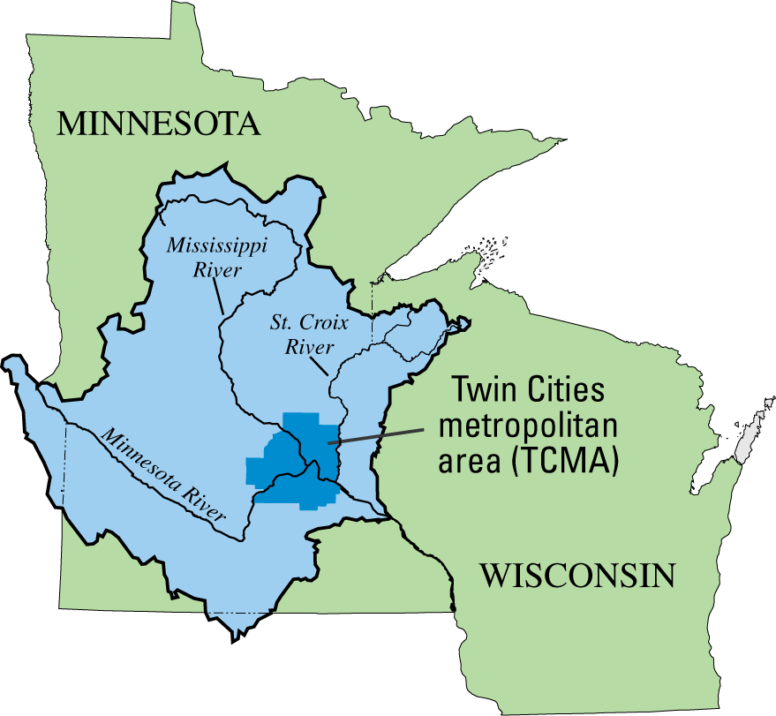
UMIS Flow System Study
2008 Update
Upper Mississippi River Basin
National Water-Quality Assessment
Study Unit

Slide 2
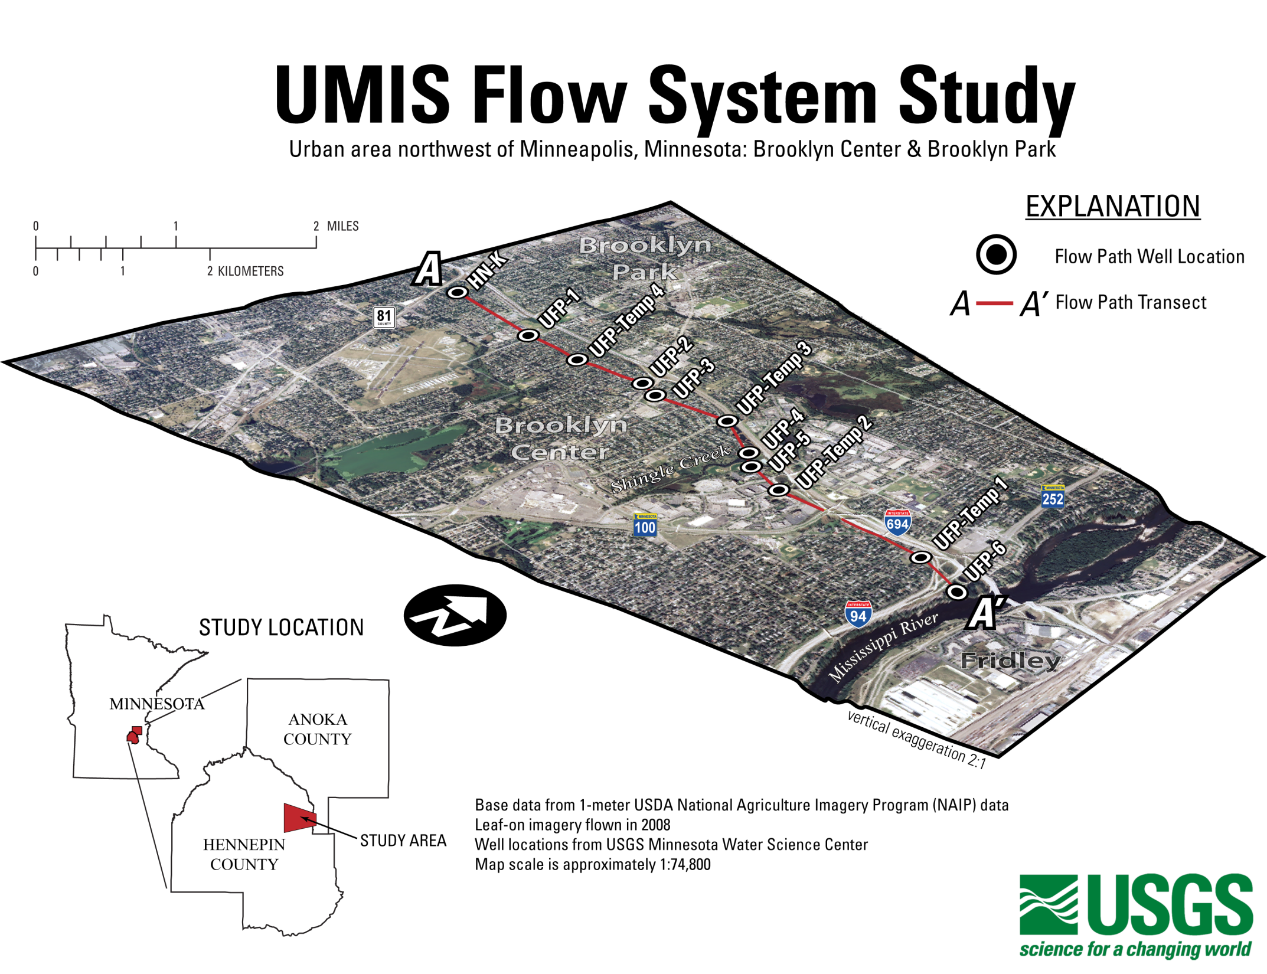

Slide 3
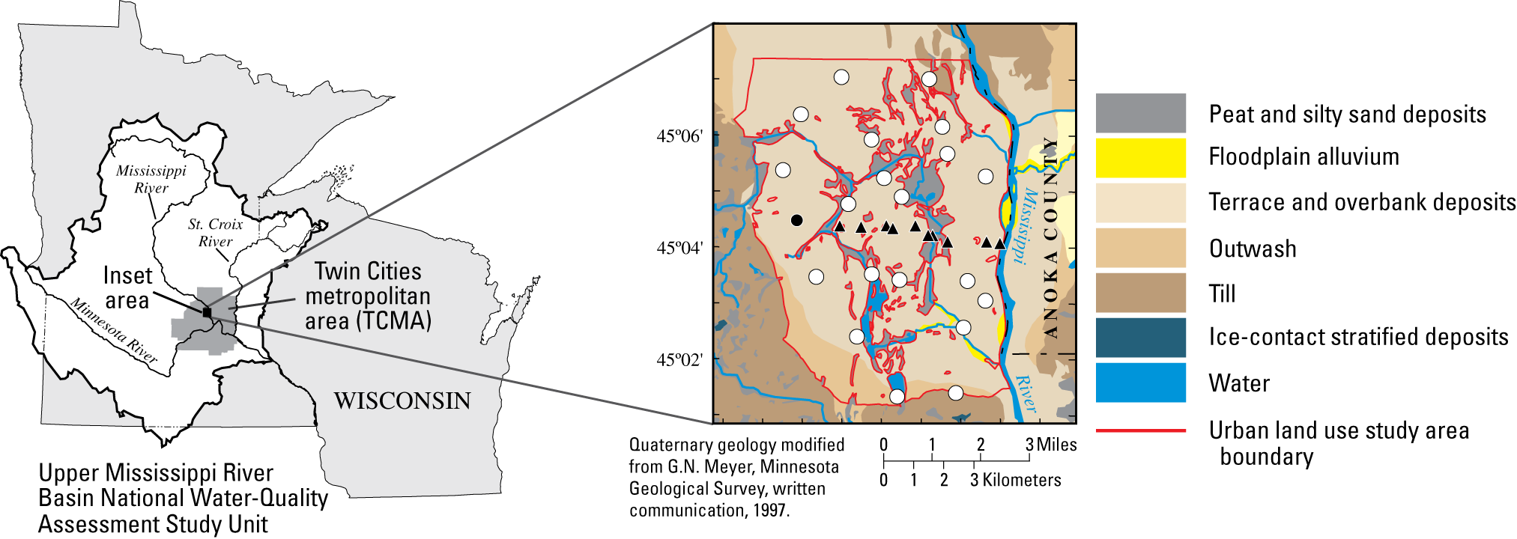


Slide 4
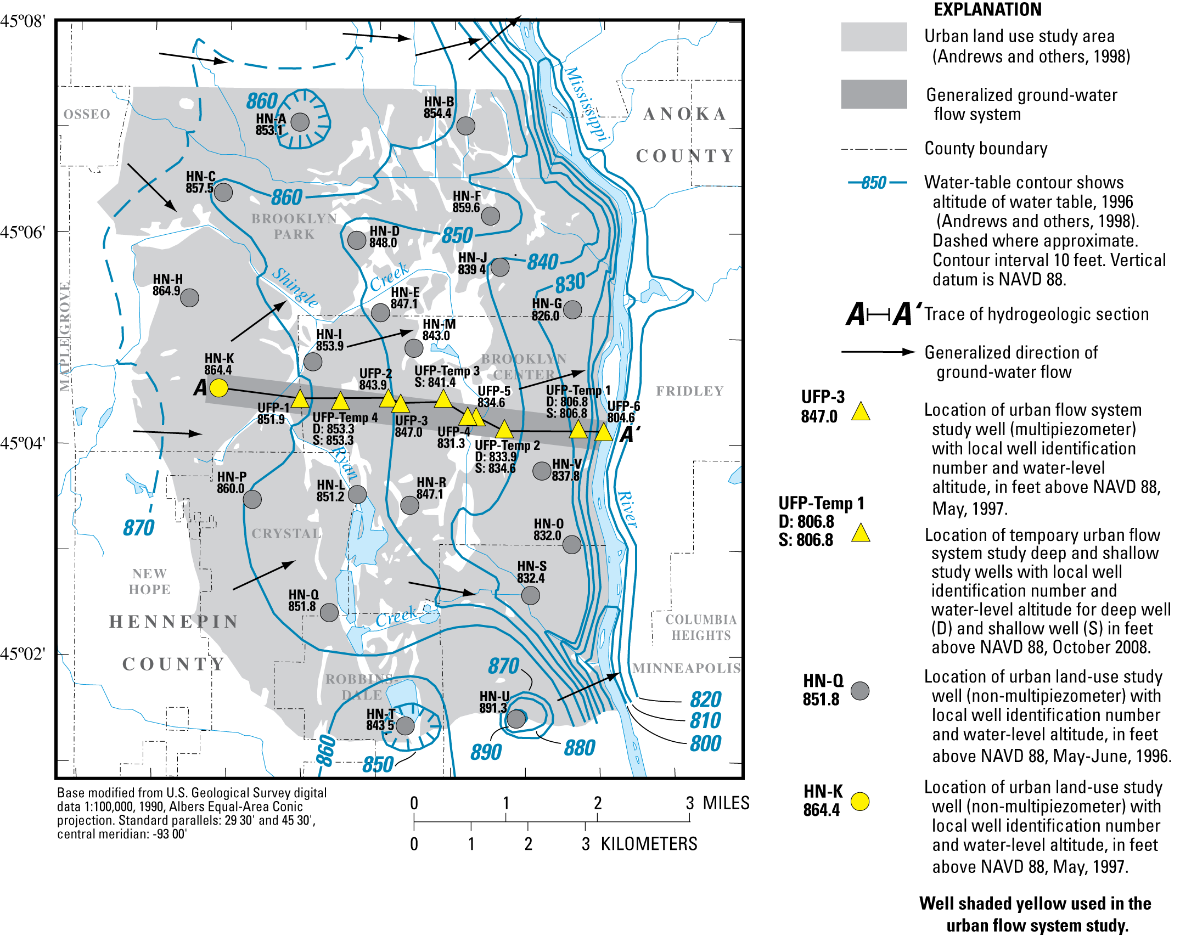

Slide 5
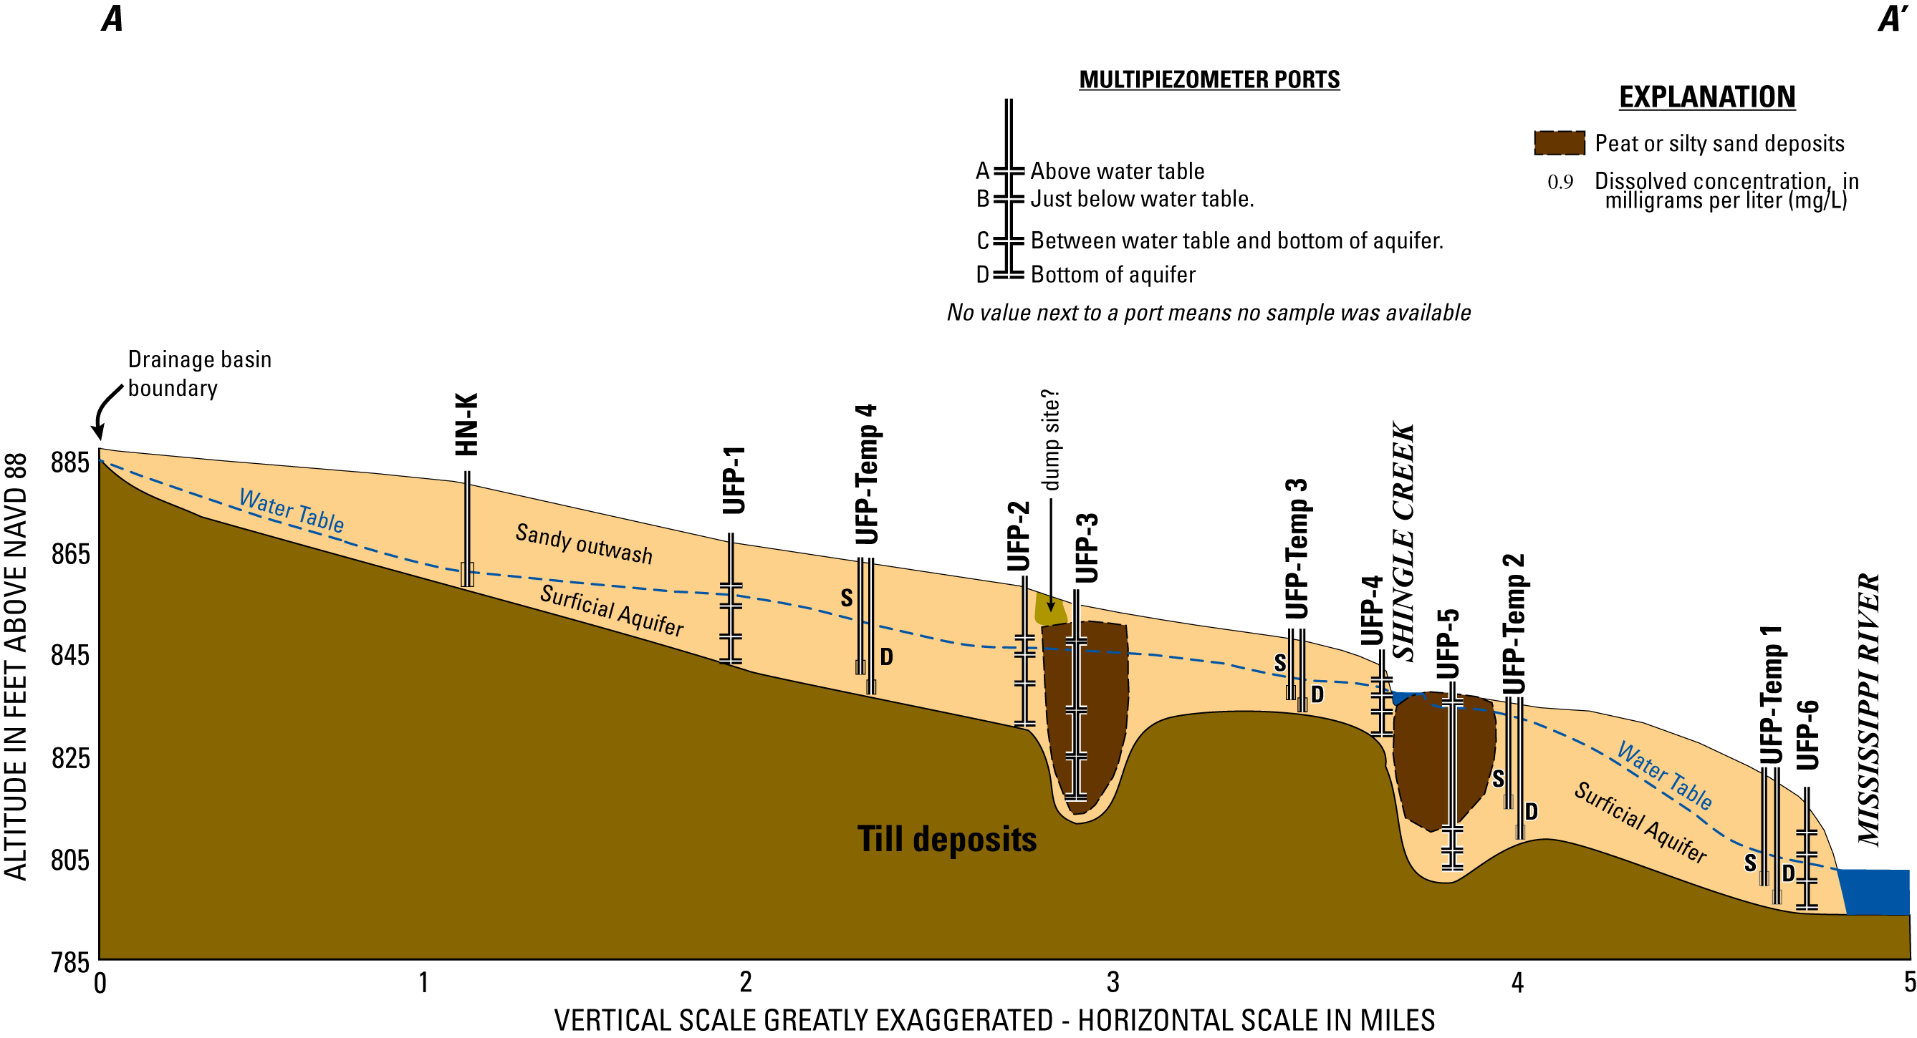
3.5
4
6
0.4
1.7
3.7
0.7
0.4
0.2
0.5
1.6
0.2
1
0.3
0.3
1.3
Dissolved Oxygen

Slide 6
1030
1030
881
781
2760
1290
1770
1210
1980
1340
1320
951
1520
2280
885
3960
Specific conductance
unfiltered, microsiemens per centimeter at 25 degrees Celsius

Slide 7
4.23
<0.04
<0.04
<0.04
3.92
<0.04
0.18
2.46
<0.04
1.14
4.77
1.16
<0.04
0.24
<0.04
1.51
Nitrate plus nitrite, milligrams per liter as nitrogen

Slide 8
<0.02
0.11
0.555
10.5
0.044
0.335
0.564
<0.02
1.61
0.204
<0.02
0.526
2.59
0.034
0.223
<0.02
Ammonia, milligrams per liter as nitrogen

Slide 9
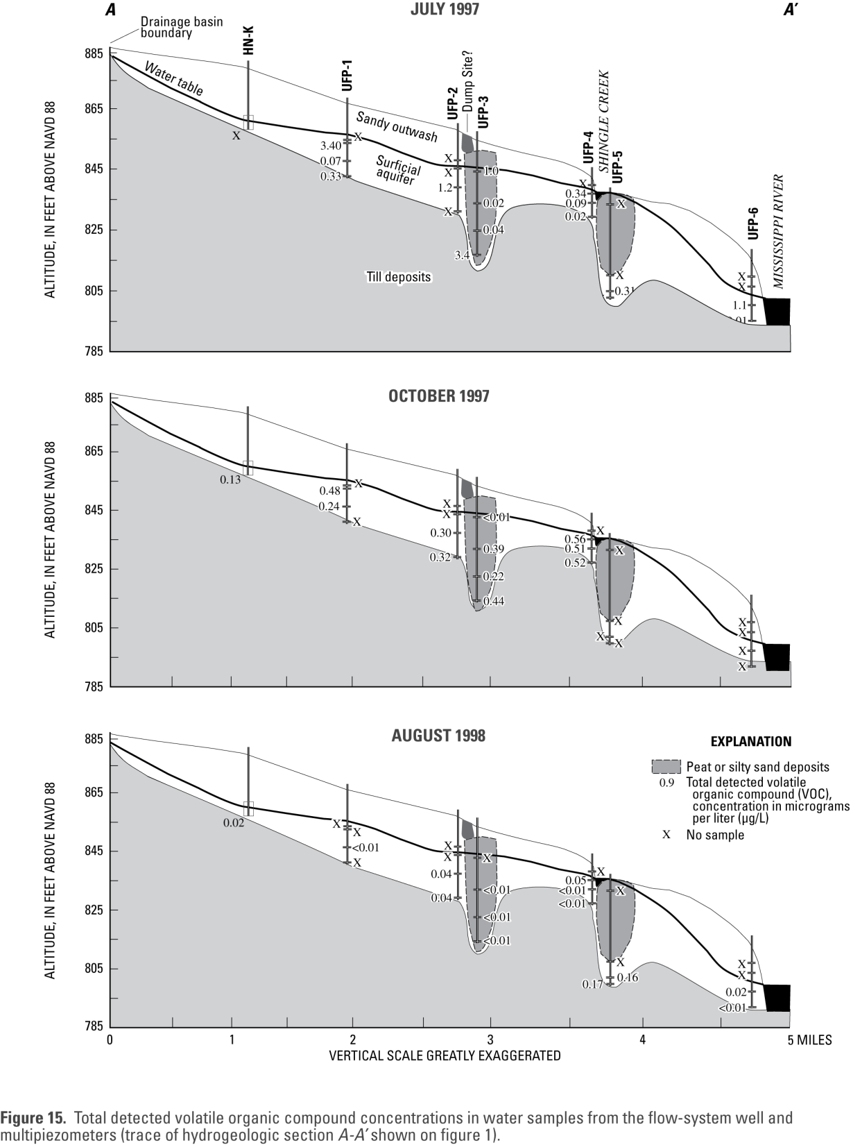

Slide 10
0.01 Total concentration, in
micrograms per liter (ug/L)
ND
ND
ND
0.11
0.01
ND
ND
ND
ND
0.38
0.02
0.07
ND
ND
0.03
Total VOCs

Slide 11
0
0
0
5
1
0
0
0
0
7
2
1
0
0
1
Number of Different VOCs Detected

Slide 12
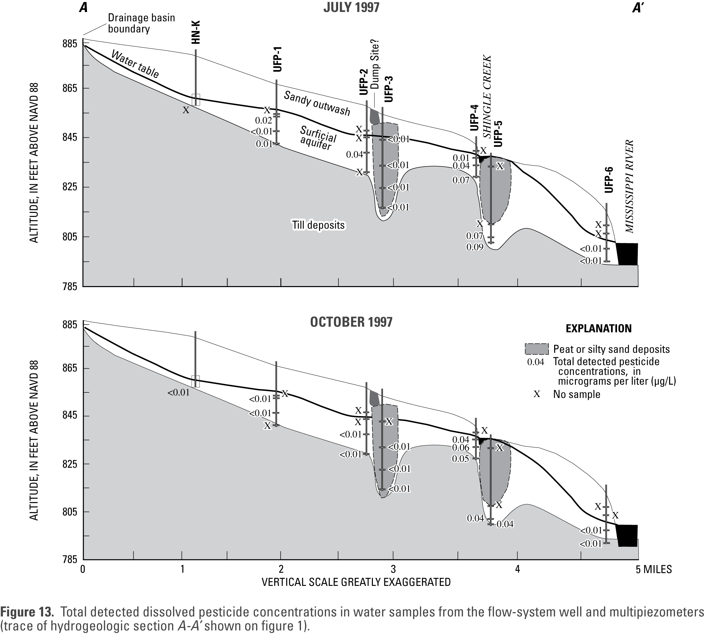

Slide 13
0.02 Dissolved concentration,
in micrograms per liter (ug/L)
0.078
0.01
ND
0.01
0.01
0.03
0.01
0.078
0.03
0.049
0.011
ND
0.06
ND
ND
ND
Total Pesticides

Slide 14
5
1
0
1
1
2
1
8
2
6
3
0
3
0
0
0
Number of Different Pesticides Detected

Slide 15
Oxic
Mixed
Mixed
Anoxic
O2>0.5
Mixed
Mixed
Mixed
Anoxic
Mixed
O2>0.5
Mixed
Mixed
Anoxic
O2>0.5
Mixed
Redox Assignments

Slide 16
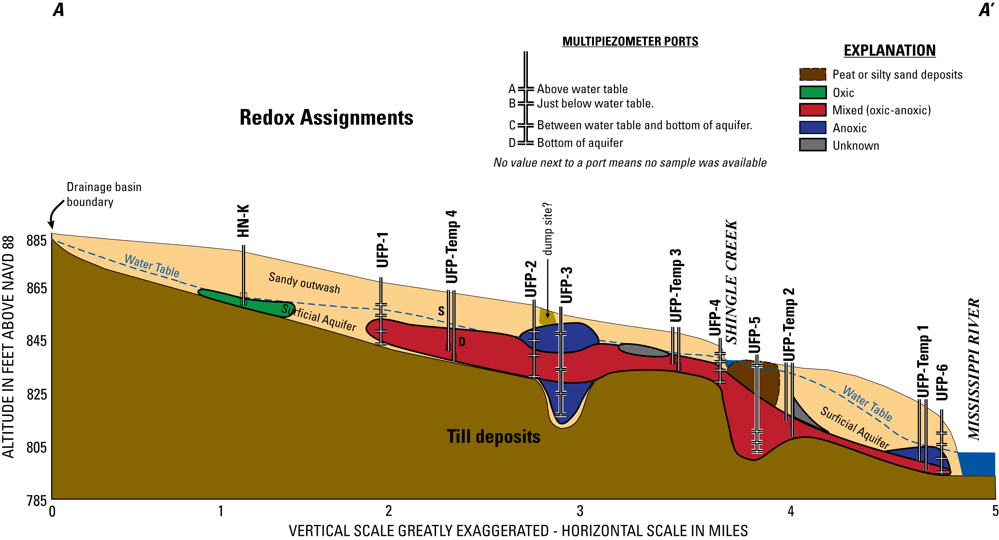

Slide 17
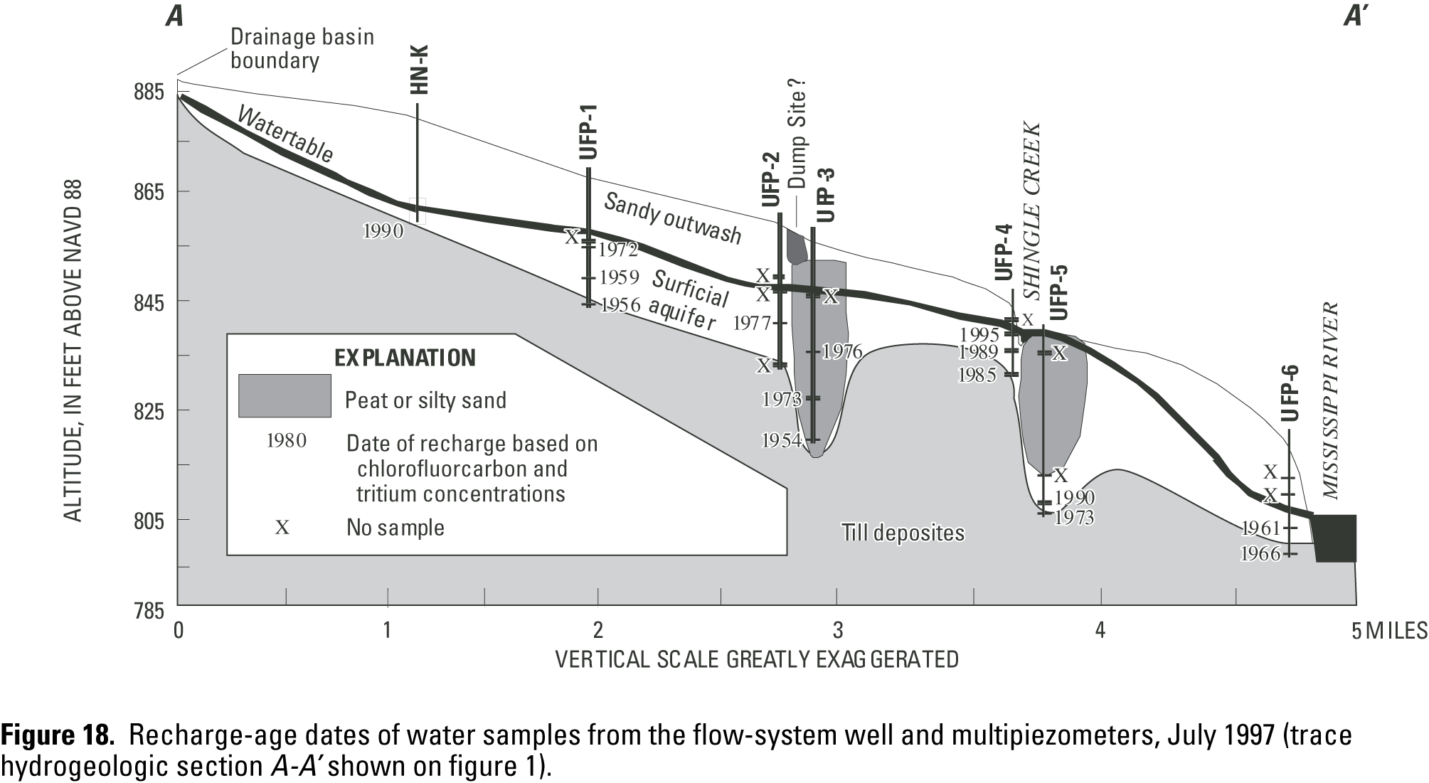

Slide 18
1989
1984
1983
1968
1986
1971
1979
1982
1984
1977
1984
1977
1975
1977
1974
1953
1976
Recharge Age Dates

