Slide 1
Long Island – New Jersey NAWQA Flow System Survey
Jeff Fischer, Leon Kauffman, Zoltan Szabo, Julia Barringer, Eric Jacobsen, Pierre LaCombe
March 10, 2009

Slide 2
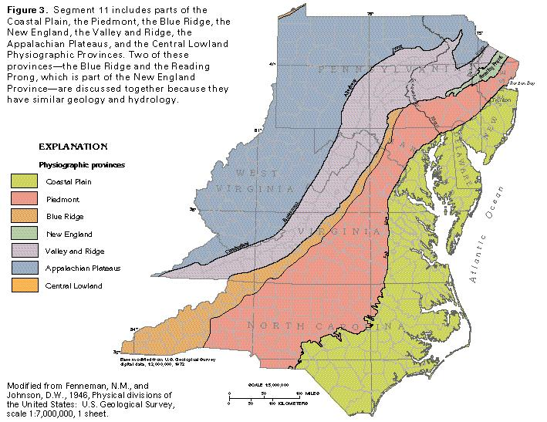
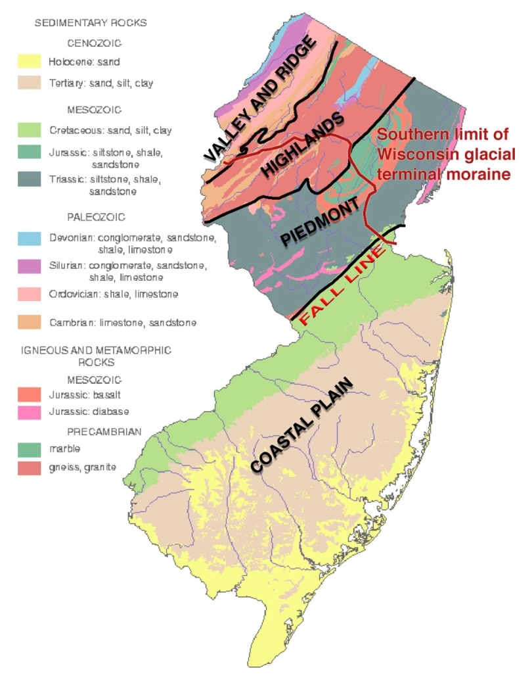
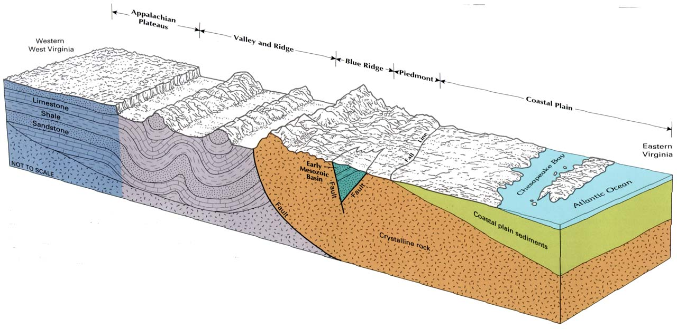
Geologic Setting
We are
Here!

Slide 3
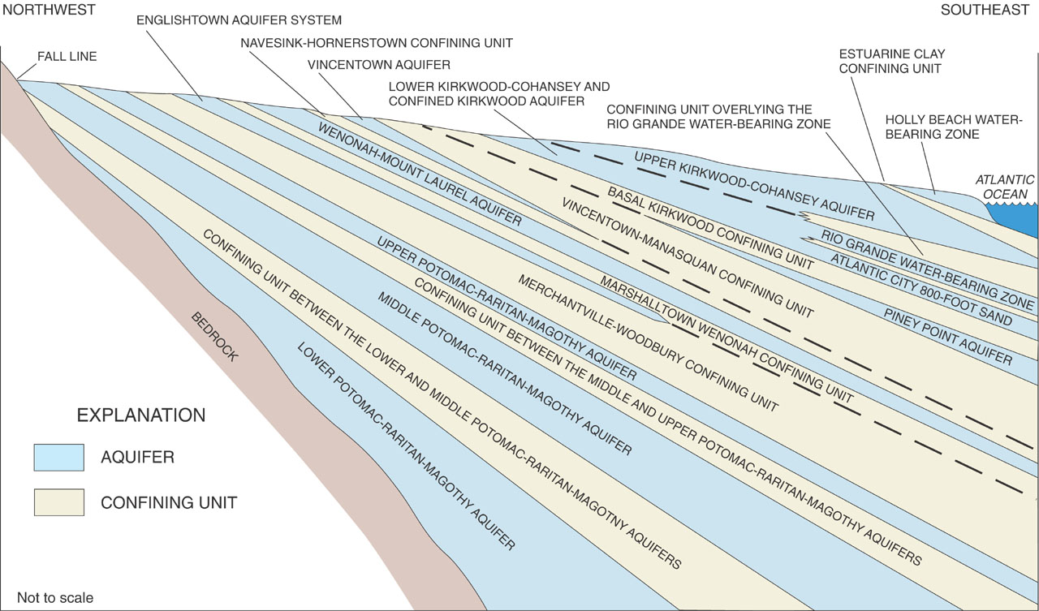
Cross-Section of NJ Coastal Plain
We are
Here!
Camden
Atlantic City
Notes:
Cross section through Coastal Plain
Point out Kirkwood, AC 800 and Piney Point

Slide 4
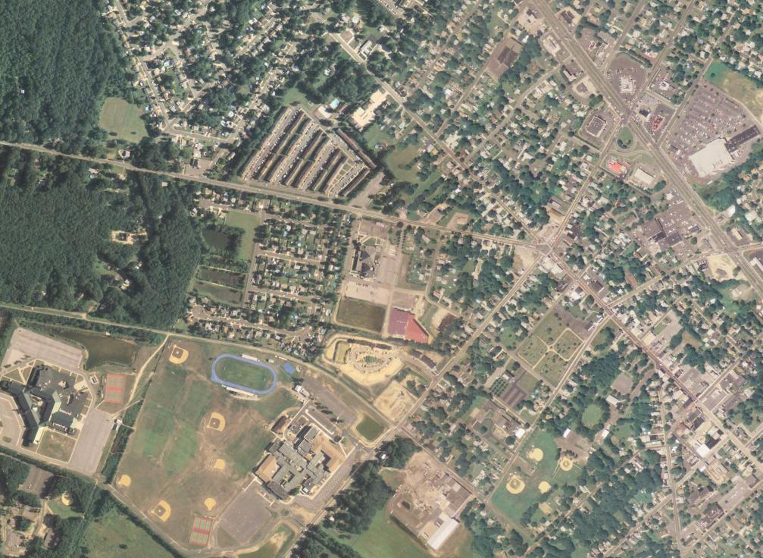
FSS Receptor – Public Supply Well Williamstown NJ
Pumpage 0.55 – 0.38 MGD
Known QW issues – PCE (80 ug/L), Hg (1.5 ug/L)
N
Approximate Capture Zone
Regional Gradient (0.001)
Supply
Well

Slide 5
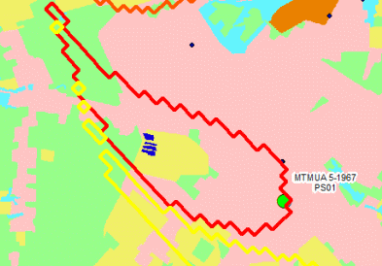
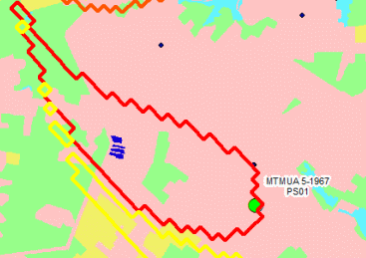
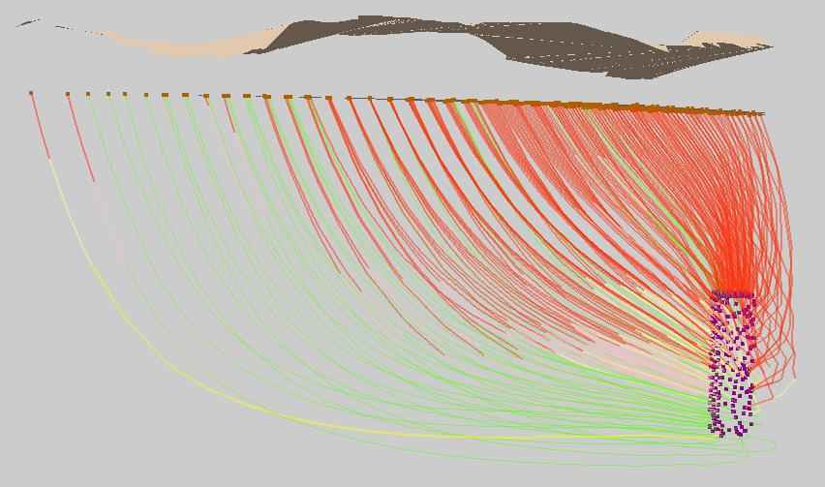
Predominant Land Use has been Urban for over 30 years
Used Land use data to determine Land-use change
Modeled ages/source of water for well placement
  Red – urban
  Yellow – agriculture
  Green – forest
1983
2003
Notes:
-3D GW flow model used to simulate contributing areas to monitoring and supply wells.
-because PS wells are installed deeper in aquifer system and are pumped more heavily than monitoring wells their contributing areas are orders of magnitude larger than those of monitoring wells.
-For instance, (compare two simulated contributing areas).
-Because ps well contributing areas are larger, they tend to encompass multiple land-use settings whereas contributing areas to monitoring wells generally encompass a single land-use setting.
-Water recharging the aquifer system in close proximity to supply wells will travel short distance before being intercepted at the well screen whereas water recharging the aquifer system in distal portions of the contributing area will travel long distances before being intercepted at well screen.
-PS wells yield water that is a mixture of different ages and that was recharged in various land-use settings.
-In contrast, monitoring wells yield water that was only recently recharged and generally beneath only a single land-use setting.

Slide 6
Geology

Slide 7
Hydrology - Depth to Water *
& Vertical Gradients
134
0.00
0.05
0.01
0.00
0.12
0.05
0.15
0.05
132
0.00
0.13
0.04
0.04
0.04
0.00
130
0.00
* All data approximate until wells surveyed in

Slide 8
SF6 Age Dates
2000
1990
1980
1970

Slide 9
Chloride (mg/L)
30
10

Slide 10
Dissolved Oxygen (mg/L)
Nitrate 3.1 – 0.6
Iron 86 – 9
Sulfate 33.7 – 0.7
Methane nd
DOC 0.9 – 0.5
Nitrate 0.8 – nd
Iron 3340 – 86
Sulfate 10.6 – 0.6
Methane 0.55 – 0.02
DOC 0.6 – 0.3
1.0

Slide 11
Total Nitrogen (mg/L)
Anoxic

Slide 12
Recharge Nitrate Concentrations
Recharge Nitrate

Slide 13
Concentrations as a Function of Groundwater Age

Slide 14
Concentrations as a Function of Groundwater Age

Slide 15
Other Geochemistry
Low pH waters 5.4 – 4.3
Little Alkalinity
Low DOC – most wells <1 mg/L, one 4.5
Mercury – 40% detection, nd – 0.6 ug/L
Radium-226, 0.15 – 5.17 pCi/L
PCE – 22% detection, nd – 0.29 ug/L

Slide 16
Detected Pesticides and VOCs

Slide 17
Summary
Flow system survey with Public well receptor – well has QW issues.
Layers of unconsolidated sand with discontinuous stringers of clay.
Zones of oxic and anoxic water.
Anoxic zone has nitrate, iron, and sulfate reduction, plus methanogenesis.

Slide 18
Summary
Hydrology and Chemistry suggest short-circuited flow paths.
Water generally less than 25 year old, but some older.
Very few agricultural inputs over past 30 years.
Pesticides and VOCs not frequently detected – most detections in post 1990 water.
Natural contaminants are QW issues.

